Slide 1
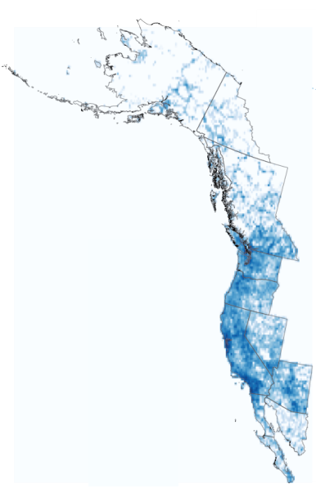
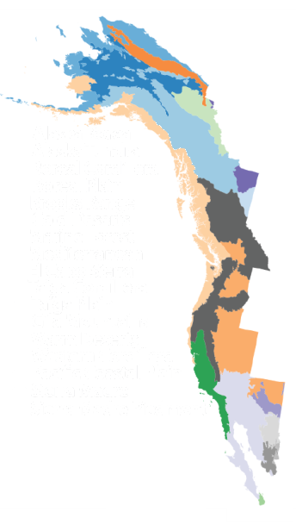
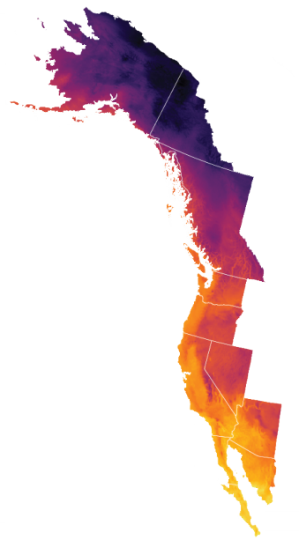
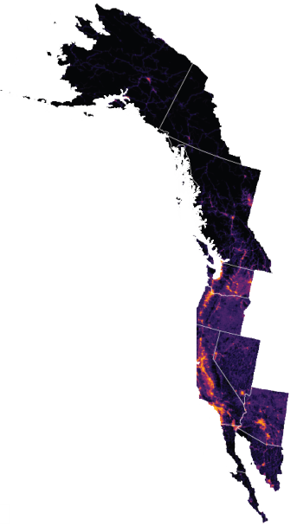
(a) Dataset Observation Density
(b) L2 Ecoregions
(c) Temperature Coldest Month
(d) Human Footprint Index
Alaska Boreal
Alaska Tundra
Boreal Cordillera
Boreal Plain
Brooks Range
Cold Deserts
Marine Forest
147K
Mediterranean
14°C
50
El Cabo Sierra
Taiga Cordillera
Taiga Plain
Gila Mountains
Warm Deserts
Western Cordillera
0
Pacific Coastal Plain
-36°C
Sierra Madre
0.0
Sierra Madre Piedmont
N
N
N
N
750 km
750 km
750 km
750 km
Notes:
素材ID：AI-080
论文：DivShift: Exploring Domain-Specific Distribution Shift in Large-Scale, Volunteer-Collected Biodiversity Datasets
会议：AAAI 2025
奖项：Outstanding Paper – AI for Social Alignment Track
图号：Figure 3，PDF第4页
类型：实验图表
借鉴点：在相同北美西海岸轮廓下并列观测密度、生态区、气温和人类活动，统一北向与比例尺。
论文URL：https://ojs.aaai.org/index.php/AAAI/article/view/35060
官方获奖URL：https://aaai.org/about-aaai/aaai-awards/aaai-conference-paper-awards-and-recognition/
原始论文与绘图来源：见本页论文链接及仓库 catalog/papers.md。
编辑与保真说明：四个地理数据图层保留为独立源图，未重建地理数据。图题、17项生态区图例、色标、北向和比例尺均为原生。源图字体用Arial/Times New Roman近似。
复刻方式：Native geographic comparison layout, annotations and legends with four separate original map data layers.

