Slide 1
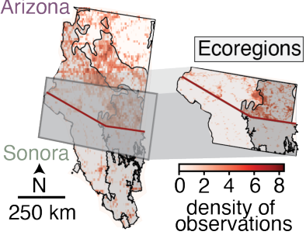
(a) Spatial bias
(c) Observer bias
10⁵
2.5
10
10
10⁴
2.0
8
8
Total landmass
N° observations / pixels
10³
1.5
DivShift-NAWC
N° species
1 observation per-species
6
6
1.0
log(N° observations)
10²
log(N° observations)
4
4
0.5
Human-modified
10¹
Engaged
2
2
0M
Wilderness
10⁰
Casual
0
10
20
30
40
50
0
10⁰
10¹
10²
10³
10⁴
10⁵
0
Human footprint index
Species
N° observations
Species
(b) Temporal bias
(d) Sociopolitical bias
80K
10
8
60K
8
City Nature
Challenge
6
N° observations
6
40K
log(N° observations)
log(N° observations)
4
4
Sonora
20K
2
2
Rest of year
Arizona
0K
0
0
0
Day of the year
365
Species
Species
Notes:
素材ID：AI-081
论文：DivShift: Exploring Domain-Specific Distribution Shift in Large-Scale, Volunteer-Collected Biodiversity Datasets
会议：AAAI 2025
奖项：Outstanding Paper – AI for Social Alignment Track
图号：Figure 4，PDF第5页
类型：实验图表
借鉴点：四区组合直方、双分布、时间曲线、关系散点和局部地图，把偏差来源与分布变化配对。
论文URL：https://ojs.aaai.org/index.php/AAAI/article/view/35060
官方获奖URL：https://aaai.org/about-aaai/aaai-awards/aaai-conference-paper-awards-and-recognition/
原始论文与绘图来源：见本页论文链接及仓库 catalog/papers.md。
编辑与保真说明：坐标轴、文字、分布色区、可见散点轮廓和时间曲线均为原生。统计几何按已发表像素边界转写，24色近似及0.35像素边界简化，不恢复或生成原始观测数据；接触点可能合成一个轮廓。旧标注覆盖下的底色按邻近同类区域补齐后以原生文字替换。仅地理局部图及其地图专用标注保留为独立原图资产。
复刻方式：Native chart geometry reconstructed from the published display, with explicit data-recovery limits and one independent geographic inset.

