Slide 1

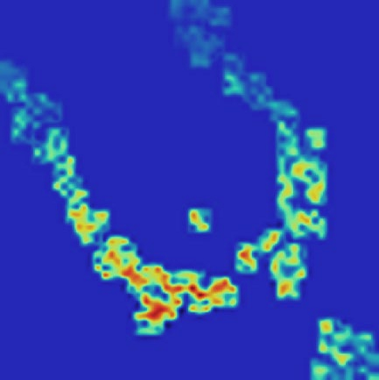
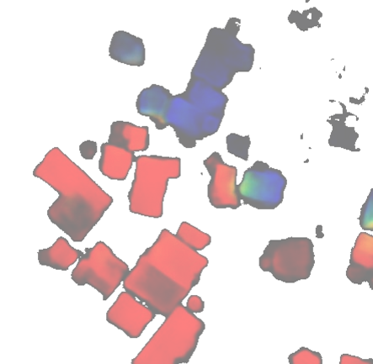
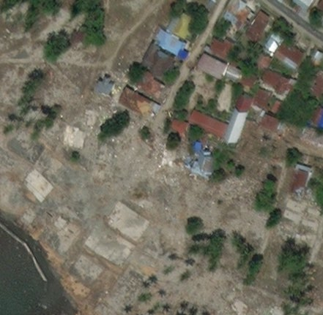







Notes:
素材ID：AI-086
论文：DISCount: Counting in Large Image Collections with Detector-Based Importance Sampling
会议：AAAI 2024
奖项：Best Paper – AI for Social Impact Track
图号：Figure 1，PDF第2页
类型：方法细节
借鉴点：用地图、检测分布、人工重要性采样及置信区间逐步说明多个区域的高效计数。
论文URL：https://ojs.aaai.org/index.php/AAAI/article/view/30235
官方获奖URL：https://aaai.org/about-aaai/aaai-awards/aaai-conference-paper-awards-and-recognition/
原始论文与绘图来源：见本页论文链接及仓库 catalog/papers.md。

