Slide 1
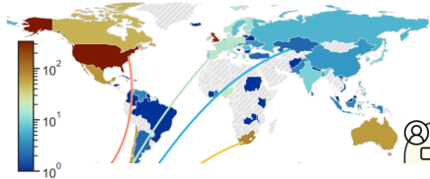
2
Participants rate their interactions
with LLMs in
multi-turn
conversations
Four LLMs are randomly
selected from pool
Conversation
continues with the
1
Participants
complete a
detailed survey
best rated LLM
A
B
We recruit participants
from across the globe
Fine-grained
Feedback
+
Human Participants
Large Language Models
Survey Participants
1,500
Conversations
Total Providers
6
With Conversations
1,396
(93.1%)
⇒
Total Conversations
8,011
⇐
Total Models
21
Birth Countries
75
Unguided
3,113
(38.9%)
Commercial API
12
(57.1%)
Reside Countries
38
Controversy guided
2,438
(30.4%)
Open Access
9
(42.9%)
Conversations / participant
5.7
Values guided
2,460
Conversations / model
1430.9
±1.0
(30.7%)
±171.1
Models seen / participant
13.9
Turns / conversation
3.4
Unique raters / model
924.3
±2.5
±1.6
±94.4
Total Interactions
27,172
Total Utterances
68,371
Notes:
素材ID：AI-011
论文：The PRISM Alignment Dataset: What Participatory, Representative and Individualised Human Feedback Reveals About the Subjective and Multicultural Alignment of Large Language Models
会议：NeurIPS 2024
奖项：Best Datasets and Benchmarks Track Paper
图号：Figure 1，PDF第2页
类型：研究流程
借鉴点：世界地图、问卷、模型交互和三组数据规模并列；适合完整呈现基准/人类研究构建过程。
论文URL：https://openreview.net/forum?id=DFr5hteojx
官方获奖URL：https://blog.neurips.cc/2024/12/10/announcing-the-neurips-2024-best-paper-awards/
原始论文与绘图来源：见本页论文链接及仓库 catalog/papers.md。

