Slide 1

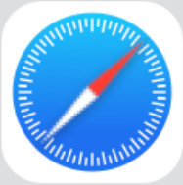





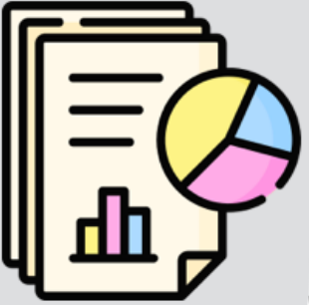
Apple’s Apps
Periodic tasks
PrivacyBudgetMaintenance,
ReportGenerator,
ReportFilesMaintenance,
StorageCulling,
Shared library
StorageMaintenance,
DifferentialPrivacy.framework
PrioReporter…
Configurations
Daemon
DP Ledger
/System/Library/DifferentialPrivacy
com.apple.dprivacyd
/private/var/db/DifferentialPrivacy
Privacy Preserving Measurements
/var/db/DifferentialPrivacy
Reports
DifferentialPrivacy_2022-04-10-024129.diff_privacy.anon
Dedisco_2022-12-24-023338.json.anon
Retired
/var/log/PrivacyPreservingMeasurement
PrivacyPreservingMeasurements_2024-12-07-114346.json.anon
Notes:
素材ID：SEC-059
论文：Auditing Apple’s DifferentialPrivacy.framework: Implementation Bugs, Misconfigurations, and Practical Risks
会议：IEEE S&P 2026
奖项：Distinguished Paper Award
图号：Figure 2，PDF第4页
类型：系统架构
借鉴点：应用/共享库、配置、守护进程、周期任务、隐私账本及输出报告形成多类对象协作图，颜色和文件样例强化层次。
论文URL：https://arxiv.org/pdf/2605.21378
官方获奖URL：https://sp2026.ieee-security.org/awards_papers.html
原始论文与绘图来源：见本页论文链接及仓库 catalog/papers.md。

