Slide 1





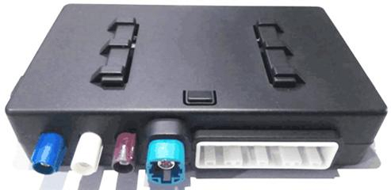

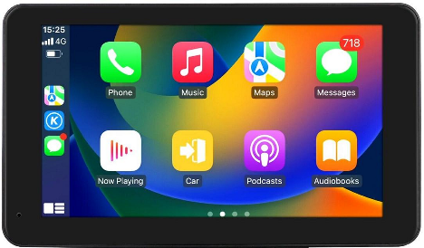








Notes:
素材ID：SE-057
论文：Towards Understanding and Characterizing Vulnerabilities in Intelligent Connected Vehicles through Real-World Exploits
会议：ICSE 2026
奖项：ACM SIGSOFT Distinguished Paper Award
图号：Figure 1，PDF第3页
类型：系统架构
借鉴点：云平台、手机、IVI、T-Box、ECU和外部接口分布在相互连接的层次图中，以编号、红色标记和硬件小图标联通软硬件视图。
论文URL：https://sen-chen.github.io/pdf/C61-ICSE2026-Towards%20Understanding%20and%20Characterizing%20Vulnerabilities%20in%20Intelligent%20Connected%20Vehicles%20through%20Real-World%20Exploits.pdf
官方获奖URL：https://conf.researchr.org/info/icse-2026/awards#acm-sigsoft-distinguished-paper-awards
原始论文与绘图来源：见本页论文链接及仓库 catalog/papers.md。

