Slide 1
#A. Patch and array extent
#B. Starting checker
M1 // N := MAX_PIPES * 2
M2 struct dc_link *links[N];
M3 // get_host_router_...(...)
M4 ...
M5 - for (i=0; i<N; ++i) {
M6 + for (i=0; i<N-1; ++i) {
M7 if (!dc->links[i] || ...)
M8 continue; ...
M9 if (hr_match) {
M10 primary=dc->links[i];
M11 secondary=dc->links[i+1];
M12 ...;
M13 break;
M14 }
M15 }
B1 checkASTCodeBody(F):
B2 for loop i < B:
B3 find access A[i+1]
B4 if no body guard:
B5 report(A[i+1])
1
extend N
2
B = N
4
5
B = N - 1
Missing extent test; V/F: 1/1
#C. Automatic refinement
C1 checkASTCodeBody(F):
C2 keep loop/access discovery
C3 N = type_extent(A)
C4 max_index = (B-1)+1
C5 if max_index < N:
C6 suppress; else: warn
3
i + 1
Vulnerable: max(i + 1) = N
Fixed: max(i + 1) = N − 1
Semantic links
Tested guards normalized; no name filter
Bound-to-access relation
6
Extent-aware condition; V/F: 1/0
Checker logic is abridged

Slide 2







(b) Evidence sources
Analyzer-native
Source context
Analyzer output
CFG / call graph
Patch / source
Build diagnostics
Optional traces
Bounded context
Paired warnings
(a) Inputs
(c) Refinement
Checker + patch
Evidence bundle
LLM edit
Compile + scan
Frozen source
origin + scope
Latest attempt L
vulnerable / fixed
V/F object scope
raw-output hash
code + feedback
Retain only after a healthy run
accept
Recover a vulnerable warning , or reduce fixed reports
while preserving vulnerable-side warning presence.
Retained D*
Best accepted checker

Slide 3
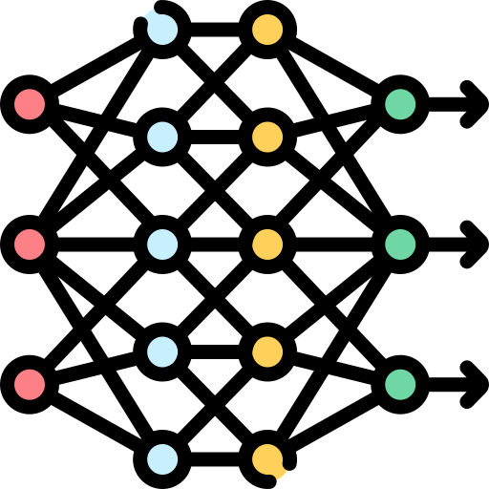

39
Generated-only CSA checkers
Same checker, patch and object scope
Main comparison · E1
KNighter
SemWeaver
SemWeaver
Report-driven loop
Native evidence
No internal evidence
GPT-6-Luna high · 32-reply ceiling*
Original 12-subject subset
Same inputs for E3 / E4
Repeated ablation · E3
Model sensitivity · E4
Native vs. no-internal
Native only · 2-reply cap
1: reuse
2: new
3: new
GPT-6-Luna
GLM-5.3
GLM-5.3
Flash
72 cells: 24 reused + 48 new
36 cells: 12 inputs × 3 models
CodeQL · E2
1 query × 3 decodes
Separate case; not pooled with the CSA comparison

