Slide 1
English sign language alphabet
Using
MobileNet & Mediapipe

Slide 2
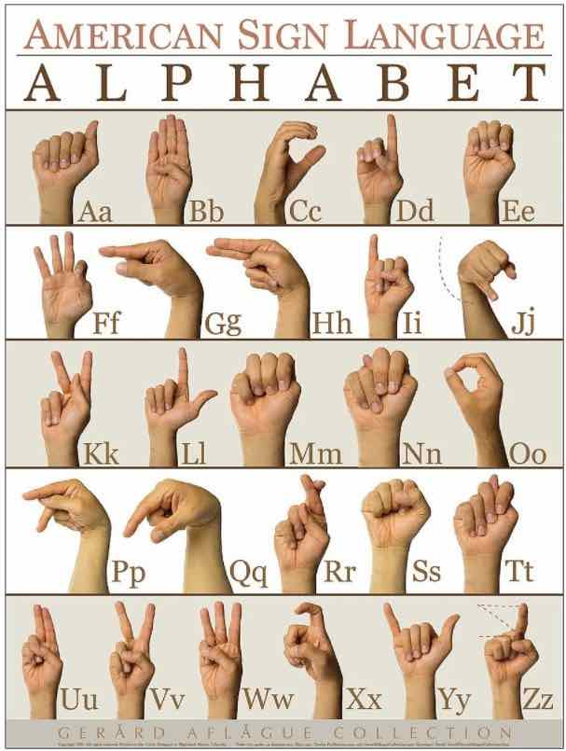
What is it ?

Slide 3
MobileNet

Slide 4
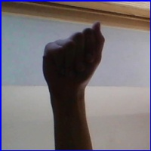

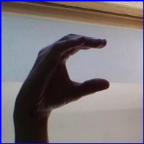

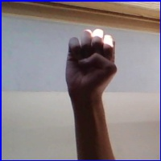
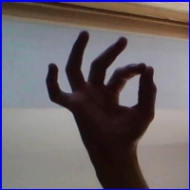
Data:
86,000
A
B
C
D
E
F

Slide 5
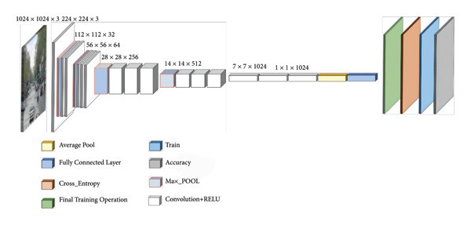
Using pretrained model
MobileNet
WHY ?

Slide 6
Using pretrained model
MobileNet
Faster Training time
Faster prediction time (important for webcam application)
Acc >=0.98

Slide 7
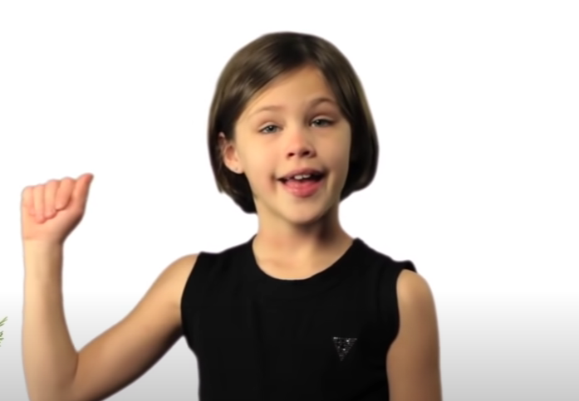
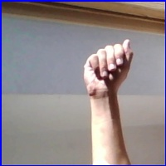
Output ?
Real-life application
HOW?
Prediction : A
Prediction : O

Slide 8
Mediapipe

Slide 9
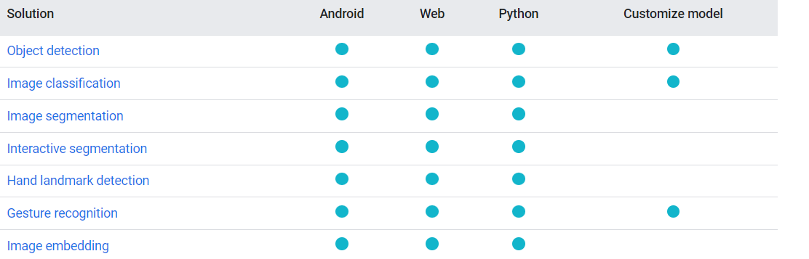
Mediapipe

Slide 10
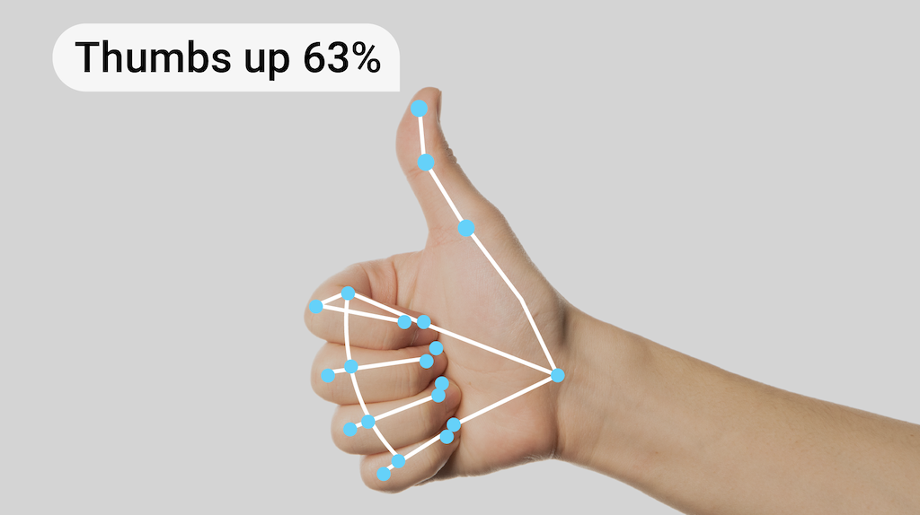
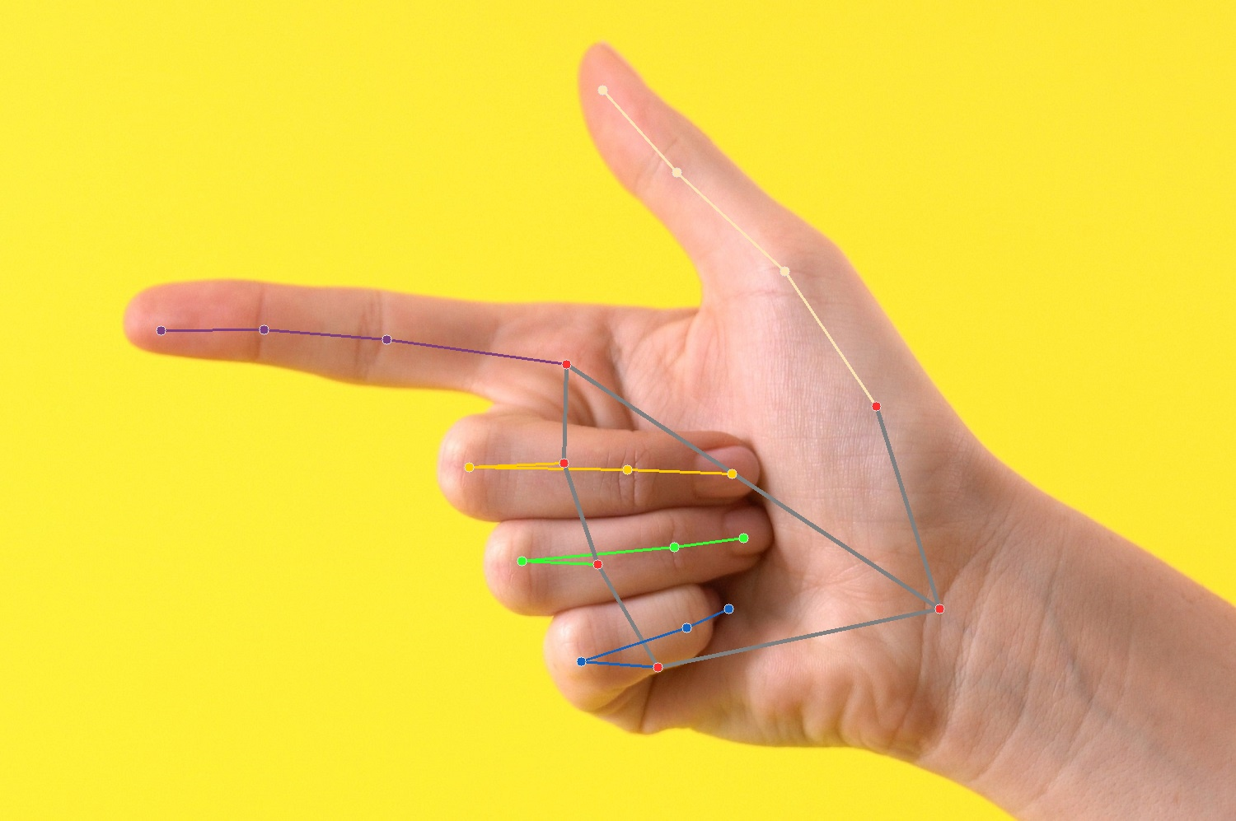
Mediapipe

Slide 11

How our application work
Prediction : A
1 – Mediapipe
2 – MobileNet
3 – integration with webcam

Slide 12
Thank you

