Slide 1

UK Train rides

Slide 2
Group Names
01
02
03
04
05
Supervised by:
Tarek Ahmed Ahmed
Mariam Helmy Ahmed
Eng./ Kareem Bakli
Mohamed Saad Zakaria
Mora Magdy Eshak
Alaa Osama Mohamed

Slide 3
Table of contents
01
02
03
04
05
Key features
of the Dataset
Project Idea
Data issues
& Recommendations
Implementation of recommendations
Data modeling

Slide 4
Project Idea
01
This project analyzes UK train operating data to identify performance trends, root causes of delays, and passenger journey impacts. Using Power BI for data integration, analysis, and visualization, we deliver actionable insights to help Railway stakeholders make informed decisions and provide them with a clear view of network performance.

Slide 5
Key features of the Dataset
02
count
Rows
Columns
18
31654 K
11
7
Text columns
Numeric columns

Slide 6
Text columns |  | Numeric columns
Transaction ID | Ticket Class | Date of Purchase | Time of Purchase
Purchase Type | Ticket Type | Price | Date of Journey
Payment Method | Departure Station | Departure Time | Arrival Time
Railcard | Arrival Destination | Actual Arrival Time
Journey Status | Reason for Delay
Refund Request

Slide 7
Data issues & Recommendations
03
Problem (1): There are missing values in the actual arrival time, which makes it difficult to calculate things like trip duration and delay time.
Recommendation: When calculating the values, we can add a condition in the function to skip flights with a cancelled Journey Status, since the actual arrival time is only empty in those cases.

Slide 8
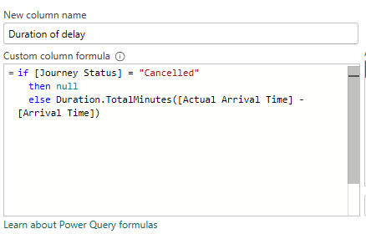
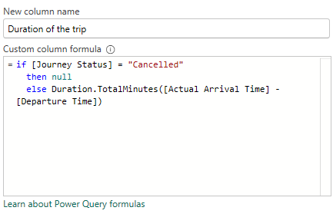
Data issues & Recommendations
03

Slide 9
Solutions Implementation

Slide 10
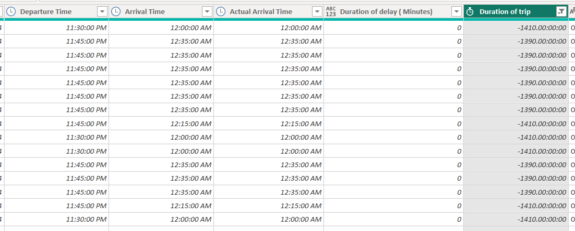
Solutions Implementation
We faced an issue while calculating the duration of trip: appearance of some negative values
The negative values happened because Power BI thinks the Actual Arrival Time (AM) is earlier than the Departure Time (PM) — it doesn’t automatically know the arrival is on the next day.

Slide 11
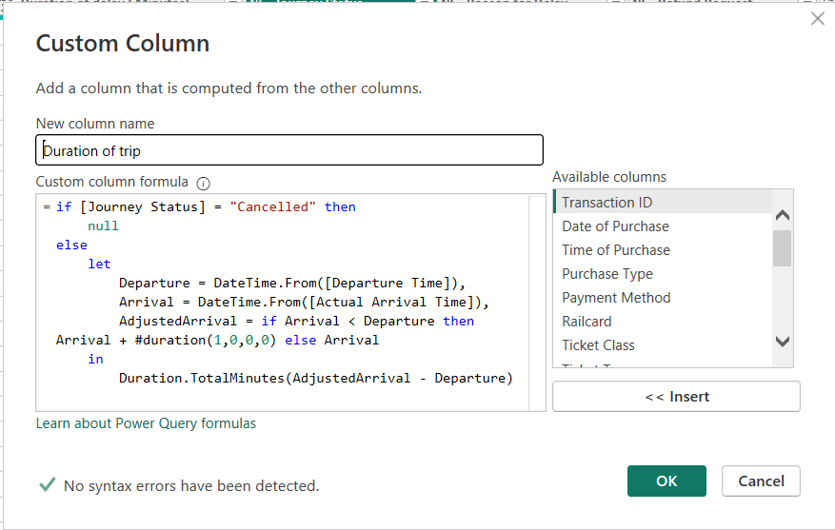
Solutions Implementation
To fix this issue, we adjusted the formula so that if the Actual Arrival Time is less than the Departure Time, it adds one day.
This way, trips that cross midnight will give you positive duration values instead of negative.

Slide 12
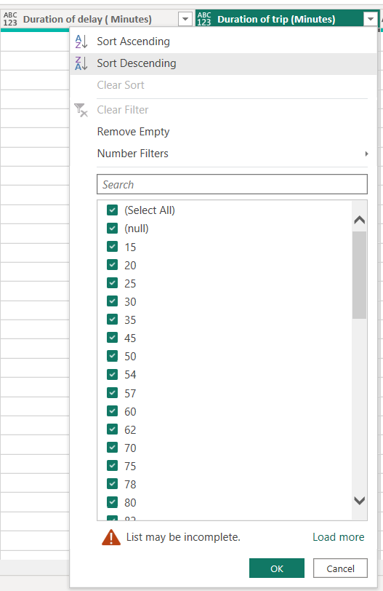
Solutions Implementation
After adjusting the formula, we successfully handled the issue of the negative values and the null values here indicate that the journey is cancelled so duration of trip is not calculated.

Slide 13
Data issues & Recommendations
03
Problem (2): In the Reason for delay column, there are missing values.
Recommendation: Replace null values with “No Delay” since all nulls correspond to flights where the Journey Status is on time.

Slide 14
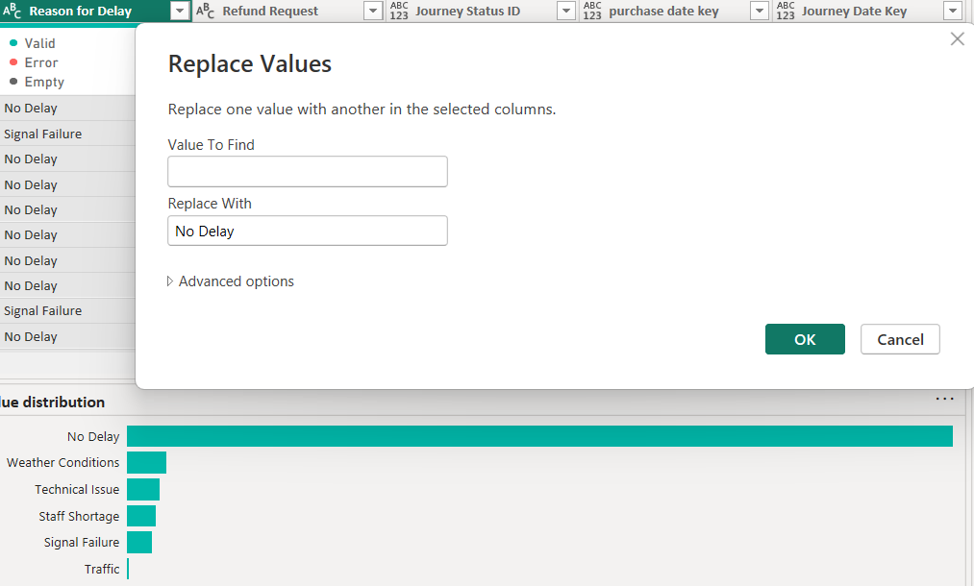
Solutions Implementation
01

Slide 15
Data issues & Recommendations
03
Problem (3): In the Reason for delay column, there are duplicate entries with slightly different names, such as:
Signal Failure & signal failure
Staff shortage & staffing
Weather & weather conditions
Recommendation: Unify these values by replacing them with a single consistent format.

Slide 16
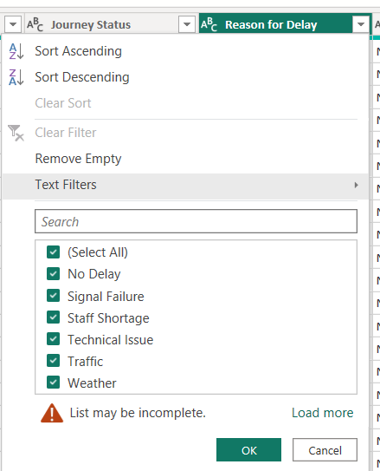
Solutions Implementation
01

Slide 17
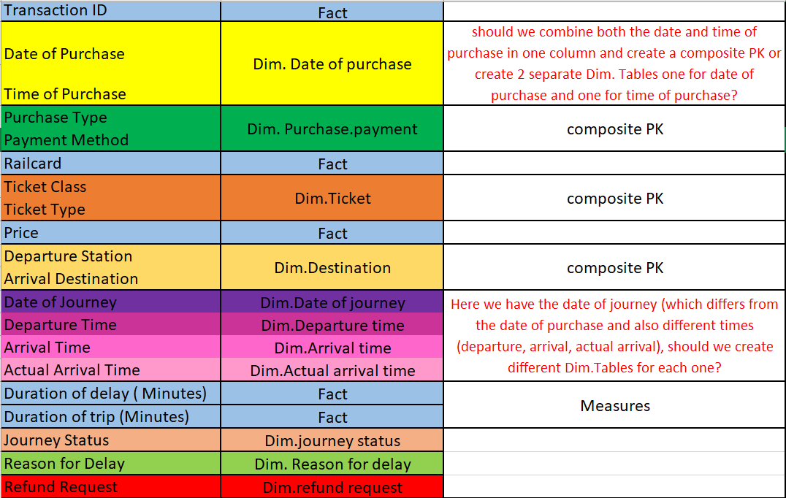
Modelling plan (before feedback)

Slide 18
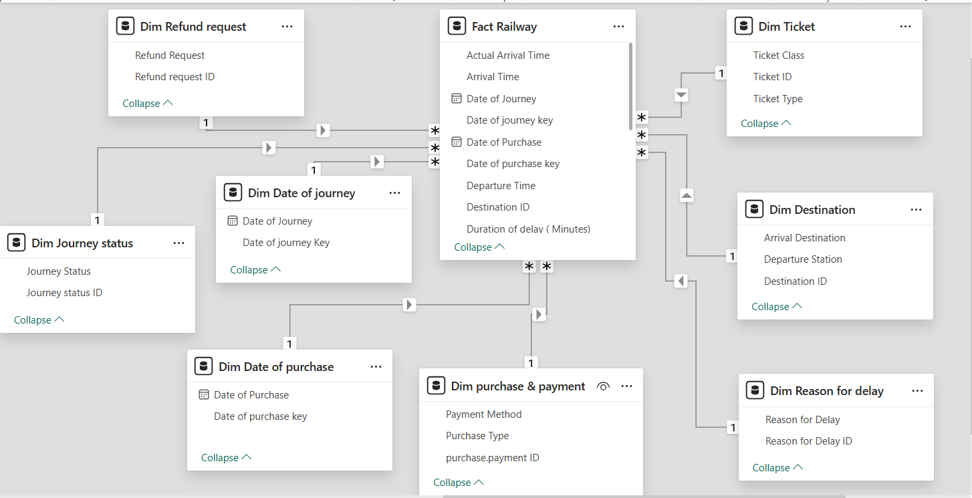
Data Modelling (before feedback)

Slide 19
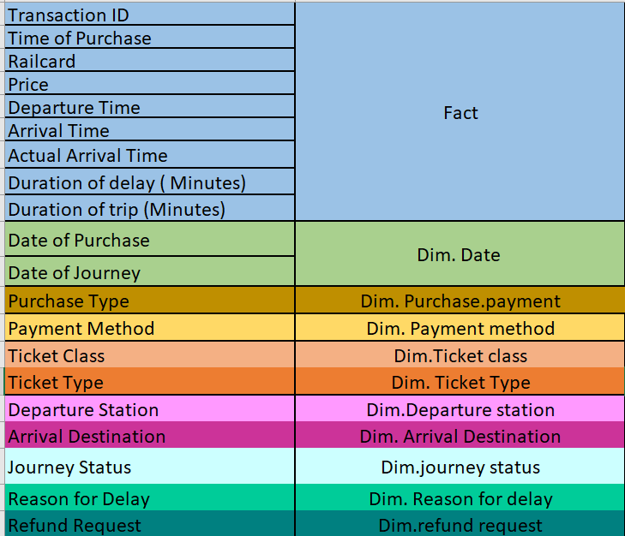
Modelling plan (after feedback)
10
Dimension Tables

Slide 20
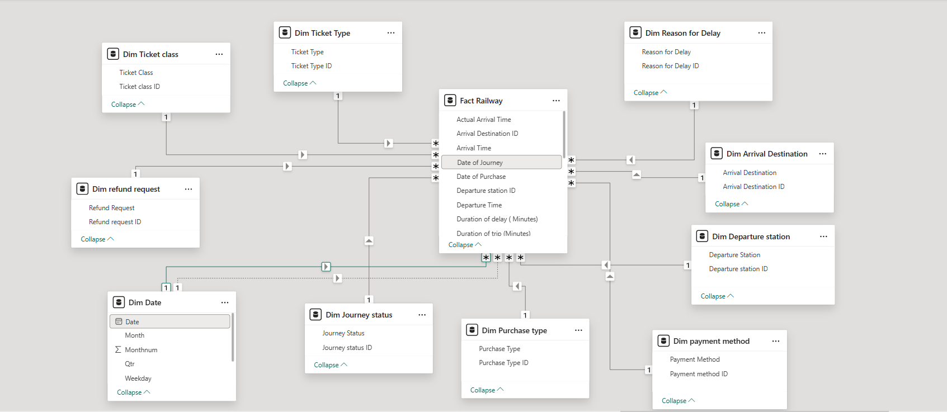
Data Modelling (after feedback)

Slide 21
DAX Measures
Refund request
# Refund requests
# Non-Refund requests
Non-refund rate
Refund rate
Railcard
# Rail-card holders
# Non rail-card holders
Revenue
Total Revenue
Average Revenue
Revenue per day
Total Revenue PV month
Revenue Variance
Revenue growth rate
Ticket
# Tickets sold
Average Ticket price
Max Ticket price
Min Ticket
price
Tickets purchased per day
Time
Distinct # of days
Average Delay time
Average trip duration
% of delayed journeys
% of on time journeys
% of cancelled journeys
# on time journeys
Total Journey

Slide 22
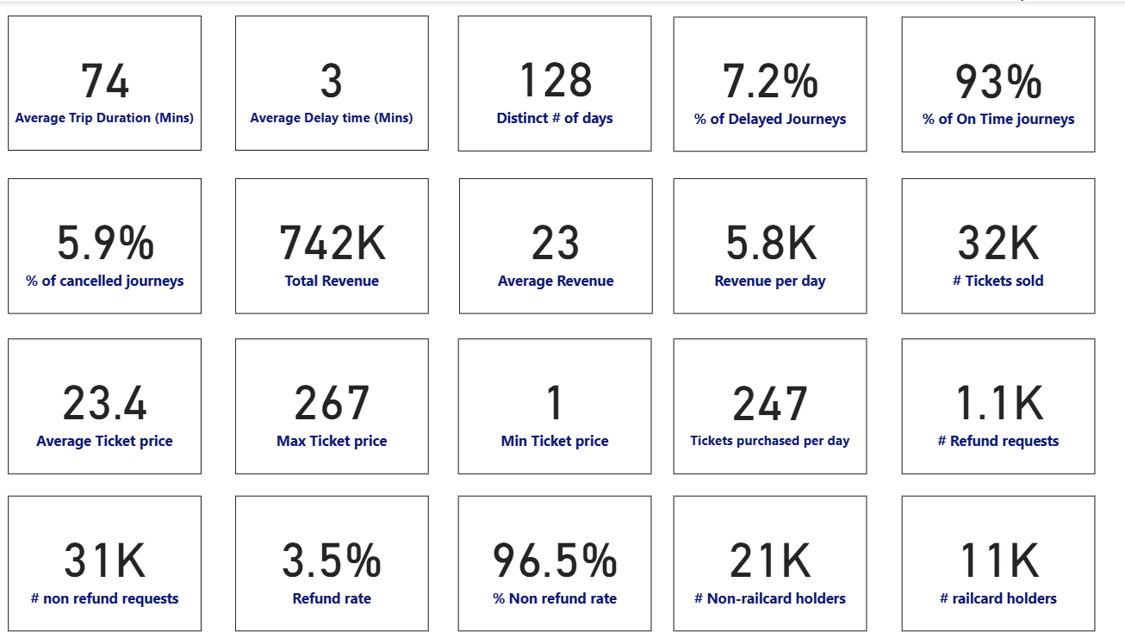
DAX Measures

Slide 23
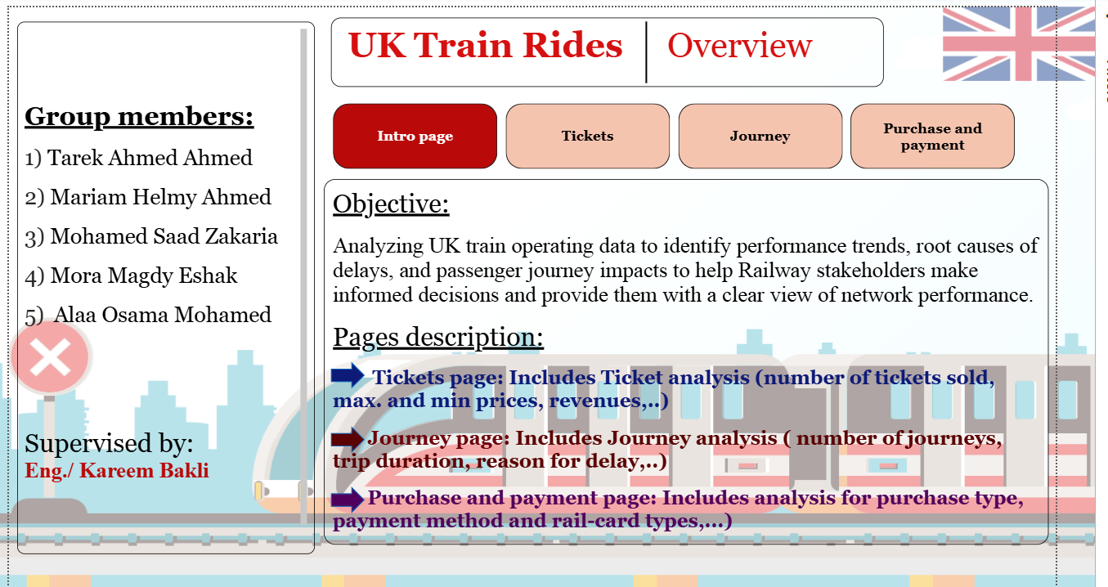
Intro page

Slide 24
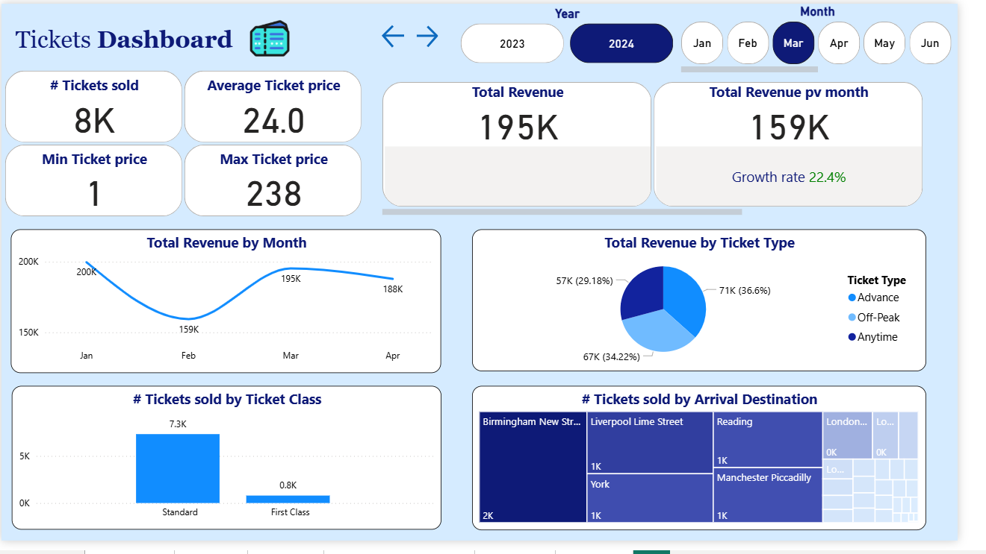
Ticket Dashboard

Slide 25
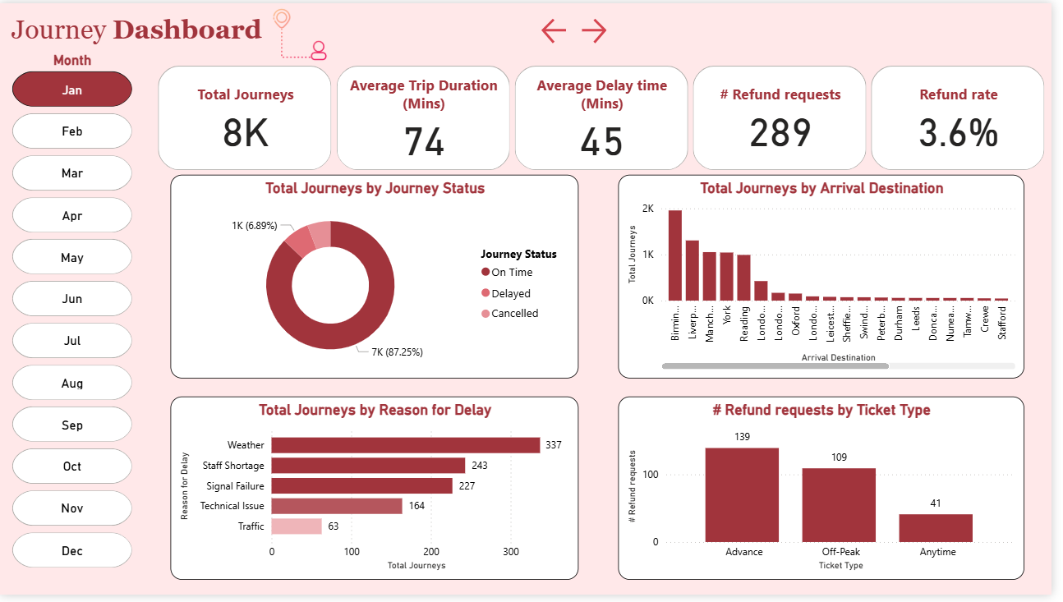
Journey Dashboard

Slide 26
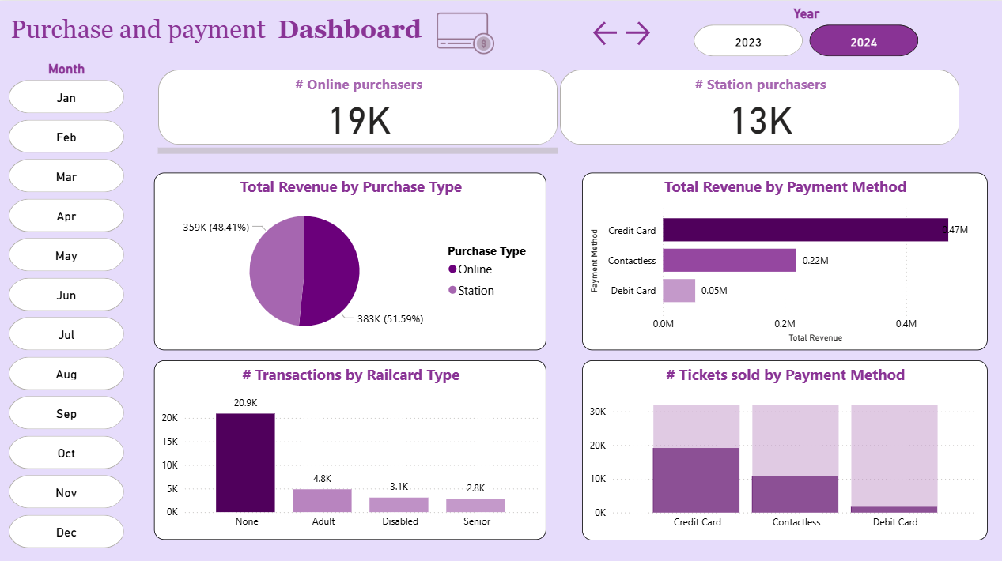
Purchase and payment Dashboard

Slide 27
Thanks!
Do you have any questions?

