Slide 1


Objectif: Simplicité, avec plus des options de TomCAT
Tarek Adra
5éme année Informatique
CNAM
2015-2016

Slide 2
Problématique
Tomcat a un conteneur de servlet que les servlets peuvent exécuter.
Et TomEE est serveur complet de l'édition Java Enterprise.. Donc, juste parce que vous avez un conteneur de servlet ne signifie pas que vous êtes un JEE serveur compatible? Que vient supplémentaire dans les serveurs pleins à part entière JEE (par exemple, Glassfish, JBoss) qui ne viennent pas avec Tomcat?

Slide 3
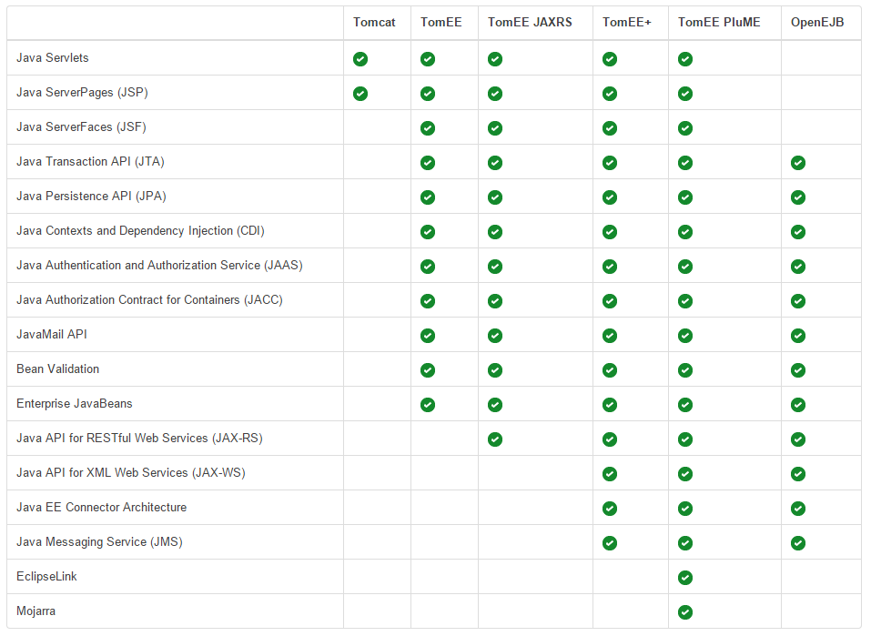

Slide 4
Plan de la présentation
C'est quoi TomEE, a propos de TomEE ( Historique, Installation )
API servie par TomEE
les avantage d'utilisation TomEE
Simple Code CRUD on utilisant TomEE (Video 2min)
Login et l'authentification en utilisant les fonctions définie dans TomEE
Comment définir les rôles pour chacun Admin, User,... etc, et comment défie/utiliser "privilige escalation".
ouverture a propos de TomEE+

Slide 5
TomEE
Apache TomEE is a Java EE Web Profile-certified stack which is built on top of an Apache Tomcat base integrated with additional related technologies. It adds implementations for the following specifications (using the Apache project shown in parentheses):

Slide 6
La version de Profil Web de Tomee contient
CDI - OpenWebBeans Apache
EJB - Apache OpenEJB
JPA - Apache OpenJPA
JSF - Apache MyFaces
JSP - Apache Tomcat
JSTL - Apache Tomcat
JTA - Apache Geronimo Transaction
Servlet - Apache Tomcat
Javamail - Apache Geronimo JavaMail
Bean Validation - Apache Bval

Slide 7
The question that was in our mind and the entire reason we created TomEE was, why should people have to choose?
The whole "Tomcat or JavaEE" thing is tired and old.
After 10 years it still comes up and people argue against each other as to which is better and why.
Here's the math in short form:
In Java EE 6, we (JCP) created the Web Profile to formally acknowledge the need for smaller runtimes with a focused set of technologies.
Great, we're half-way there, but people are still arguing "Tomcat or JavaEE". The solution was clear, Tomcat needed to be Java EE certified. The Web Profile was created to allow for exactly that.
In 2011 we (Apache) started doing the work to certify Apache Tomcat. Certification reached and announced at JavaOne 2011 as Apache TomEE. Final release announced in April.
Awesome, now we are there.
The new Status Quo
There is a lighter version of JavaEE
There is a JavaEE certified version of Tomcat
All this happened in the last 2 years. Things have changed.
If you want Tomcat and JavaEE, you can have it.

