Slide 1
Maze Solver Project using BFS Algorithm
Notes:
---

Slide 2
Introduction and Project Overview
Notes:
Title and Team Information, Project Objective and Scope

Slide 3

Title and Team Information
Project Overview
  The project focuses on solving mazes using BFS to find the shortest path efficiently within grid-based structures.
Team Members
  Developed by Tarek Mostafa Kamel (2302162)
  and Ibraheem Mohammed Abd El-Twab (2301915)
  Breadth-First Search algorithm guarantees finding the shortest path in an unweighted maze environment.
Presentation Scope
  Includes project overview, algorithm details, system design, execution, testing, and optional GUI enhancements.
Notes:
The project is titled 'Maze Solver using BFS Algorithm' and is part of the AI Course Project for Fall 2026. It was developed by a team consisting of Tarek Mostafa Kamel and Ibraheem Mohammed Abd El-Twab. The primary objective of this project is to demonstrate the application of artificial intelligence concepts, specifically search algorithms, in solving practical problems. Maze solving is a classic problem in AI that involves finding a path from a start point to an end point within a grid-based maze. This project aims to implement a robust solution using the Breadth-First Search (BFS) algorithm, which guarantees finding the shortest path in an unweighted maze. The presentation will cover the project overview, algorithm details, system design, execution steps, input/output samples, testing results, and optional GUI enhancements. By the end of this presentation, viewers will understand the rationale behind using BFS, the structure of the system, and how the solution meets the course requirements.

Slide 4

Project Objective and Scope
Objective of Maze Solver
  The project aims to efficiently solve mazes using AI search algorithms like BFS, highlighting pathfinding techniques.
Project Scope
  Scope includes reading maze input, identifying walls and paths, and applying BFS to find shortest routes.
Practical Implementation
  Implementation uses Python focusing on clarity, functionality, and optional GUI for user interaction.
Notes:
The main objective of the Maze Solver project is to apply AI search algorithms to solve a maze efficiently. The scope includes reading a maze from a text file, processing it to identify walls, paths, start, and end points, and then applying BFS to find the shortest path. The project demonstrates key AI concepts such as state representation, search strategies, and pathfinding. It also emphasizes practical implementation using Python, ensuring compatibility with Python 3.8 or newer. The solution is designed to be simple yet effective, focusing on clarity and functionality. Additionally, the project includes optional enhancements like a graphical user interface (GUI) to improve user interaction. This aligns with the course requirements, which encourage creativity and application of learned concepts. The project also serves as a foundation for understanding how search algorithms can be applied to real-world problems such as navigation and robotics.

Slide 5
Algorithm and System Design
Notes:
Breadth-First Search (BFS) Algorithm, System Design Overview

Slide 6

Breadth-First Search (BFS) Algorithm
Core BFS Concept
  BFS explores nodes level by level, ensuring the shortest path in unweighted graphs or grids.
Maze Solving Application
  BFS starts at the maze's start point and visits neighbors systematically to find shortest route.
Queue Data Structure
  A queue manages the exploration order, enabling BFS to visit nodes in correct sequence.
Notes:
Breadth-First Search (BFS) is a fundamental graph traversal algorithm widely used in pathfinding problems. BFS explores all nodes at the current depth before moving to the next level, ensuring that the shortest path is found in an unweighted graph or grid. In the context of maze solving, BFS starts from the designated start point and systematically visits neighboring cells, marking visited positions and recording the path taken. The algorithm uses a queue data structure to manage the exploration order, which guarantees that the first time the end point is reached, the path found is the shortest possible. BFS is particularly suitable for maze solving because it is simple to implement, guarantees optimality in terms of path length, and works efficiently for moderately sized grids. The algorithm's complexity is O(V + E), where V is the number of vertices (cells) and E is the number of edges (connections between cells). This makes BFS an ideal choice for this project, ensuring reliability and clarity in demonstrating AI search principles.

Slide 7

System Design Overview
Input Representation
  The maze is represented by a text file using symbols for walls, paths, start, and end points.
Algorithm Processing
  The system uses BFS to find the shortest path by constructing an internal maze representation.
Output Display
  Solved maze or step sequence is displayed in the console with the path clearly marked.
Modular Design
  Separate functions handle input reading, BFS processing, and output display for clarity and extensibility.
Notes:
The system design for the Maze Solver project consists of three main components: Input, Algorithm, and Output. The input is a text file representing the maze, where '#' denotes walls, spaces represent open paths, and optional 'S' and 'E' characters indicate the start and end points. The algorithm component processes this input, constructs an internal representation of the maze, and applies BFS to find the shortest path. The output is displayed in the console, showing the solved maze with the path marked or listing the sequence of steps from start to end. The design ensures modularity, with separate functions for reading the maze, performing BFS, and displaying results. This structure facilitates testing and future enhancements, such as adding a GUI. The system also includes error handling for invalid inputs and supports default start/end positions if not explicitly provided. Overall, the design prioritizes simplicity, clarity, and adherence to AI principles.

Slide 8
Execution and Demonstration
Notes:
How to Run the Project, Input and Output Samples

Slide 9

How to Run the Project
Project Requirements
  The Maze Solver project requires Python 3.8 or newer and essential project files like maze_solver.py and maze.txt.
Execution Instructions
  Run the solver using terminal commands specifying the maze file or default configuration for easy execution.
Maze File Format
  Maze files use '#' for walls, spaces for paths, and optional 'S' and 'E' to mark start and end points.
Output Display
  The program outputs the solved maze or path found, demonstrating the solution clearly in the terminal.
Notes:
Running the Maze Solver project is straightforward and requires Python 3.8 or newer. To execute the program, open a terminal or command prompt and navigate to the project directory. Use the command 'python maze_solver.py maze.txt' to run the solver with a specified maze file. If the script is configured to use a default file, simply run 'python maze_solver.py'. The maze file should follow the specified format: '#' for walls, spaces for paths, and optional 'S' and 'E' for start and end points. The output will display the solved maze or the path found, depending on the implementation. Ensure that all required files, including maze_solver.py and maze.txt, are present in the directory. No additional dependencies are needed unless a GUI is implemented, in which case the requirements should be listed in a requirements.txt file. This simple execution process makes the project accessible and easy to demonstrate.

Slide 10
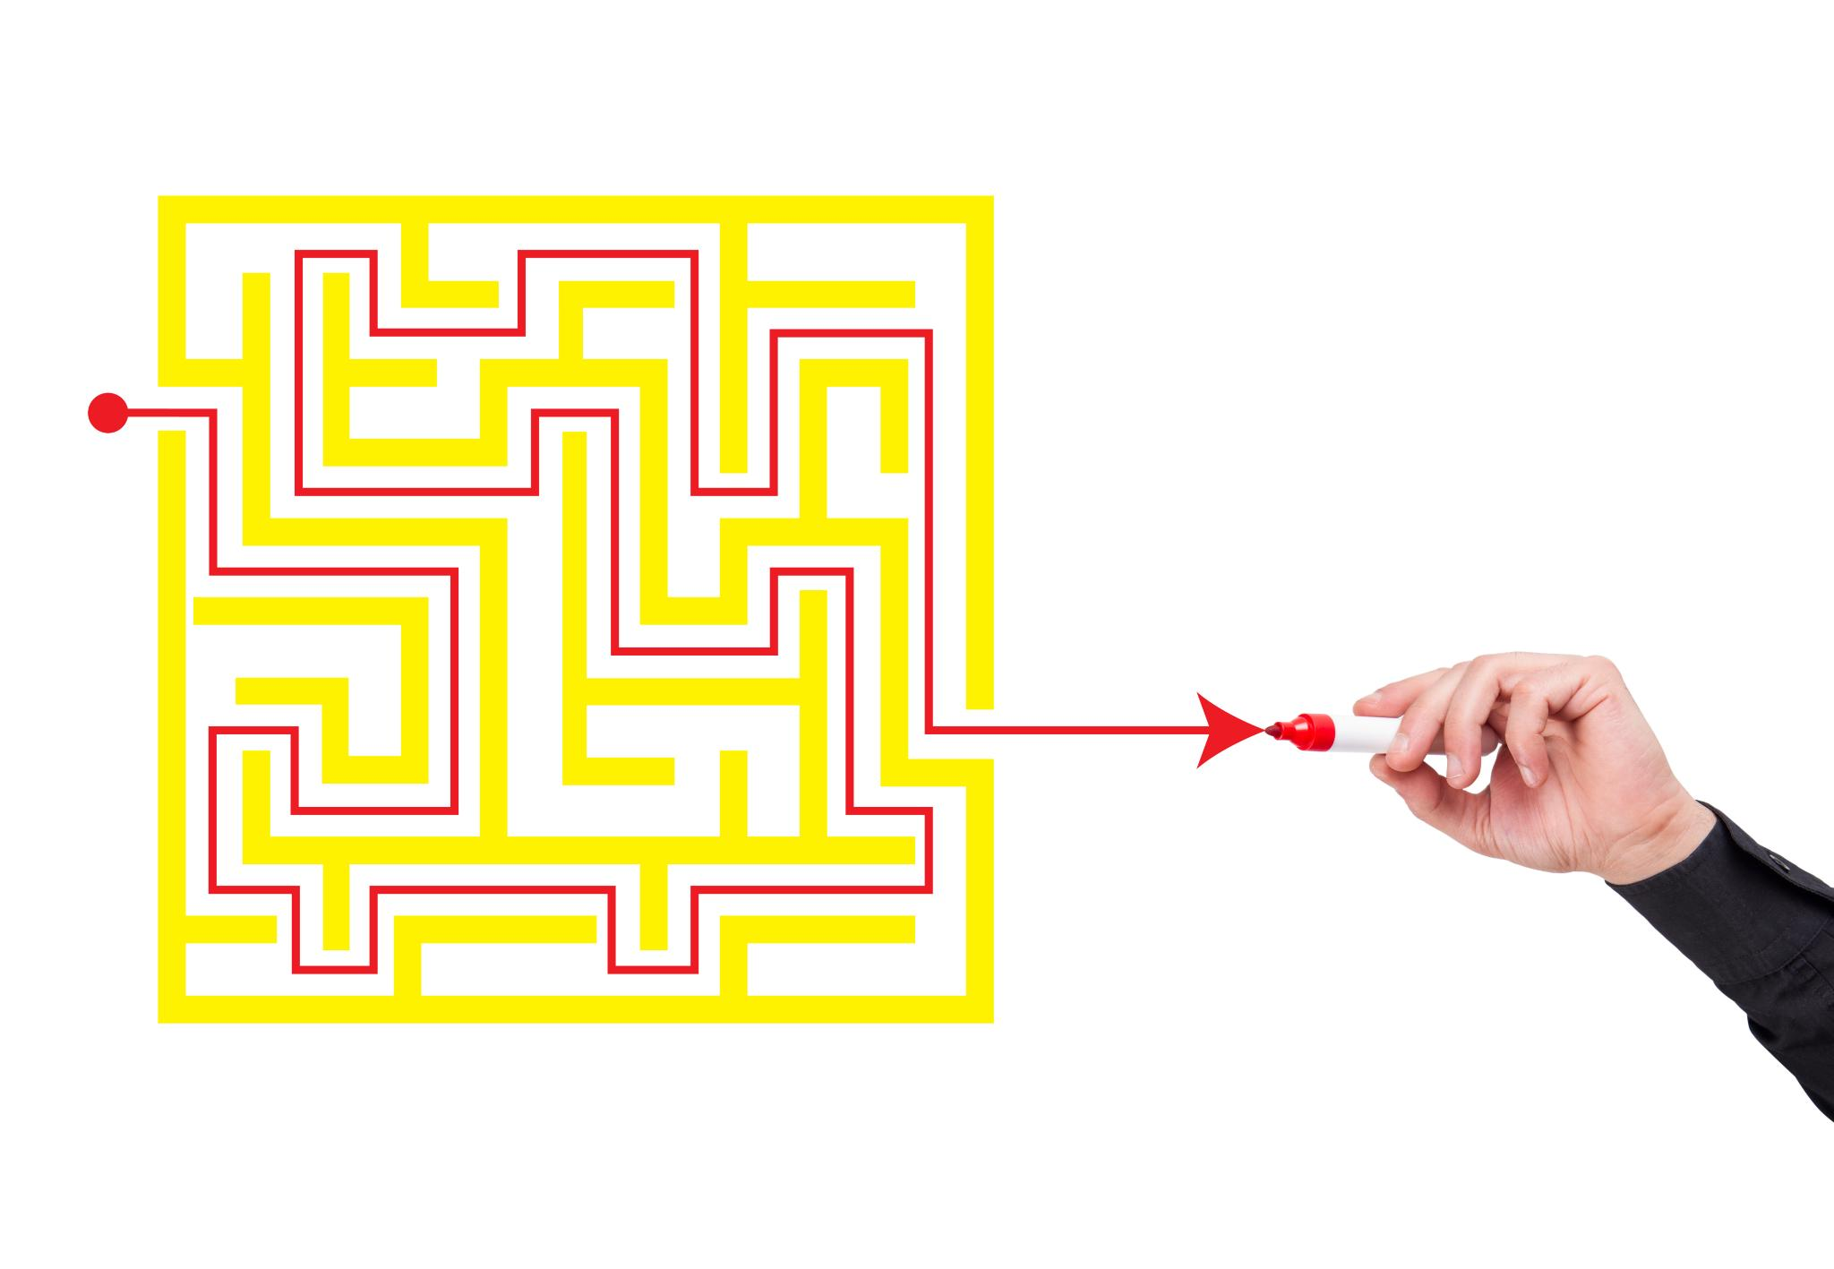
Input and Output Samples
Text File Input Format
  Maze input is a plain text file with '#' for walls and spaces for paths, including optional start 'S' and end 'E'.
Console Output Display
  Output shows the maze with the solved path marked, helping users verify the solution visually.
Notes:
The input for the Maze Solver project is a plain text file representing the maze grid. Each line corresponds to a row in the maze, with '#' indicating walls and spaces representing open paths. Optional 'S' and 'E' characters can specify the start and end points; if absent, the program assumes default positions. An example input might look like this:
#####
# S #
# #
# E #
#####
The output is typically displayed in the console, showing the maze with the solved path marked or listing the sequence of steps from start to end. For instance, the path might be indicated by dots or another symbol to differentiate it from walls and open spaces. This clear representation helps users verify the correctness of the solution. Including screenshots of both the input file and the output display in the presentation provides a visual understanding of the process and results.

Slide 11
Conclusion and Team Roles
Notes:
Summary and Key Takeaways, Team Contributions

Slide 12
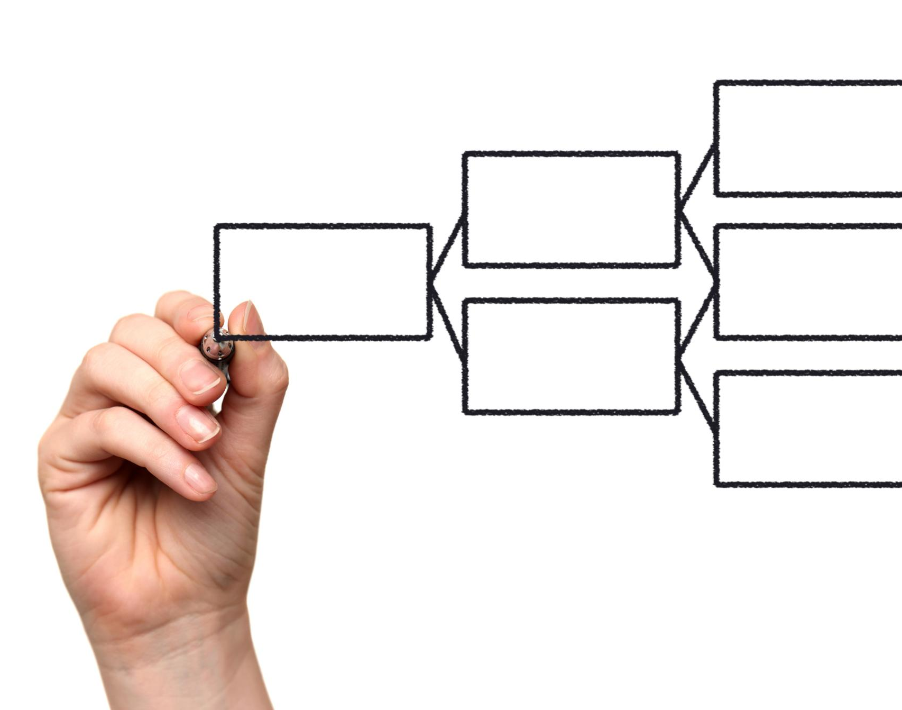
Summary and Key Takeaways
AI Search Algorithm Application
  The project showcases the use of BFS AI algorithm to solve real-world maze problems effectively and efficiently.
System Design and Modularity
  Clear, modular system design makes the solution easy to understand, maintain, and extend for future enhancements.
Simple Execution and Reliability
  The project runs on Python , confirming reliable and efficient maze-solving results with straightforward execution.
Enhancements and Future Exploration
  Optional GUI improvements demonstrate usability focus and lay groundwork for exploring advanced AI concepts later.
Notes:
The Maze Solver project successfully demonstrates the application of AI search algorithms in solving practical problems. By implementing the Breadth-First Search (BFS) algorithm, the project guarantees finding the shortest path in an unweighted maze, fulfilling the course objectives. The system design ensures clarity and modularity, making the solution easy to understand and extend. The execution process is simple, requiring only Python 3.8 or newer, and the results confirm the algorithm's reliability and efficiency. Optional enhancements, such as a graphical user interface, further improve usability and showcase the team's commitment to delivering a comprehensive solution. This project not only meets academic requirements but also provides a foundation for exploring more advanced AI concepts in future work.

Slide 13

Team Contributions
Diverse Team Roles
  Team members contributed to algorithm implementation, system design, testing, and documentation.
Effective Collaboration
  Clear communication and task division enabled efficient teamwork and timely project delivery.
Acknowledging Contributions
  Recognizing individual efforts highlights teamwork importance and academic integrity.
Notes:
The project was developed by a dedicated team consisting of Tarek Mostafa Kamel and Ibraheem Mohammed Abd El-Twab. Each member contributed to different aspects of the project, including algorithm implementation, system design, testing, and documentation. Collaboration ensured that the project met all requirements and maintained high quality standards. Clear communication and division of tasks allowed the team to work efficiently and deliver the project on time. Acknowledging individual contributions highlights the importance of teamwork in achieving project goals and reflects the academic integrity expected in the course.

