Slide 1
START
Flow Chart of App Process
Sign in/Sign up
Setup Activation
Setup the Emergency Contacts
Control Privacy
Do you want to be Mr. SOS?
NO
YES
Mr. SOS Functions
You will not be notified
You will be notified
END

Slide 2
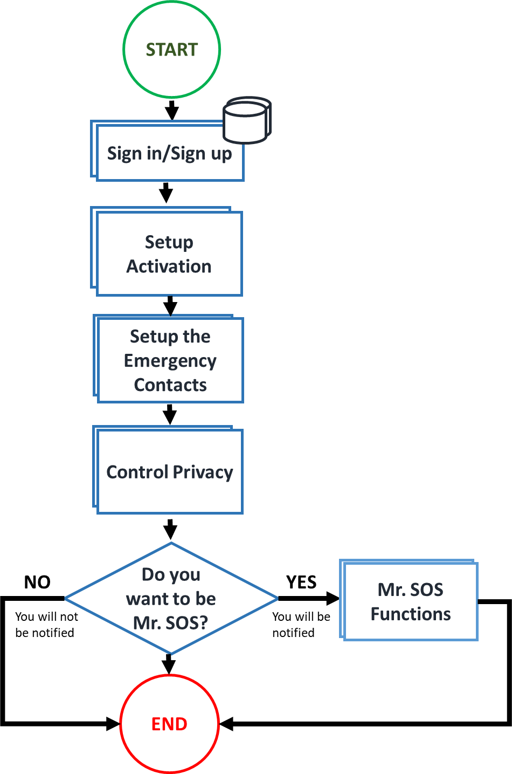

Slide 3
Setup the Emergency Contacts
Sign in/Sign up
Name
Photo
Age
Gender
Height
Phone Number
Home Address [Y/N]
Priority Contacts [Y/N]
Premium Account is created;
Receive:
Insurance Subscription
…
Normal Account is created
NO
Do you want a Premium Account?
YES

Slide 4
Setup the Emergency Contacts
Setup Activation
Emergency Button
Voice [Y/N]
Hold Volume Button [Y/N]

Slide 5
Setup the Emergency Contacts
Setup the Emergency Contacts
Set Priority Instant Call [Y/N]
Set Priority Notification Contacts
Notify Regional People [Y/N]
Notify Governmental Agencies [Y/N]
Notify your Insurance [Y/N]
(Disabled for normal subscription)

Slide 6
Setup the Emergency Contacts
Privacy Control
Show Meta Data
(Name, Photo, Gender, Age, Height)
Show Current Location
Show Number [Y/N]
Show Home Address [Y/N]
Show Priority Contacts [Y/N]
Publish Live [Y/N]

Slide 7
Mr.SOS Functions
Mr. SOS Functions
Post a Report
Call The Governmental Agencies
(Ambulance, Police, Fire Fighter)
Receive a Recognition

