Slide 1
Customer Churn Analysis
📈
FITLY ANALYTICS
Executive Summary
Churn is heavily concentrated in the Free tier (41%). Analysis identifies low engagement and slower support resolution times as primary drivers. Strategic focus on re-engagement, onboarding, and support efficiency can significantly improve retention.
Presented by: Tarek Dib 02/02/2026 For Senior Leadership

Slide 2
Project Overview & Business Goals
📈
FITLY ANALYTICS
◎ Primary Purpose
Identify the root causes of customer churn to develop data-driven strategies for improving user retention, enhancing service quality, and maximizing customer lifetime value
🎯 Business Goals
> Reduce monthly churn rates, focusing on high-risk 'Free' tier users.
> Improve early value realization to secure long-term retention.
> Establish leading indicators for an executive monitoring dashboard
❓Key Questions
> Which customer segments and subscription tiers churn the most?
> What specific user behaviors signal an imminent departure?
> How does support resolution time impact customer loyalty
📊 Success Metrics
> Churn Rate: Reduce overall percentage.
> Avg Resolution Time: Minimize hours to resolve.
> Activity Levels: Increase active days & total events.
> Recency: Decrease days since last activity.

Slide 3







Data & Methodology
📈
FITLY ANALYTICS
Data Sources
Processing Pipeline
Data Cleaning & Validation (Preprocessing):
To ensure consistency across datasets, I standardized data, handled missing values, and converted data types using mainly Panda’s package in Python
Account information (400 unique users): features include subscription plan, pricing, and churn status.
2. Feature Engineering (transformation):
Total user events
Days since last activity (reference date was assumed to be the last event date)
Activity-level segments
Average support resolution time
Customer support (879
support tickets): features include support tickets, channels, topic, and resolution time
3. Analytical Approach (Insights)
To create a unified customer-level dataset, I consolidated all cleaned features into a master dataframe
Assess relationships between engagement, support experience, and churn
User activity (445 activity records): features include event types and time.

Slide 4
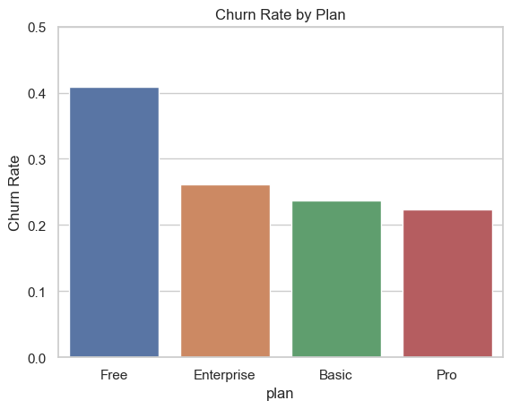
📈
FITLY ANALYTICS
Key Finding #1: High Churn is Concentrated Among Free, Low-Engagement Users
The 'Free' subscription tier shows a disproportionately high churn rate, driven primarily by users with very low engagement
Free users with only 1 recorded event exhibit the highest churn risk, with an estimated churn rate of ~46%.
Paid subscriptions (Pro, Basic, Enterprise) demonstrate significantly stronger retention, with an average churn of ~24%, indicating higher perceived value and/or better support experiences
Early engagement and onboarding represent the largest opportunity for churn reduction.

Slide 5
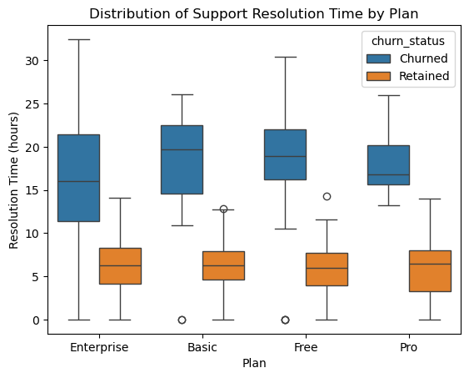
📈
FITLY ANALYTICS
Key Finding #2: Churn is driven by Free Plan Usage and Support Experience
The number of support tickets alone does not strongly predict churn
churned users consistently experience longer resolution times than retained users within the same subscription plans. Free-tier users have the highest resolution time of ~10.8 hours
The average support resolution time among inactive users is approximately 17 hours, compared to only about 6 hours among retained customers
Users on the Free subscription plan, particularly those with low engagement and slower support responsiveness, exhibit a significantly higher risk of churn compared to paid subscribers.

Slide 6
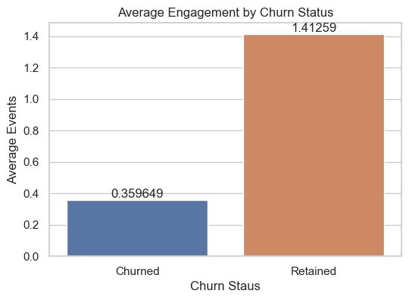
📈
FITLY ANALYTICS
Key Finding #3: Higher Engagement Strongly Improves Retention
Retained users exhibit significantly higher activity levels than churned users
On average, retained users have approximately four times more recorded events
Churn rates decrease sharply as engagement increases
Even modest increases in user engagement are associated with substantial improvements in retention

Slide 7
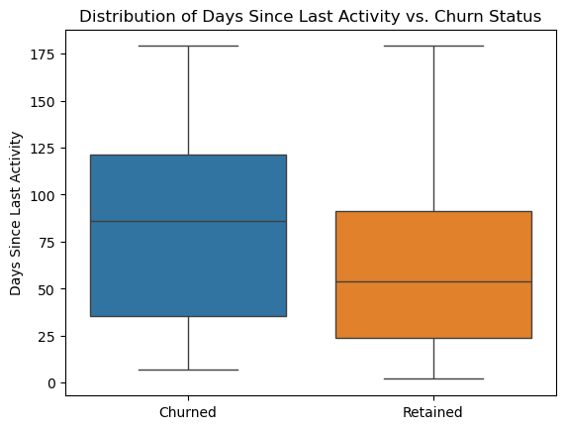
📈
FITLY ANALYTICS
Key Finding #4: User Inactivity is a Strong Predictor of Churn
Churned users show much longer periods of inactivity prior to leaving
The mean number of days since last activity among inactive users is approximately 86, compared to 54 for retained customers.
Prolonged inactivity is a strong early signal that a user is at risk of churn
Churn is rarely sudden; it is typically preceded by disengagement.

Slide 8
📈
FITLY ANALYTICS
🎯Key Metrics to Monitor
Retention: Churn rate
Support: Average resolution time in hours
Engagement: Active days per week
Risk signal: Days since last activity

Slide 9
📈
FITLY ANALYTICS
Strategic Recommendations
1. Implement an early-warning churn system
Flag users who have been inactive for over 30 days, for example
Trigger automated or personalized re-engagement efforts
2. Strengthen Early User Engagement
Improve onboarding experiences, particularly for Free and Basic users
Encourage at least 2–3 meaningful actions during the initial usage period
3. Prioritize Support Speed for At-Risk Users
Fast-track support tickets for inactive or high-value users
Introduce resolution-time Service Level Agreements (SLAs) aligned with churn risk
4. Align Teams Around Engagement Metrics
Use shared metrics across product, support, and marketing teams
Focus on preventing disengagement rather than reacting to churn

Slide 10
Conclusion
📈
FITLY ANALYTICS
Churn is primarily driven by disengagement. Users who churn are heavily concentrated among those with very low activity and long periods of inactivity.
Inactivity is a strong early warning signal. The number of days since last activity increases markedly prior to churn, indicating that users often disengage well before formally leaving.
Engagement protects against churn. Even modest increases in user activity and early activation are associated with significantly higher retention.
Support volume alone does not predict churn. Users who contact support appear in both retained and churned groups, with no clear linear relationship between ticket volume and churn.
Support quality matters more than quantity. Longer resolution times are more common among churned users within the same plan, suggesting that responsiveness and effectiveness of support may moderate churn risk.
Retention is best improved by increasing early engagement and proactively re-engaging inactive users, while focusing support efforts on faster and higher-quality issue resolution rather than reducing ticket volume.

