Slide 1


Slide 2
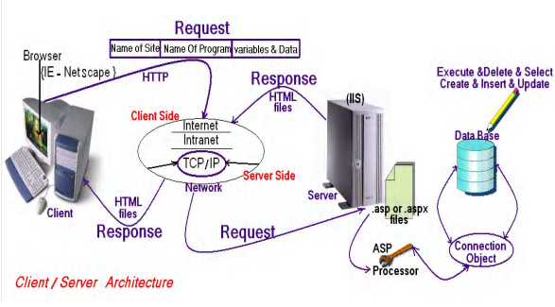
Client/Server Architecture

Slide 3
Web programming language
Web programming language
client side
HTML
CSS
Java Script
Angular
Vue
React
Server Side
ASP.Net
.NetCore
MVC
Web Forms
PHP
Laravel
symfony
Python
Flask
django

Slide 4
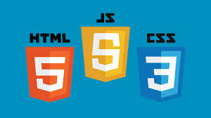
client side

Slide 5
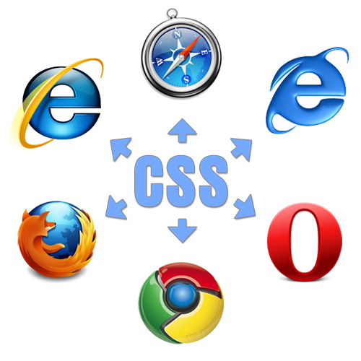
client side Cross-platform
client side Cross-platform

Slide 6

client side Cross-platform
client side Cross-platform

Slide 7

client side Cross-platform
client side Cross-platform

Slide 8
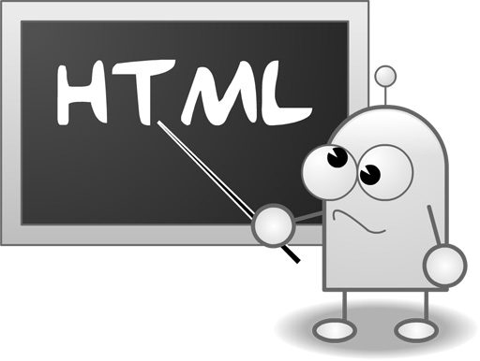
HTML Hyper Text Markup Language

Slide 9
HTML Hyper Text Markup Language
What is HTML?
HTML is a language for describing web pages.
HTML stands for Hyper Text Markup Language
HTML is a markup language
A markup language is a set of markup tags
The tags describe document content
HTML documents contain HTML tags and plain text
HTML documents are also called web pages

Slide 10
HTML Versions
Version | Year
HTML | 1991
HTML+ | 1993
HTML 2.0 | 1995
HTML 3.2 | 1997
HTML 4.01 | 1999
XHTML 1.0 | 2000
HTML5 | 2012
XHTML5 | 2013

Slide 11
CSS : Cascading Style Sheets
What is CSS?
CSS stands for Cascading Style Sheets
Styles define how to display HTML , XML elements
Styles were added to HTML 4.0 to solve a problem
Combined with JavaScript and VBScript
Separate format and content
External Style Sheets can save a lot of work

