Slide 1
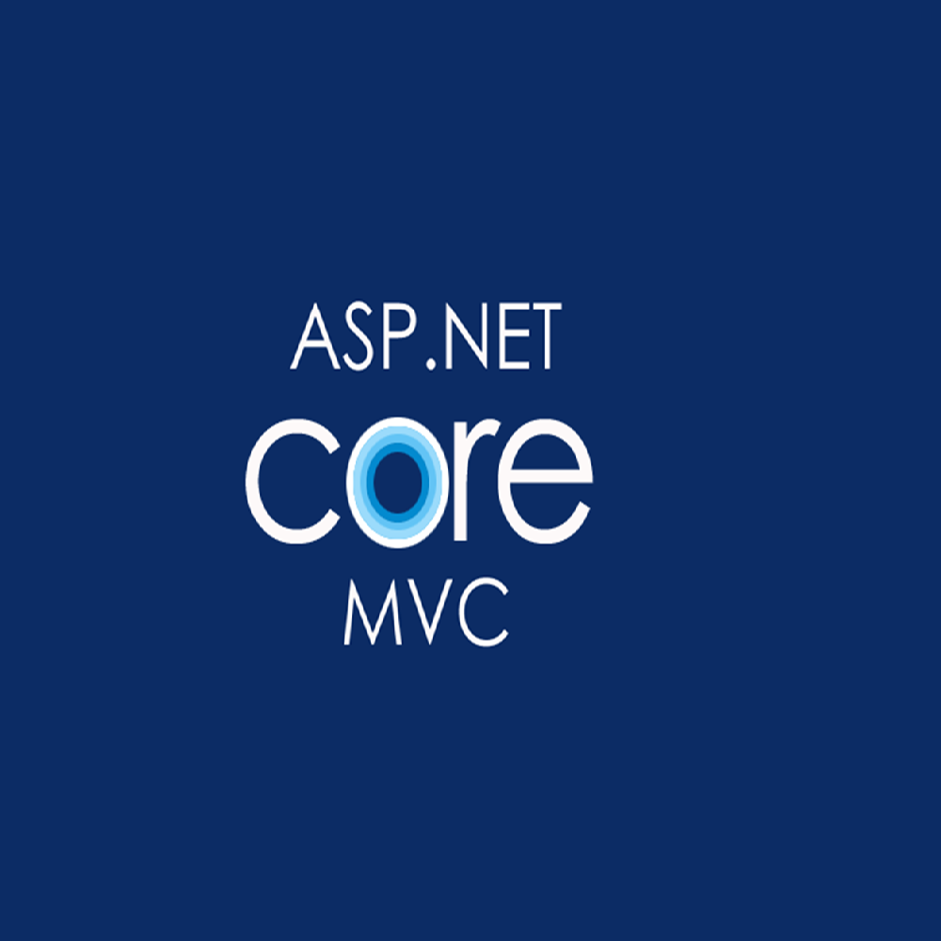

Slide 2
ASP stands for Active Server Pages
ASP is a technologies for building web pages in server side When a browser requests an ASP or ASP.NET file, the ASP engine reads the file, executes any code in the file, and returns the result to the browser.
ASP many different framework :
Classic ASP
ASP.NET
Web Forms
Web Pages
MVC
API
Core

Slide 3
Classic ASP - Active Server Pages
ASP (aka Classic ASP) was introduced in 1998 as Microsoft's first server side scripting language.
Classic ASP pages have the file extension .asp and are normally written in VBScript or jSScript.

Slide 4
ASP.NET
ASP.NET was released in 2002 as a successor to Classic ASP.
ASP.NET pages have the extension .aspx and are normally written in C# (C sharp).
ASP.NET 4.6 is the latest official version of ASP.NET.
ASP.NET 5 was expected to be an important redesign of ASP.NET.

Slide 5
ASP.NET
ASP.NET Web Forms
ASP.NET Web Forms is an event driven application model.
ASP.NET Web Forms is not a part of the new ASP.NET Core.
ASP.NET Web Pages
ASP.NET Web Pages is an SPA application model (Single Page Application).
The SPA model is quite similar to PHP and Classic ASP.
ASP.NET Web Pages is being merged into the new ASP.NET Core.
ASP.NET MVC
ASP.NET MVC is an MVC application model (Model-View-Controller).
ASP.NET MVC is being merged into the new ASP.NET Core.
ASP.NET Web API
ASP.NET API is an API application model (Application Programming Interface).
ASP.NET API is being merged into the new ASP.NET Core.
ASP.NET Core
ASP.NET Core was released in 2016.
ASP.NET Core merges ASP.NET MVC, ASP.NET Web API, and ASP.NET Web Pages into one application framework.

Slide 6
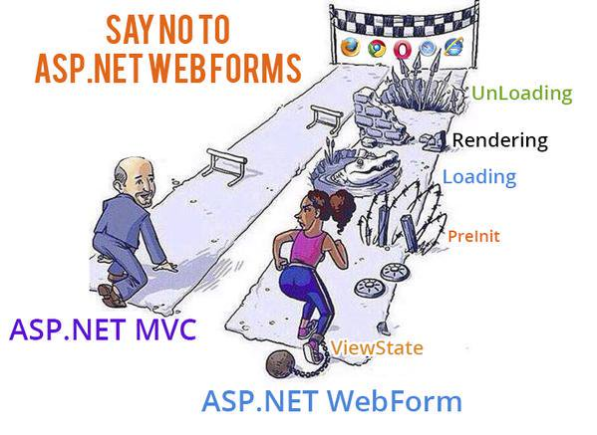
WebForms VS MVC Loading and Rendering

Slide 7


WebForms VS MVC Behind Code

Slide 8
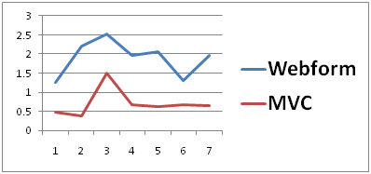
WebForms VS MVC Performance

Slide 9
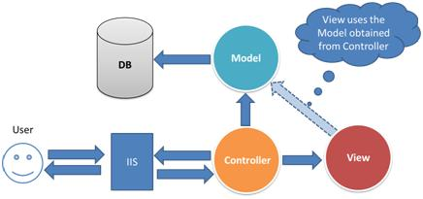
MVC architecture

Slide 10
Characteristics of .NET Core
Open source
.NET Core is an open source implementation, using MIT and Apache 2 licenses.
.NET Core is a .NET Foundation project and is available on GitHub.
As an open source project, it promotes a more transparent development process and promotes an active and engaged community.
Cross-platform
Application implemented in .NET Core can be run and its code can be reused regardless of your platform target.
It currently supports three main operating systems (OS)
Windows,Linux,MacOS
Command-line tools
All product scenarios can be exercised at the command-line.
Compatible
.NET Core is compatible with .NET Framework, Xamarin and Mono, via the .NET Standard Library
Modular
.NET Core is released through NuGet in smaller assembly packages.
.NET Framework is one large assembly that contains most of the core functionalities.

Slide 11
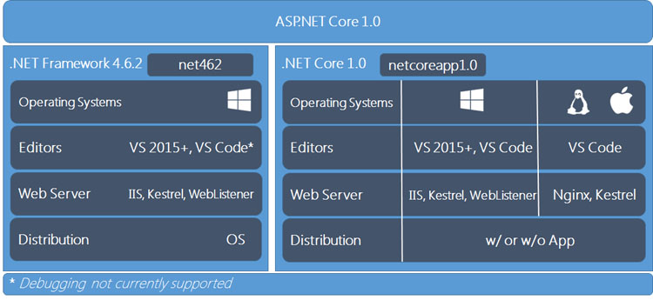
.Net Framework VS .NET Core

Slide 12
.Net Framework VS .NET Core

