Slide 1


Slide 2
Laravel Course layout
Client/Server Architecture
What is Laravel
Install Apache, Mysql, Composer, Node.js , laravel on windows
Files structure
Route, View, Controller
pass data from Controller to View & blade syntax & php syntax
Migration
create, read (CRUD)
update, and delete (CRUD)
Validation
Layouts
project

Slide 3
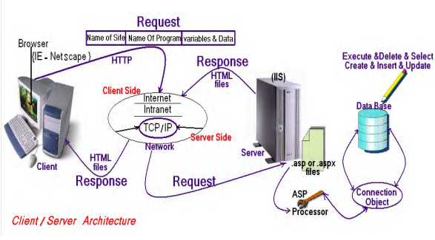
Client/Server Architecture

Slide 4
Web programming language
Web programming language
Server Side
Java Script
client side
PHP
ASP.Net
HTML
CSS

Slide 5
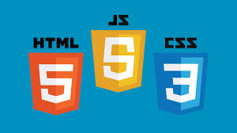
client side

Slide 6

client side Cross-platform
client side Cross-platform

Slide 7

client side Cross-platform
client side Cross-platform

Slide 8

HTML Hyper Text Markup Language

Slide 9
HTML Hyper Text Markup Language
What is HTML?
HTML is a language for describing web pages.
HTML stands for Hyper Text Markup Language
HTML is a markup language
A markup language is a set of markup tags
The tags describe document content
HTML documents contain HTML tags and plain text
HTML documents are also called web pages

Slide 10
HTML Versions
Version | Year
HTML | 1991
HTML+ | 1993
HTML 2.0 | 1995
HTML 3.2 | 1997
HTML 4.01 | 1999
XHTML 1.0 | 2000
HTML5 | 2012
XHTML5 | 2013

Slide 11
CSS : Cascading Style Sheets
What is CSS?
CSS stands for Cascading Style Sheets
Styles define how to display HTML , XML elements
Styles were added to HTML 4.0 to solve a problem
Combined with JavaScript and VBScript
Separate format and content
External Style Sheets can save a lot of work

Slide 12
Laravel Course layout
Laravel is MVC PHP framework created by Taylor Otwell in 2011
Free open-source license with many contributors worldwide
One of the best frameworks together with Symfony, CodeIgniter, Yii
Has powerful features, saving us time
Uses Symfony packages
Lets see some statistics

Slide 13
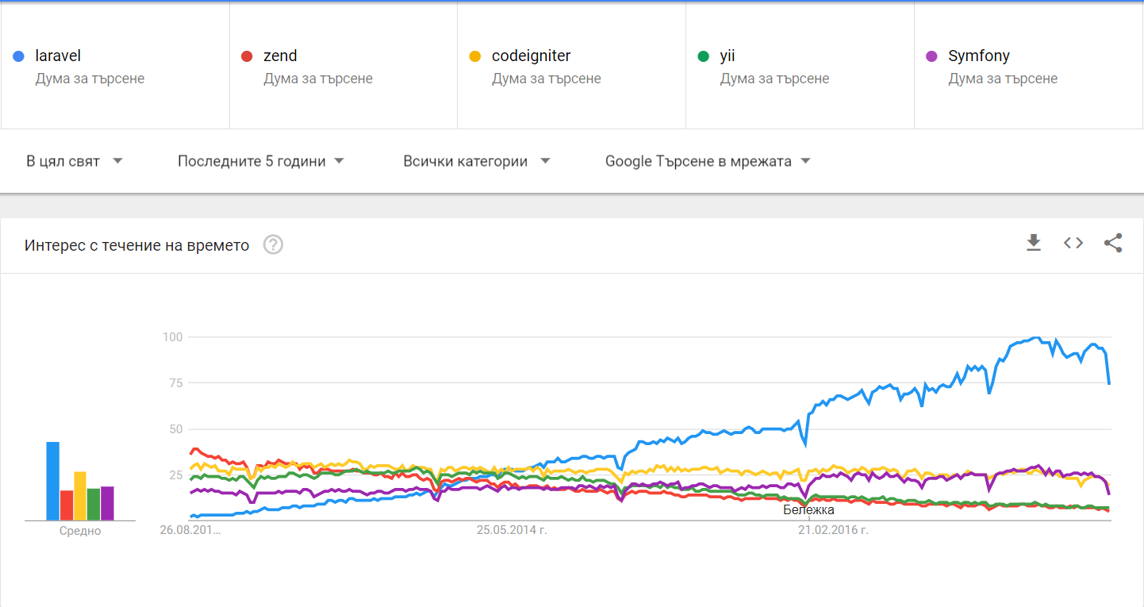
Google Trends (2012 – 2017)

Slide 14
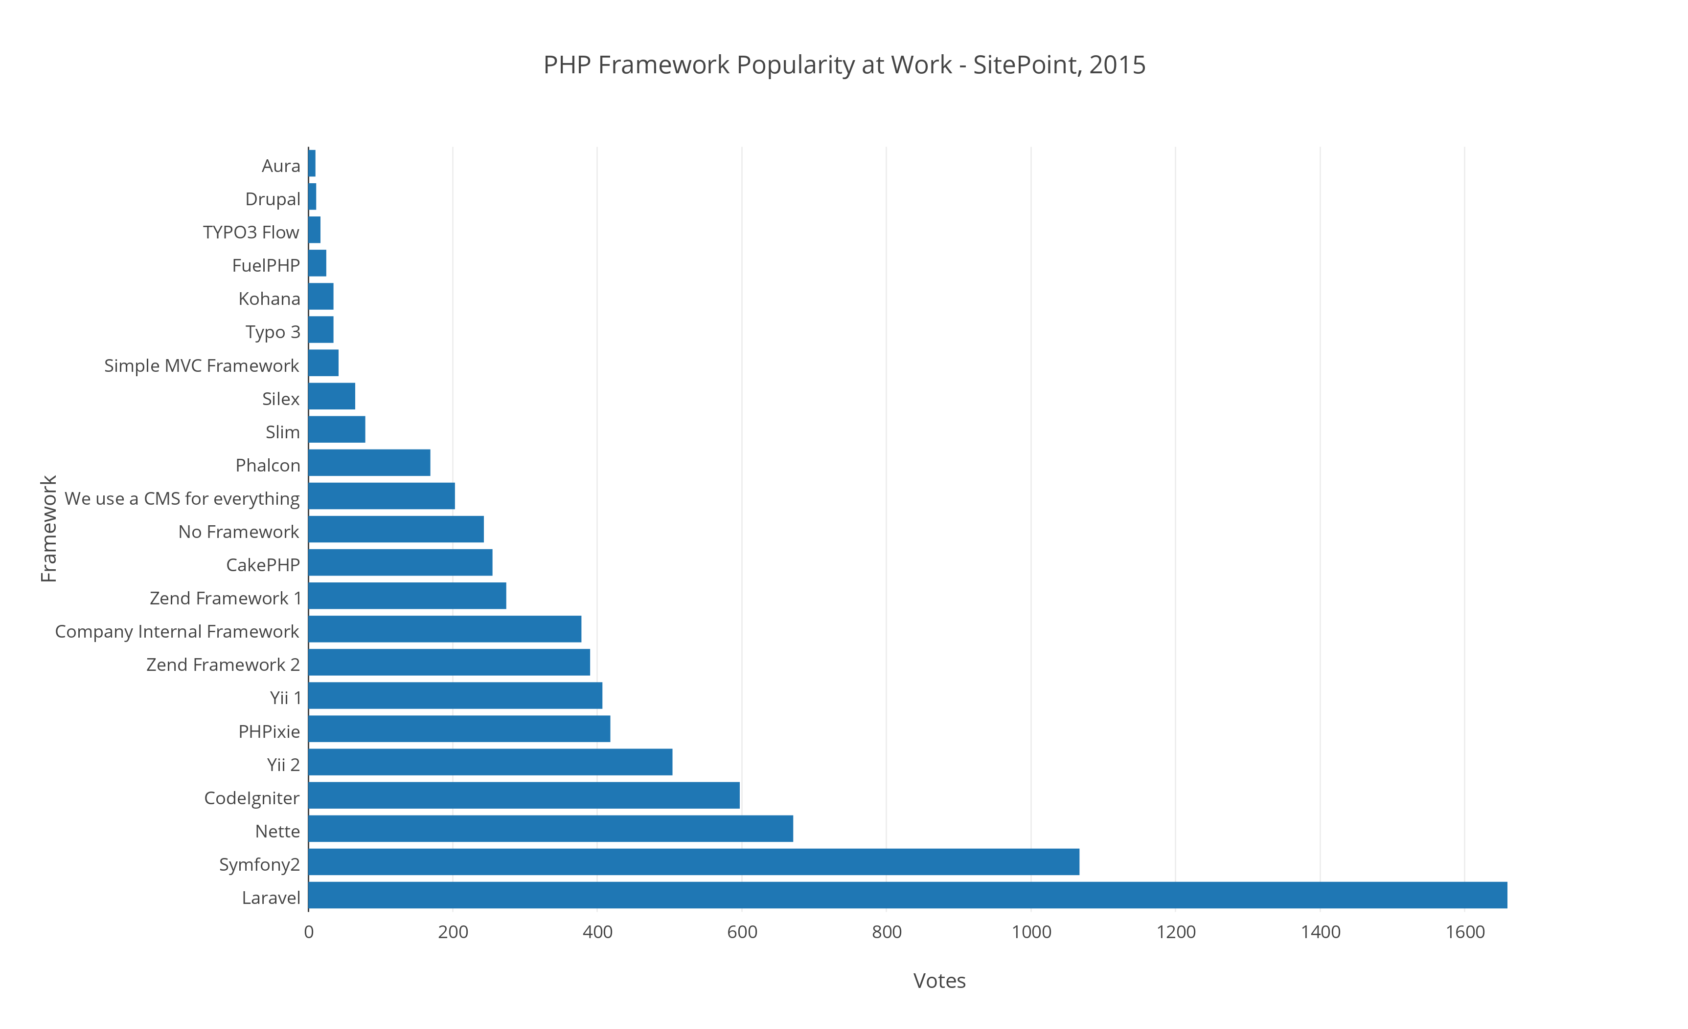
Google Trends (2012 – 2017)

Slide 15
Features
Eloquent ORM (object-relational mapping) – implements ActiveRecord
Query builder – helps you to build secured SQL queries
Restful controllers – provides a way for separating the different HTTP requests (GET, POST, DELETE, etc.)
Blade template engine – combines templates with a data model to produce views
Migrations – version control system for database, update your database easier
Database seeding – provides a way to populate database tables with test data used for testing
Pagination – easy to use advanced pagination functionalities
Forms security – provides CSRF token middleware, protecting all the forms

Slide 16

Environment Setup
Node.js Setup
https://nodejs.org/en/

Slide 17

Environment Setup
Composer Setup
To manage its dependencies
https://getcomposer.org/download/

Slide 18

Environment Setup
Postman
Makes API Development Simple
https://www.getpostman.com/

Slide 19

Environment Setup
GitHub
Version Control
https://github.com/

Slide 20

Environment Setup
visual studio code IDE Setup
https://code.visualstudio.com/

Slide 21
Environment Setup
visual studio code IDE extensions
Laravel 5 Snippets
Laravel Artisan
https://code.visualstudio.com/

Slide 22
Project Setup
composer global require "laravel/installer"
composer create-project --prefer-dist laravel/laravel alhendy
npm install
php artisan serve
https://laravel.com/docs/5.7/installation

Slide 23
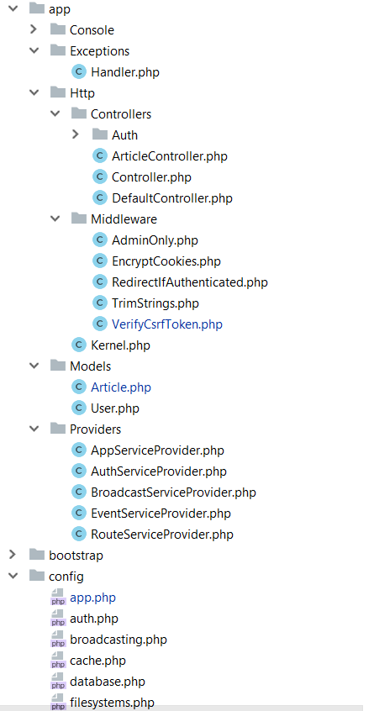
The structure
app/Http folder contains the Controllers, Middlewares and Kernel file
All the models should be located in app/Models folder
The service providers that are bootstrapping functions in our app are located in app/Providers folder
All the config files are located in app/config folder

Slide 24
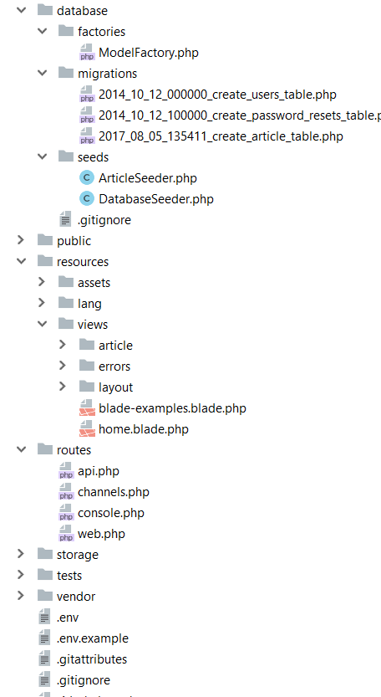
Database folder contains the migrations and seeds
The public folder is the actual folder you are opening on the web server.
All JS / CSS / Images / Uploads are located there.
The resources folder contains all the translations, views and assets (SASS, LESS, JS)
that are compiled into public folder
The routes folder contains all the routes for the project
All the logs / cache files are located in storage folder
The vendor folder contains all the composer packages (dependencies)

Slide 25
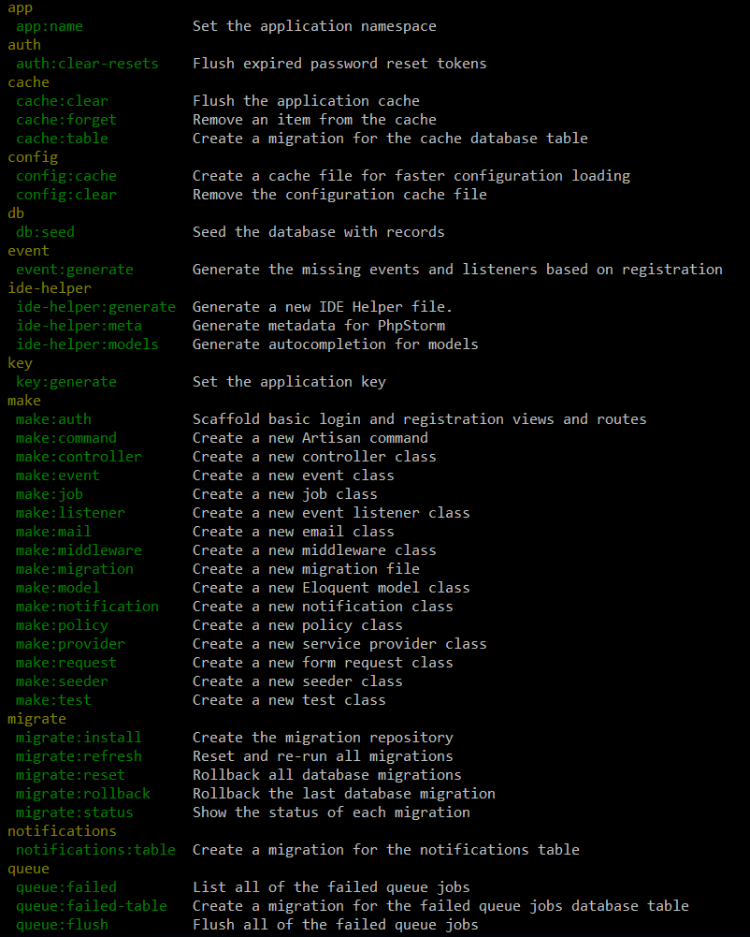
Artisan !
Artisan is command-line interface for Laravel
Commands that are saving time
Generating files with artisan is recommended
Run php artisan list in the console

Slide 26
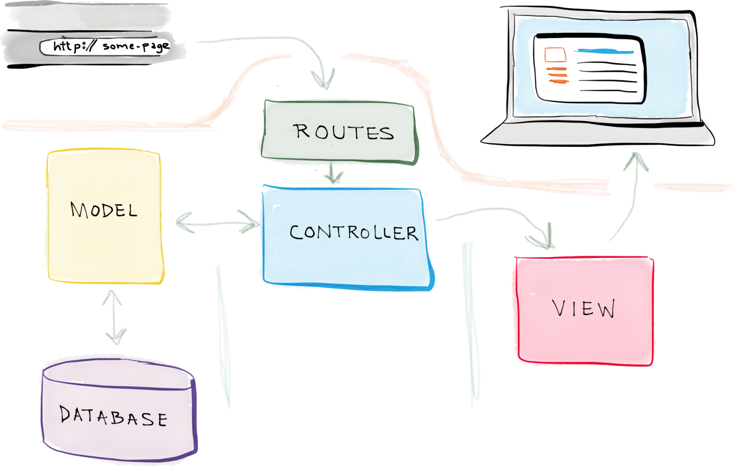
Laravel Architecture

Slide 27

Routing
Basic Routing

Slide 28
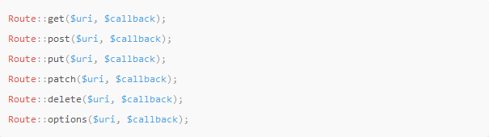
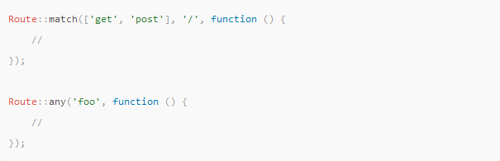
Available Router Methods

Slide 29

View Routes

Slide 30


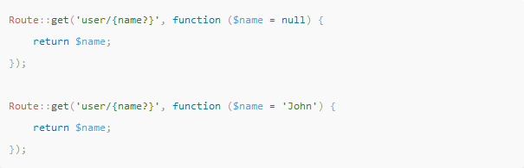
Route Parameters
Required Parameters
Optional Parameters

Slide 31
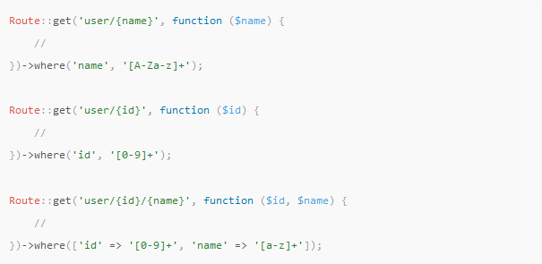
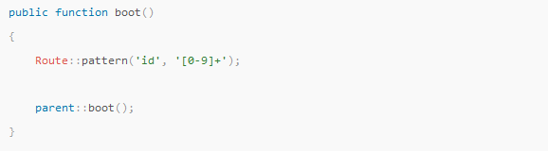
Regular Expression Constraints
Local Constraints
Global Constraints

Slide 32

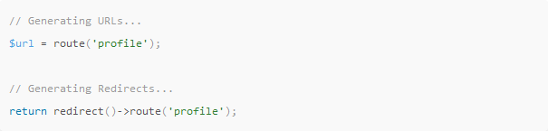
Named Routes
Create Named Routes
Generating URLs To Named Routes

Slide 33
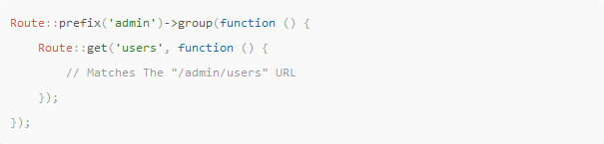
Route Prefixes

