Slide 1
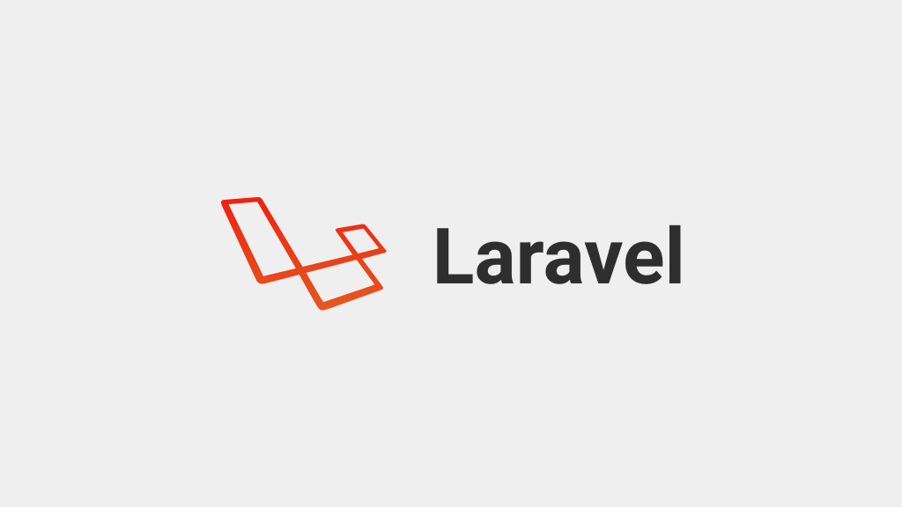

Slide 2
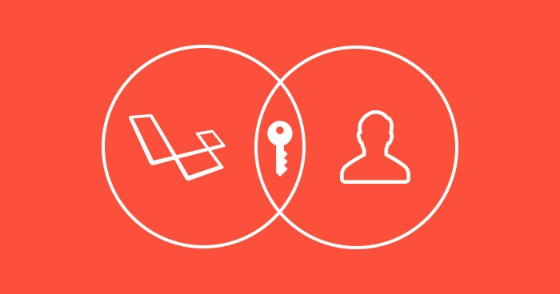
Authentication Lec 5
Cross – Site Request Forgery (CSRF)
DB config ENV
Config / database
MySQL phpmyadmin
Authentication
DB class
create, read (CRUD)
update, and delete (CRUD)

Slide 3
DB config ENV
DB_CONNECTION=mysql
DB_HOST=127.0.0.1
DB_PORT=3306
DB_DATABASE=PetrojetDB
DB_USERNAME=root
DB_PASSWORD=mysql

Slide 4
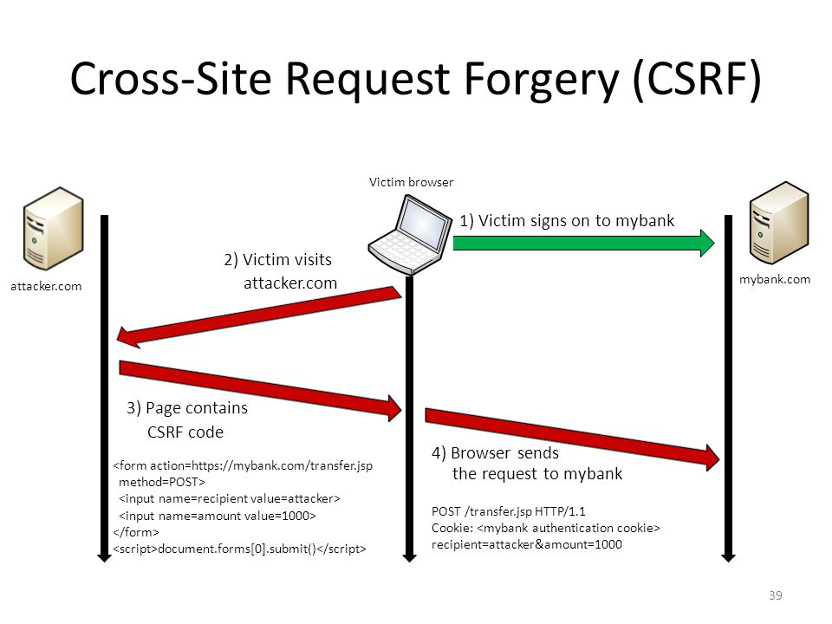

Slide 5
php artisan make:auth –h Authentication
Description:
Scaffold basic login and registration views and routes
Usage:
make:auth [options]
Options:
--views Only scaffold the authentication views
--force Overwrite existing views by default

Slide 6
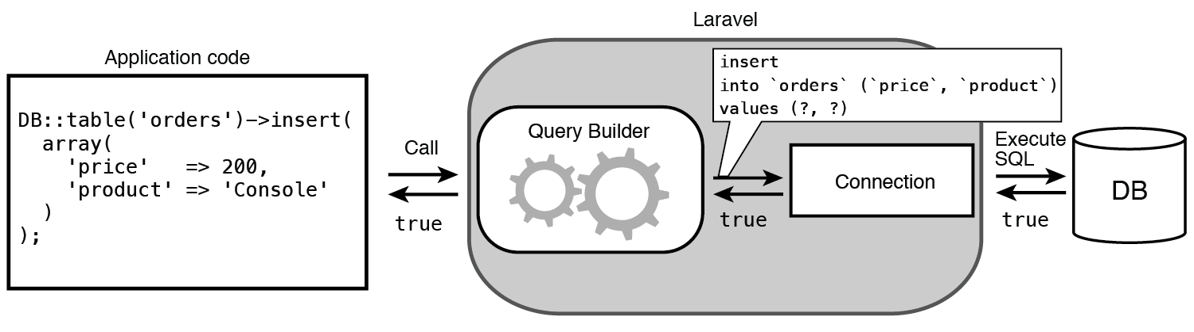
DB class

Slide 7
DB class
use DB;
create, read (CRUD)
DB::select('select * from users where active = ?', [1]);
DB::insert('insert into users (id, name) values (?, ?)', [1, 'Dayle']);
DB::update('update users set votes = 100 where name = ?', ['John']);
DB::delete('delete from users where id = ?', [2]);

