Slide 1
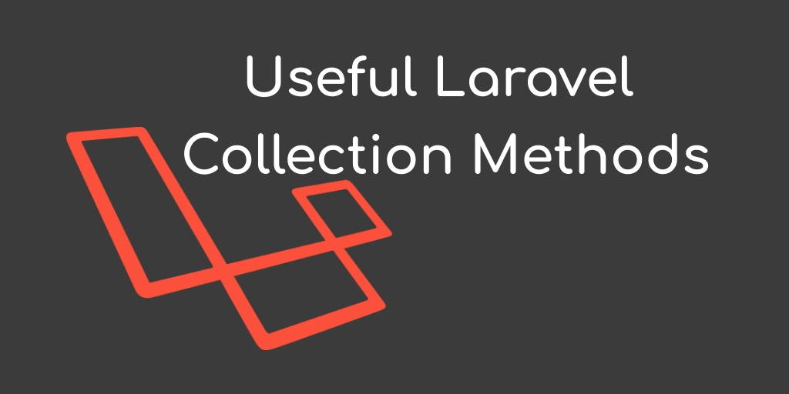
Collection

Slide 2
Collection Methods
union VS , merge
unique ,
when ,
where , whereIn ,whereNotIn
all X collect ,
avg , sum, count, max,min
chunk X collapse
partition ,
pipe,
pluck ,
Random Select random Value
Map
reject , reverse, search , shift , slice
each , every , filter , except , only
combine , contains ,diff ,diffKeys
get , groupBy , has, implode , intersect , isEmpty
toArray , toJson, keyBy , keys ,last
flatMap , flatten , flip , forget, forPage

Slide 3
Collection Methods
pop Remove from Last And Return Value
Pull Remove By Key And Return Value
Prepend Add in frist
Push Add in Last
Put Add in Key And Value

Slide 4
Sort Collection Methods
shuffle Random Sort
Sort
sortBy
sortByDesc
take

