Slide 1


Slide 2
Controller Lec 3
controller
Request Object
Send Data View to Action by Different Method
Validate Data
Show Error Massage
Show Old Data

Slide 3

Controller Object

Slide 4
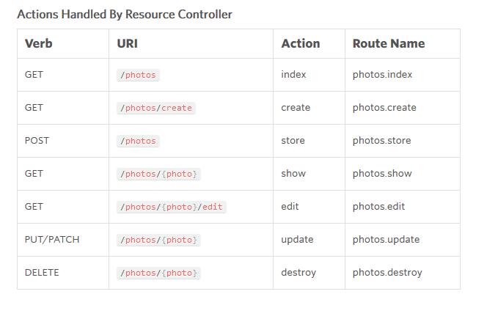
Controller resource

Slide 5
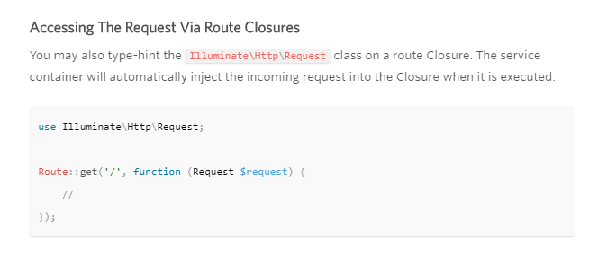
Request Accessing The Request
Illuminate\Http\Request

Slide 6
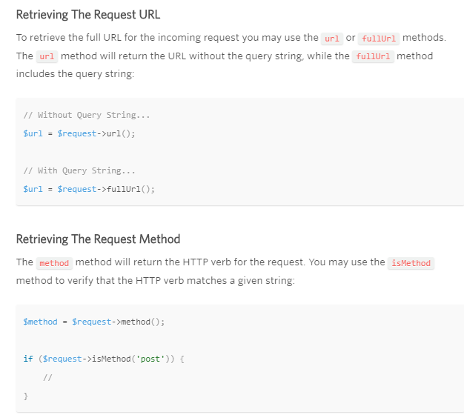
Request Path & Method

Slide 7
Request Retrieving Input
Illuminate\Http\Request
Illuminate\Support\Facades\Input;

Slide 8
Validate Data Server Side
Routing URL
Required Parameters
Regular Expression
Middleware
Request Validate

Slide 9
Validate Available Validation Rules
$request->validate([
'Email' => 'required',
'password' => 'required',
'MylogoPhoto' => 'required|image|mimes:jpeg,png,jpg,gif,svg'
]);

