Slide 1


Slide 2
Laravel Lec 2
Routing
Quick review Php Syntax
View Blade syntax
Controller
pass data from Action to View
Layouts

Slide 3
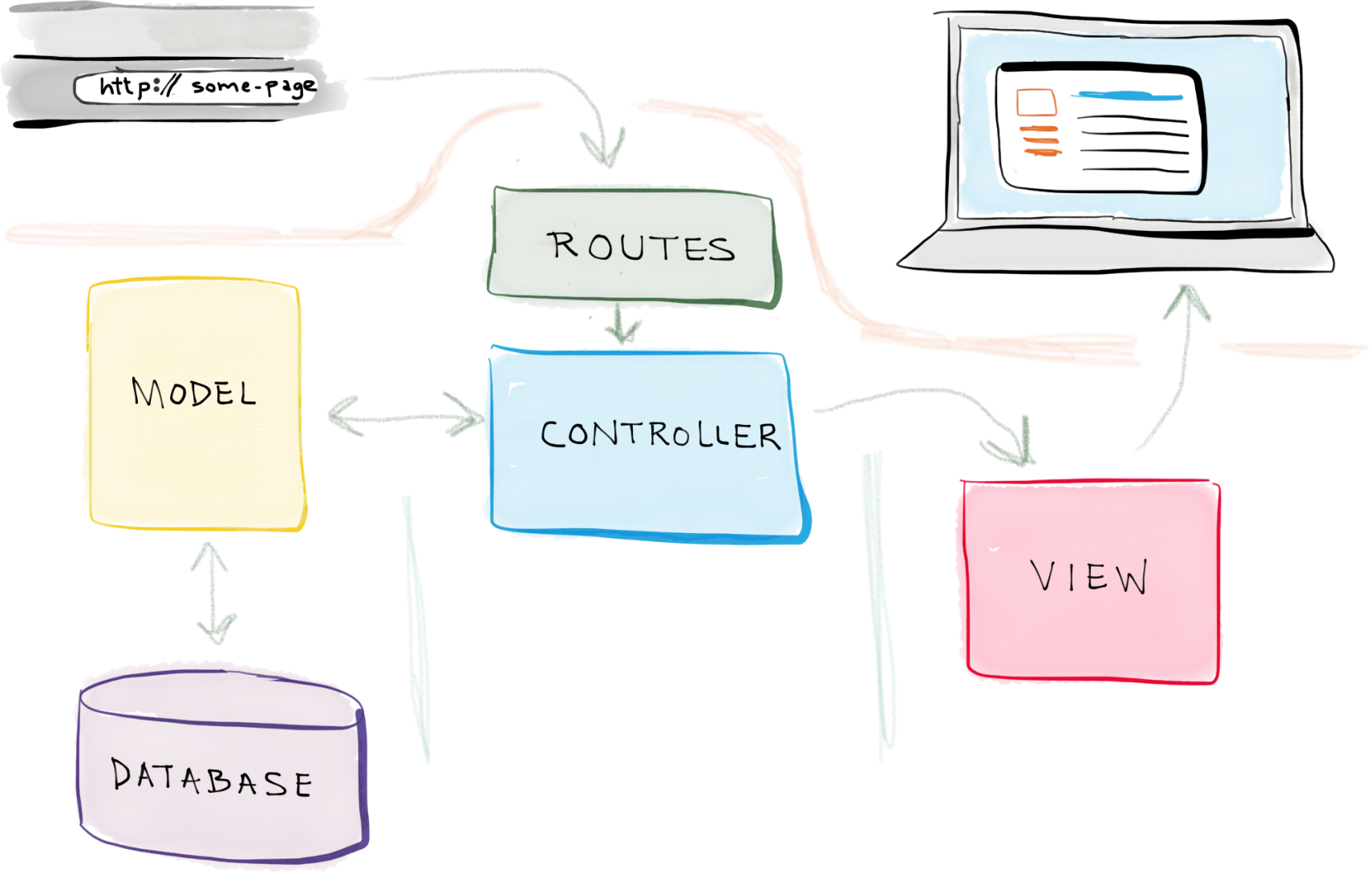
Laravel Architecture

Slide 4

Routing - Basic Routing

Slide 5
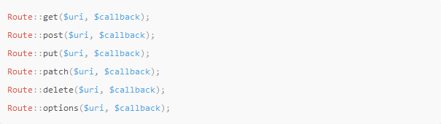
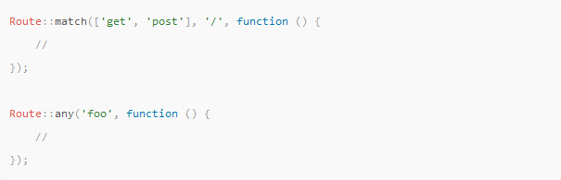
Routing Available Router Methods

Slide 6

Routing View Routes

Slide 7


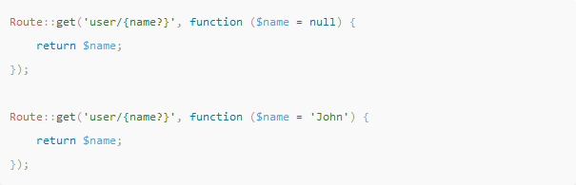
Routing Parameters
Required Parameters
Optional Parameters

Slide 8
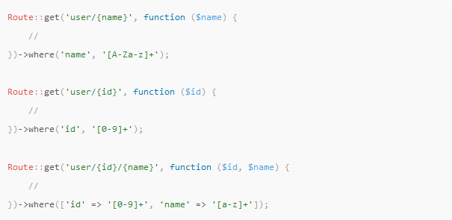
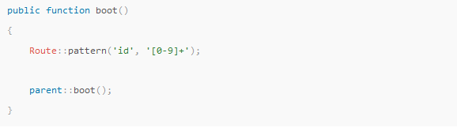
Routing Regular Expression Constraints
Local Constraints
Global Constraints

Slide 9

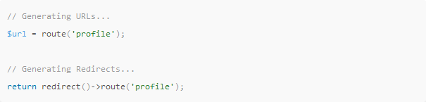
Routing Named Routes
Create Named Routes
Generating URLs To Named Routes

Slide 10
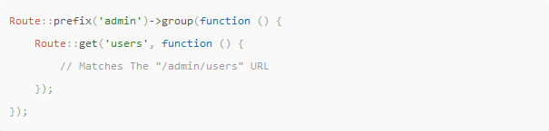
Routing Prefixes

Slide 11
Routing Show route:list
php artisan route:list

Slide 12
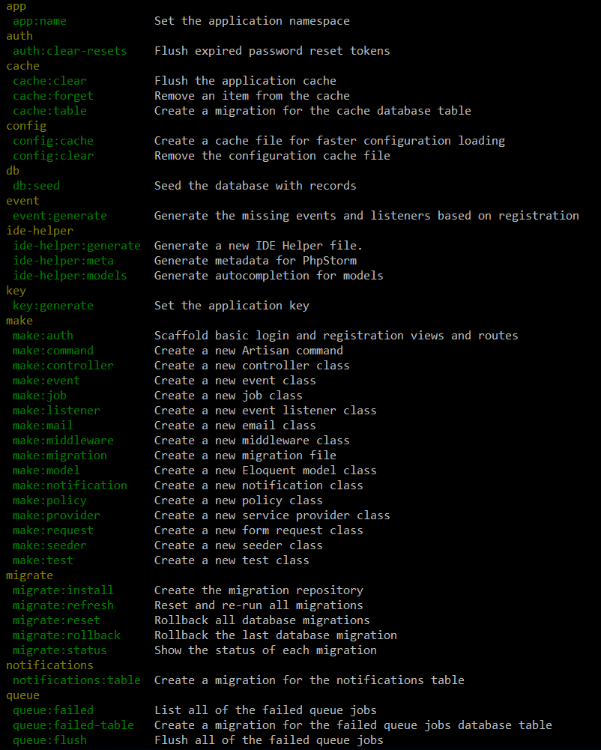
Artisan !
Artisan is command-line interface for Laravel
Commands that are saving time
Generating files with artisan is recommended
Run php artisan list in the console

Slide 13
Blade syntax - Basic output
// Displaying
{{ $x }} - Echo content
{!! $x !!} - Echo content without escaping special characters
{{ $x or 'default' }} - Echo content with a default value
// Comments
{{-- This comment will not be present in the rendered HTML --}}
// PHP
@php...@endphp
<?php ?>

Slide 14
Blade syntax - Path Control
// If Statements
@if, @elseif, @else and @endif
@unless, @endunless
// Loops
@for...@endfor
@foreach...@endforeach
@forelse...@empty...@endforelse
@while...@endwhile
@continue, @continue($user->type==1)
@break, $break($user->type==1)
$loop - index, iteration, remaining, count, first, last, depth, parent

Slide 15
Blade syntax - Template inheritance
// Defining A Layout
@yield('name')
@yield('x', 'y') - Yields the content of a section called x; defaults to y if x is not defined.
@section('name')
@endsection
// Extending A Layout
@extends('template')
@section('name')
@endsection
@section('name', 'value')
@section('name', $value)

Slide 16
Blade syntax - including
@include('view.name'])
@include('view.name', ['some' => 'data'])
@includeIf('view.name', ['some' => 'data'])
@includeWhen($boolean, 'view.name', ['some' => 'data'])

Slide 17
Blade syntax - Forms
// csrf_token
{{ csrf_token() }}
// CSRF Field
@csrf
// Method Field
@method('PUT')

