Slide 1
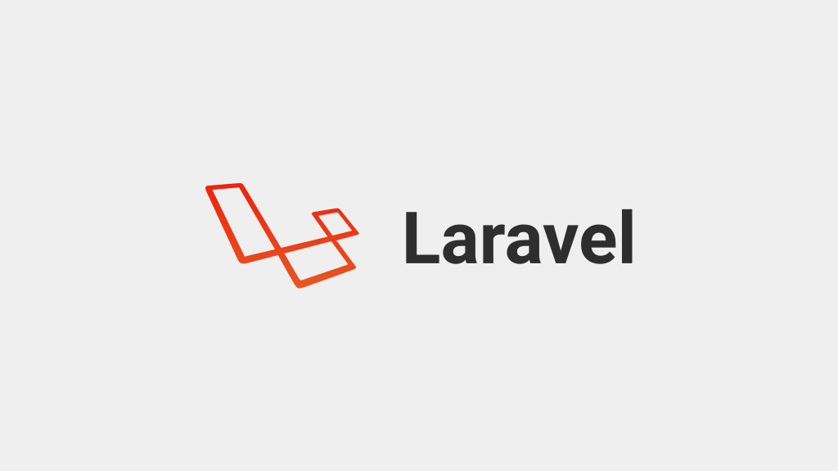

Slide 2
Laravel Introduction
Client/Server Architecture
What is Laravel
Environment Setup
Files structure
Laravel reference

Slide 3
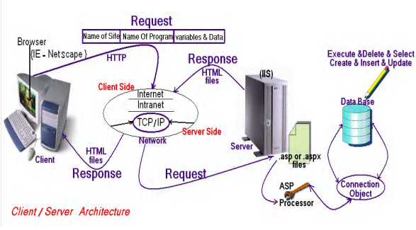
Client/Server Architecture

Slide 4
Web programming language
Web programming language
client side
HTML
CSS
Java Script
Angular
Vue
React
Server Side
ASP.Net
.NetCore
MVC
Web Forms
PHP
Laravel
symfony
Python
Flask
django

Slide 5

client side Cross-platform
client side Cross-platform

Slide 6
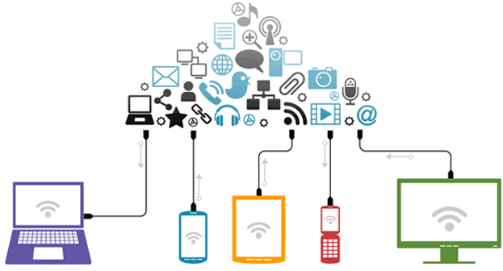
client side Cross-platform
client side Cross-platform

Slide 7

HTML Hyper Text Markup Language

Slide 8
HTML Hyper Text Markup Language
What is HTML?
HTML is a language for describing web pages.
HTML stands for Hyper Text Markup Language
HTML is a markup language
A markup language is a set of markup tags
The tags describe document content
HTML documents contain HTML tags and plain text
HTML documents are also called web pages

Slide 9
HTML Versions
Version | Year
HTML | 1991
HTML+ | 1993
HTML 2.0 | 1995
HTML 3.2 | 1997
HTML 4.01 | 1999
XHTML 1.0 | 2000
HTML5 | 2012
XHTML5 | 2013

Slide 10
CSS : Cascading Style Sheets
What is CSS?
CSS stands for Cascading Style Sheets
Styles define how to display HTML , XML elements
Styles were added to HTML 4.0 to solve a problem
Combined with JavaScript and VBScript
Separate format and content
External Style Sheets can save a lot of work

Slide 11
Laravel Course layout
Laravel is MVC PHP framework created by Taylor Otwell in 2011
Free open-source license with many contributors worldwide
One of the best frameworks together with Symfony, CodeIgniter, Yii
Has powerful features, saving us time
Uses Symfony packages
Lets see some statistics

Slide 12
Laravel Course PreRequisite
Necessary Requirements
HTML
PHP
SQL
Preferred Requirements
CSS
JS
Git

Slide 13
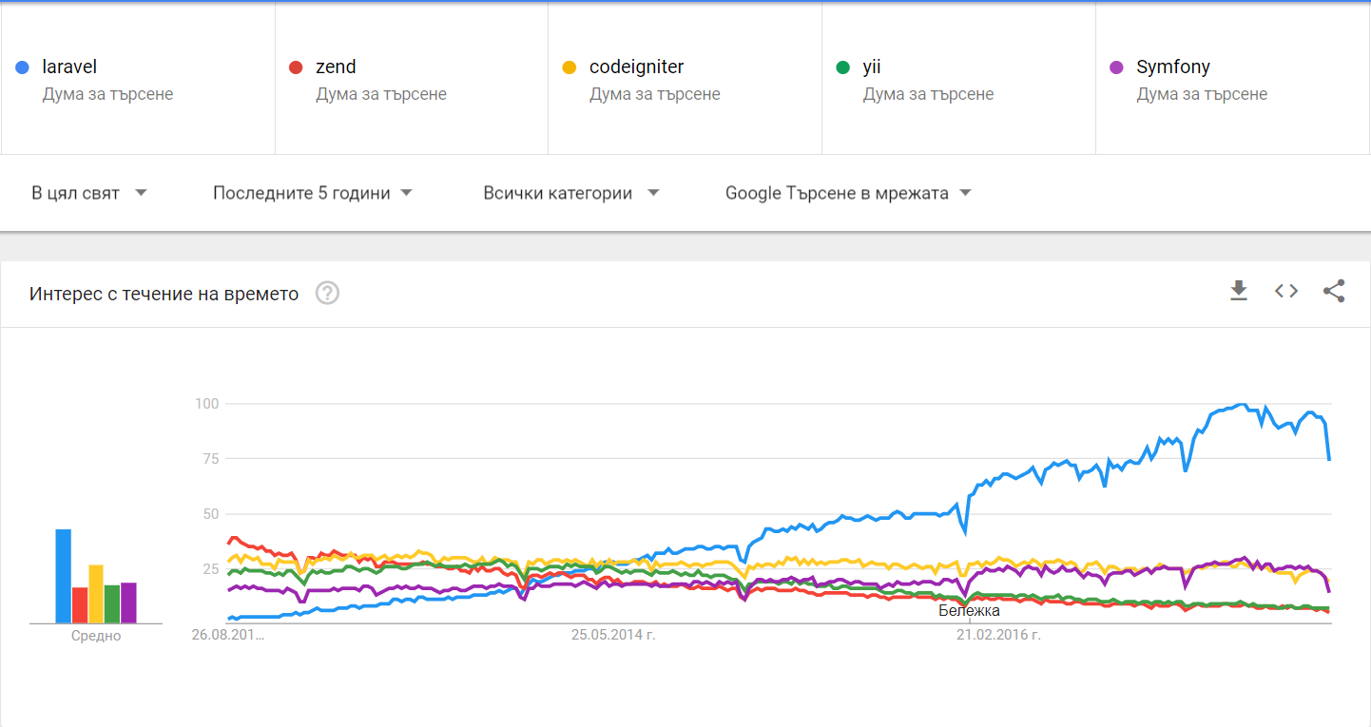
Google Trends (2012 – 2017)

Slide 14
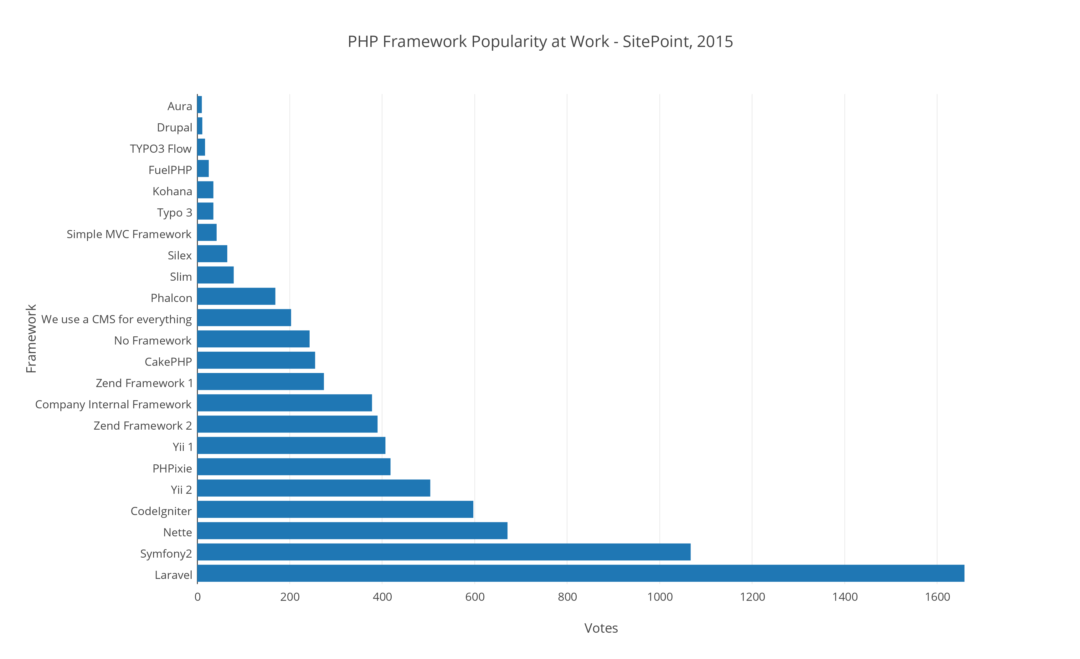
Google Trends (2012 – 2017)

Slide 15
Features
Eloquent ORM (object-relational mapping) – implements ActiveRecord
Query builder – helps you to build secured SQL queries
Restful controllers – provides a way for separating the different HTTP requests (GET, POST, DELETE, etc.)
Blade template engine – combines templates with a data model to produce views
Migrations – version control system for database, update your database easier
Database seeding – provides a way to populate database tables with test data used for testing
Pagination – easy to use advanced pagination functionalities
Forms security – provides CSRF token middleware, protecting all the forms

Slide 16





Environment Setup
Required Programs
Ampps
Node.js
Composer To manage its dependencies
Optional Programs
VScode IDE Setup
GitHub Version Control
Postman Makes API Development Simple
filezilla FTP solution for both client and server.
PuTTY is an SSH and telnet client

Slide 17
Environment Setup
visual studio code IDE extensions
Laravel 5.6 Snippets
Laravel Blade Snippets
Laravel goto view
laravel-goto-controller Laravel Artisan
Git
MySQL
https://code.visualstudio.com/

Slide 18
Environment Setup
visual studio code User Snippets
"Route::resource('$1','$2Controller');\n php artisan make:Controller $2Controller -r -m $2",
https://code.visualstudio.com/

Slide 19
Project Setup
composer global require "laravel/installer"
composer create-project --prefer-dist laravel/laravel ProjectName
npm install
Composer install
php artisan key:generate
php artisan serve or “php -S localhost:8000 -t public/”
https://laravel.com/docs/5.7/installation

Slide 20
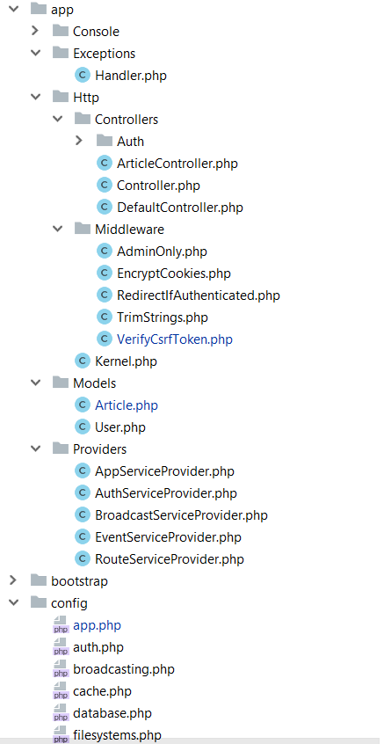
The structure
app/Http folder contains the Controllers, Middlewares and Kernel file
All the models should be located in app/Models folder
The service providers that are bootstrapping functions in our app are located in app/Providers folder
All the config files are located in app/config folder

Slide 21
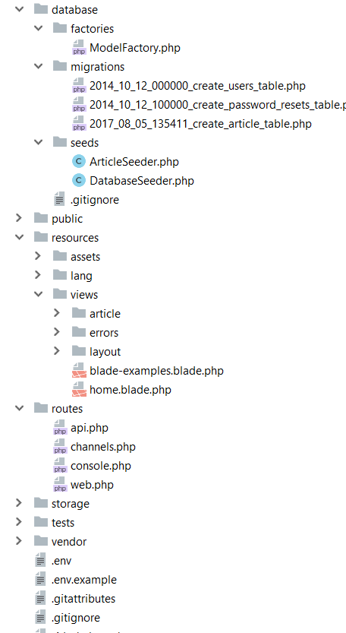
Database folder contains the migrations and seeds
The public folder is the actual folder you are opening on the web server.
All JS / CSS / Images / Uploads are located there.
The resources folder contains all the translations, views and assets (SASS, LESS, JS)
that are compiled into public folder
The routes folder contains all the routes for the project
All the logs / cache files are located in storage folder
The vendor folder contains all the composer packages (dependencies)

Slide 22
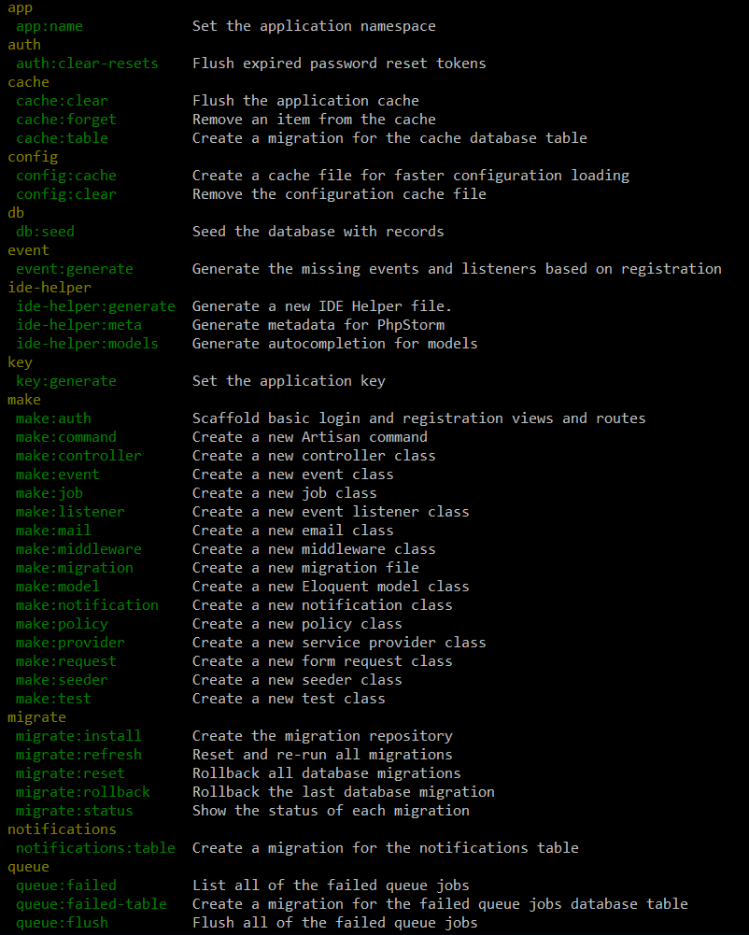
Artisan !
Artisan is command-line interface for Laravel
Commands that are saving time
Generating files with artisan is recommended
Run php artisan list in the console

Slide 23
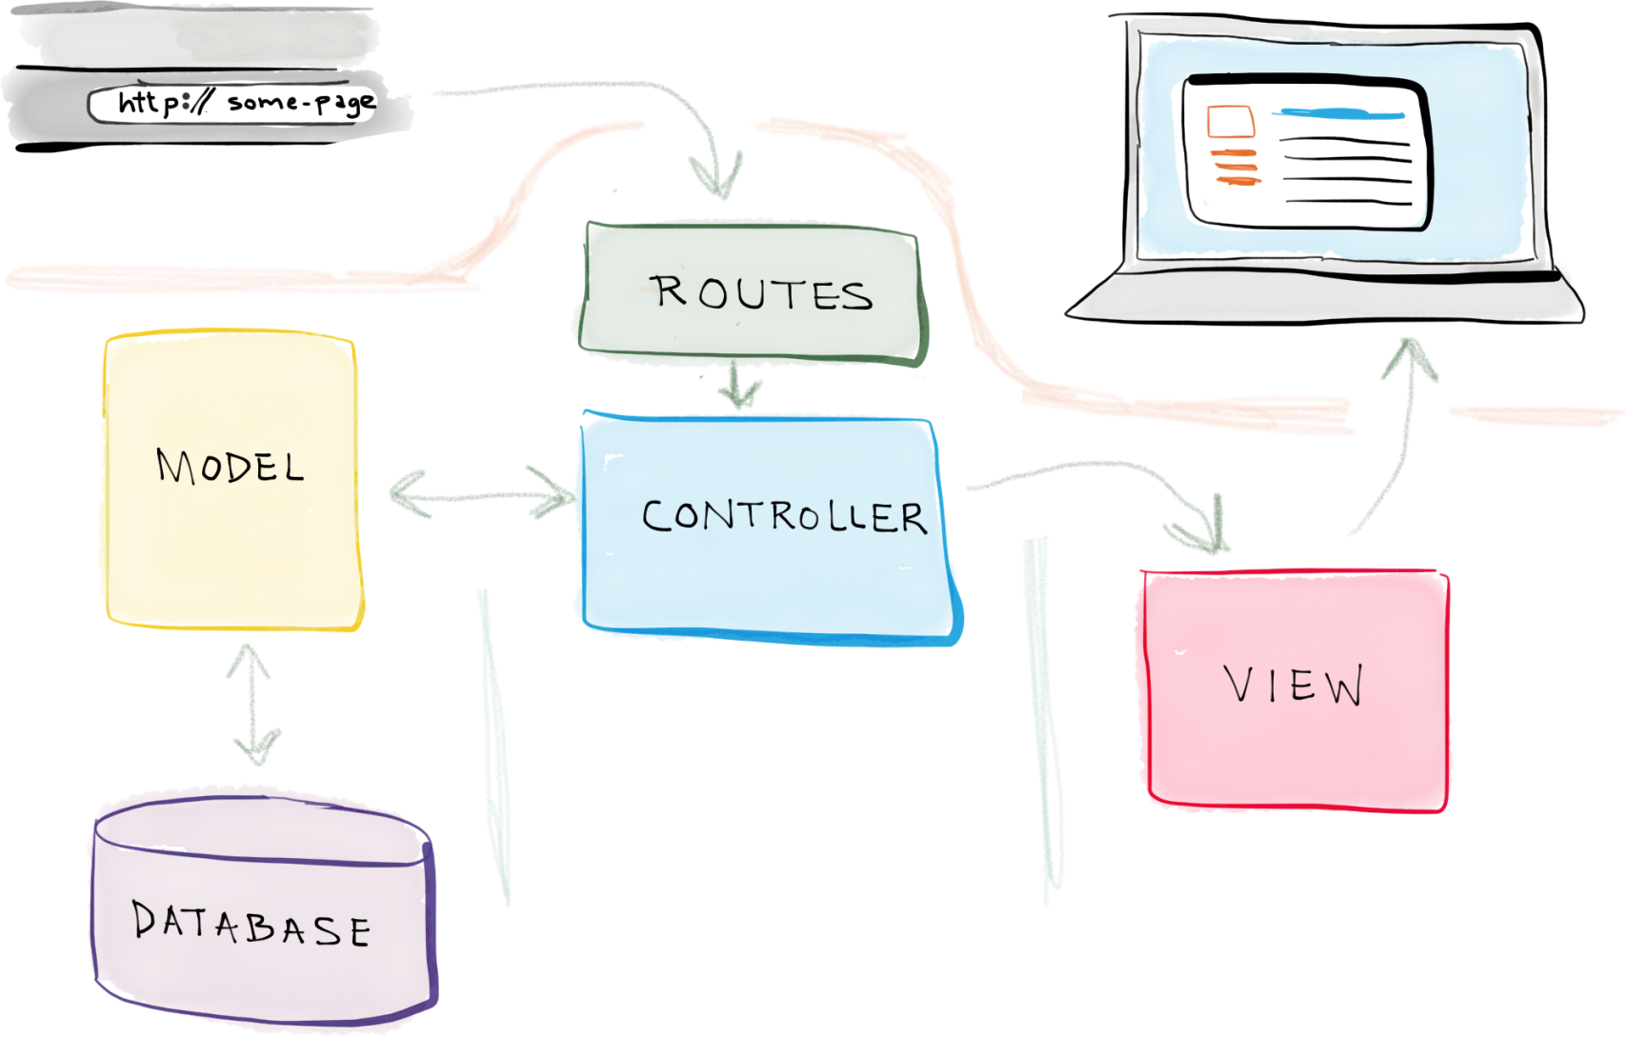
Laravel Architecture

Slide 24
Laravel reference
https://laravel.com/api/5.7/index.html
https://laravel.com/docs/5.7

Slide 25
How to Format Laravel Blade Codes in Visual Studio Code?

