Slide 1


Slide 2
Routing Lec 2
Laravel Architecture
Routing - Basic Routing
Routing Available Router Methods
Routing View Routes
Routing Parameters
Routing Regular Expression Constraints
Routing Named Routes

Slide 3
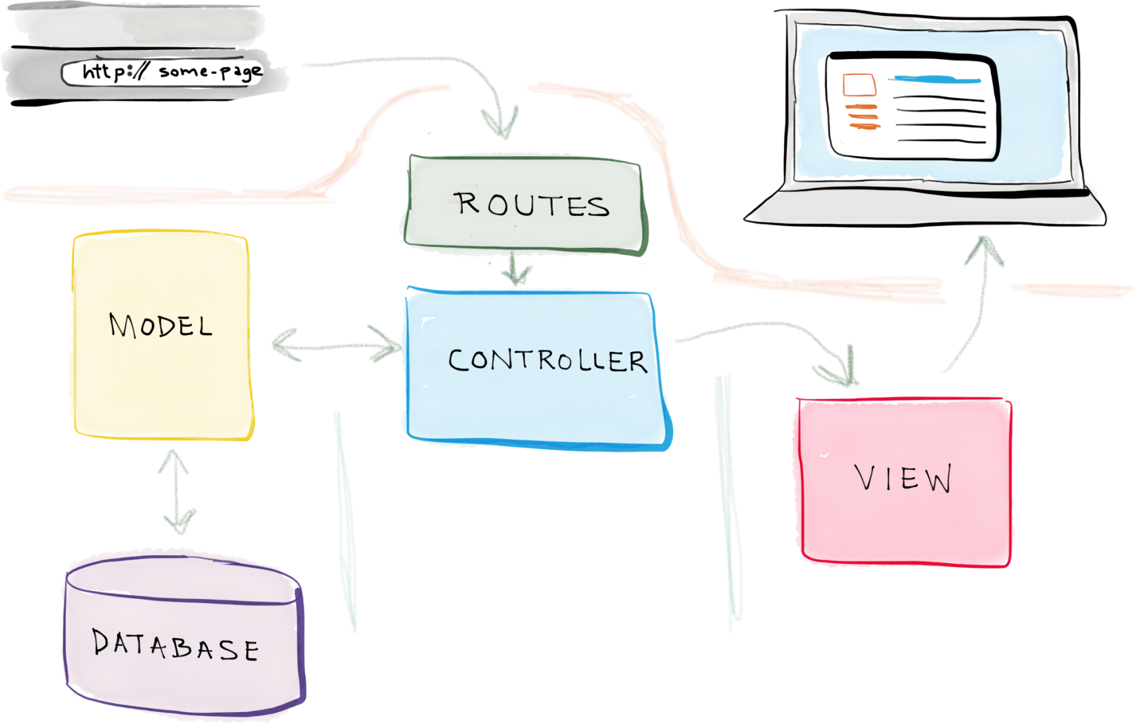
Laravel Architecture

Slide 4

Routing - Basic Routing

Slide 5
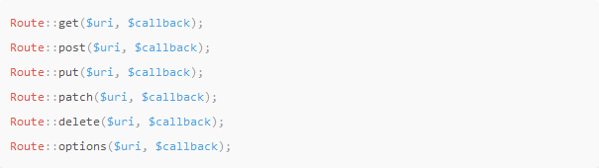
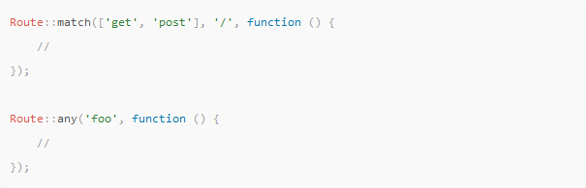
Routing Available Router Methods

Slide 6

Routing View Routes

Slide 7


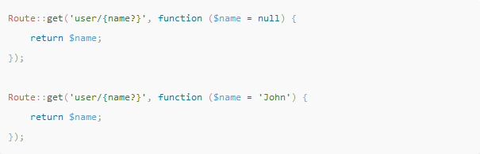
Routing Parameters
Required Parameters
Optional Parameters

Slide 8
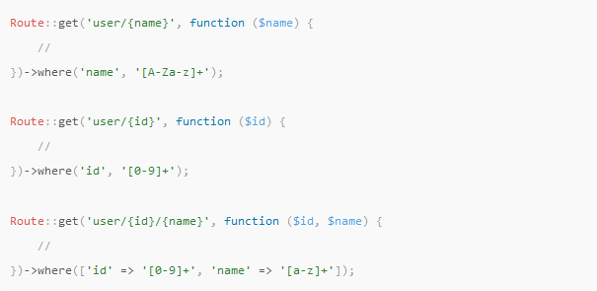
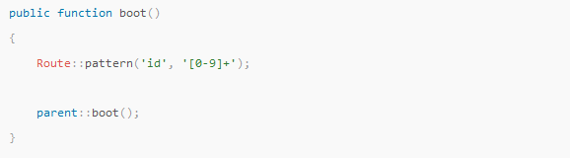
Routing Regular Expression Constraints
Local Constraints
Global Constraints
https://regexr.com/

Slide 9

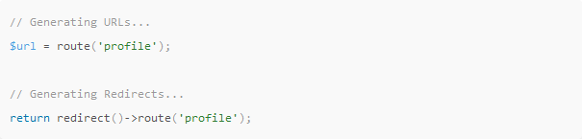
Routing Named Routes
Create Named Routes
Generating URLs To Named Routes

Slide 10
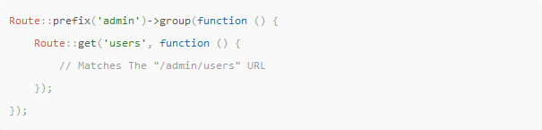
Routing Prefixes

Slide 11
Routing Show route:list
php artisan route:list

