Slide 1
PHP

Slide 2
Flask Course PreRequisite
Necessary Requirements
Preferred Requirements
SQL
HTML
CSS
JS
Git

Slide 3
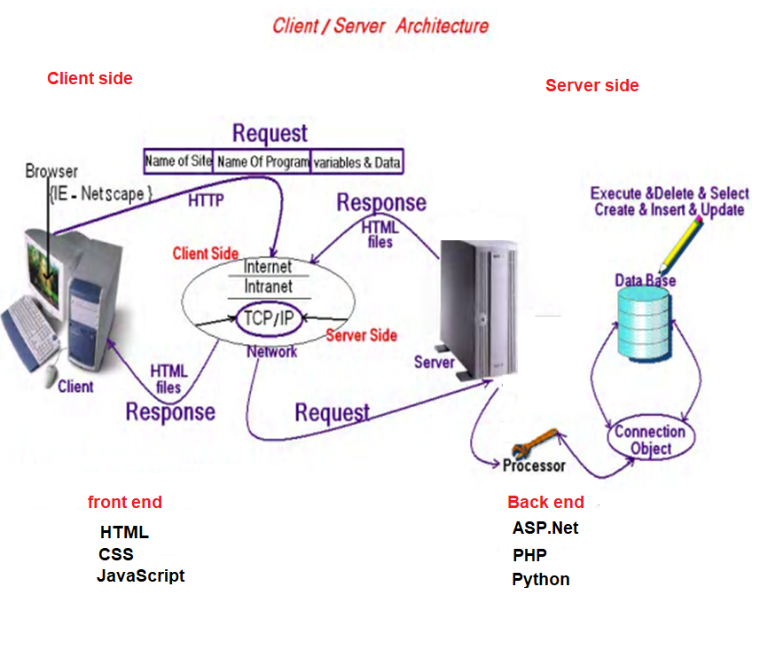
Client/Server Architecture

Slide 4
Web programming language
Web programming language
client side front end
HTML
CSS
Java Script
Angular
Vue
React
Server Side Back end
ASP.Net
.NetCore
MVC
Web Forms
PHP
Laravel
symfony
Python
Flask
django

Slide 5



Environment Setup
Required Programs
Php
Optional Programs
VScode IDE Setup
GitHub Version Control
Postman Makes API Development Simple
filezilla FTP solution for both client and server.
PuTTY is an SSH and telnet client

Slide 6
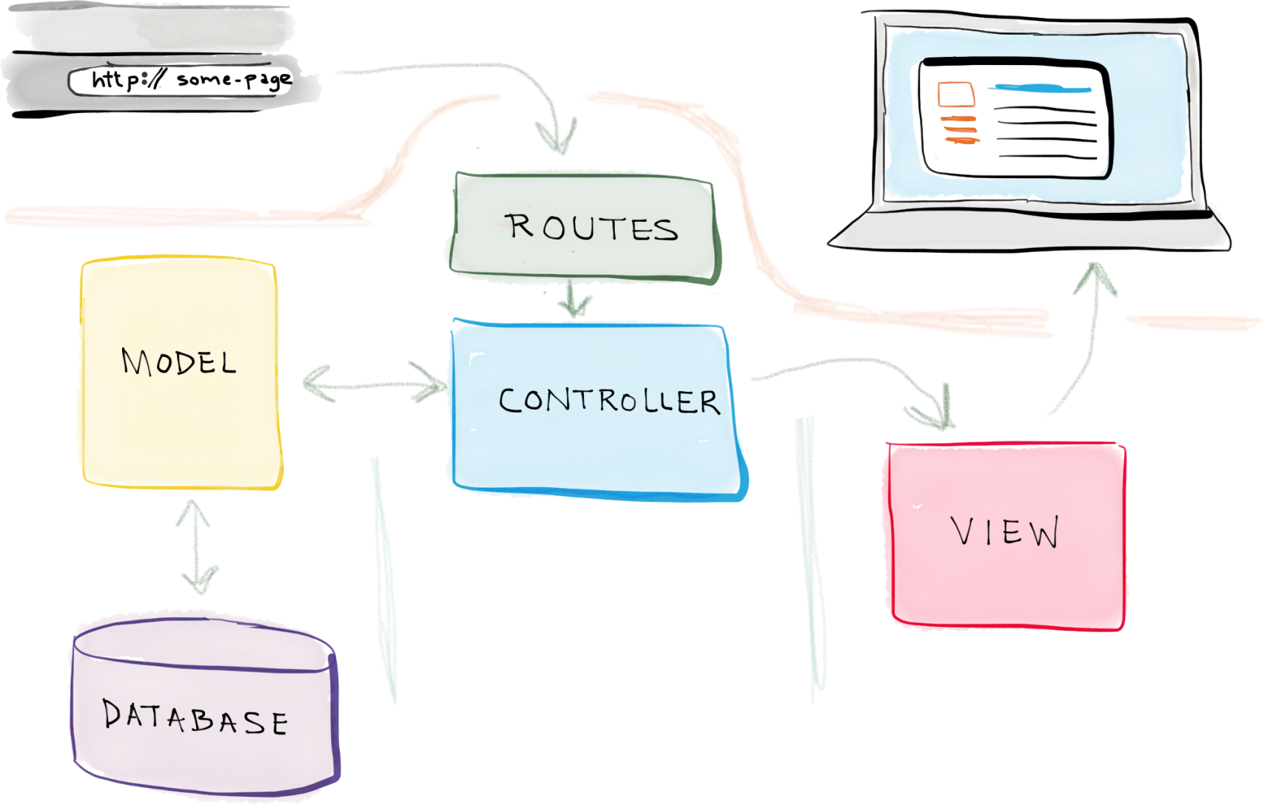
Flask Architecture

Slide 7
Install Flask
pip install flask

