Slide 1


Slide 2
lecture 1
Environment Setup
Comments
Input&Output
Variables & Constants
Data Types info
Casting
Python Collections
Operators

Slide 3



Environment Setup
Required Programs
Python
Optional Programs
VScode IDE Setup
GitHub Version Control

Slide 4
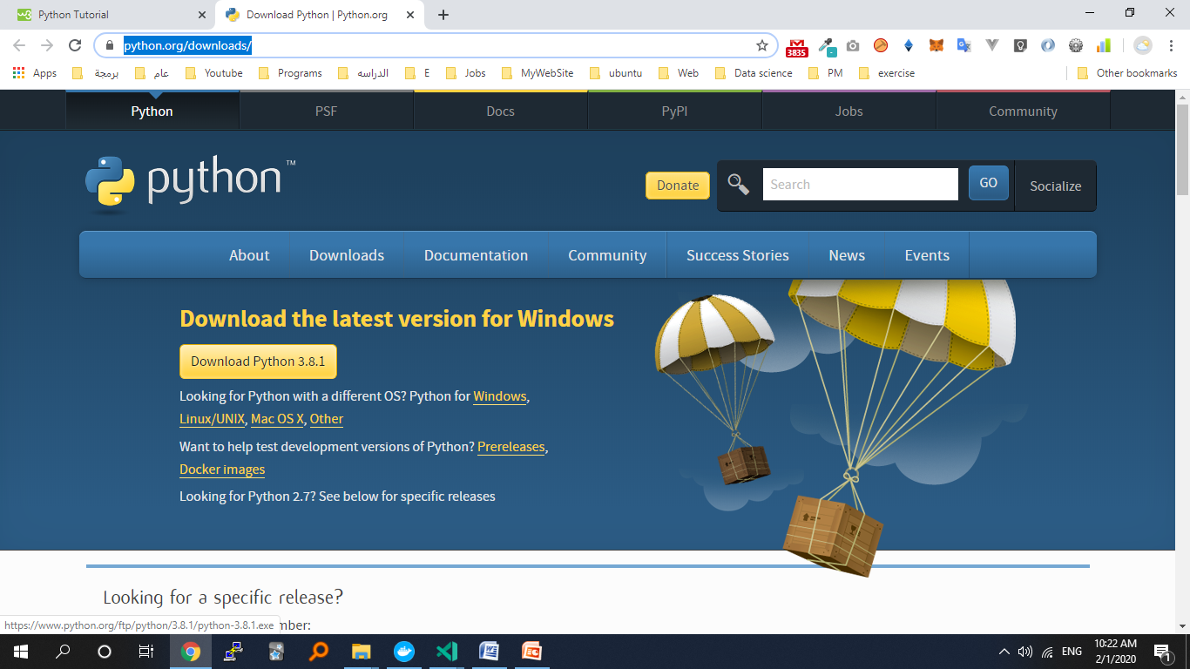
Downloads Python

Slide 5
Environment Setup
visual studio code IDE extensions
Python
https://code.visualstudio.com/

Slide 6
test a short amount of code in python
# On Command Line
# python
# >>>print("Hello W3School")
# >>>exit()
# Or python filename

Slide 7
Comments
Why We using Comments ?
Comments can be used to explain Python code.
Comments can be used to make the code more readable.
Comments can be used to prevent execution when testing code.
Single Line Comments
#print("Hello, World!")
Multi Line Comments
""" This is a comment written in more than just one line """

Slide 8
Input&Output
The input() function allows user input.
input(prompt)
The print() function prints the specified message to the screen The message can be a string, or any other object, the object will be converted into a string before written to the screen.
print(object(s), separator=separator, end=end, file=file, flush=flush)
Ex :
print(“hello”, input(“Enter Your Name ”))
print("hello %d, how %s you" % (5, "sdfd"))
print("Hello {name}".format(name=x))
print("Hello", "how are you?", sep="---")

Slide 9
Variables & Constants
Rules for variable name
start with a letter or the underscore character
cannot start with a number
can only contain alpha-numeric characters and underscores (A-z, 0-9, and _ )
case- sensitive (age, Age and AGE are three different variables)
Scalar Variables Ex :
x=55 #int
f=55.66 #float
y=" RTC" #str
b=False #bool
n=None #NoneType
Composed
Lists :
L=[1, " RTC ", False]
Tuples:
t=(1, " RTC ", False)
Sets
s={1, " RTC ", False}
Dictionaries
d={
"key1" : 1,
"key2" : " RTC ",
"key3" : False
}

Slide 10
Constants
A constant is a type of variable whose value cannot be changed. It is helpful to think of constants as containers that hold information which cannot be changed later.
Constants Ex :
constant.py
PI = 3.14
main.py
import constant
print(constant.PI)

Slide 11
Python Casting
specify a type on to a variable
Ex :
# To list()
l1= list([1, " RTC ", False])
l2= list((1, " RTC ", False))
l3= list({1, " RTC ", False})
l4= list({"key1" : 1, "key3" : False})
# To tuple()
t1= tuple([1, " RTC ", False])
t2= tuple((1, " RTC ", False))
t3= tuple({1, " RTC ", False})
t4= tuple({"key1" : 1, "key3" : False})
# To set()
s1= set([1, " RTC ", False])
s2= set((1, " RTC ", False))
s3= set({1, " RTC ", False})
s4= set({"key1" : 1, "key3" : False})
Ex :
# To int()
x = int(1) # x will be 1
y = int(2.8) # y will be 2
z = int("3") # z will be 3
# To float()
x = float(1) # x will be 1.0
y = float(2.8) # y will be 2.8
z = float("3") # z will be 3.0
w = float("4.2") # w will be 4.2
# To str()
x = str("s1") # x will be 's1'
y = str(2) # y will be '2'
z = str(3.0) # z will be '3.0’

Slide 12
Python Collections
 |  | ordered | changeable | duplicate
List |  | TRUE | TRUE | TRUE
Tuple |  | TRUE | FALSE | TRUE
Set |  | FALSE | TRUE | FALSE
Dictionary | Key | FALSE | FALSE | FALSE
 | value | FALSE | TRUE | TRUE

Slide 13
Data Types info

Slide 14
Operators
Operators (Decreasing order of precedence) | Meaning
** | Exponent
*, /, //, % | Multiplication, Division, Floor division, Modulus
+, - | Addition, Subtraction
<= < > >= | Comparison operators
= %= /= //= -= += *= **= | Assignment Operators
is is not | Identity operators
in not in | Membership operators
not or and | Logical operators

