Slide 1
Introductory Genomics
Inusa Jacob

Slide 2
Introduction
What is a genome?
•An organism's complete set of DNA is called its genome.
•Every single cell in an organism contains a complete copy of DNA base pairs, that make up the genome of that organism.
•With its four-letter language, DNA contains the information needed to build the entire organism.
•A gene traditionally refers to the unit of DNA that carries the instructions for making a specific protein or set of proteins.

Slide 3
Introduction
•Genomics is the large-scale study of groups of genes.
•These groups can be all the genes of an organism, or multiple organisms.
•The full complement of genetic material in an organism is called its genome.
•Therefore, genomics involves studies that are conducted at the level of the genome.

Slide 4
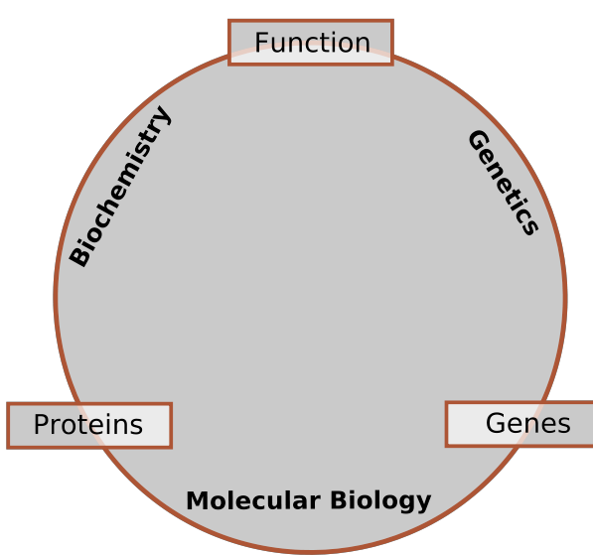
Introduction

Slide 5
GENOMICS
Genomics is divided into two basic areas:
structural genomics
functional genomics
Notes:
Functional genomics is a field of molecular biology that attempts to make use of the vast data generated by genomic and transcriptomic projects (such as genome sequencing projects and RNA sequencing) to describe gene (and protein) functions and interactions
Structural genomics seeks to describe the 3-dimensional structure of every protein encoded by a given genome. This genome-based approach allows for a high-throughput method of structure determination by a combination of experimental and modeling approaches.

Slide 6
Some terminologies
Gene (DNA): Discrete units of hereditary information located on the chromosomes.
RNA: Single stranded transcripts of DNA genes.
cDNA: single stranded DNA that is the complement (c) of RNA.
Genotype: Genetic makeup of an organism.
Phenotype: The physical expressed traits of an organism.

Slide 7
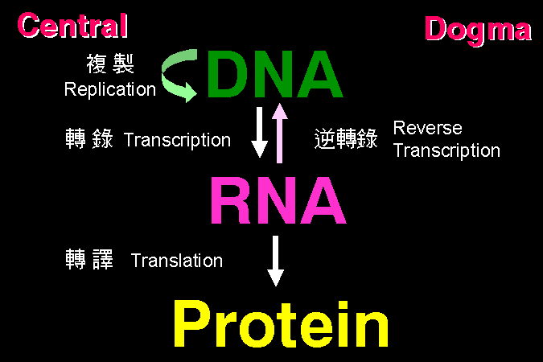
Molecular Biology
Central dogma: Molecules and Processes
Genotype
Phenotype
Source: adhingra@wsu.edu

Slide 8
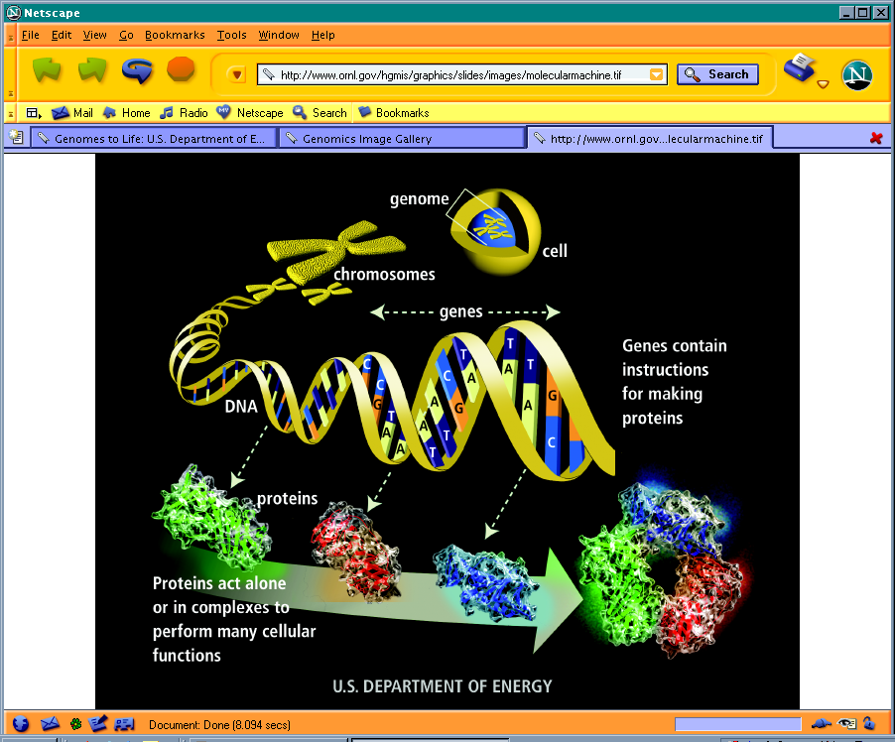
Overview

Slide 9
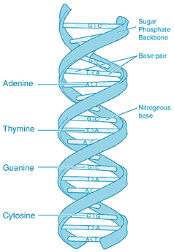
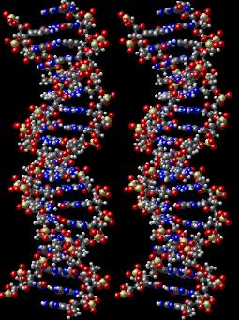
DNA structure
Sugar-phosphate
backbone
(Sides of ladder)
Nitrogenous
base
(Rungs of ladder)
The double helix

Slide 10
DNA is double stranded
Adenine (A) meant to always pairs with Thymine (T)
Cytosine (C) meant to always pairs with Guanine (G)
5’..GATCTAGCGATGCCGATGAAACATGATCATG..3’
3’..CTAGATCGCTACGGCTACTTTGTACTAGTAC..5’
Canine and feline parvo viruses: ssDNA

Slide 11
Common techniques in Molecular Biology studies

Slide 12
From sample to sequence
Extract RNA/DNA
(RT)-PCR
Gel electrophoresis, DNA purification
Sequencing, Bioinformatics

Slide 13
PCR animation¹
Polymerase chain reaction

Slide 14
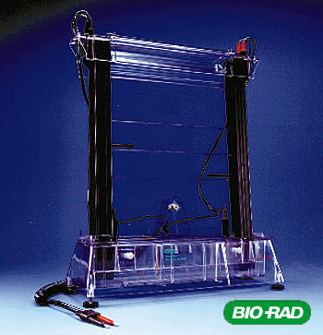
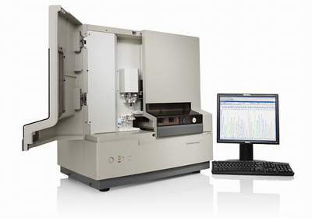
1st Generation Sequencing technologies
Manual Sequencer
Sanger Sequencer

Slide 15
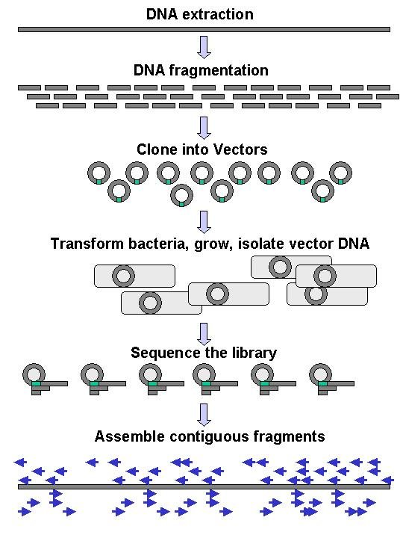
First generation genome sequencing
Sequencing involves:
DNA fragmenting into small pieces
Sequence determination
Assembly into large contiguous sequences
Problems occur:
Cloning steps
Bacterial transformation and amplification
Sequencing chemistry (GC compressions, homopolymer runs)
Assembly of repetitive regions

Slide 16
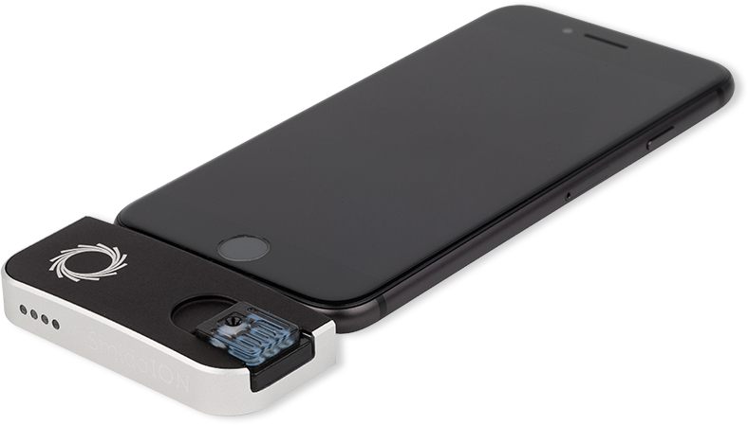
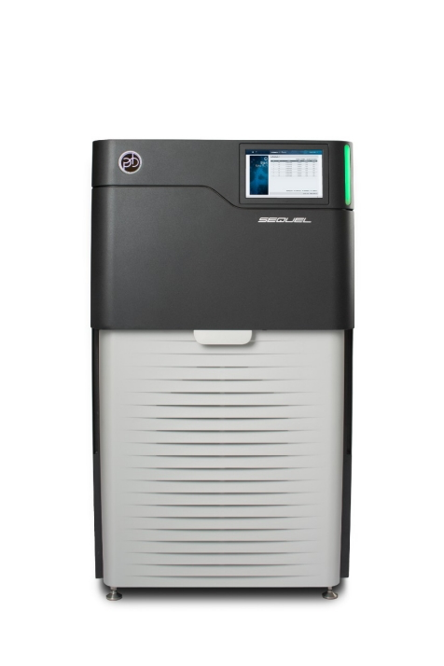
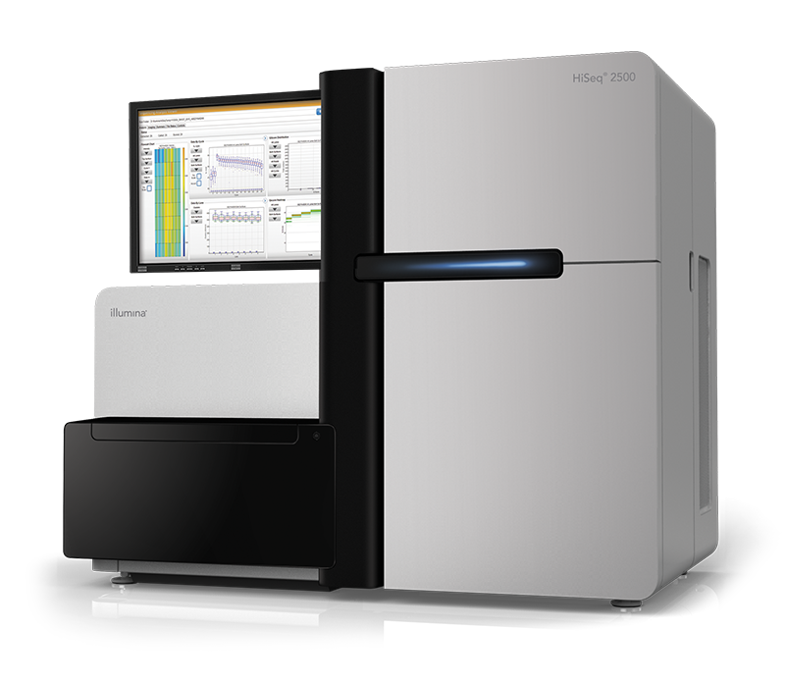
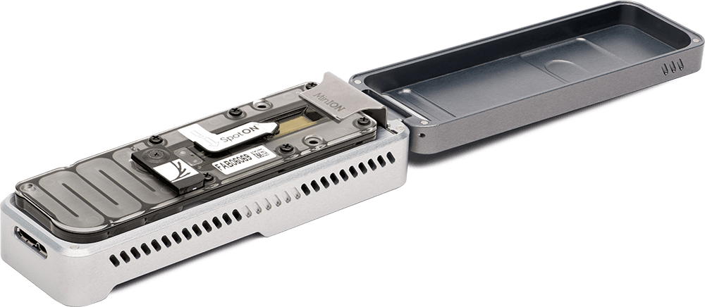
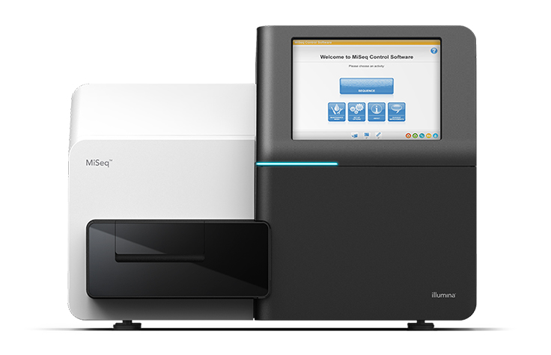
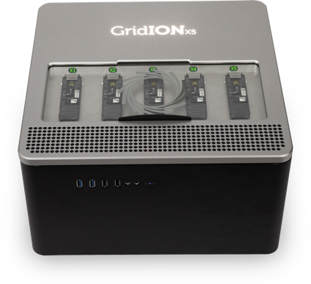
Next Generation and Third generation Sequencers
ONT SmidgeION
Illumina Hi-seq
ONT MinION
PacBio Sequencer
Illumina Mi-seq
ONT GridION

Slide 17
atcttttacttttttcatcatctatacaaaaaatcatagaatattcatcatgttgtttaaaataatgtattccattatgaactttattacaaccctcgtt
tttaattaattcacattttatatctttaagtataatatcatttaacattatgttatcttcctcagtgtttttcattattatttgcatgtacagtttatca
tttttatgtaccaaactatatcttatattaaatggatctctacttataaagttaaaatctttttttaattttttcttttcacttccaattttatattccg
cagtacatcgaattctaaaaaaaaaaataaataatatataatatataataaataatatataataaataatatataatatataataaataatatataatat
ataatatataataaataatatataatatataatatataataaataatatataataaataatatataatatataatatataatactttggaaagattattt
atatgaatatatacacctttaataggatacacacatcatatttatatatatacatataaatattccataaatatttatacaacctcaaataaaataaaca
tacatatatatatataaatatatacatatatgtatcattacgtaaaaacatcaaagaaatatactggaaaacatgtcacaaaactaaaaaaggtattagg
agatatatttactgattcctcatttttataaatgttaaaattattatccctagtccaaatatccacatttattaaattcacttgaatattgttttttaaa
ttgctagatatattaatttgagatttaaaattctgacctatataaacctttcgagaatttataggtagacttaaacttatttcatttgataaactaatat
tatcatttatgtccttatcaaaatttattttctccatttcagttattttaaacatattccaaatattgttattaaacaagggcggacttaaacgaagtaa
ttcaatcttaactccctccttcacttcactcattttatatattccttaatttttactatgtttattaaattaacatatatataaacaaatatgtcactaa
taatatatatatatatatatatatatatatatattataaatgttttactctattttcacatcttgtccttttttttttaaaaatcccaattcttattcat
taaataataatgtattttttttttttttttttttttttattaattattatgttactgttttattatatacactcttaatcatatatatatatttatatat
atatatatatatatatatatattattcccttttcatgttttaaacaagaaaaaaaactaaaaaaaaaaaaaataataaaatatatttttataacatatgt
attattaaaatgtatatataaaaatatatattccatttattattatttttttatatacattgttataagagtatcttctcccttctggtttatattacta
ccatttcactttgaacttttcataaaaattaatagaatatcaaatatgtataatatataacaaaaaaaaaaaaaaaaaaaaaaaaaaaaaaaaaaaaata
tatatatatatatatatacatataatatatatttcatctaatcatttaaaattattattatatattttttaaaaaatatatttatgataacataaaaaga
atttaattttaattaaatatatataattacatacatctaatattattatatatatataataagttttccaaatagaatacttatatattatatatatata
tatatatatatatattcttccataaaaagaataaaataaaataaaaacaccttaaaagtatttgtaaaaaattccccacattgaatatatagttgtattt
ataaaattaaagaaaaagcataaagttaccatttaatagtggagattagtaacattttcttcattatcaaaaatatttatttcctaattttttttttttg
taaaatatatttaaaaatgtaatagattatgtattaaataatataaatatagcaaaatgttcaattttagaaatttgcctctttttgacaaggataattc
aaaagatacaggtaaaaaaaaaaaaataaagtaaaacaaaacaaaacaaaaaacaaaaaaaaaaaaaaaaaaaaaaatgacatgttataatataatataa
taaataaaaattatgtaatatatcataatcgaagaaacatatatgaaaccaaaaagaaacagatcttgatttattaatacatatataactaacattcata
tctttatttttgtagatgatataaaaaattttataaactcttatgaagggatatatttttcatcatccaataaatttataaatgtatttctagacaaaat
tctgatcattgatccgtcttccttaaatgttattacaataaatacagatctgtatgtagttgatttcctttttaatgagaaaaataagaatcttattgtt
ttagggtaatgaaatatatatagatttatatttttatttatttattatatattattttttaatttttcttttatatatttattttatttagtgtataaaa
tgatatcctttatatttatatttacatgggatattcaaataataacaaaaatgagtatacacatatatatatatatatatatatatatgtatattttttt
tttttttttatgttcctataggaaagggaagaattcactgatttgtagtgtttacaatattagggaatgcaactttacacttttgaaaaaaattcagtta
agcaaaaatattaataacattaaaaagacactgatagcaaaatgtaatgaatatataataacattagaaaataagaaaattactttttatttcttaaata
aagattatagtataaatcaaagtgaattaatagaagacggaaaagaacttattgaaaatatctatttgtcaaaaaatcatatcttgttagtaataaaaaa
ttcatatgtatatatataccaattagatattaaaaattcccatattagttatacacttattgatagtttcaatttaaatttatcctacctcagagaatct
ataaataataaaaaaaagcatataaataaaataaatgatgtatcaaataatgacccaaaaaaggataataatgaaaaaaatacttcatctaataatataa
cacataacaattataatgacatatcaaataataataataataataataatattaatggggtgaaagaccatataaataataacactctggaaaataatga
tgaaccaatcttatctatatataatgaagatcttaatgttttatatatatgccaaaatatgtataacgtcctttttgttttgaatttaaataacctaagt
What do we do with a genome sequence?

Slide 18
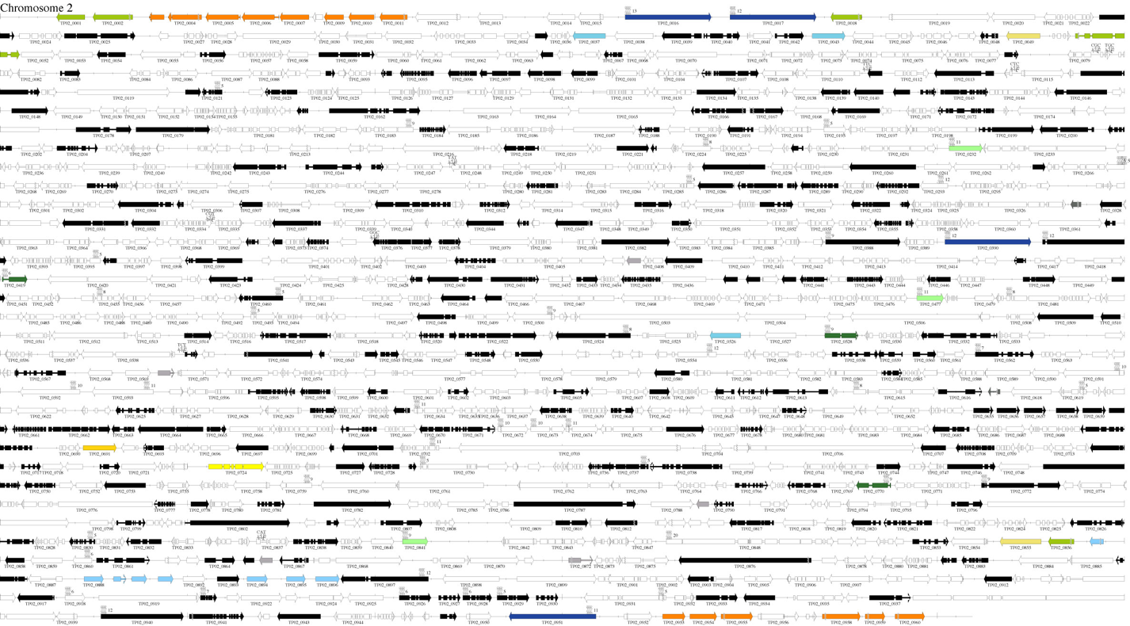

Slide 19
Assembly
Annotation
Characterization

Slide 20
Sequence analysis
Sequence editing and alignment
(MEGA, BioEdit, Figtree, PhyML, RaxML)
Bioinformatics tools;
Command line
Artemis
DISCOVAR
ABySS
Soapdenovo2
Velvet
-Qiime, Mothur, EPI2ME, R, MG-Mapper
ExPASy Bioinformatics Resource Portal🡪 http://expasy.org/

Slide 21
Genome databases
Ensembl SILVA 32/Greengenes/NCBI
Model organisms - Bacteria
Plants - Fungi
Fish -Archaea
EuPathDB
AmoebaDB
CryptoDB
FungiDB
GiardiaDB
MicrosporidiaDB
PiroplasmaDB
PlasmoDB

Slide 22
APPLICATIONS
Genomic medicine
Synthetic biology and bioengineering
Conservation genomics
Other considerations
Metagenomics
Mitogenomics

Slide 23

THANK YOU FOR LISTENING
QUESTIONS??

