Slide 1

Time Domain Analysis

Slide 2
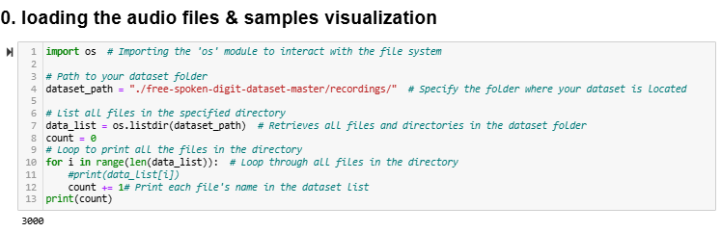
loading the audio files & samples visualization.

Slide 3
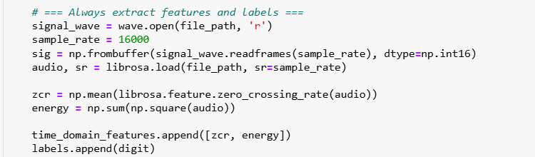
Extract statistical features

Slide 4

Implement basic filtering techniques

Slide 5
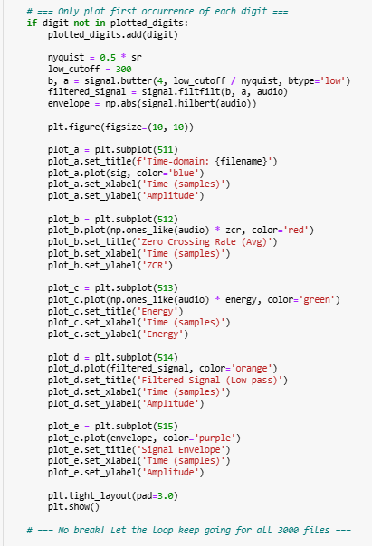
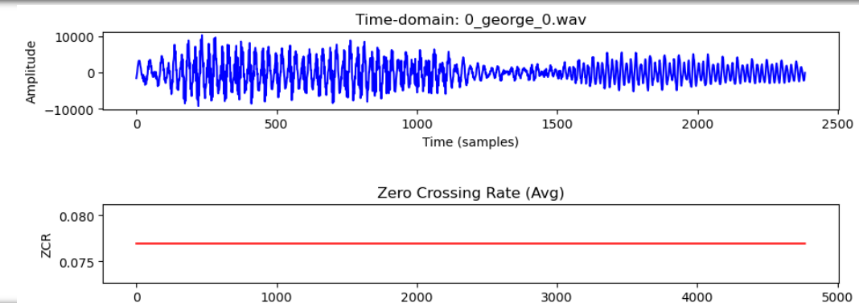
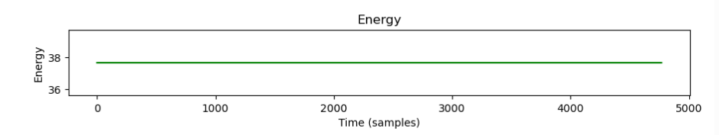
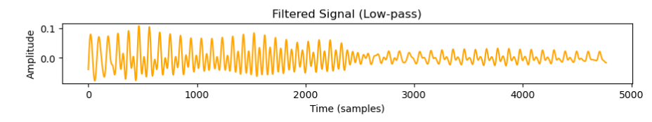
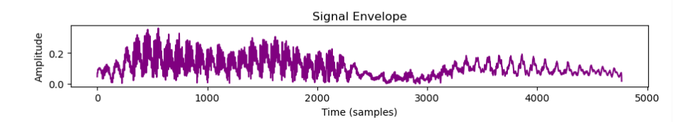
Plotting the results

Slide 6
Frequency Domain Analysis

Slide 7
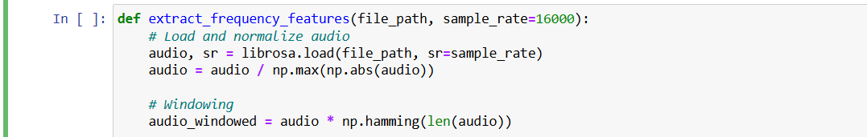
Set up

Slide 8
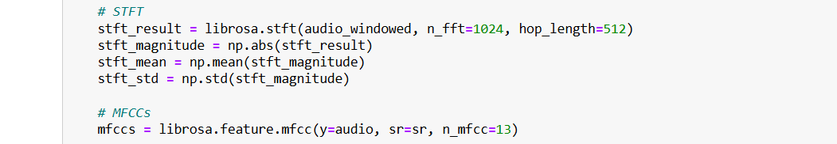
Transform

Slide 9
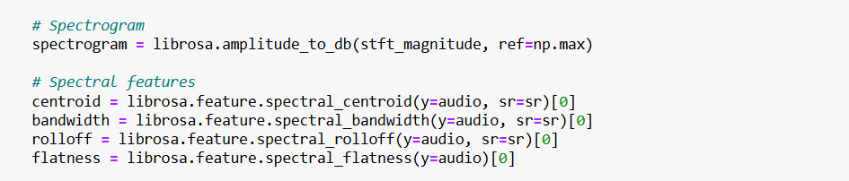
Spectrom

Slide 10
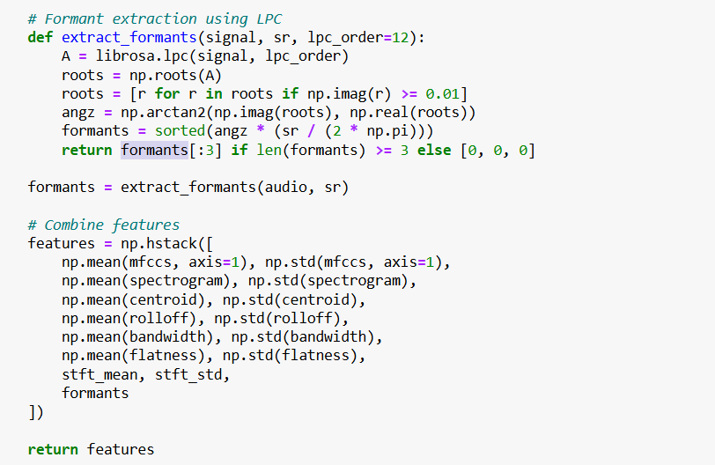
Extraction

Slide 11
Wavelet Transform Analysis

Slide 12
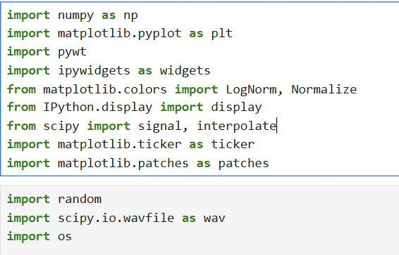
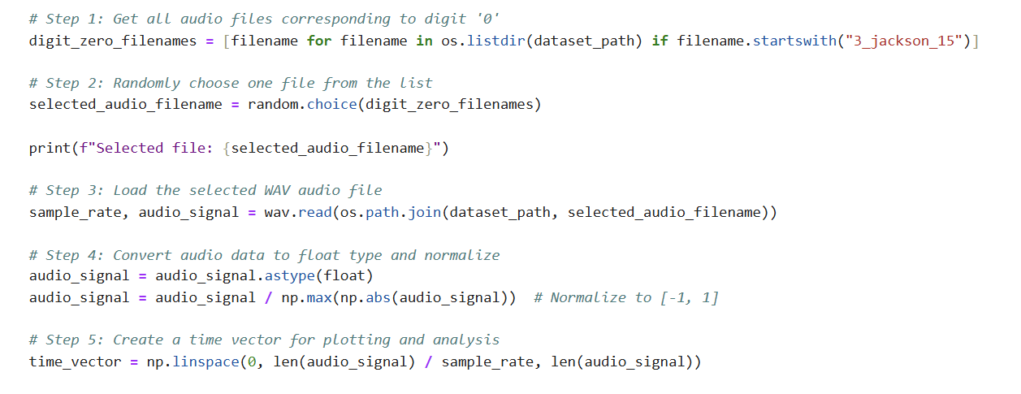
Implementation of discrete wavelet transform
Importing the needed libraries.
Preparing the audio files.

Slide 13
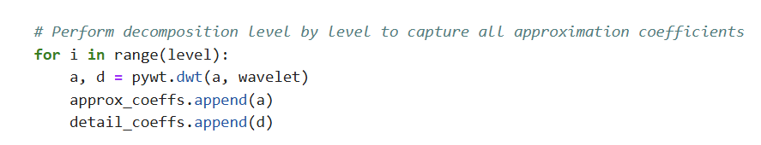
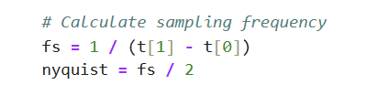
Implementation of discrete wavelet transform
Decomposing the signal
Storing the details and approximations
Removing the smallest coefficient which help in compressing.
Computes the Nyquist frequency for bands labeling.
Display mode with 3 choices which are: (coefficients – heatmap – energy distribution)

Slide 14
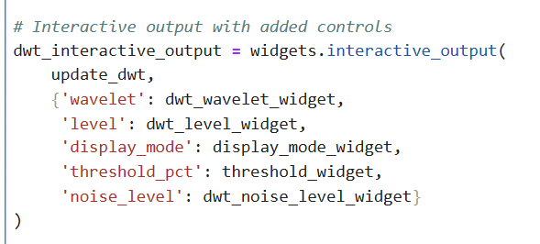
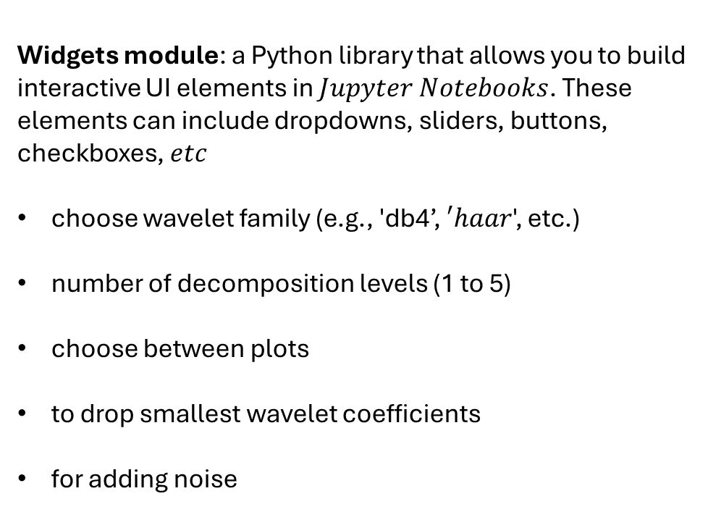
Implementation of discrete wavelet transform
Widgets module: a Python library that allows you to build interactive UI elements in $Jupyter Notebooks$. These elements can include dropdowns, sliders, buttons, checkboxes, $etc$
choose wavelet family (e.g., 'db4’, $′haar$', etc.)
number of decomposition levels (1 to 5)
choose between plots
to drop smallest wavelet coefficients
for adding noise

Slide 15
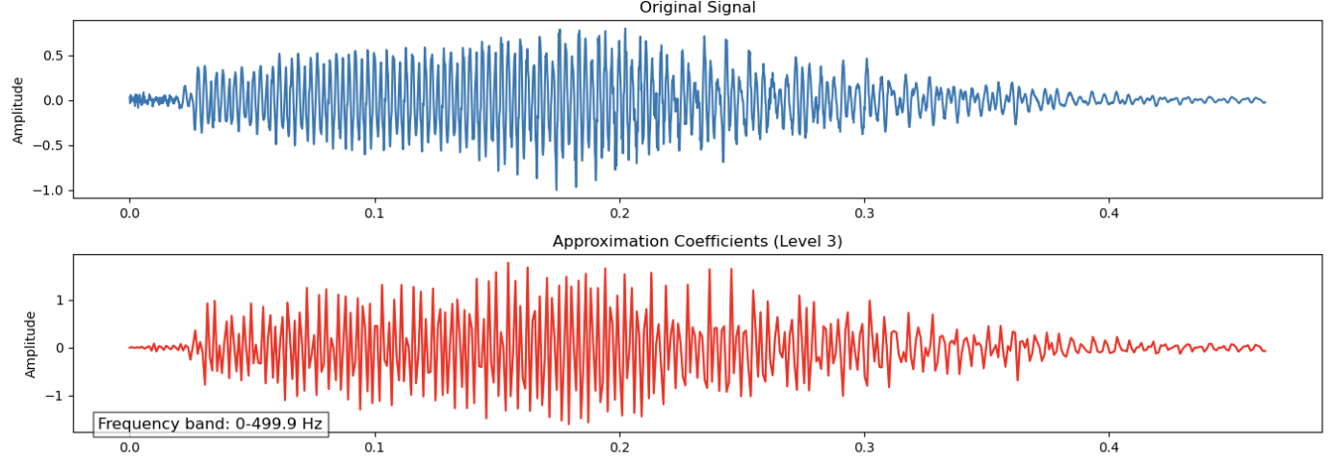
Implementation of discrete wavelet transform
Display mode with 3 choices:

Slide 16
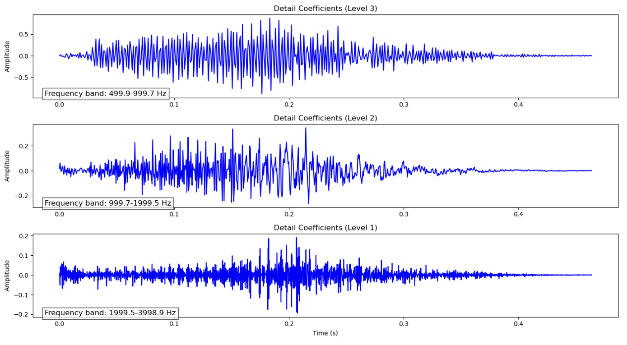
Implementation of discrete wavelet transform
The frequency bands vs number of levels

Slide 17
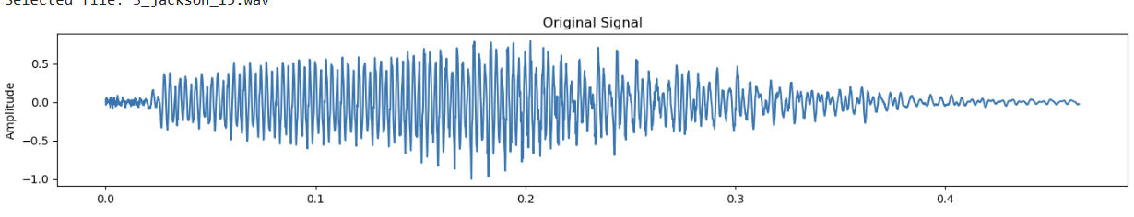
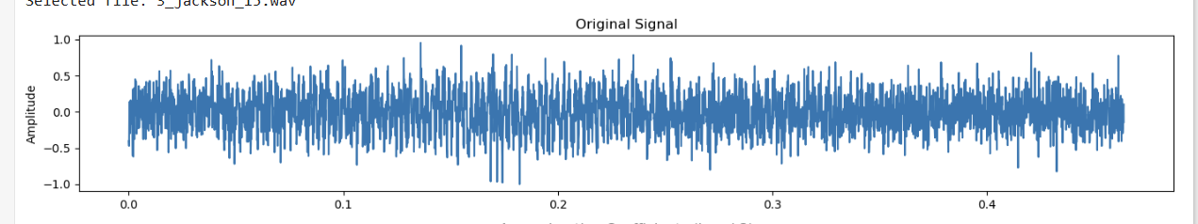
Implementation of discrete wavelet transform
Studying the effect of noise
Noise level = 0
Noise level = 0.5

Slide 18
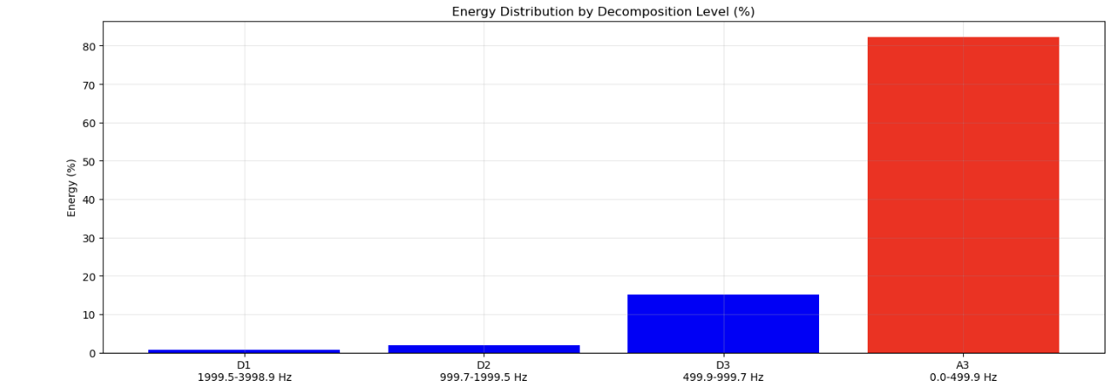
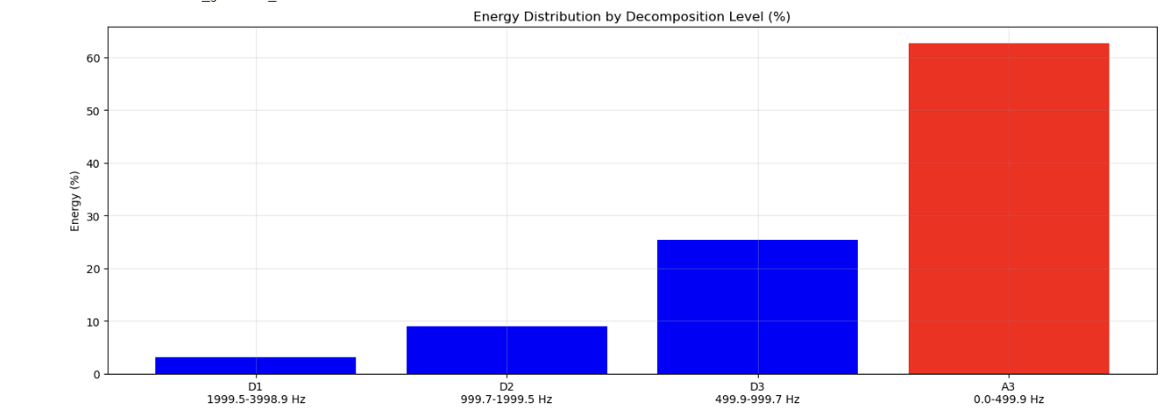
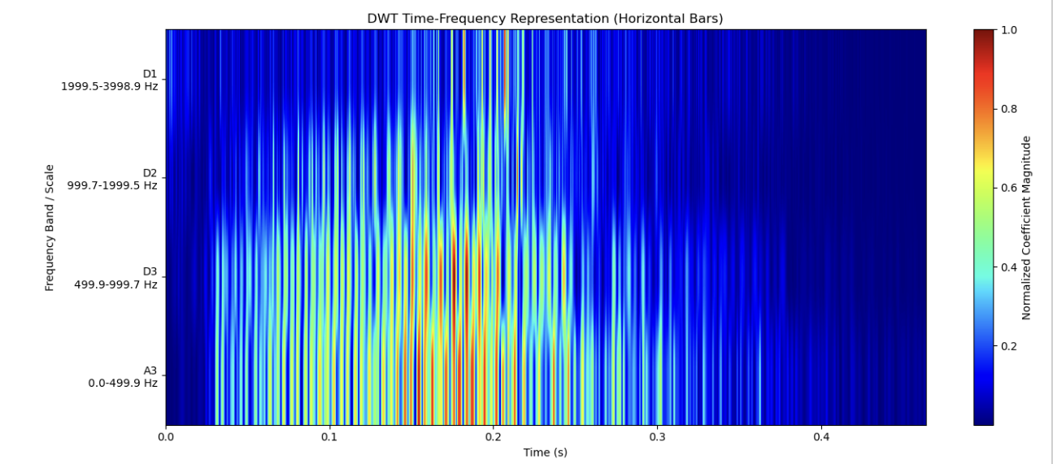
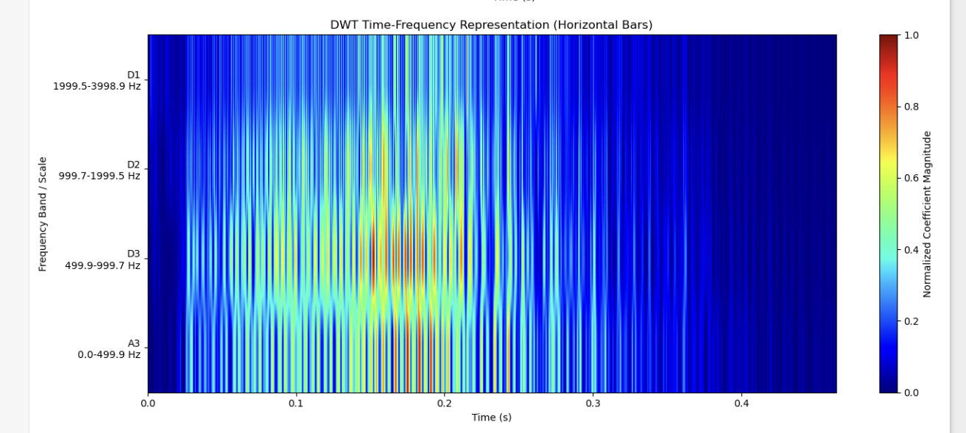
Implementation of discrete wavelet transform
Simple comparison between db4 and haar

Slide 19
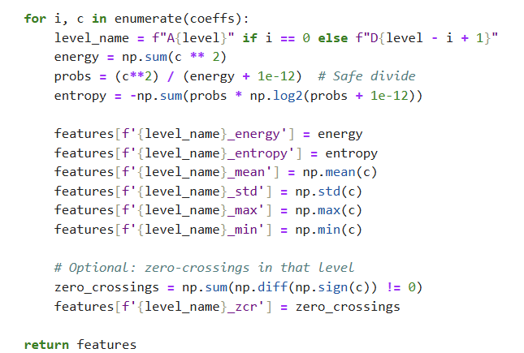
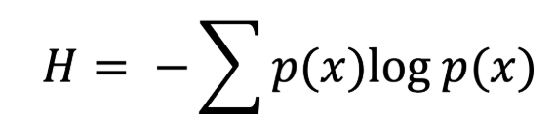
Extract wavelet-based features
We will extract the energy, entropy, max, min, std, mean , and zero crossing rate.
Decomposing the audio signal to details and approximation levels
Energy: it is sum of squares of coefficients.
Entropy, it measures the uncertainty in the frequency band and the higher it is the more complex the signal. Its formula is
Minimum – Maximum – Standard deviation - Mean
Extracting the zero - crossing rate,
Higher ZCR implies higher frequency.

Slide 20
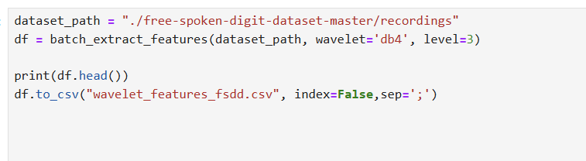
Extract wavelet-based features
Saves the features to a CSV file for the purpose of using them in the next step ( Classification system ).

Slide 21
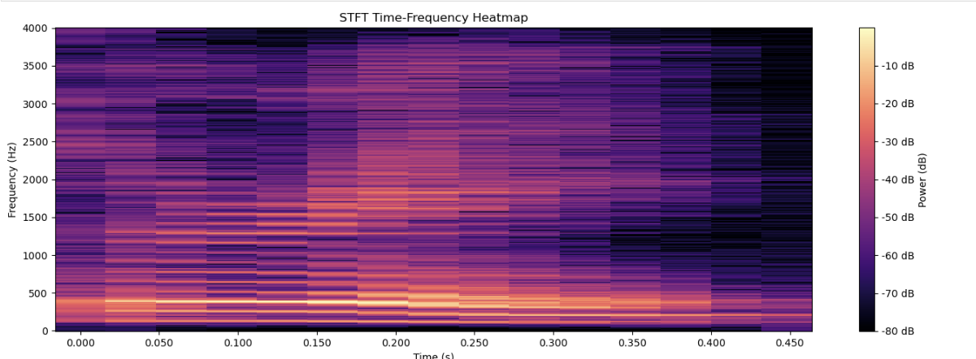
Comparing DWT with STFT results
STFT heatmap

Slide 22
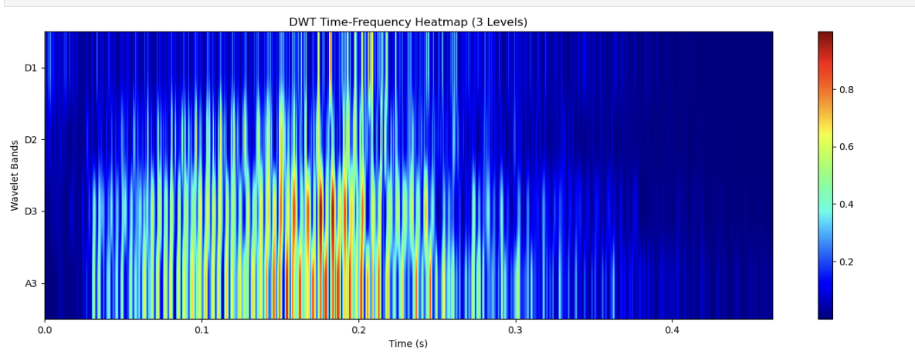
Comparing DWT with STFT results
DWT heatmap

Slide 23
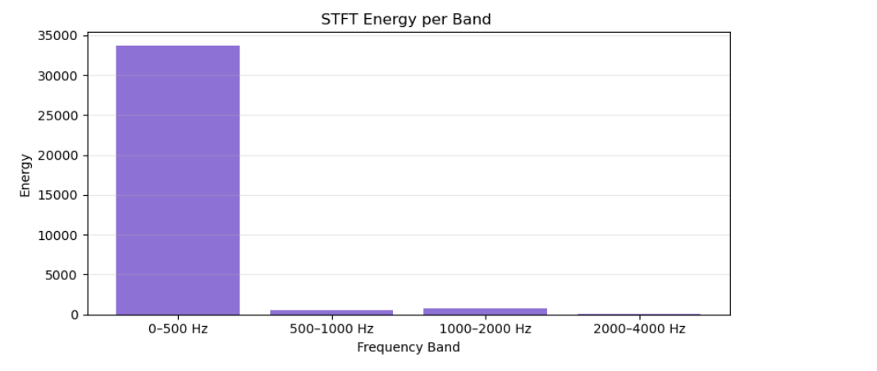
Comparing with STFT results
STFT energy distribution

Slide 24
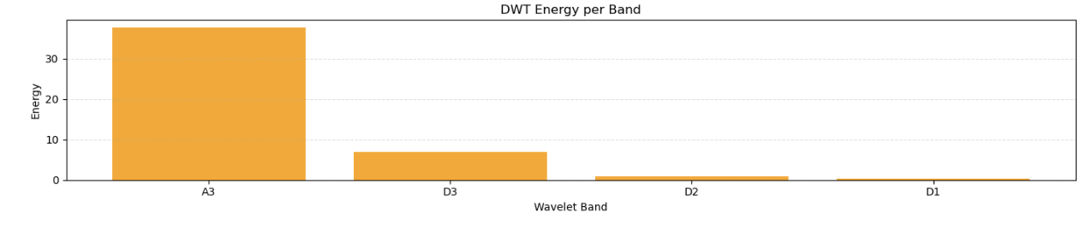
Comparing with STFT results
DWT energy distribution

Slide 25
Comparing with STFT results
Energy distribution is different.
Basis functions used for the decomposition are different.
DWT provides more resolution for low frequencies, so if the signal itself has more energy content at low frequency, it will be captured clearly by DWT.
STFT treats all frequencies equally. Also, energy that should be at specific frequency may leak into nearby frequency in the STFT.

Slide 26
Analyze time-frequency resolution benefits
DWT heatmap
Higher frequency → Shorter time segment
Lower frequency → Longer time segment

Slide 27
Analyze time-frequency resolution benefits
STFT heatmap
The time segment was fixed, regardless of whether the frequency was low or high.

Slide 28
Analyze time-frequency resolution benefits
DWT | STFT
Variable resolution | Fixed resolution
For higher frequency, time resolution will be more | Fixed window width regardless of the frequency
For lower frequency, frequency resolution will be more. | -

Slide 29
Classification System

Slide 30
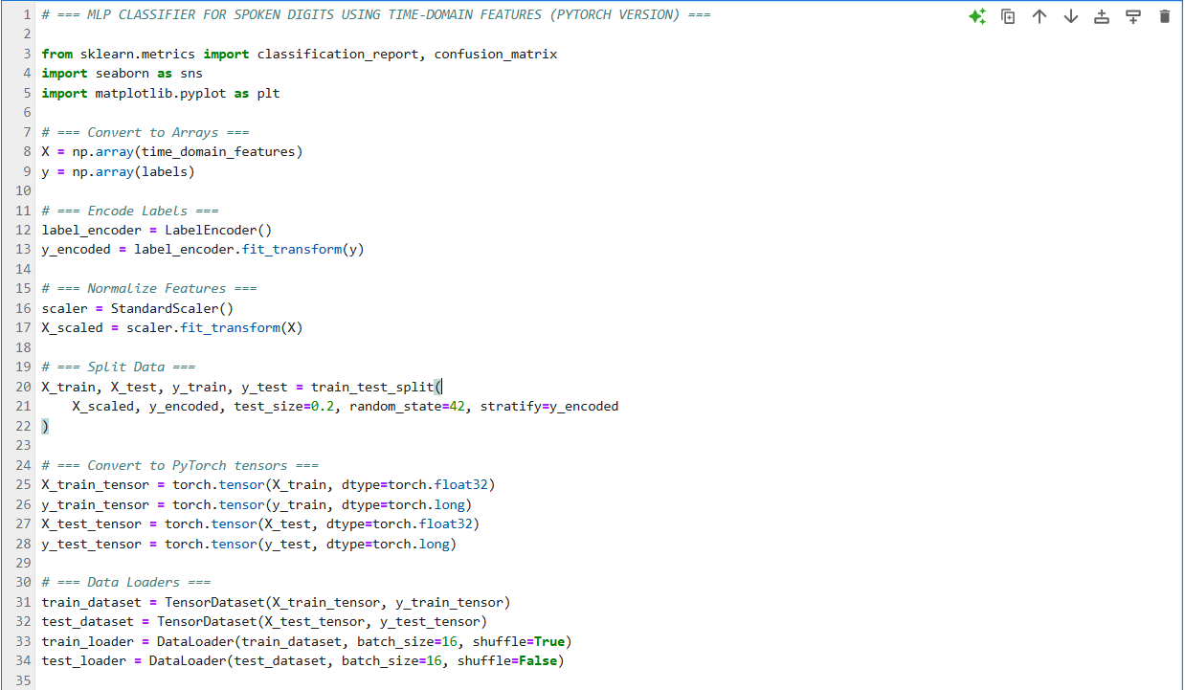
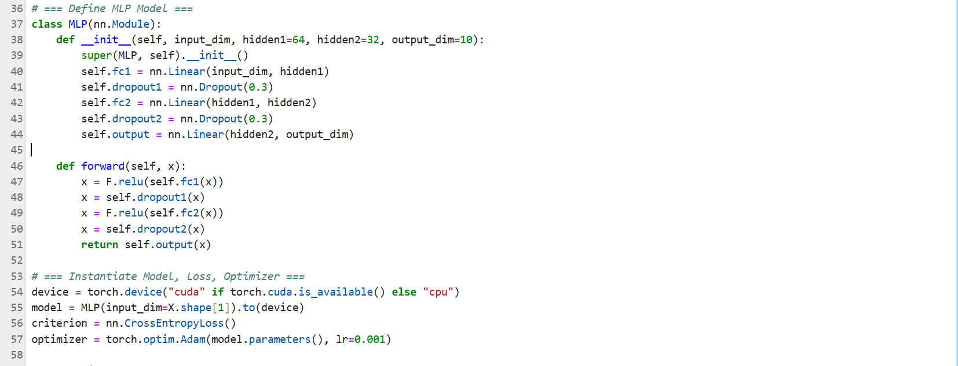
MLP classifier – Time domain features

Slide 31
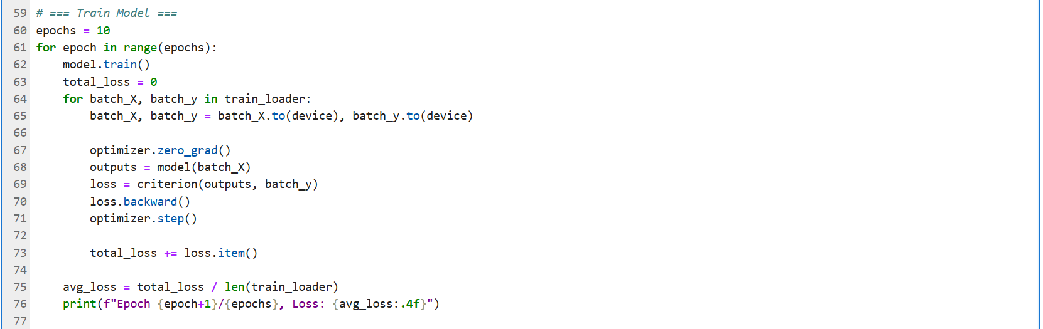
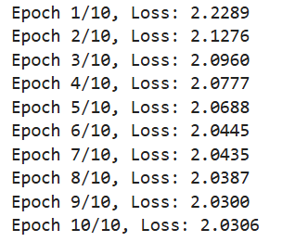
MLP classifier – Time domain features

Slide 32
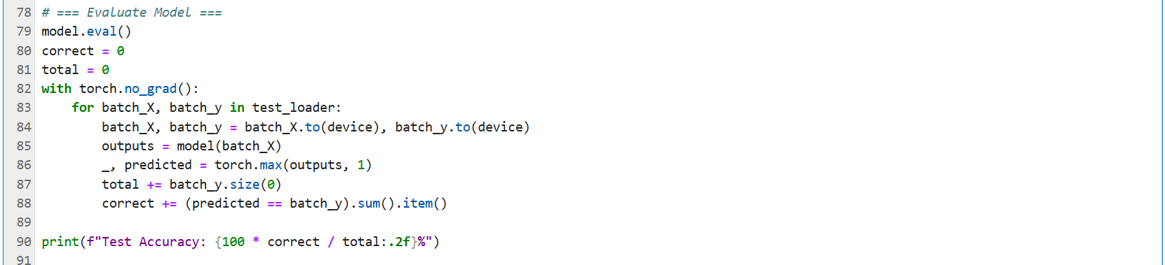
MLP classifier – Time domain features

Slide 33
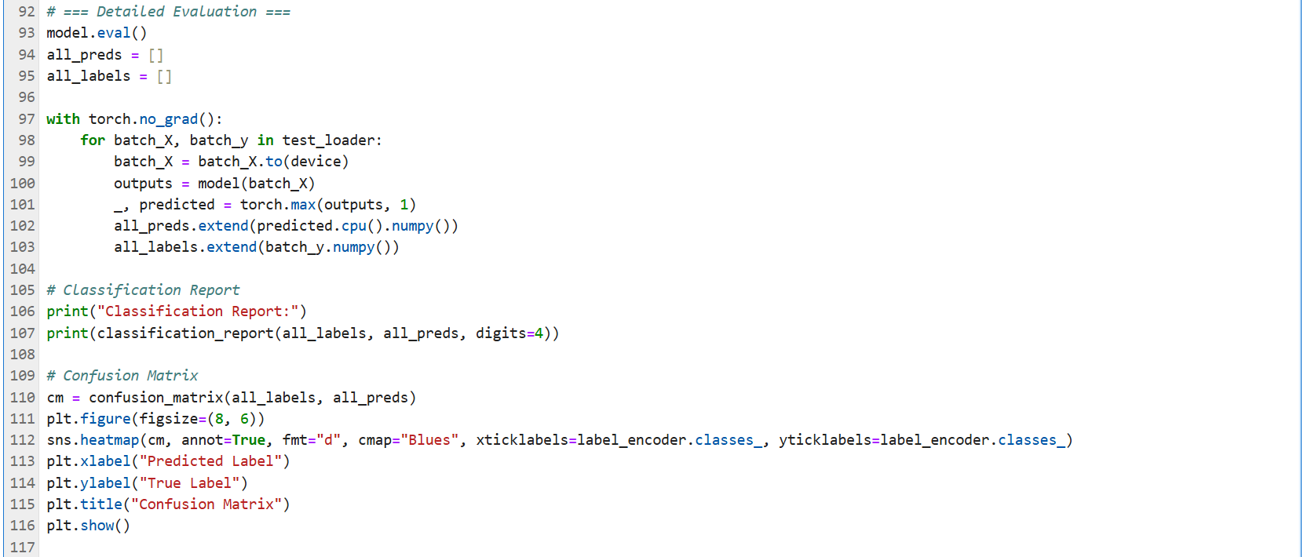
MLP classifier – Time domain features

Slide 34
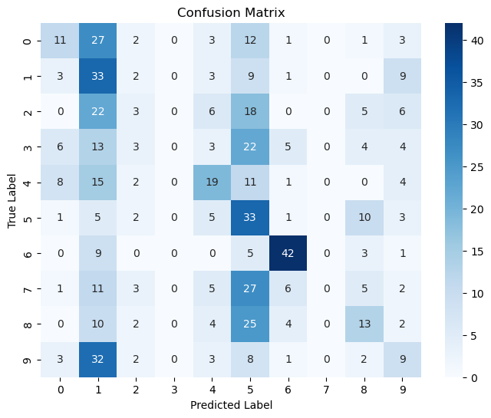
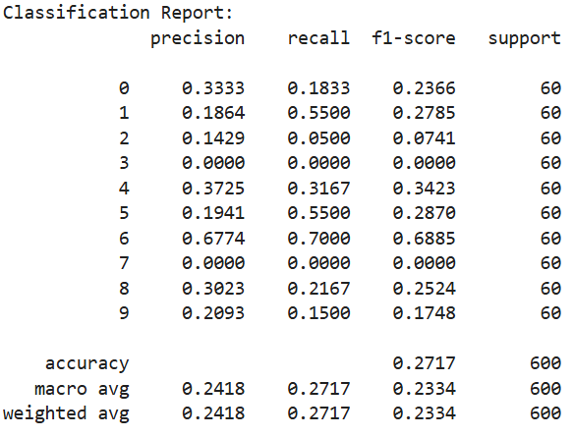
MLP classifier – Time domain features

Slide 35

MLP classifier – Frequency domain features

Slide 36
MLP classifier – Frequency domain features

Slide 37
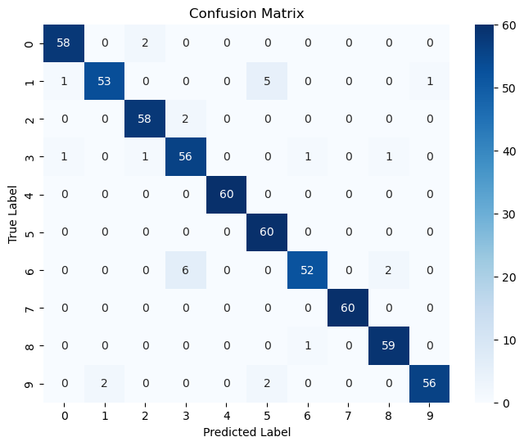
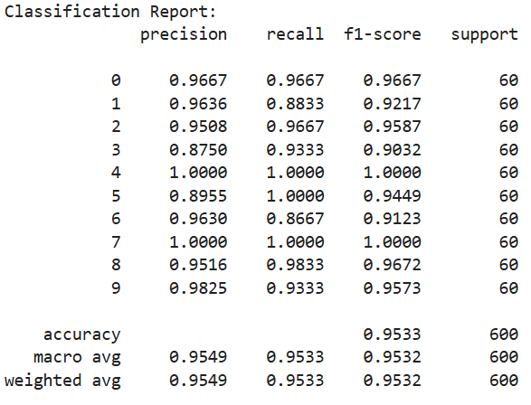
MLP classifier – Frequency domain features

Slide 38
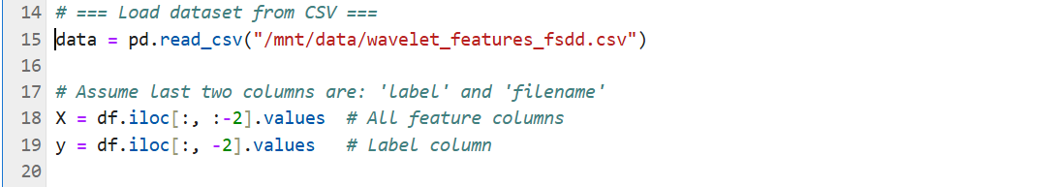
MLP classifier – Wavelet domain features

Slide 39
MLP classifier – Wavelet domain features

Slide 40
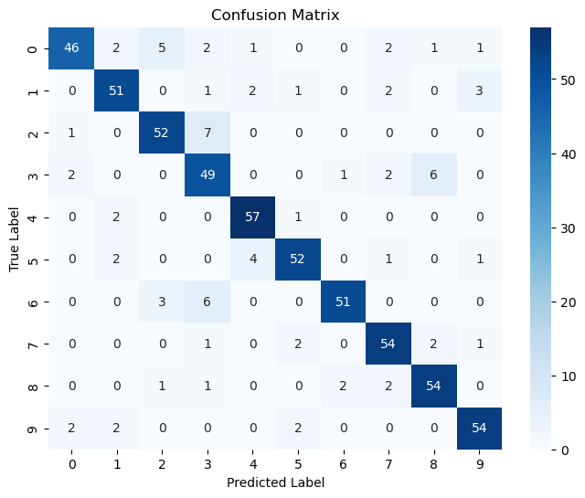
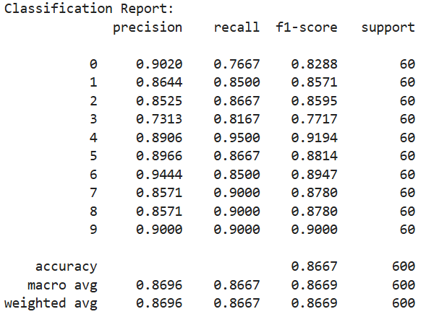
MLP classifier – Wavelet domain features

Slide 41
Conclusion
Time-domain features are simple/basic for audio recognition
Poor performance
Fail to identify digits 3 and 7
ZCR and Energy are not enough
Frequency-domain features excel in audio recognition
Excellent performance
Slight deviations for digits 1, 3, 6, and 9
Bandwith, centroid, and MFCCs form the toolbox for speech applications
Wavelet-based features also excel, but not as good as frequency features
Strong performance
Noticeable deviations for digits 0, 3, and 6
Approximation and detail coefficient help in audio recognition tasks

