Slide 1

Time Domain Analysis

Slide 2

loading the audio files & samples visualization.

Slide 3

Extract statistical features

Slide 4

Implement basic filtering techniques

Slide 5
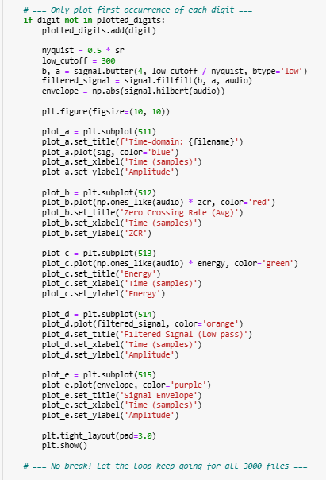
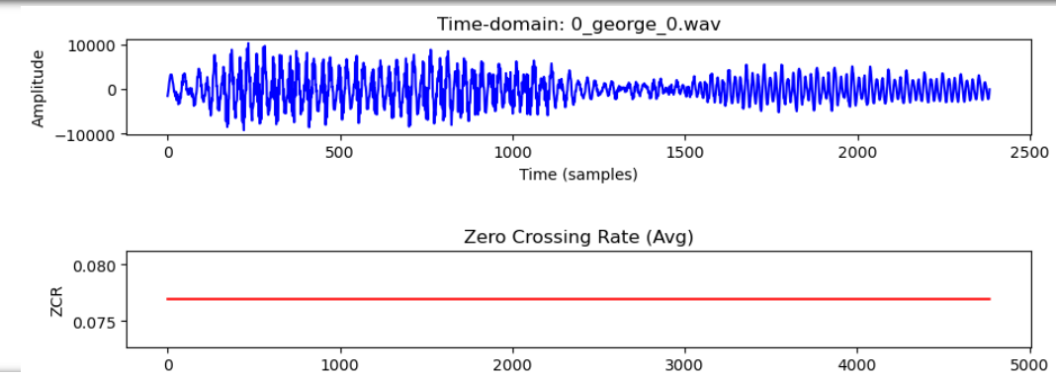



Plotting the results

