Slide 1

Wavelet Transform Analysis

Slide 2
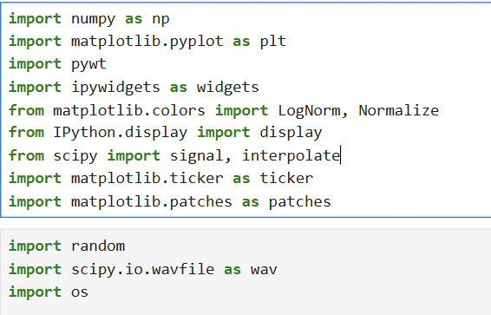
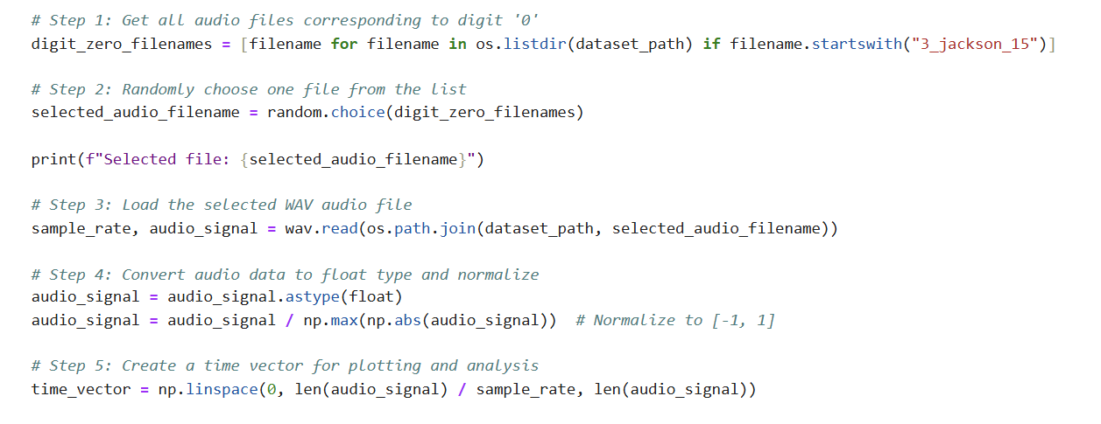
Implementation of discrete wavelet transform
Importing the needed libraries.
Preparing the audio files.

Slide 3
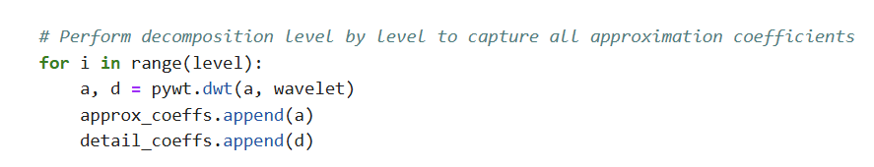
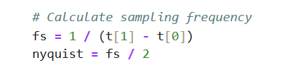
Implementation of discrete wavelet transform
Decomposing the signal
Storing the details and approximations
Removing the smallest coefficient which help in compressing.
Computes the Nyquist frequency for bands labeling.
Display mode with 3 choices which are: (coefficients – heatmap – energy distribution)

Slide 4
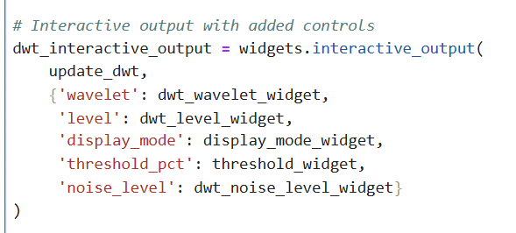
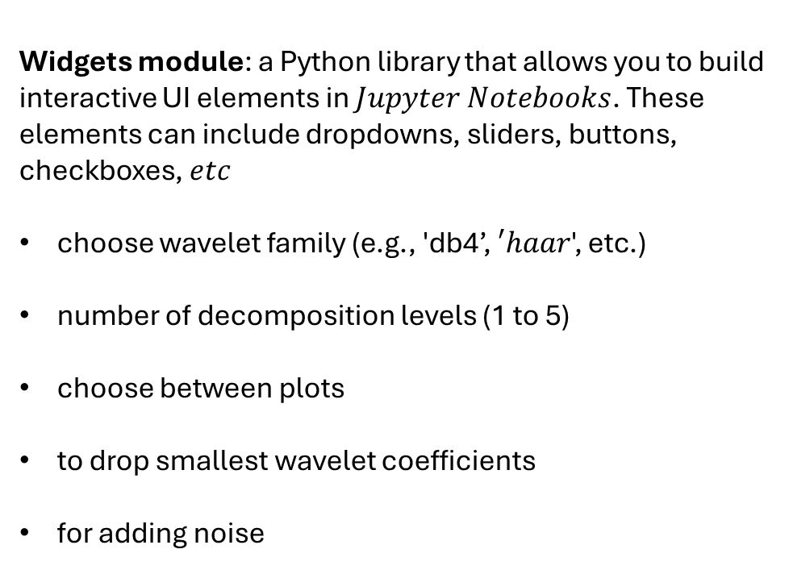
Implementation of discrete wavelet transform
Widgets module: a Python library that allows you to build interactive UI elements in $Jupyter Notebooks$. These elements can include dropdowns, sliders, buttons, checkboxes, $etc$
choose wavelet family (e.g., 'db4’, $′haar$', etc.)
number of decomposition levels (1 to 5)
choose between plots
to drop smallest wavelet coefficients
for adding noise

Slide 5
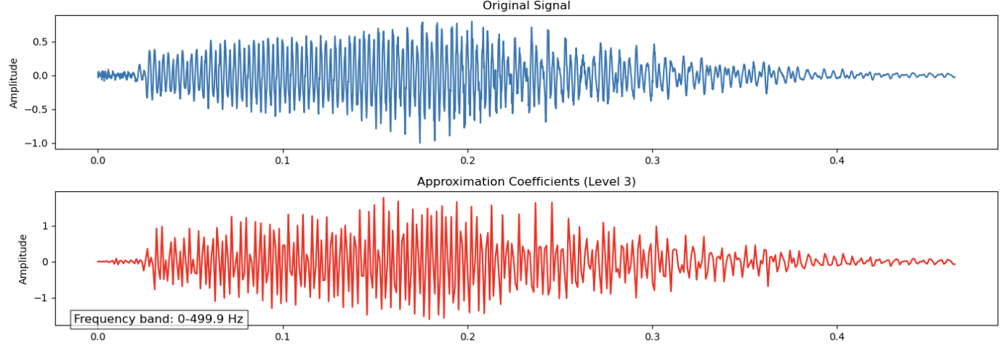
Implementation of discrete wavelet transform
Display mode with 3 choices:

Slide 6
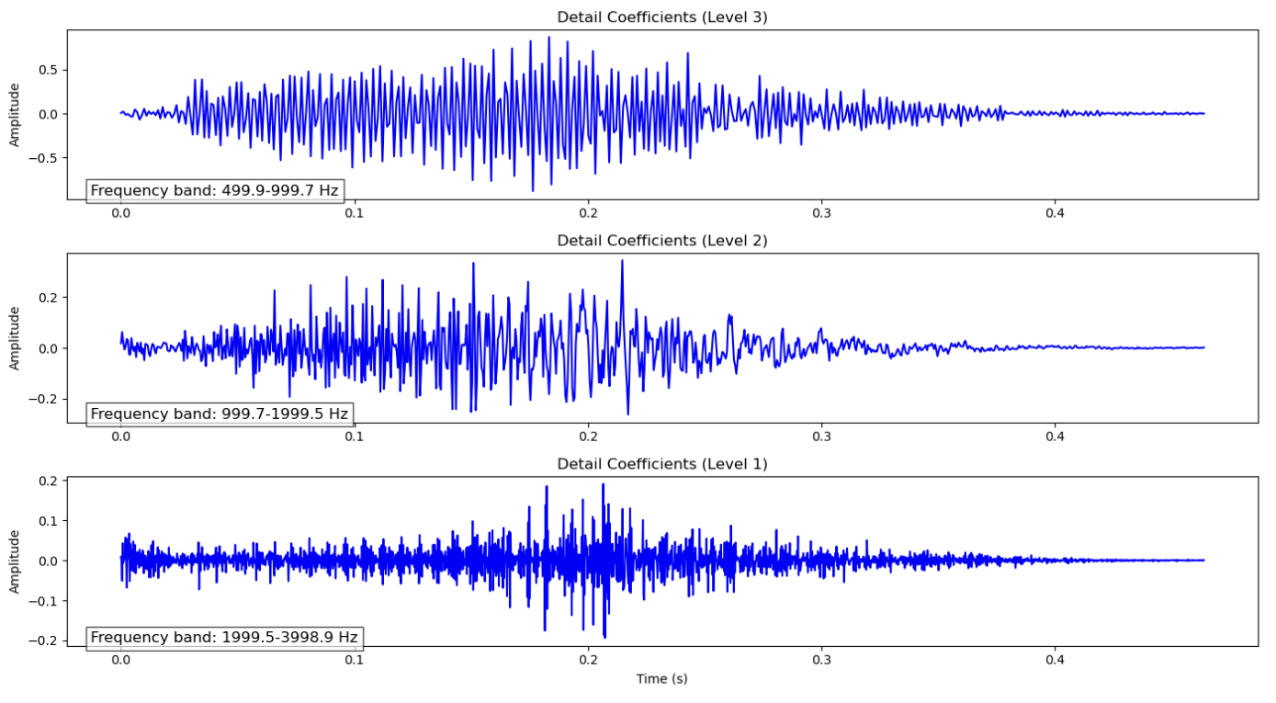
Implementation of discrete wavelet transform
The frequency bands vs number of levels

Slide 7
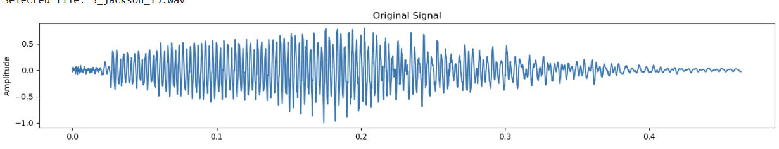
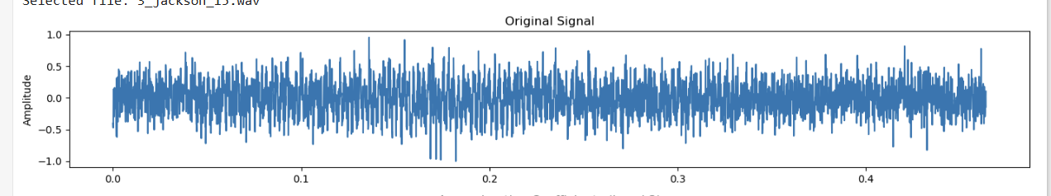
Implementation of discrete wavelet transform
Studying the effect of noise
Noise level = 0
Noise level = 0.5

Slide 8
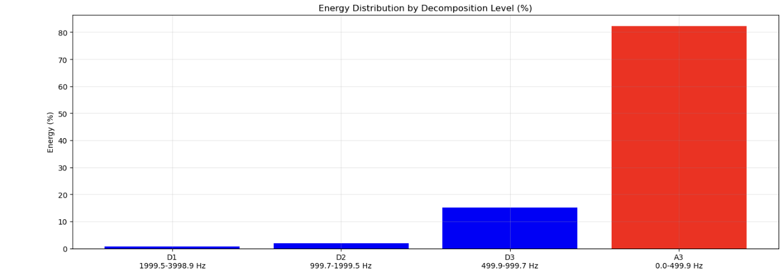
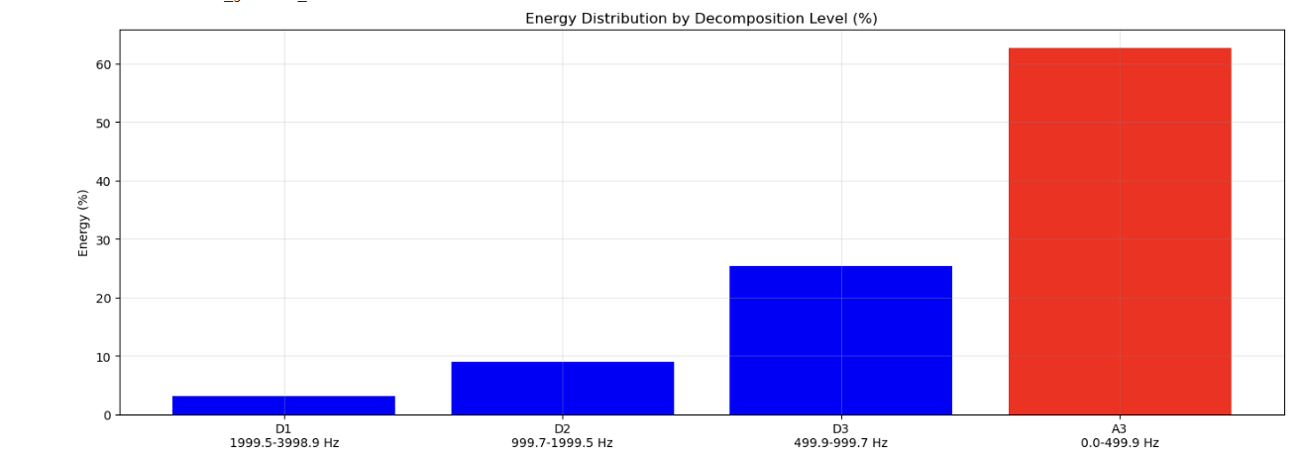
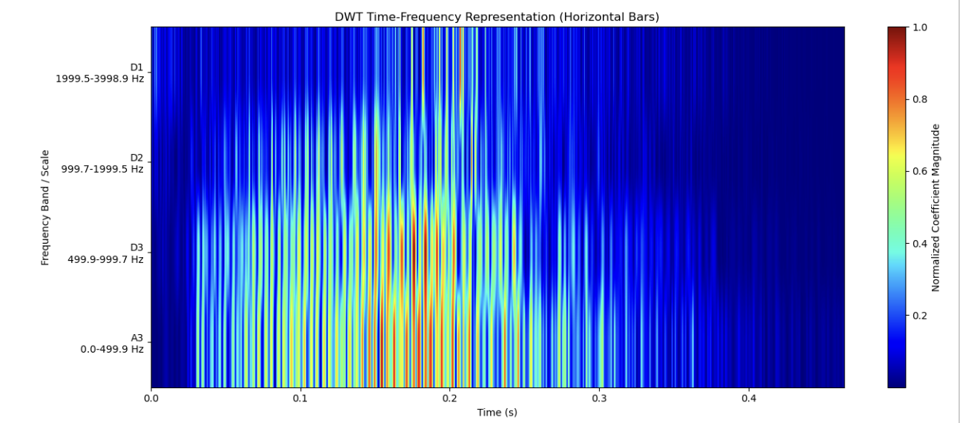
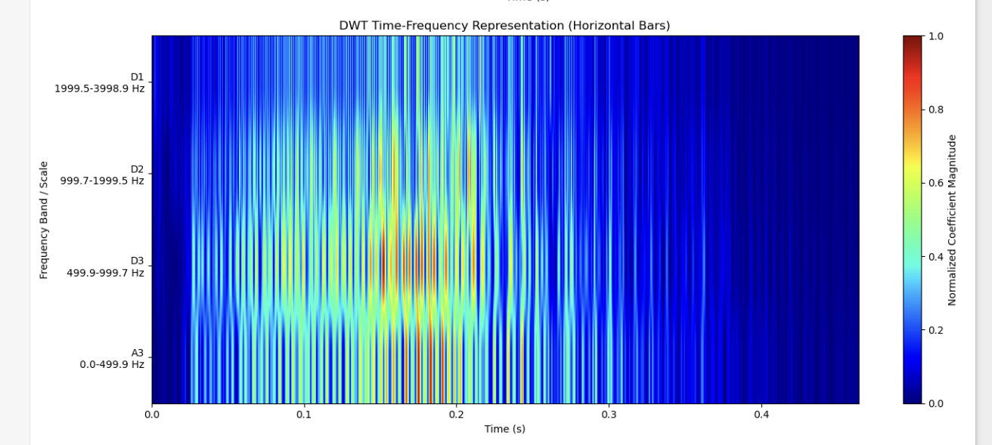
Implementation of discrete wavelet transform
Simple comparison between db4 and haar

Slide 9
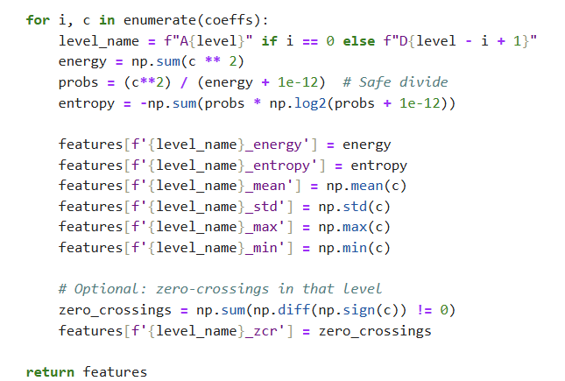
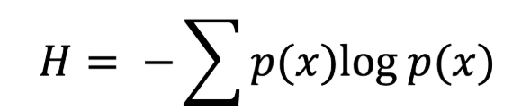
Extract wavelet-based features
We will extract the energy, entropy, max, min, std, mean , and zero crossing rate.
Decomposing the audio signal to details and approximation levels
Energy: it is sum of squares of coefficients.
Entropy, it measures the uncertainty in the frequency band and the higher it is the more complex the signal. Its formula is
Minimum – Maximum – Standard deviation - Mean
Extracting the zero - crossing rate,
Higher ZCR implies higher frequency.

Slide 10
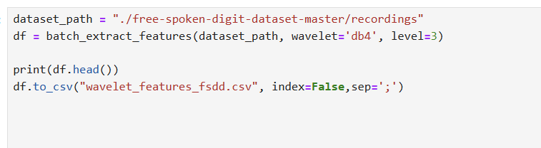
Extract wavelet-based features
Saves the features to a CSV file for the purpose of using them in the next step ( Classification system ).

Slide 11
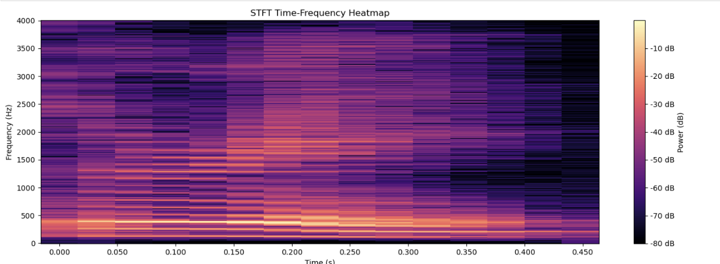
Comparing DWT with STFT results
STFT heatmap

Slide 12
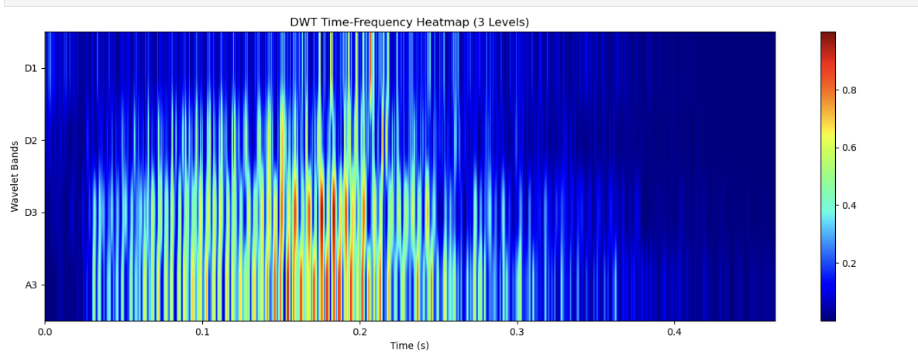
Comparing DWT with STFT results
DWT heatmap

Slide 13
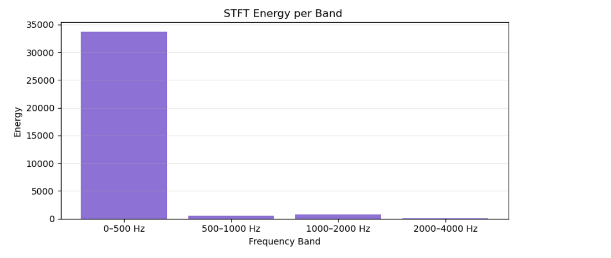
Comparing with STFT results
STFT energy distribution

Slide 14
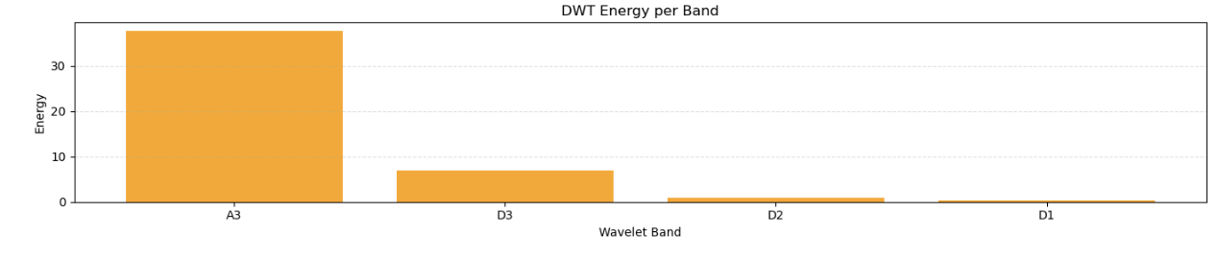
Comparing with STFT results
DWT energy distribution

Slide 15
Comparing with STFT results
Energy distribution is different.
Basis functions used for the decomposition are different.
DWT provides more resolution for low frequencies, so if the signal itself has more energy content at low frequency, it will be captured clearly by DWT.
STFT treats all frequencies equally. Also, energy that should be at specific frequency may leak into nearby frequency in the STFT.

Slide 16
Analyze time-frequency resolution benefits
DWT heatmap
Higher frequency → Shorter time segment
Lower frequency → Longer time segment

Slide 17
Analyze time-frequency resolution benefits
STFT heatmap
The time segment was fixed, regardless of whether the frequency was low or high.

Slide 18
Analyze time-frequency resolution benefits
DWT | STFT
Variable resolution | Fixed resolution
For higher frequency, time resolution will be more | Fixed window width regardless of the frequency
For lower frequency, frequency resolution will be more. | -

