Slide 1

Frequency Domain Analysis

Slide 2
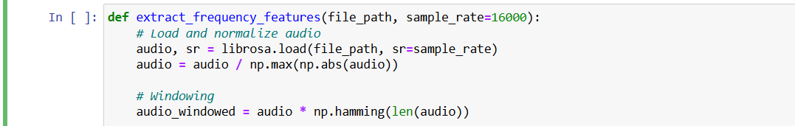
Set up

Slide 3
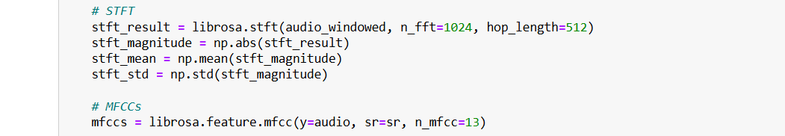
Transform

Slide 4
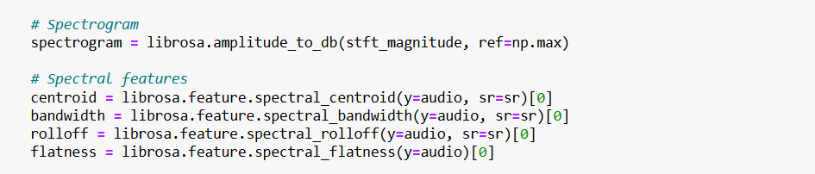
Spectrom

Slide 5
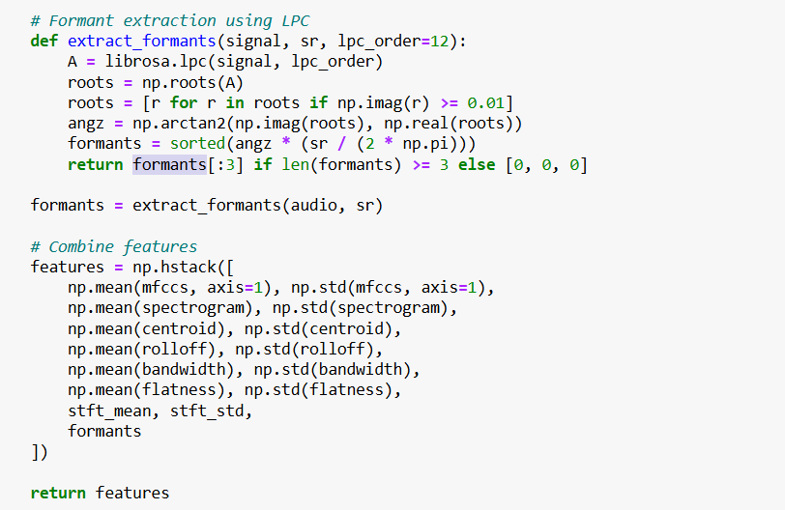
Extraction

