Slide 1
Time series Analyis and forecasting
Group 17 – 66,71,72
TY B

Slide 2
Introduction
Time series is a sequence of data points collected over time, and time series analysis involves analyzing past behavior to forecast future behavior. Time series forecasting is important for making predictions in various fields, such as finance, economics, meteorology, and engineering. It helps reveal patterns and trends, enabling informed decision-making. Accurate forecasts are crucial for resource planning, inventory management, demand prediction, and strategic decision-making. Time series analysis and forecasting play a vital role in understanding and predicting the behavior of complex systems over time.

Slide 3
Examples of time series
Here are some examples of time series:
Daily temperature readings
Stock prices over time
Sales data over time
Traffic volume data over time
Daily or monthly energy consumption data
Monthly or quarterly GDP figures
Daily or weekly website traffic data
Hourly or daily weather data
Monthly or quarterly employment figures
Daily or weekly social media engagement data.
Each of these examples represents a set of data points collected over time, making them a time series.

Slide 4
Components of Time Series:
1. Trend Component - The long-term direction of a time series. It can be increasing, decreasing, or stable over time.
Formula: Trend = a + bt, where a is the intercept, b is the slope, and t is time.
2. Seasonal Component - The short-term regular variations that repeat at fixed intervals over time. It is usually associated with calendar effects such as holidays, seasonality, and other regular patterns.
Formula: Seasonal factor = Actual value / (Trend * Irregular component)
3. Cyclical Component - The periodic fluctuations that are not seasonally related, but occur due to underlying economic or business cycles. These fluctuations can occur over several years.
4. Irregular Component - The random fluctuations that are not accounted for by the trend, seasonal, or cyclical components. It represents the noise or error in the time series data.
Understanding these four components is important for analyzing and forecasting time series data. By separating the different components, we can better understand the behavior of a time series, identify patterns and trends, and make accurate predictions. a time series.

Slide 5
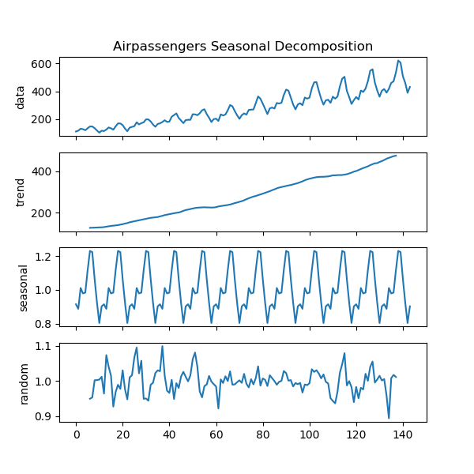
Seasonal decomposition
The seasonal decomposition method involves three main steps:
Trend estimation: This involves estimating the underlying trend of the time series using a moving average or other smoothing techniques.
Seasonal adjustment: This step involves removing the seasonal component of the time series. This can be done using a variety of methods, such as a seasonal index or a seasonal filter.
Residual analysis: After removing the trend and seasonal components, the residual component, also known as the irregular component, is analyzed to identify any remaining patterns or trends.

Slide 6
Stationarity and non-stationarity
Stationarity - A stationary time series has a constant mean, constant variance, and autocovariance that does not depend on time.
Non-Stationarity - A non-stationary time series has a changing mean, changing variance, and autocovariance that depends on time.
Examples of Stationarity and Non-Stationarity:
Stationary Time Series: Daily stock returns of a company where the mean and variance remain constant over time.
Non-Stationary Time Series: Monthly sales of a company that exhibits an increasing trend over time.

Slide 7
ADF test
The Augmented Dickey Fuller (ADF) test is used to determine whether a time series is stationary or non-stationary. The null hypothesis of the test is that the time series has a unit root, indicating non-stationarity. The alternate hypothesis is that the time series is stationary. The test involves estimating the regression of the differenced time series on lagged values of the time series and differenced errors, and the test statistic is compared to critical values to determine if the null hypothesis should be rejected.

Slide 8
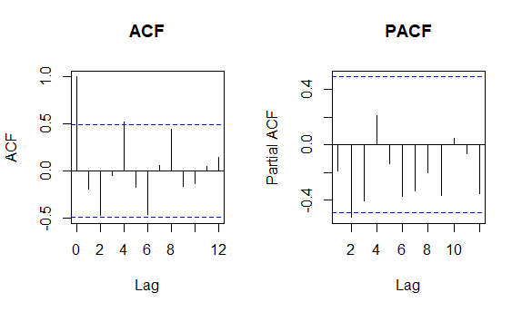
ACF and PACF
ACF (Auto-correlation function) and PACF (Partial auto-correlation function) are used to identify the correlation structure in time series data.
ACF:
- Measures the correlation between a time series and its lags.
- Shows the correlation at each lag for a range of lags.
- ACF is useful in identifying the order of MA (moving average) models.
PACF:
- Measures the correlation between a time series and a lagged version of itself, after removing the effect of intervening lags.
- Shows only the correlation at each lag for a range of lags.
- PACF is useful in identifying the order of AR (auto-regressive) models.
I

Slide 9
Seasonal Arima
Seasonal ARIMA:
Seasonal ARIMA (p, d, q)x(P, D, Q)m is an extension of ARIMA that includes seasonal components.
The model is used for time series data that exhibits seasonal patterns.
Seasonal ARIMA can be used to forecast future values of a time series, taking into account the seasonal variations.
Both ARIMA and Seasonal ARIMA require parameter tuning to identify the optimal values for the AR, I, and MA components, as well as the seasonal components in the case of Seasonal ARIMA. These models can be useful in predicting future trends in time series data, such as stock prices, weather patterns, or economic indicators.

Slide 10
About Dataset
The monthly beer production in Australia dataset comprises the total amount of beer produced each month, in millions of gallons, from January 1956 to August 1995.This dataset is often used as a benchmark dataset for time series analysis and forecasting due to its long time span and the presence of both trend and seasonality in the data.
The dataset can be used to explore the patterns and trends in beer production over time, identify any seasonality in the data, and develop models to forecast future beer production. It may be of interest to economists, businesses, and policymakers in the alcohol industry, as well as researchers studying time series analysis and forecasting methods.

Slide 11
Steps/Procedure followed:
Import the dataset
Visualize
Seasonal decomposition
ADF Test to check Stationarity ↔️ differencing ; findout the "d" value
ACF and PACF plots to determine p and q
Modelling
Seasonal ARIMA
Forecasting

Slide 12

Thank You!

