Slide 1
Omnidirectional Macnum Wheeled Robot
MTE 431 Mobile Robots
Group Course Project
Abdallah Amr – 12020011
Mostafa Osama – 120200018
Omar Fekry – 120200085
Tarek Shohdy – 120200030
Yomna Mohamed - 120200175

Slide 2
Contents
01
02
03
04
Kinematic Analysis
Mechanical Design
Software Implmentation
Calibrating and Testing

Slide 3
01
Kinematic Analysis

Slide 4

Kinematic Analysis
Rolling constraint: The wheel must roll when motion takes place in appropriate direction. [$\begin{matrix}sin({α+β+γ)} & −\cos{(α+β+γ)} & −l\cos{(β+γ)]}\end{matrix}∗ \dot{ζ_{R}}−r\dot{∅}\cos\left(γ\right)=0$ Where, $(l, α):$ defines the rotation axis position. $β$: the wheel angle (fixed). $γ$: rollers angle. $r_{SW}$ : roller radius. ${\dot{∅}}_{SW}$ : roller speed.

Slide 5
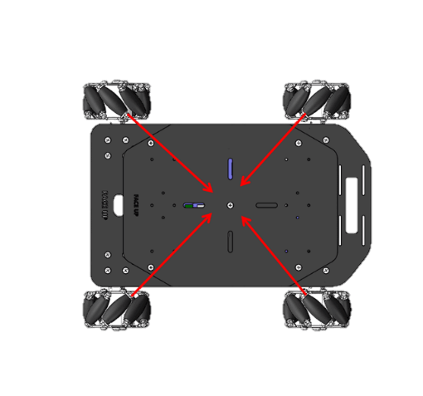

Kinematic Analysis
$$l=18.1cm , r=3cm$$
Wheel | α | β | γ
1 | 30 | 60 | -45
2 | 150 | -60 | -135
3 | 210 | -120 | -45
4 | -30 | 120 | -135
2
1
3
4

Slide 6

Kinematic Analysis
$$\left[\begin{matrix}{\dot{∅}}_{1} \\ {\dot{∅}}_{2} \\ {\dot{∅}}_{3} \\ {\dot{∅}}_{4}\end{matrix}\right]=\frac{1}{r}\left[\begin{matrix}1 & −1 & −0.26 \\ 1 & 1 & −0.26 \\ 1 & −1 & 0.26 \\ 1 & 1 & 0.26\end{matrix}\right] \left[\begin{matrix}\dot{x_{R}} \\ \dot{y_{R}} \\ \dot{θ_{R}}\end{matrix}\right]$$

Slide 7
02
Mechanical Design

Slide 8
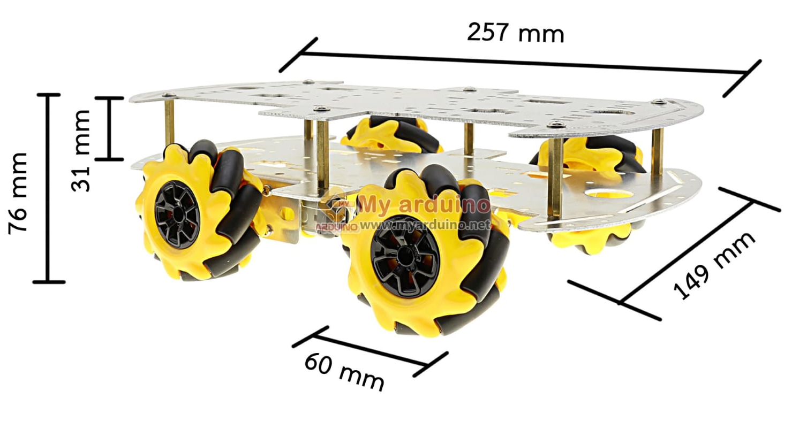
Mechanical Design
We used a standard mecanum wheel kit to avoid the designing process but we took in considerations: - Mecanum Wheel Size and Type - Chassis Configuration - Motor Selection - Battery and Power Management

Slide 9
03
Software Implmentaion

Slide 10
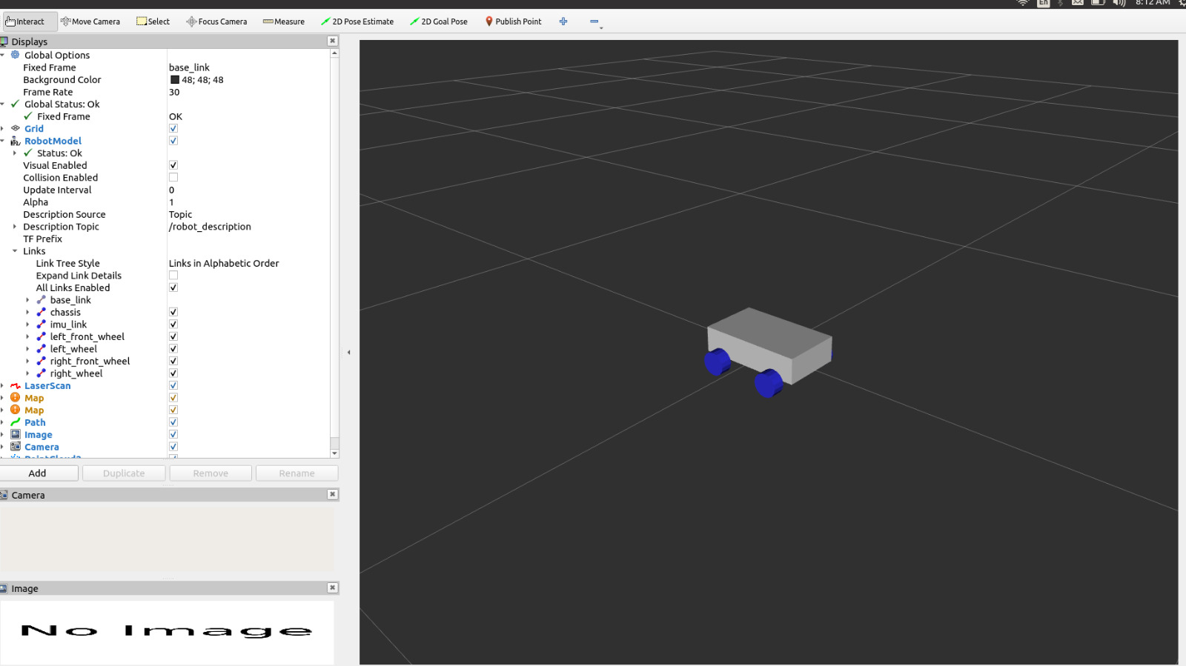
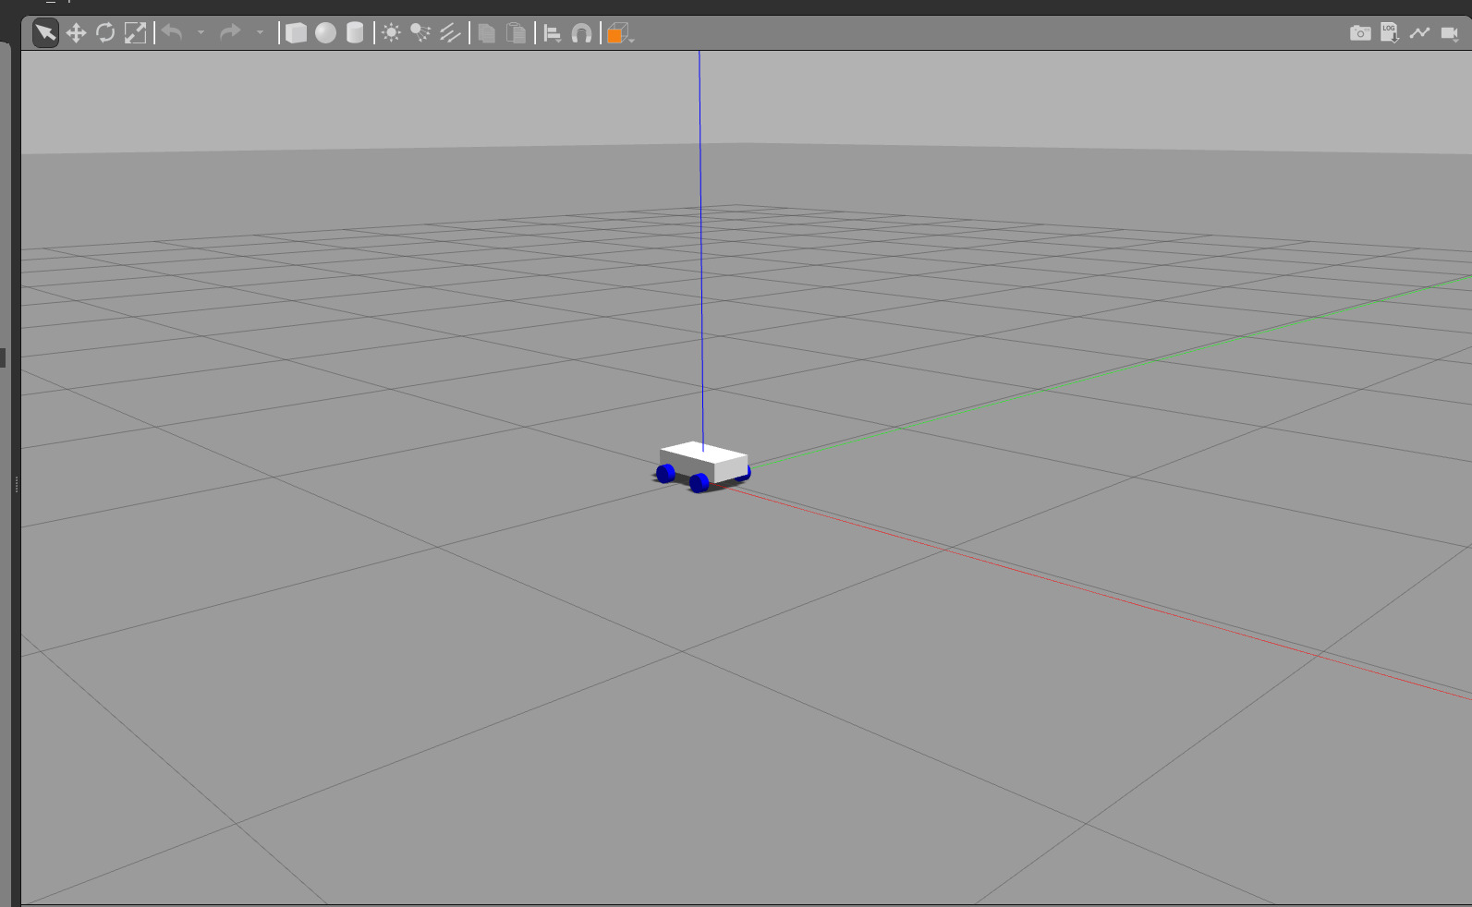
Software Implmentatoin
a. Raspberry Pi Setup b. Kinematic node c. URDF Creation and simulation d. PID Controller Implementation e. Macnum bot launch file f. Controller Macnum bot launch file

Slide 11
Challenges
a. Sensor calibration and Accuracy b. Bridging Data c. PID Tuning

Slide 12
04
Calibrating and Testing

Slide 13
Sensor Calibration
• Results: Imu data sent from the node are reliable and precise enough at least for the angular velocity and yaw angle.

Slide 14
Open-Loop Control Testing
• Results: the unidentical motors lead to a less expected behavior from the robot, as it will move in the x direction correctly, but it will deviate and turn and the speed in the x direction will not be the same as given.

Slide 15
Closed-Loop Control Testing
• Results: The robot is quiet stable, but with the changed environment and all the approximations in the robot model, it’s difficult to achieve some perfect response from the system.

Slide 16
Thanks!
Do you have any questions?

