Slide 1
Trigonometrische Kurven
10A
Der Typ, der auch vor euch steht

Slide 2


Slide 3
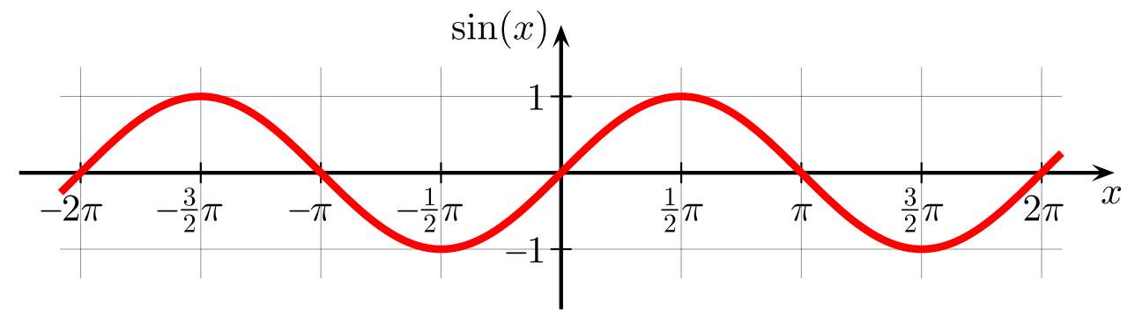

Slide 4
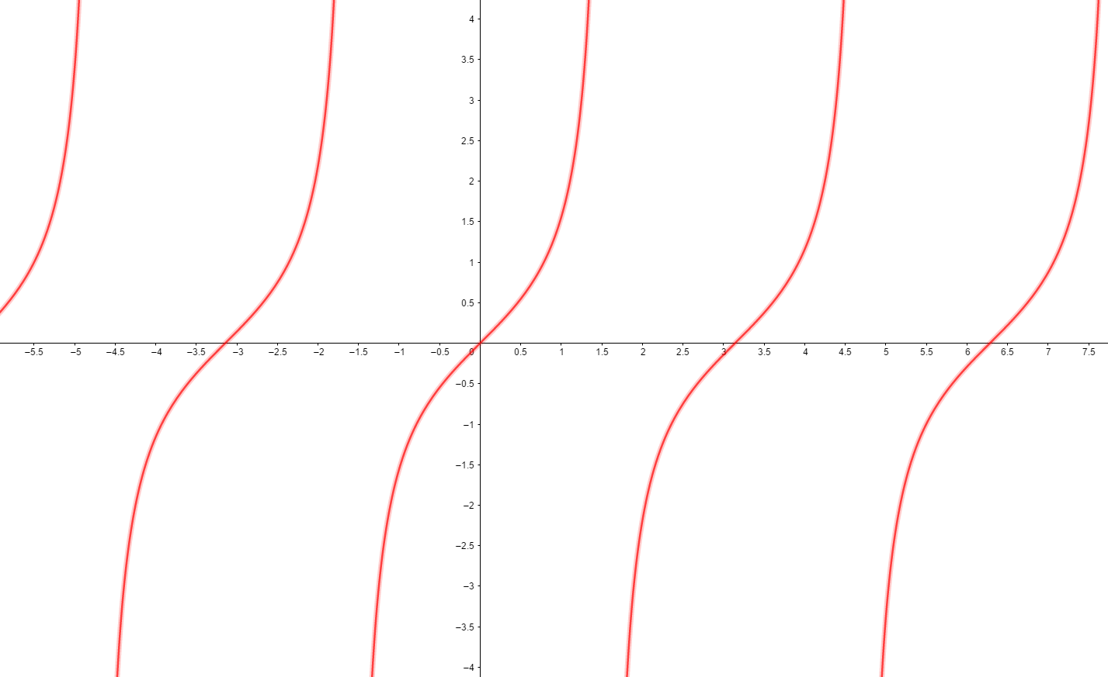
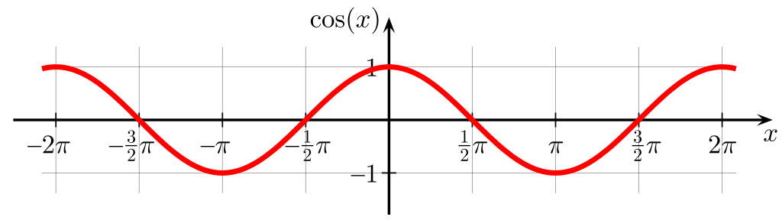



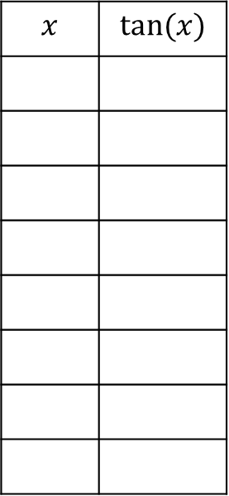



$$x$$ | $$tan⁡(x)$$
0
0
30
$$1/\sqrt{3}$$
45
1
60
$$\sqrt{3}$$
90
ERR
120
$$−\sqrt{3}$$
135
$−$1
150
$$−1/\sqrt{3}$$
$$\frac{1}{2}π$$

Slide 5
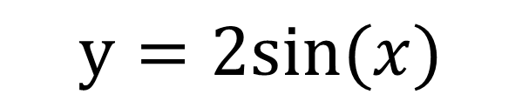
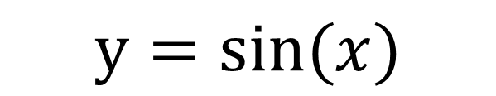
$$y=sin⁡(x)$$
$$y=2sin⁡(x)$$

Slide 6
$$y=2sin⁡(x)$$

Slide 7
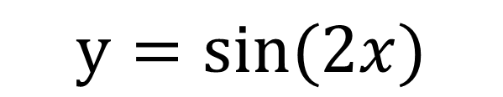
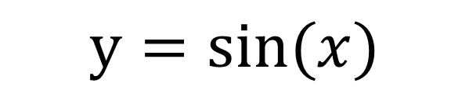
$$y=sin⁡(x)$$
$$y=sin⁡(2x)$$

Slide 8
$$y=sin⁡(2x)$$

Slide 9
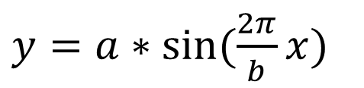

Sinuskurve mit Schwingungsweite a, Periode b
→
$y=a∗sin⁡(\frac{2π}{b}x)$
Einheitsperiode(Periode 1):
$$y=sin⁡(2πx)$$

Slide 10




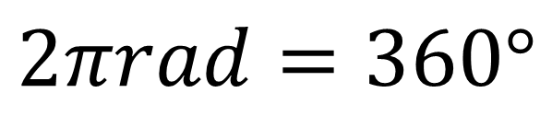
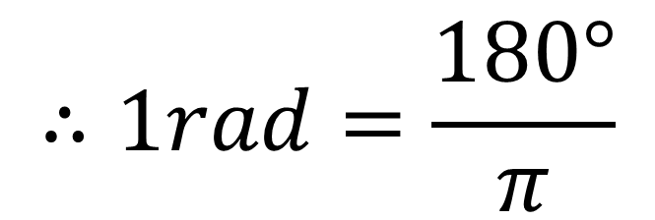

++P.S.
°
: Gradmaß(degree).
=360°
$$\frac{1}{6}π$$
s
$$2πrad=360°$$
$$\frac{s}{r}$$
$$\frac{s}{r}$$
=
$$∴1rad=\frac{180°}{π}$$
: Gon(grade).
=100^{g}
^{g}
60°
( )
$$\frac{s}{r}$$
/
rad
=
^{r}
:Radian
$$\frac{1}{2}$$
=
r
⚠relativ nutzlos in Mittelstufenmathematik⚠

Slide 11

Animation: BYEONGWOO KIM
Script: BYEONGWOO KIM
Møøse trained by: BYEONGWOO KIM
Special Møøse Effects: BYEONGWOO KIM
Large møøse on the left hand side of the screen in the third scene from the end,
given a thorough grounding in Latin, French and "O" Level Geography: BYEONGWOO KIM
Møøses' noses wiped by: BYEONGWOO KIM
Møøse Costumes:BYEONWOO KIM
Møøse Choreographed by:BYEONGWOO KIM
Miss Taylor's Møøses by:BYEONGWOO KIM
Møøse trained to mix concrete and sign complicated insurance forms by:BYEONGWOO KIM
Suggestive poses for the Møøse suggested by:BYEONGWOO KIM
Antler-care by:BYEONGWOO KIM
Assisted By: BYEONGWOO LLAMA III SY LLAMA MERLE Z. LLAMA IX KIM
Directed By 40 SPECIALLY TRAINED ECUADORIAN MOUNTAIN LLAMAS 6 VENEZUELAN
RED LLAMAS 142 MEXICAN WHOOPING LLAMAS
14 NORTH CHILEAN GUANACOS (CLOSELY RELATED TO THE LLAMA)
REG LLAMA OF BRIXTON 76000 BATTERY LLAMAS FROM "LLAMA-FRESH" FARMS LTD. NEAR PARAGUAY
And BYEONGWOO KIM& BYEONGWOO KIM
Background Music: Gísli Gunnarsson

