Slide 1

Graph Builder
ZACHERY SMITH AND TAREN LEWIS

Slide 2
System Description: • Component based Graph Builder • Data Visualization Tool • Customizable Displays and Attributes

Slide 3
Required Features (“Base” system): • Automatic graph plotting of CSV data • Customizable graphics and visual settings • Graphs are opened, copied, and exported
“Mouse” Tracker, overlays a vertical line
Ability to add new components & features

Slide 4
Adopted Best Fit Patterns: • Prototype • Decorator / Wrapper
• Composite • Observer • Future

Slide 5
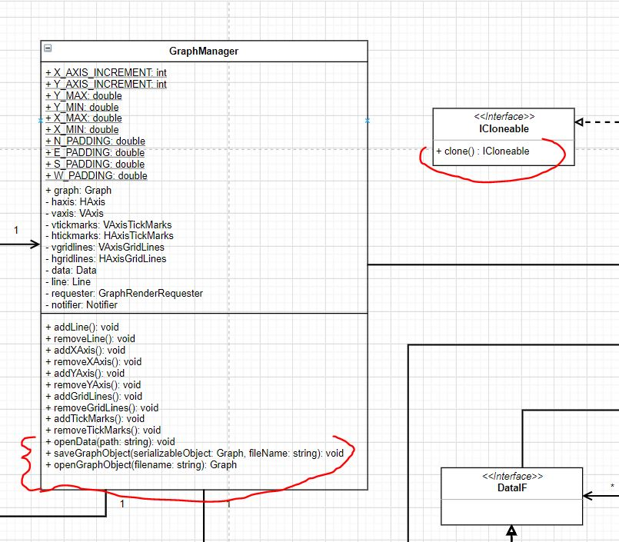
Prototype:
Allow graphs to be copied because of their expensive construction
Allow different occurrences of graph objects to be easily recorded for later use

Slide 6
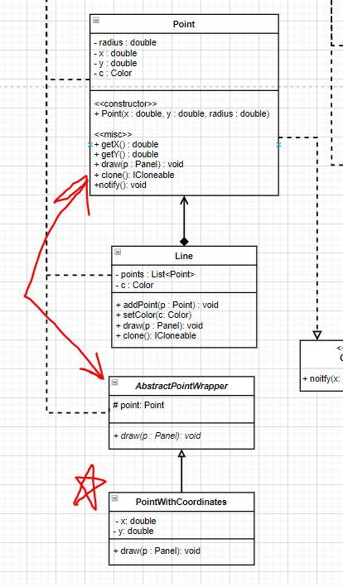
Decorator /
Wrapper:
Allow additional features to be easily added to the system, while still maintaining the basic functionality

Slide 7
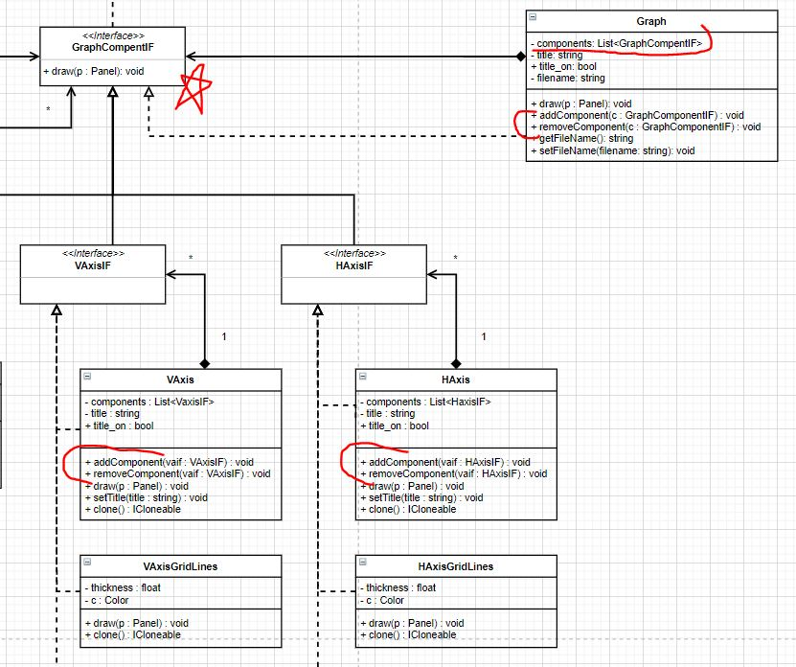
Composite:
Graph objects and some subcomponents will be composite in nature
Simplifies complex relationships

Slide 8
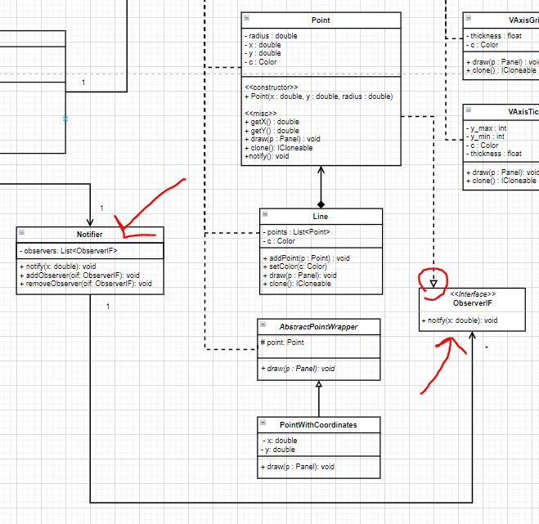
Observer pattern details:
Used to notify data point to allow for dynamic experience
Each data point will be notified of the mouse’s position on the display
If the mouse position
matches the location of the data point then it will show line indicating the y-value

Slide 9
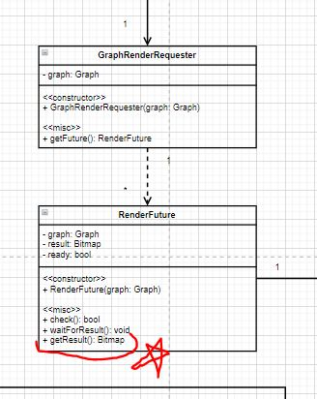
Future pattern details:
Will be used to asynchronously render the graphic for the graph prior to being displayed on the GUI
Prevents the user from having to wait for the drawing computations to complete
Avoids high amounts of computation occuring all at one time

Slide 10
Future pattern details:
Will be used to asynchronously render the graphic for the graph prior to being displayed on the GUI
Prevents the user from having to wait for the drawing computations to complete
Avoids high amounts of computation occuring all at one time

Slide 11
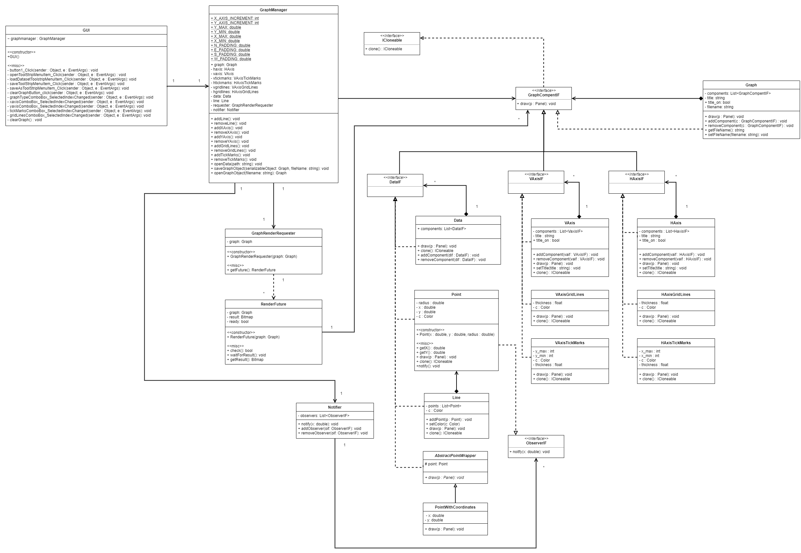
Complete UML (get your magnifying glass)

Slide 12
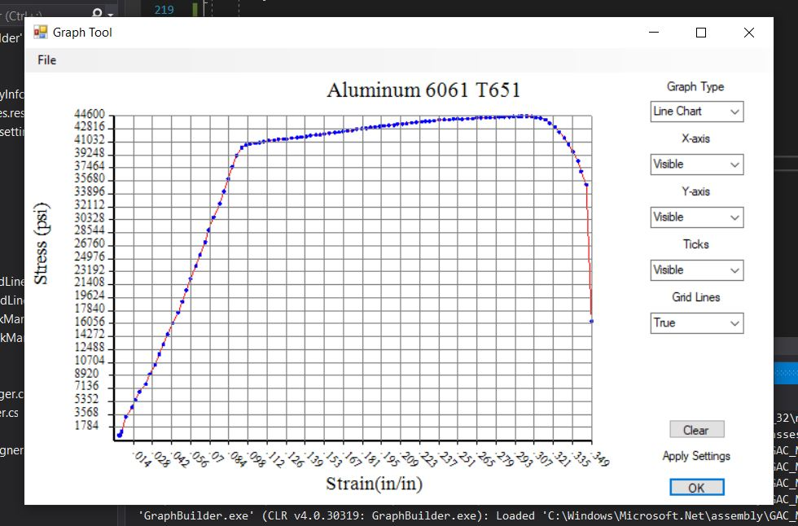
Prototype of GUI (Line Chart - All Settings Enabled):

Slide 13
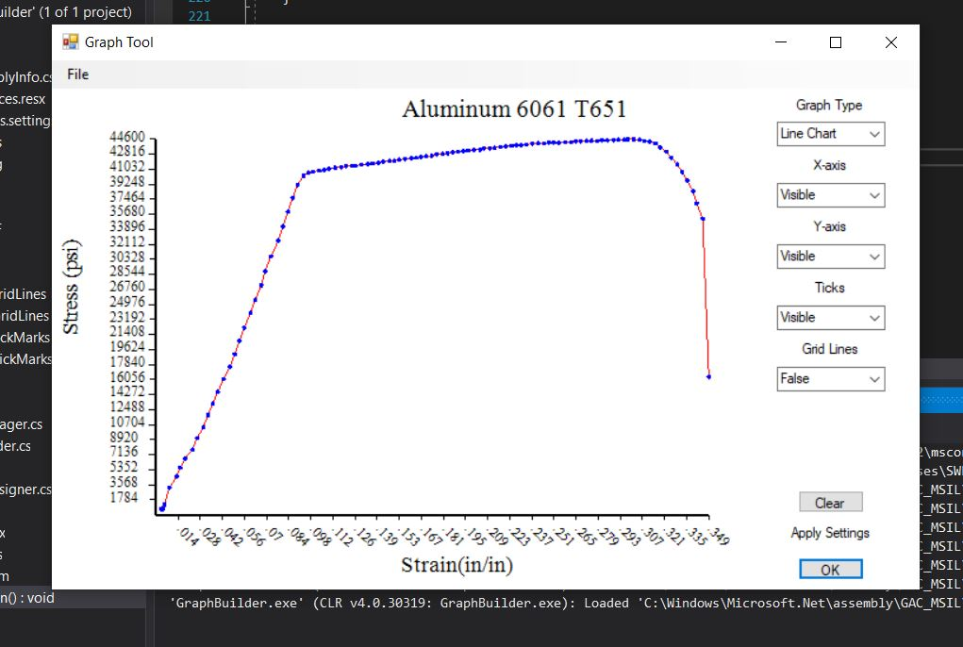
Prototype of GUI
(Line Chart - No Grid):

Slide 14
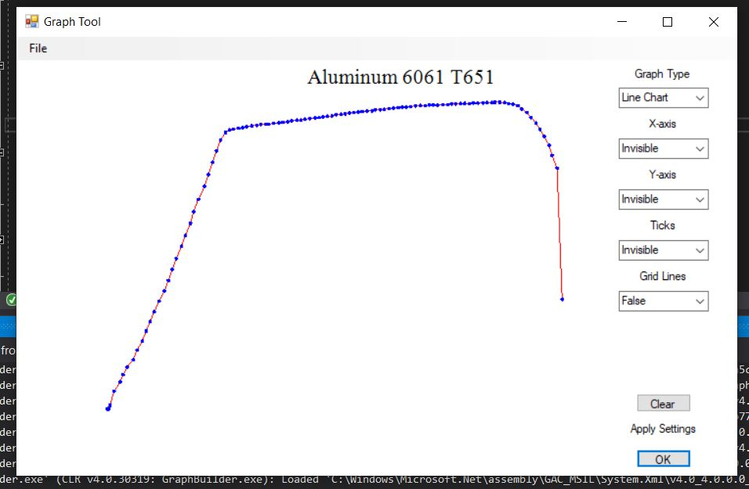
Prototype of GUI
(Line Chart - All Settings Disabled):

