Slide 1
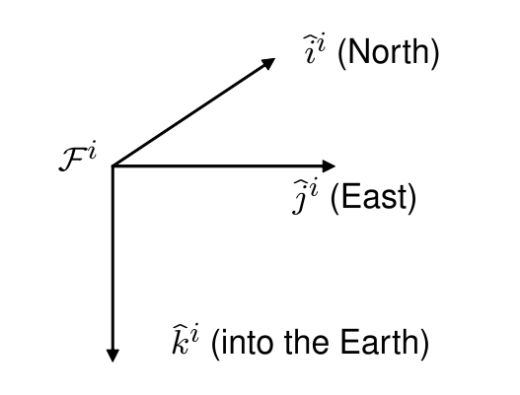
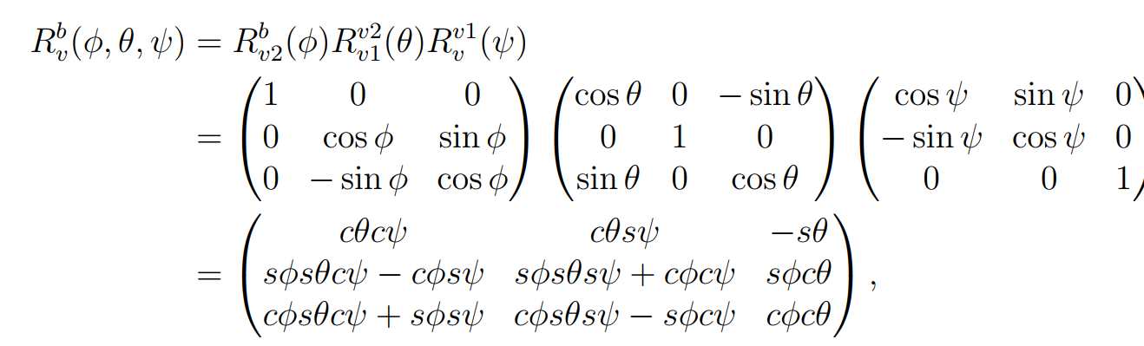
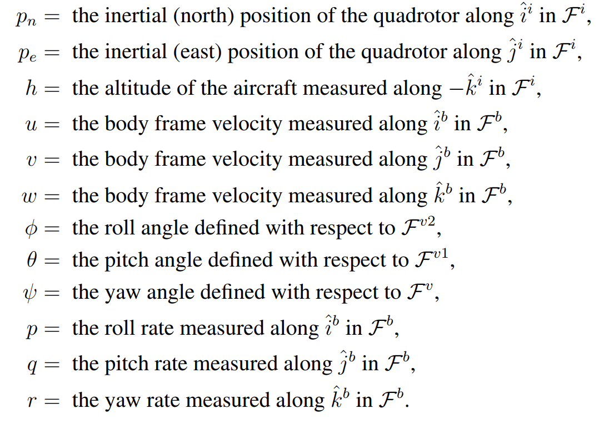
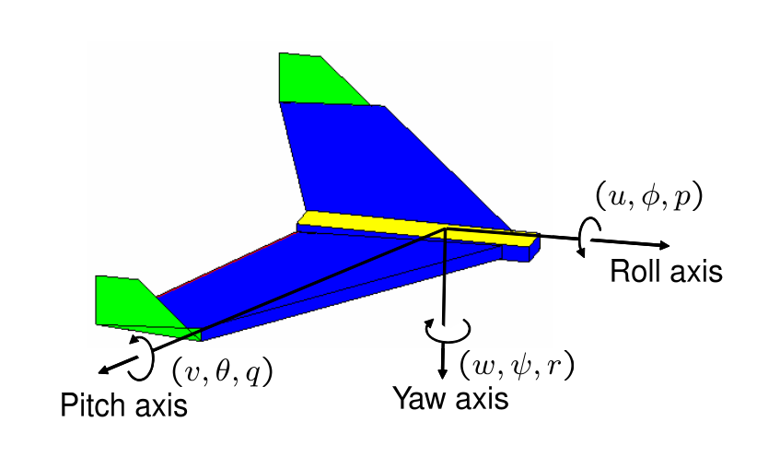
Quadrotor modeling )from Randal Beard)
transformation from the vehicle/Inertial frame to the body frame
1- Identify state:
Using Euler angles (world frame) and body rates( body frame).

Slide 2
Drone dynamics and control
Tareq Alqutami

Slide 3
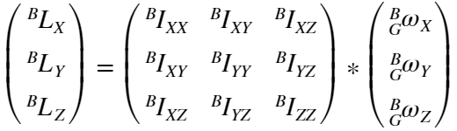



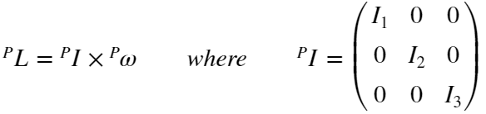

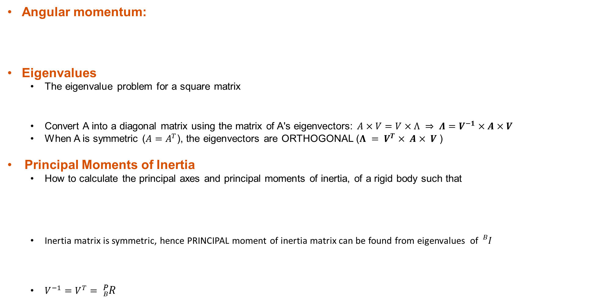
Prerequisite Knowledge: Inertia and eigenvectors
Angular momentum:
Eigenvalues
The eigenvalue problem for a square matrix
Convert A into a diagonal matrix using the matrix of A's eigenvectors: $A×V=V×Λ ⇒ Λ=V^{−1}×A×V$
When A is symmetric ($A=A^{T}$), the eigenvectors are ORTHOGONAL ($Λ = V^{T}× A× V$ )
Principal Moments of Inertia
How to calculate the principal axes and principal moments of inertia, of a rigid body such that
Inertia matrix is symmetric, hence PRINCIPAL moment of inertia matrix can be found from eigenvalues of ${}_{}^{B}I$
$V^{−1}=V^{T}= {}_{B}^{P}R$
Notes:
Note: in order to interpret V as a rotation matrix, we need to ensure that the 3 basis vectors in form a right handed co-ordinate frame

Slide 4
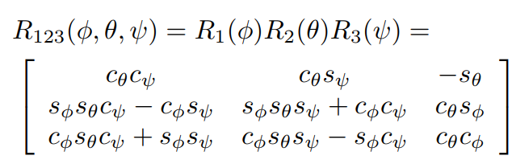
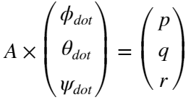
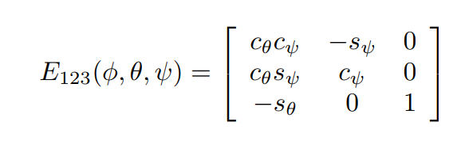
Prerequisite Knowledge: rotation matrix
Rotation matrix transformations
A passive rotation is a single rotation about a single coordinate axis
Three coordinate rotations in sequence can describe any rotation
There are many sequences such as (xyz), (zxz), etc
Example is the XYZ(123) sequence
Euler angle rates and body rates (angular velocities)
The relationship between the Euler angle rates and the angular velocity of the body is encoded in the Euler angle rates matrix. Multiplying this matrix by the vector of Euler angle rates gives the angular velocity in the global coordinates
Example Euler angle rates to body rates matrix:
Notes:
Important Note: Some authors prefer to write the matrix that maps from the body-fixed coordinates to the world coordinates; others prefer the matrix that maps from the world coordinates to
the body-flxed coordinates. Converting between the two conventions is by performing the transpose of the matrix

Slide 5
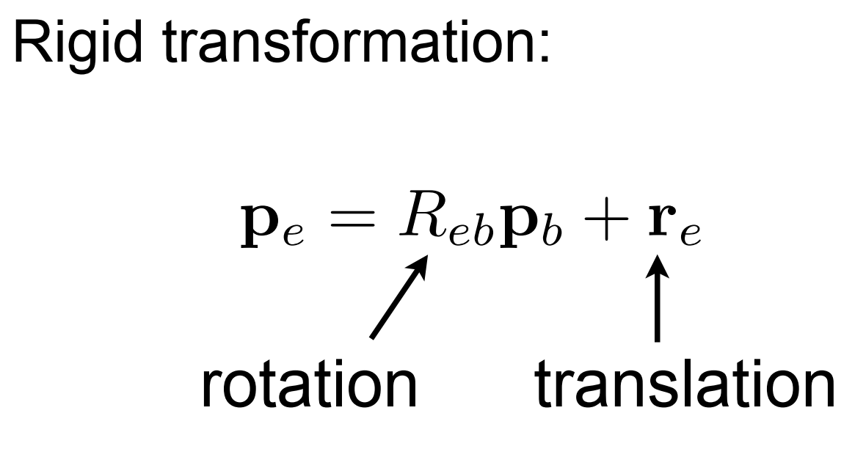
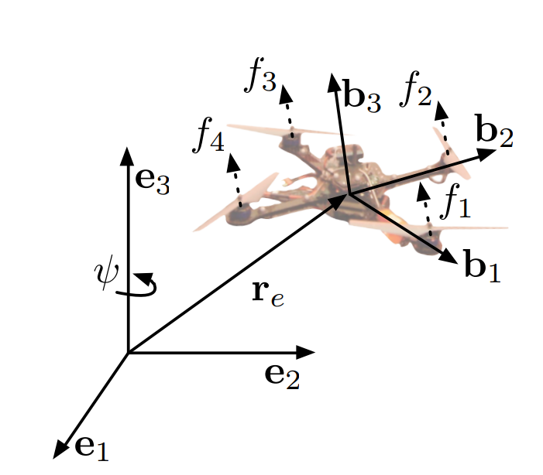
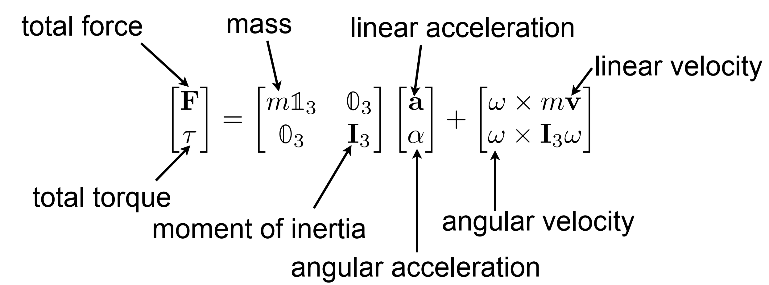
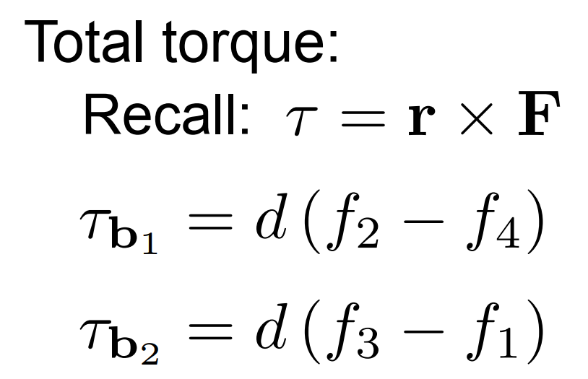
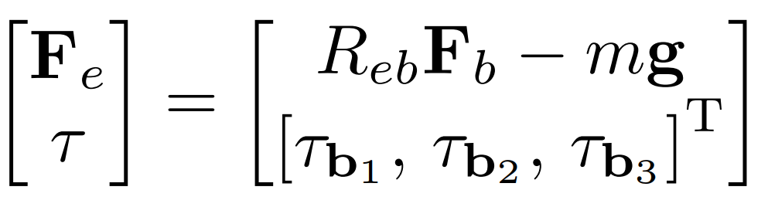
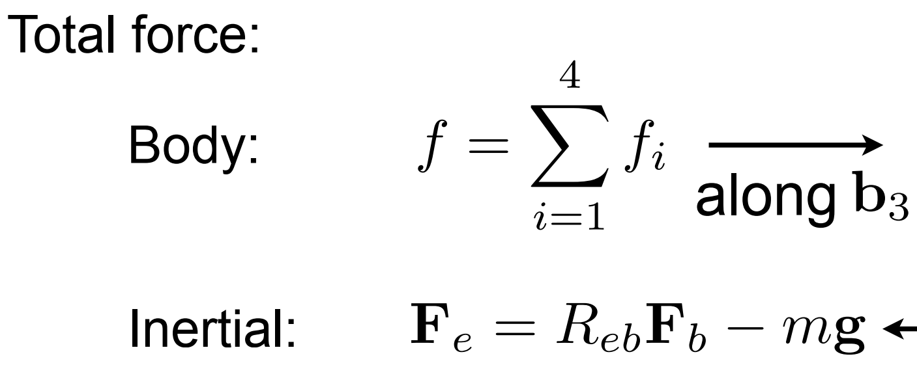
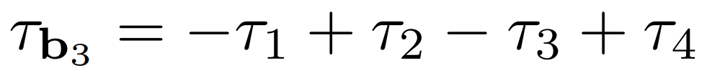
Prerequisite Knowledge: Rigid body F/T

Slide 6
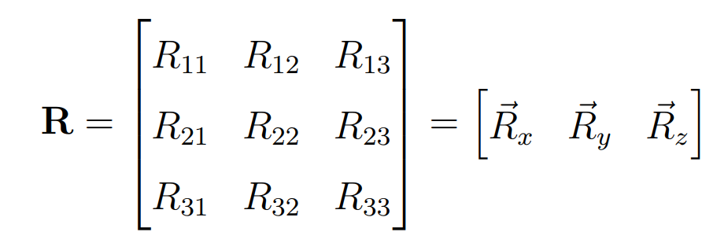
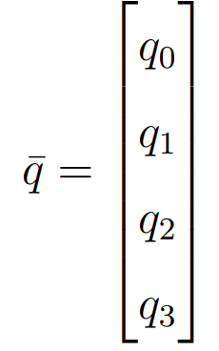
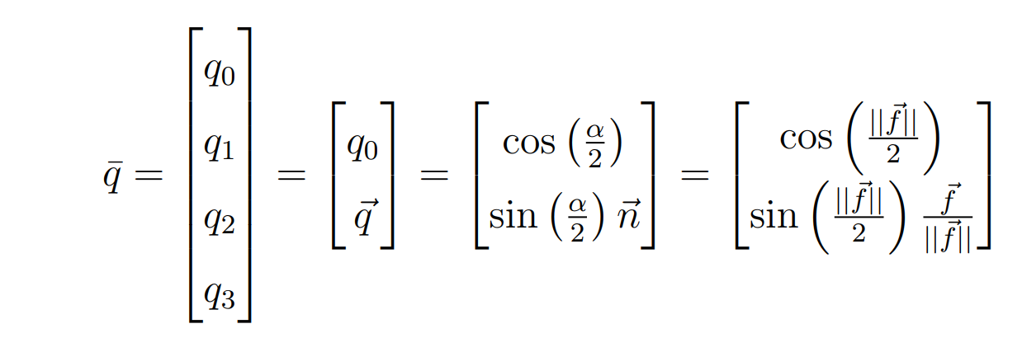
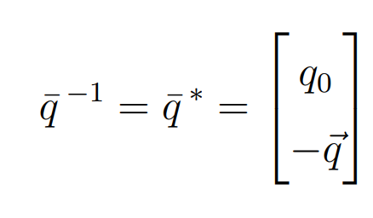
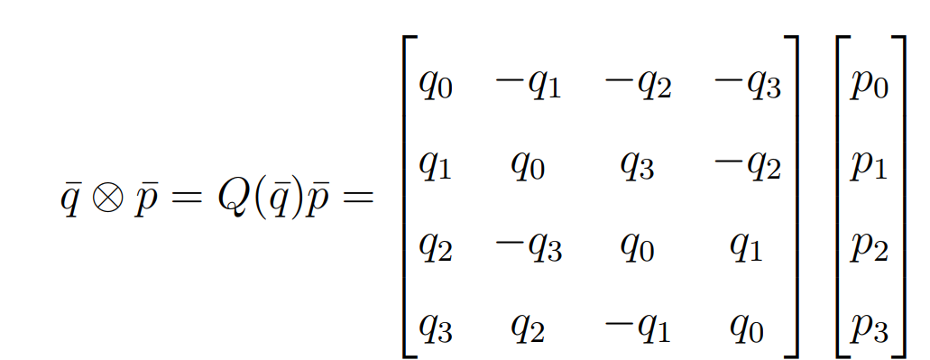
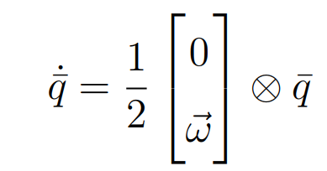
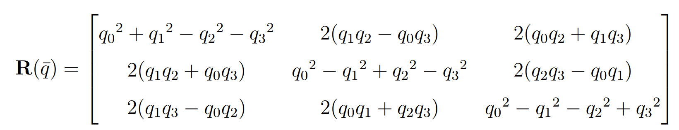

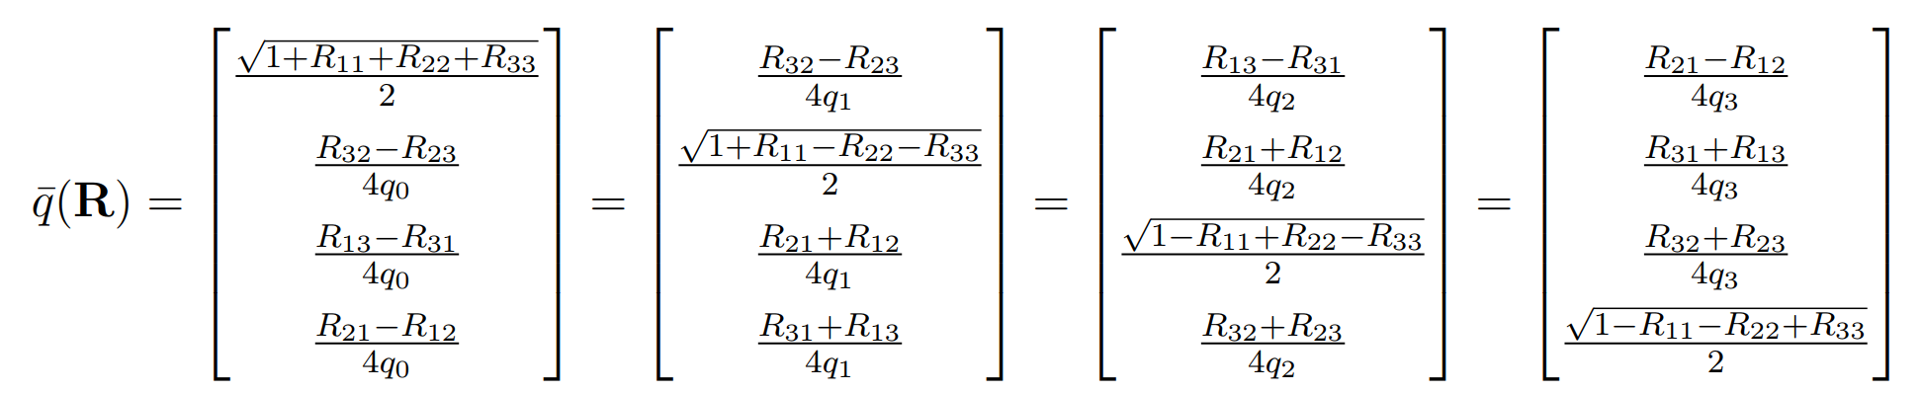
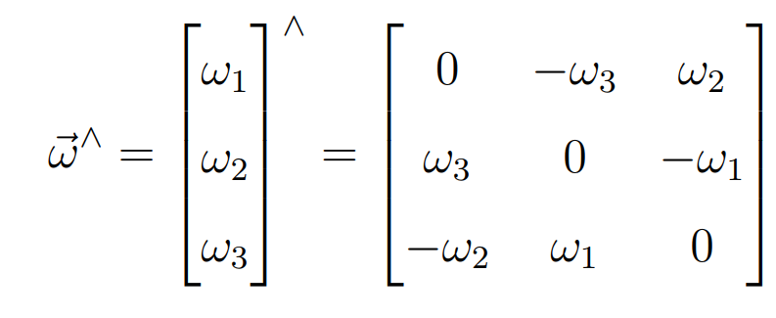
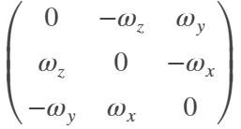


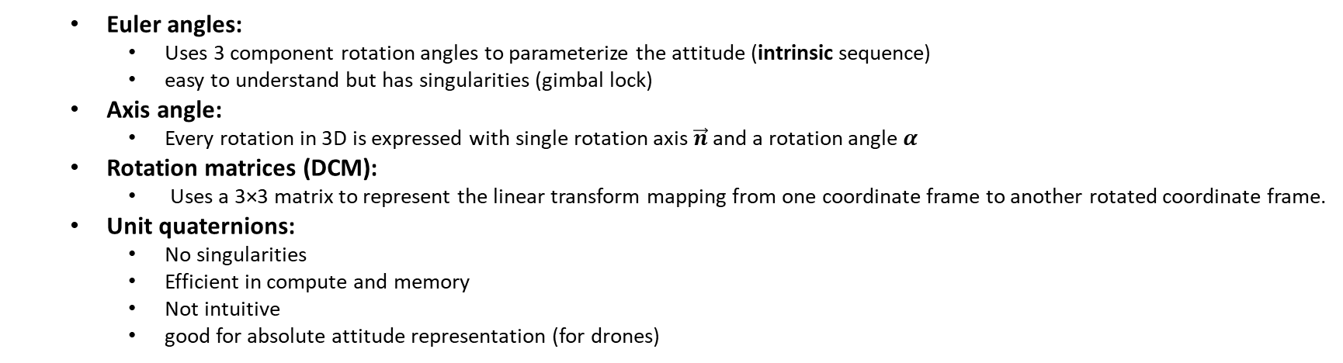
Prerequisite Knowledge: Attitude representation
Euler angles:
Uses 3 component rotation angles to parameterize the attitude (intrinsic sequence)
easy to understand but has singularities (gimbal lock)
Axis angle:
Every rotation in 3D is expressed with single rotation axis $\vec{n}$ and a rotation angle $α$
Rotation matrices (DCM):
Uses a 3×3 matrix to represent the linear transform mapping from one coordinate frame to another rotated coordinate frame.
Unit quaternions:
No singularities
Efficient in compute and memory
Not intuitive
good for absolute attitude representation (for drones)
Conversion
concatenation
Inverse and derivative
Skew Symmetric Matrix
Notes:
According to the “Right Hand Rule”, the positive direction for rotations is clockwise in the axis direction.
https://stevendumble.com/attitude-representations-understanding-direct-cosine-matrices-euler-angles-and-quaternions/#:~:text=Direct%20Cosine%20Matrix%20(DCM)%20%E2%80%93,quaternion%20to%20parameterize%20the%20attitude.
A passive rotation matrix takes the space associated with the rotated system and evaluate it wrt to the fixed system, while an active rotation evaluates the fixed system wrt to the rotated one;

Slide 7
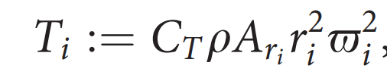
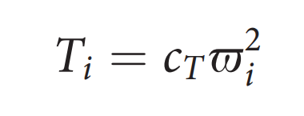
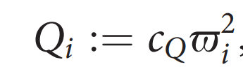


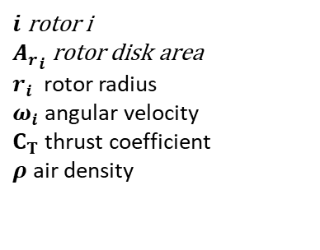
Rotor Dynamics
SS Thrust (hovering):
Simple lumped model:
reaction torque (due to rotor drag) acting on the airframe generated by a hovering rotor
$i$ rotor i
${A_{r}}_{i}$ rotor disk area
$r_{i}$ rotor radius
$ω_{i}$angular velocity
$C_{T}$ thrust coefficient
$ρ$ air density
Notes:
C_Tthrust coefficient (depends on rotor geometry and profile)
c_T > 0 is modeled as a constant that can be easily determined from static thrust tests c_Q (which also depends on Ar, r, and roh) can be determined by static thrust tests

Slide 8
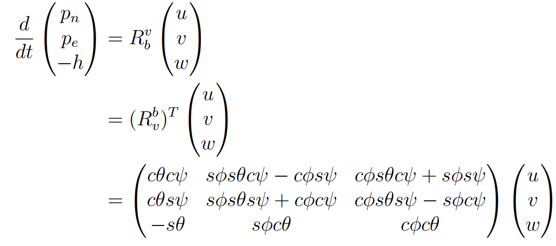
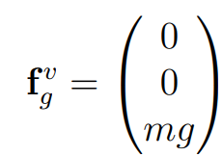
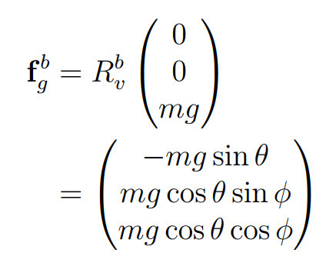
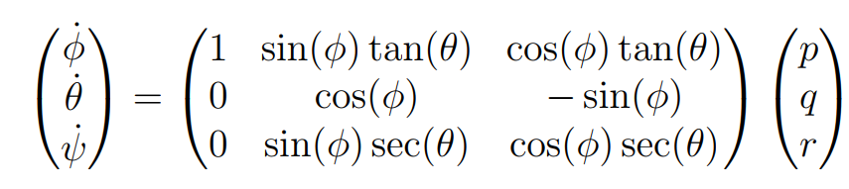
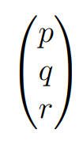
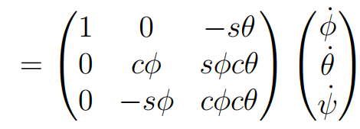
Quadrotor modeling
2- Kinematics:
Inertial position and body velocities:
Euler rates and body rates:
Gravity in body frame:

Slide 9


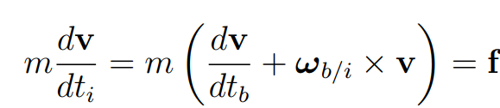
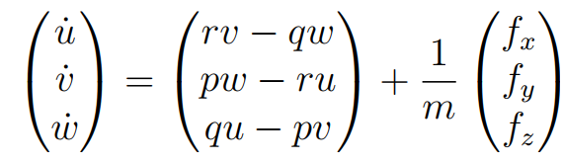
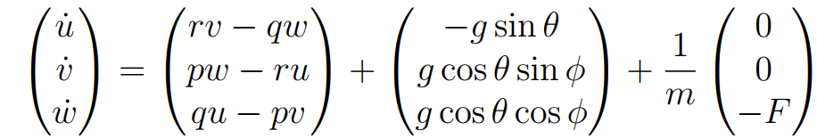
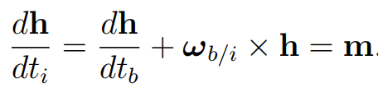
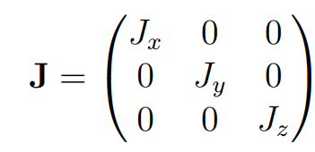


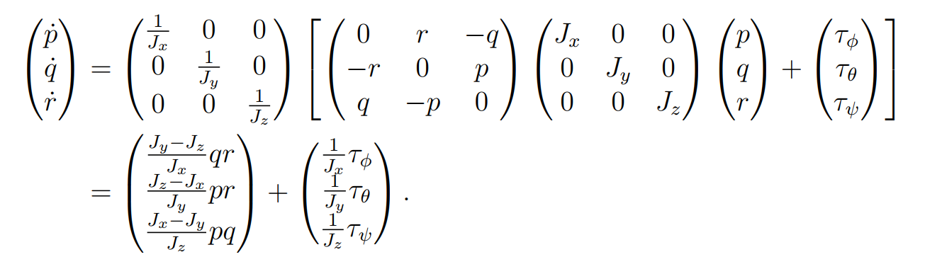
Quadrotor modeling
3- Dynamics:
Linear motion in body frame:
Rotational motion in body frame:
h is the angular momentum and m is the applied torque
Generic
Gravity Thrust

Slide 10

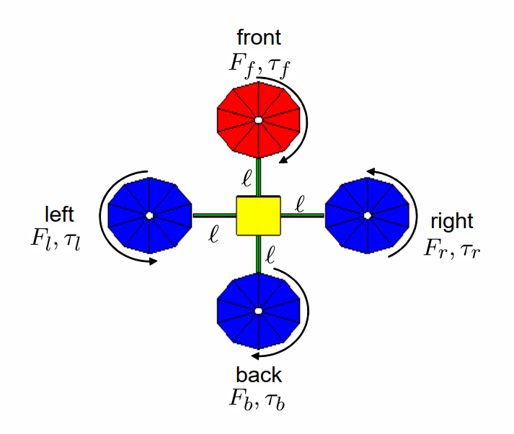
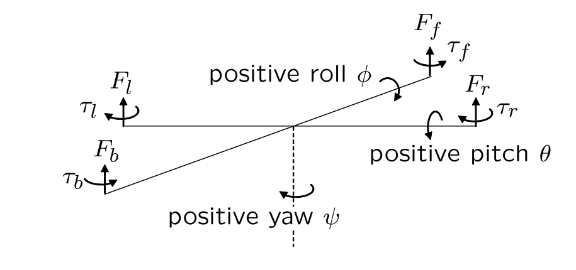



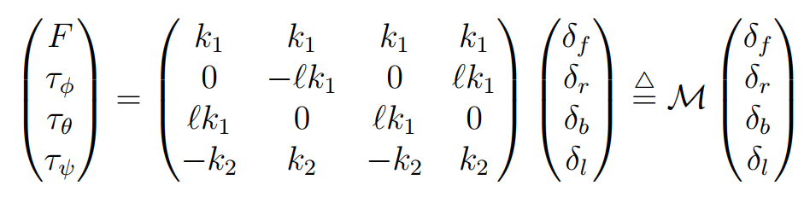
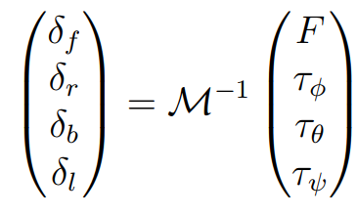

Quadrotor modeling
4- Forces and moments:
Assume the aerodynamic forces and moments are negligible
Allocation matrix
The control strategies derived in subsequent sections will specify forces and torques. The actual motors commands can be found as
$δ$ is the motor command signal
Notes:
Due to Newton’s third law, the drag of the propellers produces a yawing torque on the body of the quadrotor. The direction of the torque will be in the oppositive direction of the motion of the propeller.
lift and drag produced by the propellers is proportional to the square of the angular velocity
assume that the angular velocity is directly proportional to the pulse width modulation commend sent to the motor

Slide 11
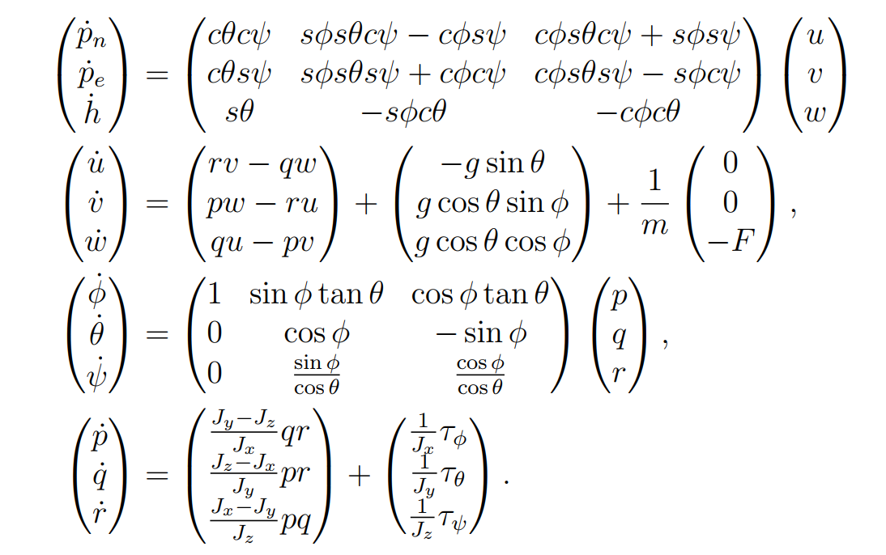
Quadrotor modeling
5- Summary of EOMs

Slide 12
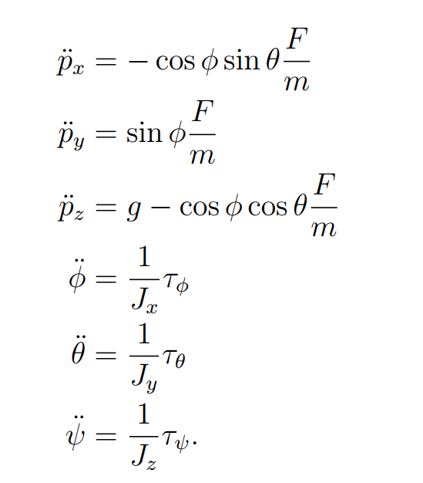
Quadrotor modeling
5- Simplified model for control design
Assume Euler rates are equal to body rates (pitch and roll are small angles)
Neglecting the Coriolis terms
Assuming relative position and heading of the quadrotor with respect to a ground target rather than Inertial position

Slide 13





Quadrotor modeling
Volt
6- Sensor models
Gyro
Accelerometer
Measures specific force in body frame
$Ω_{gyro}$ is the angular rate in radians per second
$β_{x}$ sensor bias
$k_{x}$ sensor gain (volts per sensor unit)
$η_{x}$sensor zero mean white noise
A acceleration in meters per second

Slide 14
Control architecture
Desired Position and Vel, yaw
Position, Vel, yaw
Position and velocity control
State estimator
altitude control
Desired attitude
Current attitude
Attitude control
Angular rates (pqr)
Angular rates
Rate control
torques
thrust
Mixer
Motor Angular velocities
Motor control
Position and velocity controller calculates the desired attitude

Slide 15
Control architecture
Desired Position and Vel
Position and Vel
Position and velocity control
State estimator
Desired thrust force or acceleration
Desired yaw
Force/acceleration to attitude
|Thrust|
Desired attitude
Current attitude
Attitude control
Angular rates (pqr)
Angular rates
Rate control
torques
thrust
Mixer
Motor Angular velocities
Motor control
Position and velocity controller calculates the desired thrust force (in inertial frame) and the attitude control aligns this force with world frame

Slide 16





Quaternion Attitude Control
PX4 implementation
Reduced attitude control:
The yaw angle is not controlled directly, but $q_{sp}$ is always chosen such that no rotation about the yaw axis is induced
Full attitude control:
Pointing direction of the thrust vector as well as the yaw angle are controlled.
$q_{sp}$ is chosen such that the corresponding z-axis is aligned with commanded body z-axis, and $ψ = ψ_{sp}$

Slide 17

Position/Velocity Control – Quaternion representation

Slide 18






Position/Velocity Control
Limiting horizontal thrust based on maximum tilt angle $α$
$T_{z_{max}}$ is max thrust the drone can produce
$α$ is maximum allowed tilt angle
Thrust setpoint from velocity control is (Tx,Ty, Tz)
Saturate the horizontal thrust setpoints as follow:
Calculate required horizontal thrust at maximum tilt
$$T_{hor}=\left|T_{z}\right|∗tan(α)$$
Calculate maximum allowed horizontal thrust (maximum thrust -vertical commanded thrust )
$$T_{{hor}_{max}}=\sqrt{\left|{\left(T_{z_{max}}\right)}^{2}−{\left(T_{z}\right)}^{2}\right|}$$
Take the minimum of the previous two as the allowed $T_{hor}$
$$T_{hor}=\min\left(T_{hor},T_{{hor}_{max}}\right)$$
Saturate set points of horizontal thrust $T_{h}={\left[T_{x},T_{y}\right]}^{T}$coming from velocity control if exceed allowed $T_{hor}$ value
$$T_{h}=\left[\begin{aligned}T_{x} \\ T_{y}\end{aligned}\right]= \left\{\begin{aligned} \frac{T_{h}}{\left\|T_{h}\right\|}∗T_{hor} if T_{h}^{T}∗T_{h}>{\left(T_{hor}\right)}^{2} \\ T_{h} else\end{aligned}\right.$$
$$T_{hor}$$
$$T_{z_{max}}$$
$$T_{z}$$
$$T_{α}$$
$$α$$
Notes:
Double vertical bars refer to norm of a vector

Slide 19

Thrust to attitude
Thrust setpoint from velocity control after saturation is $T_{c}={\left[T_{x},T_{y}, T_{z}\right]}^{T}$
$φ_{c}$ is yaw setpoint
Calculate attitude set point as follows:
Desired body_z axis direction
$${\vec{z}}_{b}=\frac{T_{c}}{\left\|T_{c}\right\|}$$
Desired body x axis direction after projecting by desired yaw direction
$${\vec{x}}_{b}=\left[\begin{aligned}−sin⁡(φ_{c}) \\ cos⁡(φ_{c}) \\ 0\end{aligned}\right]×{\vec{z}}_{b}$$
$${\vec{x}}_{b}=\frac{{\vec{x}}_{b}}{\left\|{\vec{x}}_{b}\right\|}$$
Desired body y axis direction
$${\vec{y}}_{b}={\vec{z}}_{b}×{\vec{x}}_{b}$$
Form the desired rotation matrix
$$R=\left[\begin{matrix}{\vec{x}}_{b} & {\vec{y}}_{b} & {\vec{z}}_{b}\end{matrix}\right]$$
Convert to quaternion setpoint
Notes:
Double vertical bars refer to norm of a vector

