Slide 1


FX Deals Importer Using Spring Boot

Slide 2

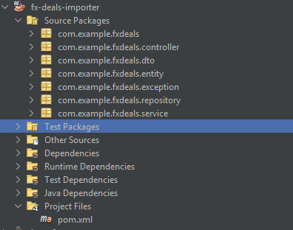

Spring Boot REST API
FX deals ingestion & validation
PostgreSQL database
Dockerized deployment
Layered architecture
DTOs separate API from database
Clean, maintainable design

Slide 3
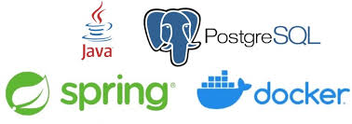


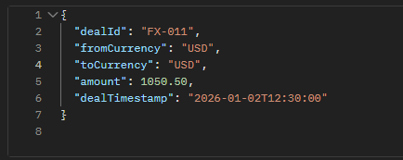
Java 21 + Spring Boot
NetBeans for integration
PostgreSQL database
Docker containerization
Postman for testing( POST, GET and Upload .csv fils).

Slide 4
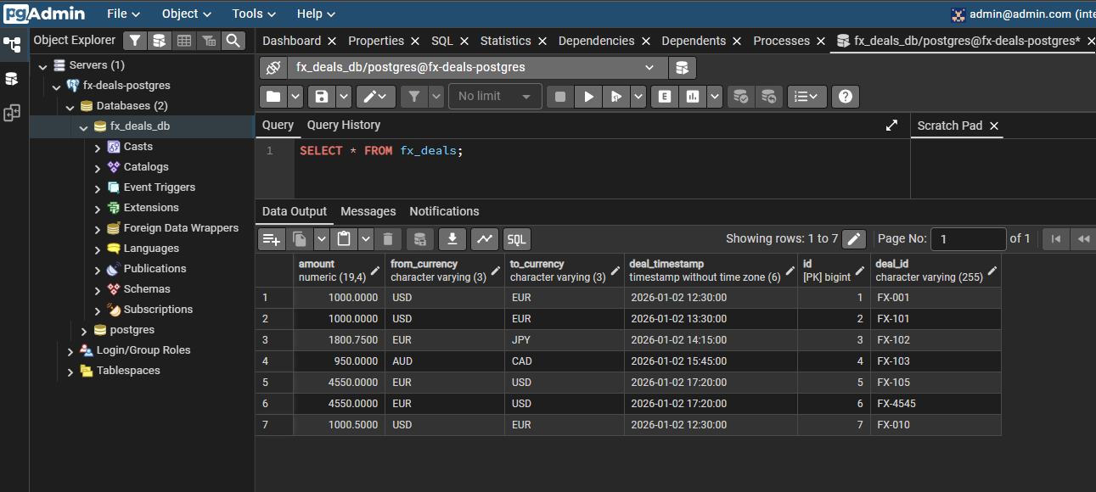

PostgreSQL table
Unique dealId
ISO currency codes
Financial precision using BigDecimal
Timestamped transactions
FxDeal entity

Slide 5
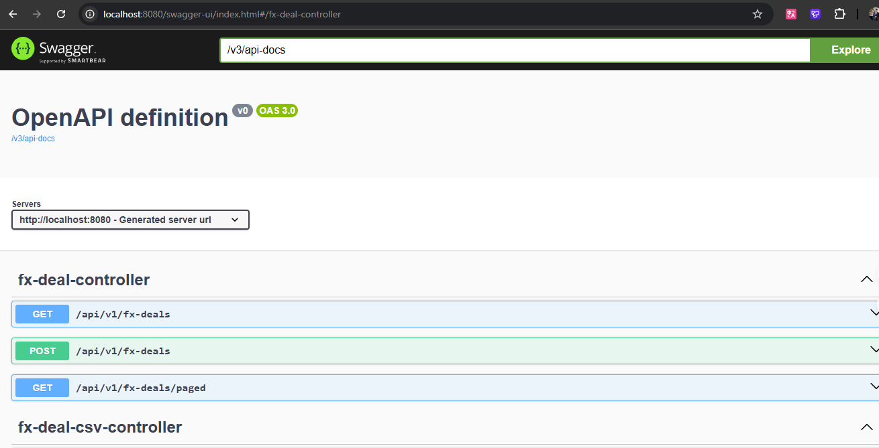
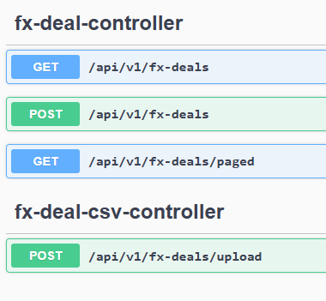
REST API Endpoints
POST /fx-deals
GET /fx-deals
Pagination support
CSV upload endpoint ( my additional feature)

Slide 6

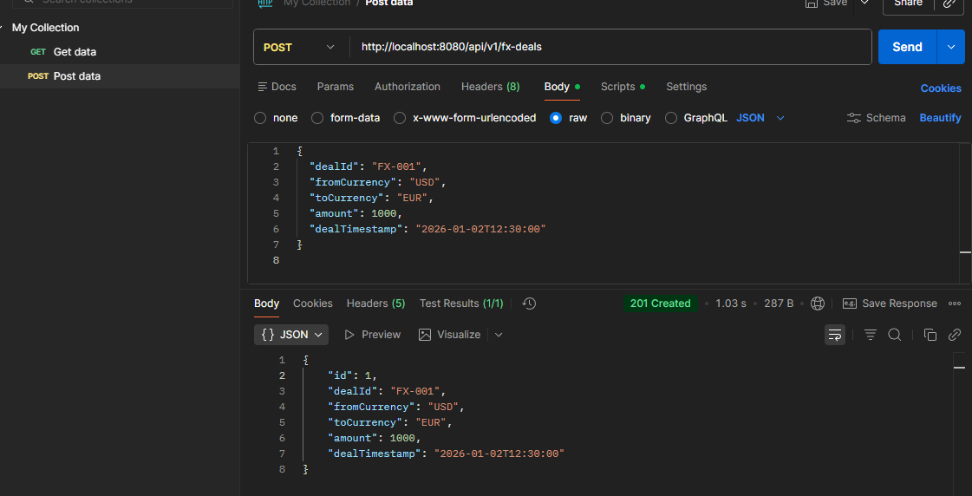
Create FX Deal (POST)
POSTMaN
Postman POST request (JSON body)
Success response (201 Created)
JSON-based input
Validation applied
Duplicate prevention

Slide 7
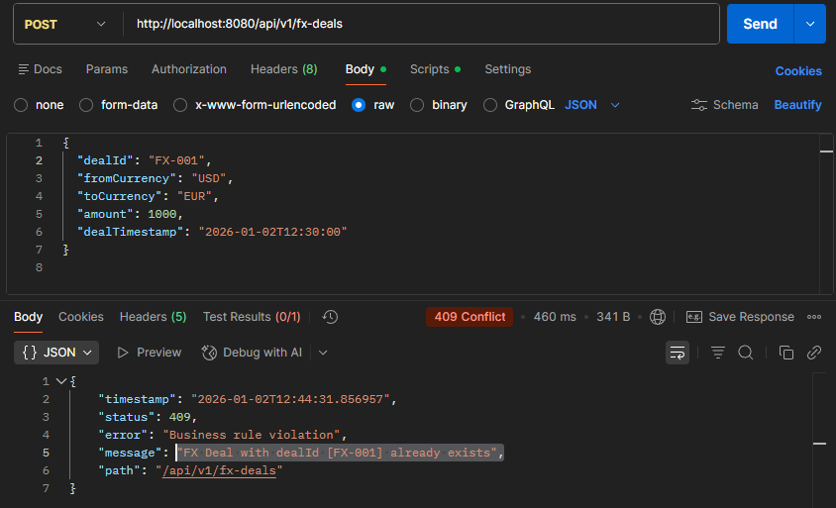
POSTMaN error response (409 Conflict)
Duplicate deal detection
Currency mismatch validation
Global exception handling
(➔Not added) Rejected
Because same the previous ID
Also, check when have the
same currency, to be reject.

Slide 8
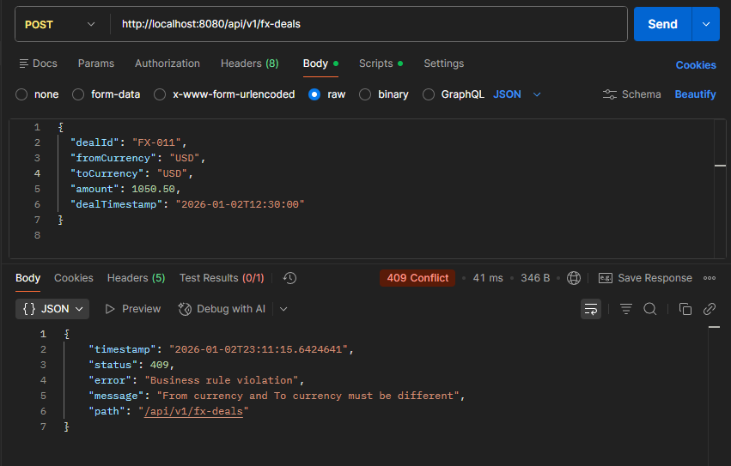
POSTMaN error response (409 Conflict)
Duplicate deal detection
Currency mismatch validation
Global exception handling
(➔Not added) Rejected
Invalid Currency Combination
fromCurrency equals toCurrency

Slide 9
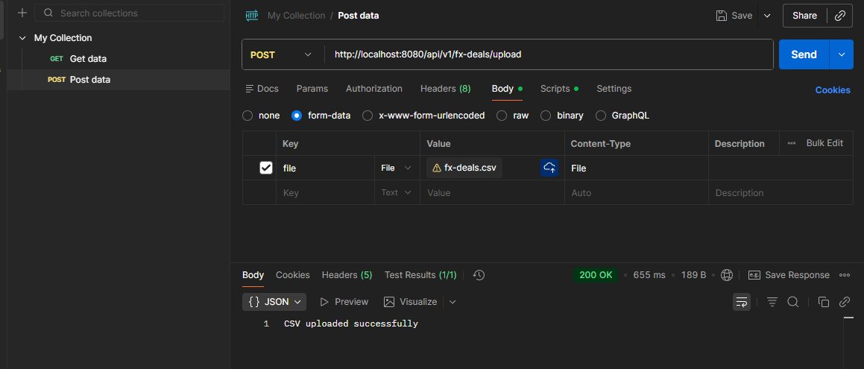
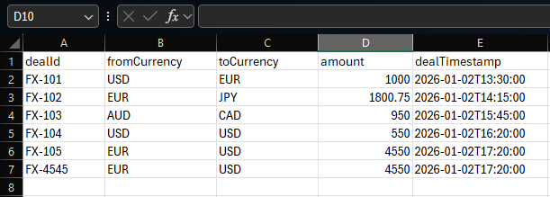
.CSV Upload Feature
Excel CSV file (above created .csv)
Postman upload request
“CSV uploaded successfully” response
Bulk FX deal ingestion
Skips duplicates
Supports real Excel-generated CSV
Expected CSV Columns: dealId ,fromCurrency,toCurrency,amount,dealTimestamp

Slide 10

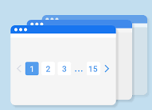
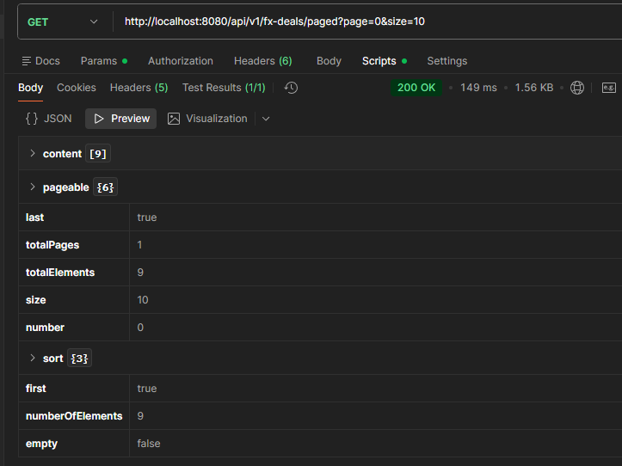
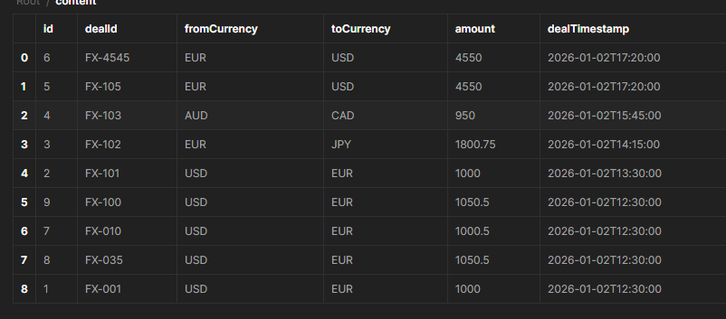
Pagination and Data Retrieval
To support scalability and large datasets, pagination was implemented using Spring Data JPA.
This endpoint allows:
Controlled data retrieval
Sorted results by deal timestamp
Reduced memory usage for large tables
GET http://localhost:8080/api/v1/fx-deals/paged?page=0&size=10

Slide 11
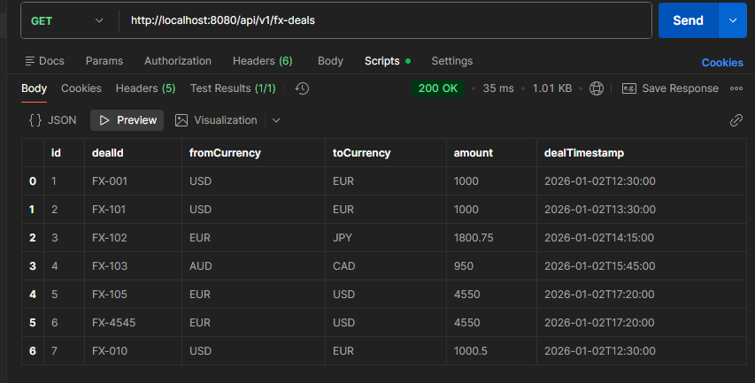
Verify Imported Data
GET /fx-deals response after .CSV upload
Data persisted successfully
Consistent API output
End-to-end validation

Slide 12
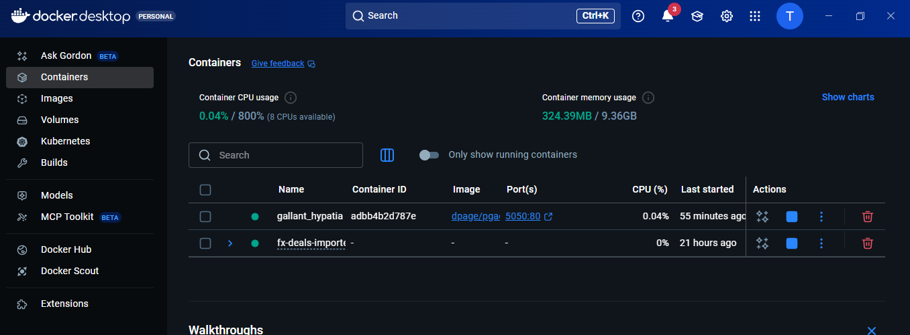
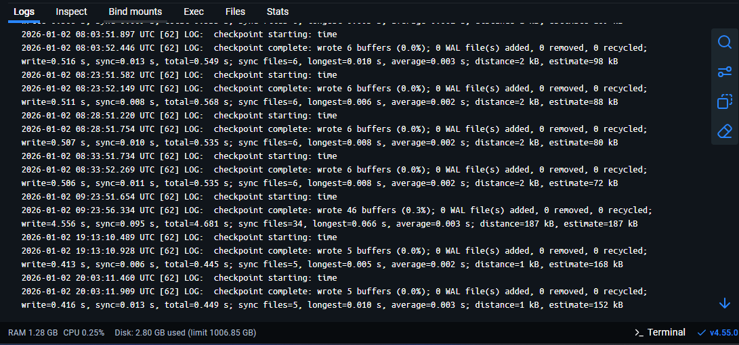
Docker Deployment
Docker Desktop showing running container
Terminal logs inside container
Application containerized
Easy deployment
Environment consistency

Slide 13
Challenges & Solutions
Challenge 1: Entity Exposure Risk
Initially, the database entity was used directly in API requests and responses.
Solution:
Introduced DTOs (FxDealRequestDTO, FxDealResponseDTO)
Ensured clean separation between API layer and persistence layer.
Challenge 2: CSV Parsing and Data Consistency
Importing bulk FX deals from CSV required careful column mapping and type conversion.
Solution:
Used Apache Commons CSV library
Implemented header-based parsing to ensure correct column mapping.

Slide 14
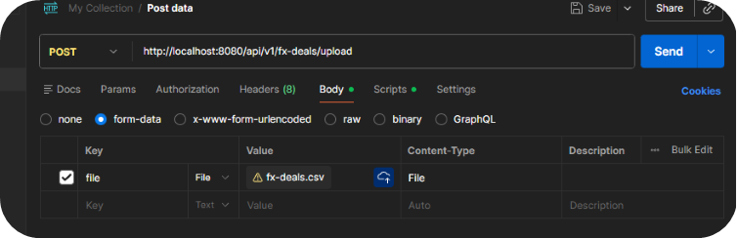

Challenge 3: Validation Placement
Applying strict validation during CSV import could block bulk data ingestion.
Solution:
Enforced validation rules for REST API requests
Allowed CSV import to prioritize throughput while avoiding duplicate deal IDs.

Slide 15
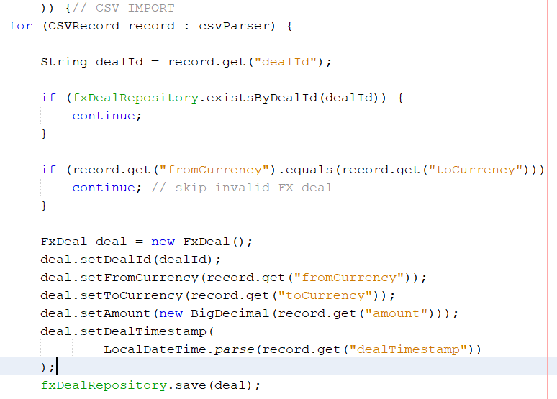
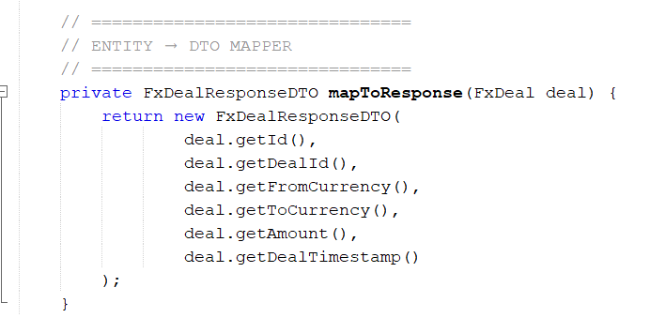
DTO vs Entity separation
CSV parsing issues resolved
Validation placement decisions
Code snippet screenshots (DTO mapping, CSV import)

Slide 16

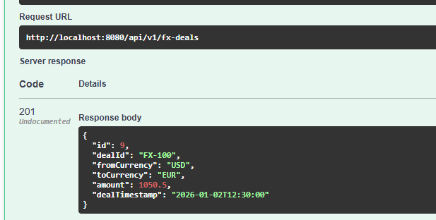
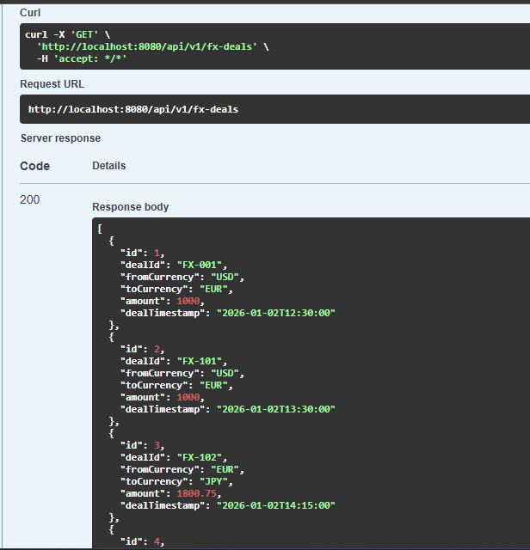
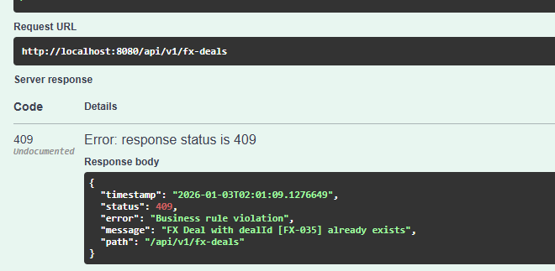
Final Results
Multiple successful API calls:
Fully working backend
Assignment requirements met
Production-ready architecture

Slide 17

Thank you
Eng. Tareq
Mobile: 0786415882
University of Jordan graduate 2026!
tareq19000009gmail.com
Alternative:
tareqshawabkehwork@gmail.com

