Slide 1
INFO5995 Assignment 1
AI- Assisted Cryptographic Vulnerability Discovery
Tutorial 28 Group 5
Tareq Alsubaie, Bharathwaj Murali, Peisen Zheng, Nishanth Shanmugasundaram, Shyam Karthick Venkatraman Balakrishnan
Notes:
Hello everyone. In this presentation, we analyse the provided Android APK, a1_case1.apk, to identify a vulnerability
related to security-sensitive randomness. Since an APK is a packaged Android application, we first decompiled it to
inspect its manifest, activities, and Java logic. Our goal was to understand how the app handles authentication, what
assets it protects, and whether any random-looking values are actually generated in an insecure way.
From static analysis and the app demo, we found that the application performs registration, login, and profile access
entirely on the device, with no backend service. The key issue we focus on is that the app generates a session token
using java.util.Random, which is not suitable for security-sensitive authentication data.

Slide 2
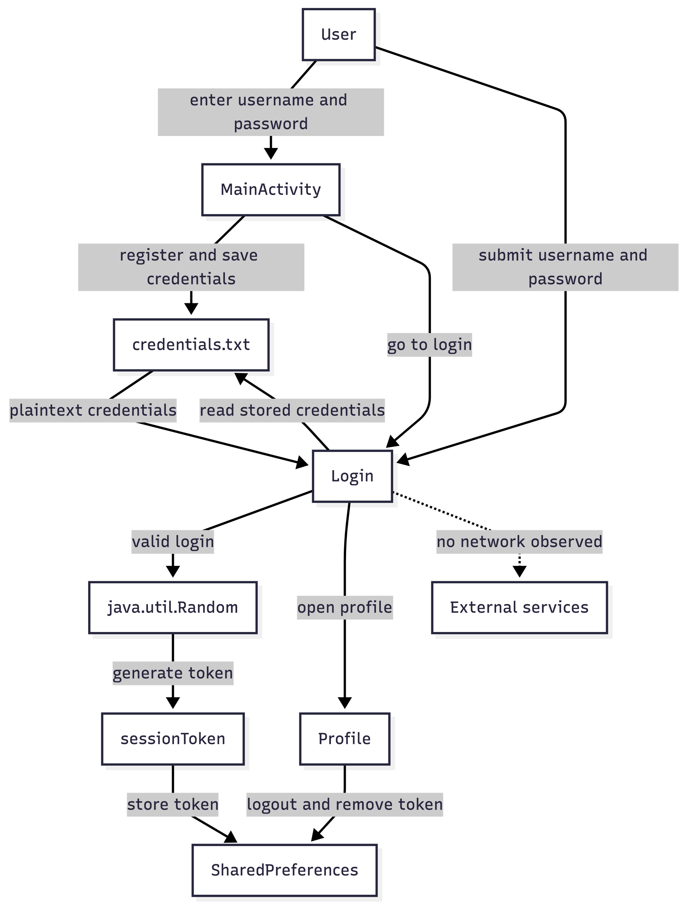
App Overview and System Model
- MainActivity: user registers with username and password
- Login: verifies stored credentials and generates a session token
- Profile: authenticated area; logout removes token
- Local file storage stores credentials
- SharedPreferences stores sessionToken
- Protected assets: credentials, session token, and authentication state
Notes:
Our system model has five main elements. First, MainActivity collects a username and password during registration.
Second, the Login activity reads stored credentials, checks the user’s input, and generates a session token after
successful login. Third, the Profile activity represents the authenticated area of the app. Fourth, local file storage
stores the saved credentials. Fifth, SharedPreferences stores the session token.
The important protected assets are the user credentials, the session token, and the integrity of the app’s local
authentication state. The main data flow is: the user enters credentials, the app stores and later reads them for
verification, then after login it creates a session token and stores that token locally. Because the entire trust
decision happens on-device, the token becomes a critical security asset.

Slide 3
Threat Model and Discovery Method
- Realistic attacker: rooted-device user, malware, or forensic examiner
- Capabilities: decompile APK, inspect code, observe login behavior
- Capabilities: read or modify local app storage
- Decompiled the APK and reviewed manifest and authentication classes
- Searched for random, token, and session-related values
- Located generateSessionToken() in the Login class
Notes:
Our attacker model is a realistic local attacker. This could be a user with a rooted device, a forensic examiner, or
malware with elevated local privileges. This attacker can decompile the APK, inspect the code, observe when login
happens, and read or modify locally stored application data.
To find the vulnerability, we decompiled the APK and reviewed the manifest and authentication-related classes. We then
searched for values treated as random, token, or session-related. This led us to the Login class, where we found a
method called generateSessionToken(). The method creates a 16-character token, but it uses java.util.Random. We used
this code-level evidence, along with the app demo and adb-related inspection workflow, to validate that the token is
part of the app’s authenticated session logic and is therefore security-sensitive.

Slide 4
Vulnerability and Attack Scenario
- Session token is generated in Login.generateSessionToken()
- The token is 16 characters long and uses java.util.Random
- Problem: java.util.Random is not cryptographically secure
- Session tokens represent authenticated state and must be unpredictable
- Attack: learn token logic, access local storage, predict or replace token
- Result: unauthorized authenticated access to the app
Notes:
The vulnerability is insecure session token generation using weak randomness. java.util.Random is a general-purpose
pseudo-random generator, but it is not designed for cryptographic security. A session token should be hard to predict,
because it represents authenticated state. If the token is predictable or reproducible, an attacker may be able to
impersonate a logged-in user or tamper with session state.
A realistic attack scenario is as follows. First, the attacker decompiles the APK and understands how the token is
generated and stored. Second, the attacker gains local access to the device environment or observes the app’s
authenticated state. Third, because the token comes from a non-cryptographic generator and is stored locally, the
attacker may predict, recreate, or replace the token. Finally, the attacker uses that manipulated or predicted token
to bypass the intended login protection and access the profile area as an authenticated user.

Slide 5
Fix and Key Takeaway
- Replace java.util.Random with SecureRandom
- Use a cryptographically strong generator for session tokens
- This reduces token predictability and forgery risk
- The token may look random, but the API must match the security role
- Key lesson: validate both what a value protects and how it is generated
Notes:
The concrete fix is to replace java.util.Random with SecureRandom when generating session tokens. SecureRandom is
designed for cryptographic use and produces values that are much harder to predict. This directly addresses the core
weakness because the session token is an authentication-related security value, not just a UI identifier.
In addition, the app should avoid relying only on client-side local trust for session management, because storing
authentication state locally increases attack exposure. For this assignment, however, the main technical mitigation is
replacing the weak randomness source with a cryptographically strong one and ensuring the token remains unpredictable.
Our key lesson is that not every random-looking value is safe. In security analysis, we must check both the generator
and the role of the value. Here, the token looks random, but because it uses the wrong API for a security-sensitive
purpose, it creates a real authentication risk.

