Slide 1

SemWeb Project: Food Delivery Discovery Service
Course Teacher:
Antoine Zimmermann
Victor Charpenay
Presented by : Group 1
Tareq Md Rabiul Hossain CHY
Nushrat JAHAN

Slide 2
Context
Development of a Semantic Web-based food delivery service.
Integration with CoopCycle and use of Apache Jena Fuseki for RDF data storage.
Utilizes RDF, SPARQL, SHACL, and Python in a command-line application.
Objectives
Offer personalized food ordering options based on location, time, and price.
Scripts for data collection/validation and user preference settings.

Slide 3


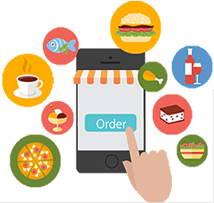
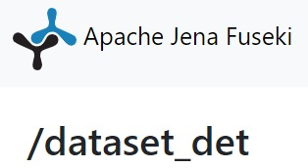


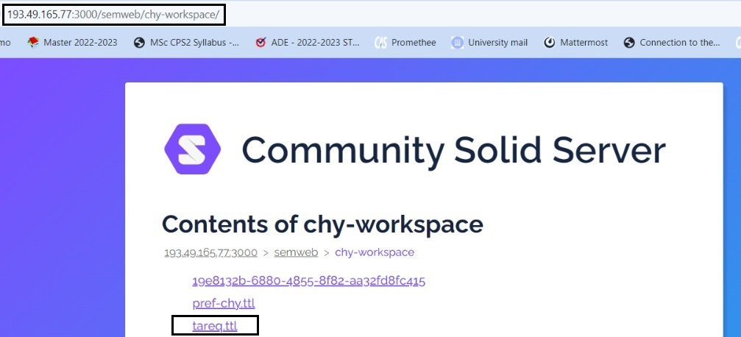

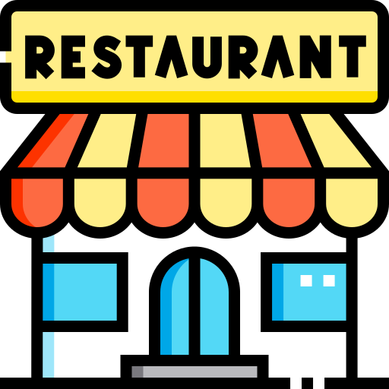
Use Case Scenario
Preference
Price range
Preference
Opening &
Closing time
Customer
Preference
Food Delivery Discovery Service
Location
Restaurant Data

Slide 4
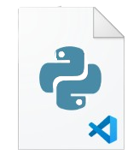
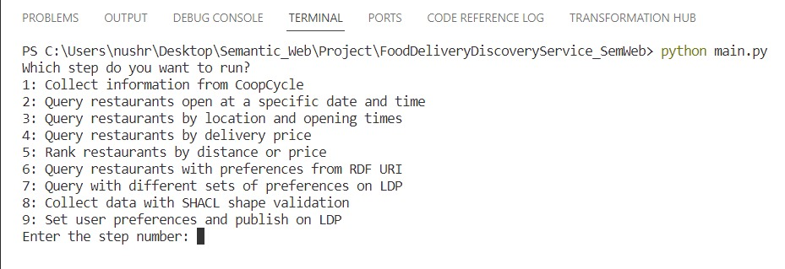
File Structure
collect.py
query1.py
query2.py
query3.py
main.py
query4.py
query5.py
query6.py
collecShapeValidation.py
describe.py

Slide 5
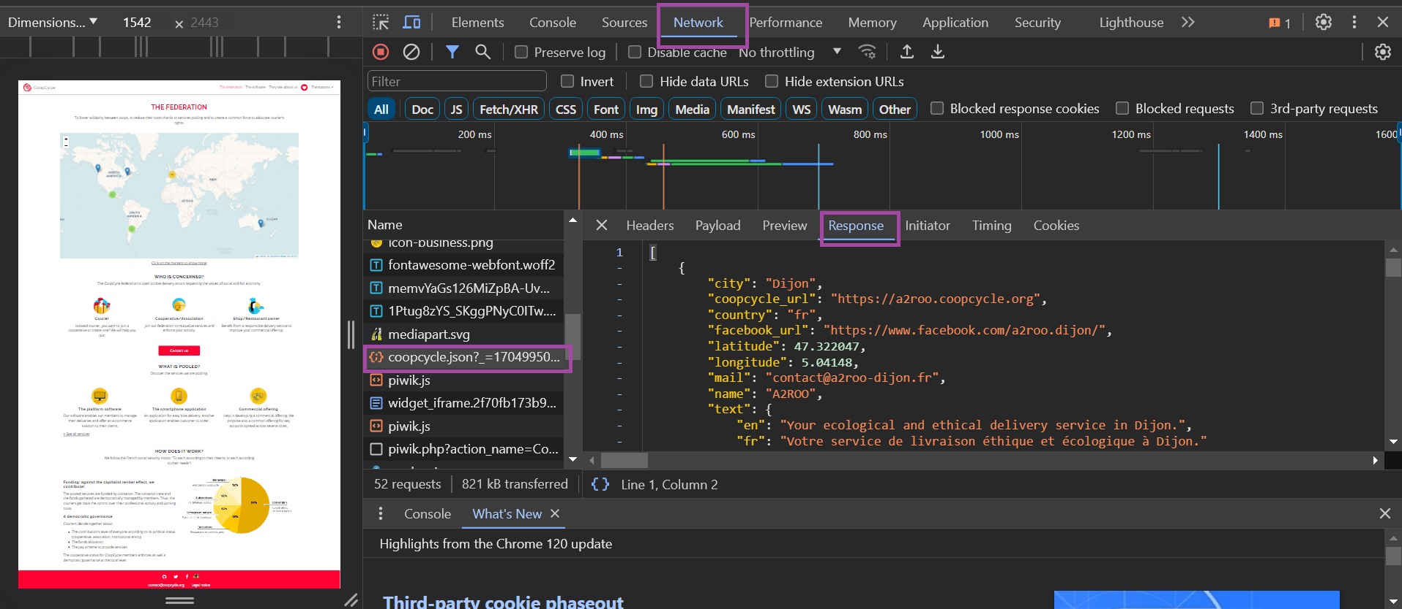
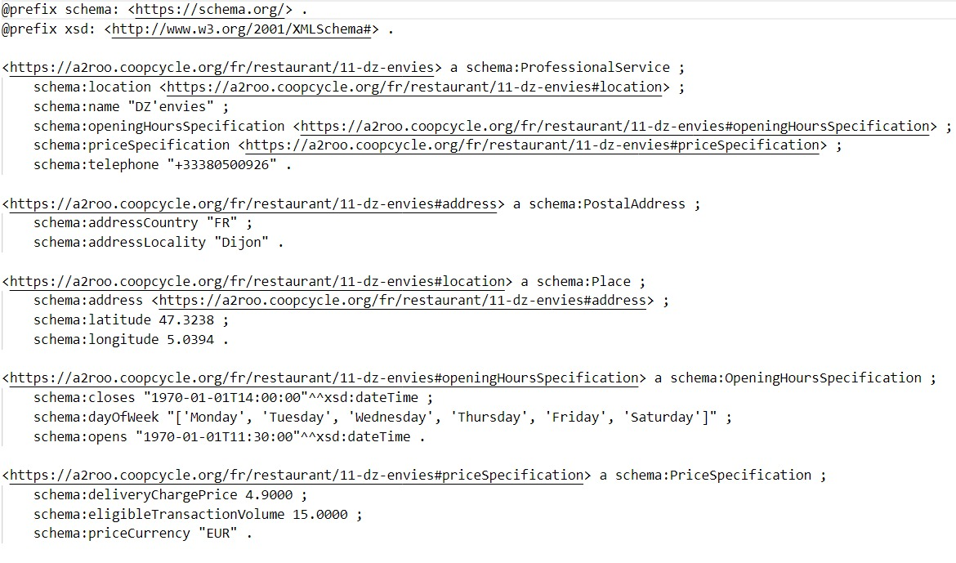
collect.py
Collect coopcycle.json from CoopCycle .
Take coopcycle urls from the collected json file (coopcycle.json).
Collect data.
Data check before uploading to the triplestore (e.g. Fuseki).
Data upload in the triplestore (e.g. Fuseki).
https://coopcycle.org/en/federation/

Slide 6
Query(query1.py, query2.py, query3.py, query4.py, query5.py, query6.py)
Use SPARQL query to collect data from Fuseki triplestore.
query1.py: Find restaurants open at specific dates/times. Command-line interface only.
query2.py: Add location-based search functionality to query1.py
query3.py: Add price-based(accepting delivery below a certain price) search into query2.py
query4.py: Enable ranking of restaurants by distance or price into query3.py
query5.py: Modify query4.py to fetch and Integrate user preferences from RDF URIs.
query6.py: Modify query5.py to Test with different sets of user preferences from the Linked Data Platform Server Community Solid Server Workspace .

Slide 7
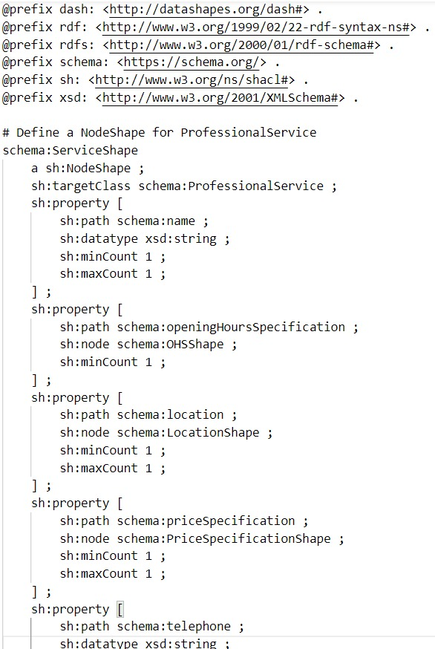
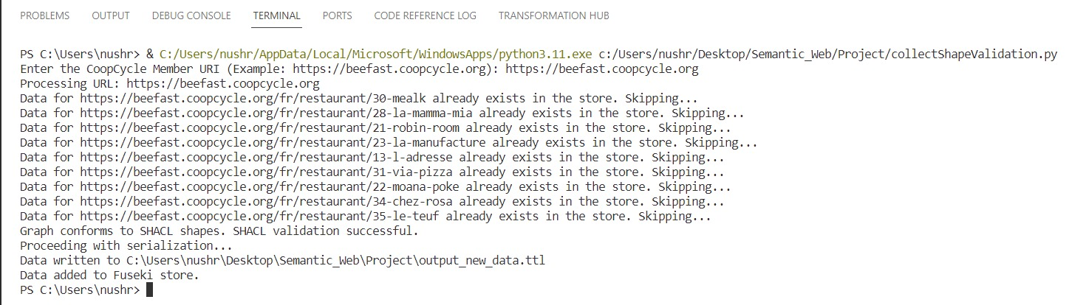
collectShapeValidation.py
Use SPARQL query to collect data from Fuseki triplestore.
Modify collect.py to validate RDF data using SHACL shape.ttl before storage and to collect data from any CoopCycle member.
shape.ttl

Slide 8
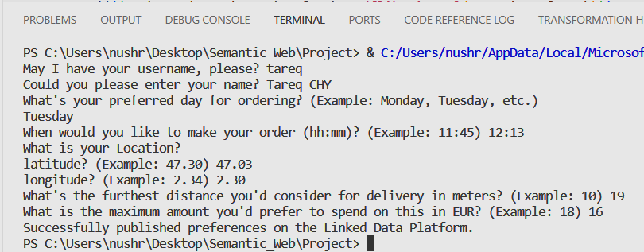
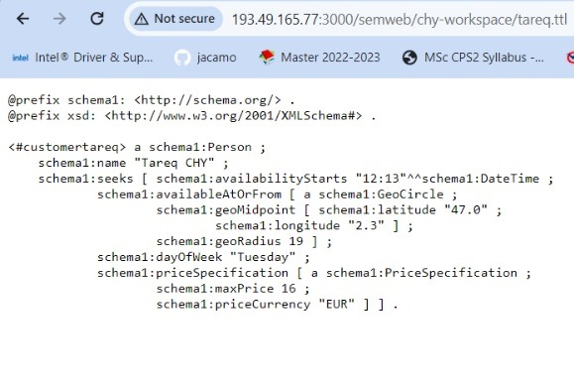
describe.py
Preference Setting Program
Assist users in setting preferences via Q&A. Publishes preferences as RDF on the Linked Data Platform.
tareq.ttl

Slide 9
What we learn from the project?
Integration of Semantic Web Technologies
Data Handling and Querying
Data Integration and Validation
User Preference Handling
Practical Application of Theoretical Knowledge
Notes:
Based on the provided information about the Semantic Web project, here's a concise summary of what you can learn from this project:
1. **Integration of Semantic Web Technologies:** You'll learn how to apply various Semantic Web technologies in a practical scenario. This includes designing and implementing a food delivery discovery service using standard vocabularies and Linked Data principles.
2. **Data Handling and Querying:** The project will teach you to handle different forms of data, including RDF (Resource Description Framework) and JSON-LD. You will gain experience in SPARQL querying to retrieve relevant information from a triplestore, a type of database used for storing and querying RDF data.
3. **Semantic Web Programming:** Developing this application requires software development skills, particularly in Semantic Web programming frameworks. This includes data serialization and deserialization in RDF, using SPARQL for data querying, and SHACL for data validation.
4. **Data Integration and Validation:** You will learn to integrate and validate heterogeneous data sources, ensuring that the application dynamically discovers new businesses and includes them in query results.
5. **User Preference Handling:** The project involves creating mechanisms to store and retrieve user preferences related to location, time, price range, and food type, enhancing your understanding of user-centric application design.
6. **Command-line Interface Development:** Developing a command-line interface for the application will improve your skills in creating user-friendly, efficient, and effective command-line tools.
7. **Practical Application of Theoretical Knowledge:** By working on this project, you will apply theoretical concepts learned in your course to a real-world application, solidifying your understanding and skills in the Semantic Web domain.
This project provides a comprehensive learning experience in Semantic Web technologies, data handling, application development, and user-centric design, essential for students in the field of computer science and web technologies.

Slide 10


