Slide 1
IntelliJobs
(An online job portal)
PRESENTATION ON

Slide 2


IUBAT- International University of Business Agriculture and Technology
Topic: IntelliJobs (An Online Job Portal)
Prepared for: Practicum Committee, Department of Computer Science & Engineering
Supervisor:
Ehsan Ahmed Niloy
Lecturer,
Dept. of Computer Science & Engineering,
IUBAT
Prepared by:
Md. Imam Hossain
ID: 18103077
Program: BCSE

Slide 3

Contents
Organizational Overview
Project Overview
Introduction
Objective
Incremental Process Model
Feasibility Study
User Requirement

Slide 4
Contents
System Requirement
Functional Requirement
Non-functional Requirement
Use Case Diagram
Project Estimation
Project Scheduling Chart
Cost Estimation

Slide 5
Contents
Risk Management
Entity Relationship Diagram
Activity Diagram
Data Flow Diagram
Project Demonstration
Drawbacks
Future Works
Conclusion

Slide 6
ORGANIZATIONAL OVERVIEW

Slide 7

Web Design and Development Company
Established in 2019
Social Media Marketing
Billing Software

Slide 8
PROJECT OVERVIEW

Slide 9

Introduction
Web based system
Beneficial to search job
User Friendly Interface
PHP(Laravel), HTML, CSS, Bootstrap &
JavaScript
troduction

Slide 10

Objectives
To Make an User Friendly System
To Make the System Hazards Free
To Make the System Time Saving

Slide 11
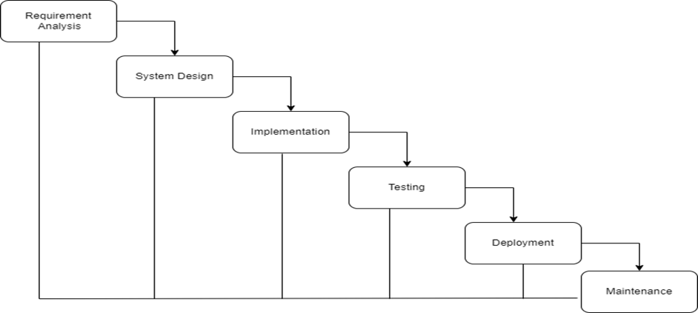
Process Model
Figure: Waterfall Process Model

Slide 12

Process Model
Requirements are fixed and clear that may not change
There are no ambiguous requirements
It is good to use this model when the technology is well understood
The project is short and cast is low
Risk is zero or minimum

Slide 13
Process Feasibility Study
Technical Feasibility
Operationally Feasibility
Economical Feasibility

Slide 14
REQUIREMENT ENGINEERING

Slide 15
User Requirements
Admin can:
See candidate list
See employer list
See posted jobs
See posted exams
Manage categories

Slide 16
User Requirements
Employer can manage:
Profile
Company details
Jobs
Exams
Applied candidates

Slide 17
User Requirements
Applicant can:
Manage profile
View job posts
Apply jobs
Participate exams

Slide 18
System Requirements
Admin:
Admin can login At First.
Admin can see:
Registered candidate list
Registered company list
Posted job list
Posted exams

Slide 19
System Requirements
Applicant-
Applicant must log in first
Has to be a registered user
Can see their profile
Search job
Update profile
Apply jobs

Slide 20
System Requirements
Employer-
must be a registered user
must log in at first
can post job & see company profile
update their profile
accept or reject a candidate
view job applicants
view applicants’ details

Slide 21
Functional Requirements
Online job search tool.
Jobs to be displayed on homepage.
View submitted candidates CV, Download CV submitted by candidate.
Apply for a job with the click of a button.
Login and update profile.

Slide 22
Non-Functional Requirements
Authentication.
User activity Tracing.
Better component design to get better performance.
Secured profile for all user and can’t access other,s credentials without authorization.

Slide 23
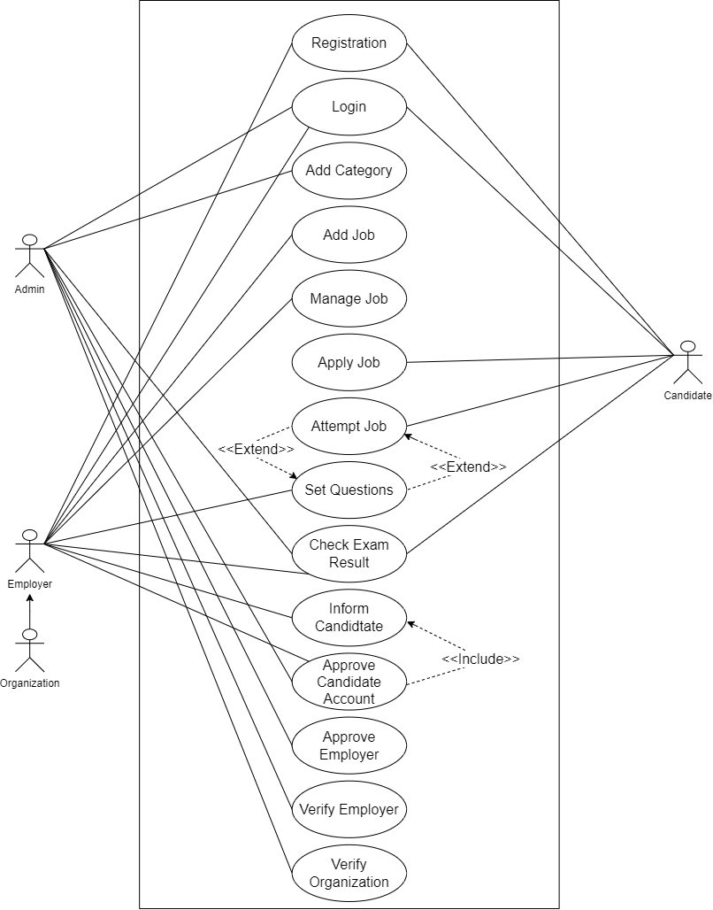
Use Case Diagram

Slide 24
PROJECT ESTIMATION

Slide 25
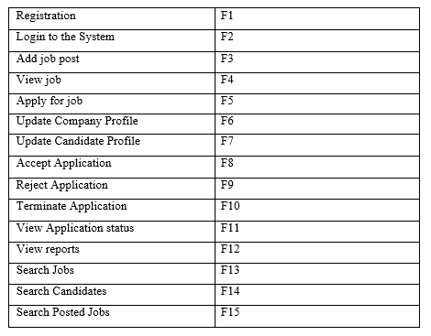
Functions of Proposed System

Slide 26
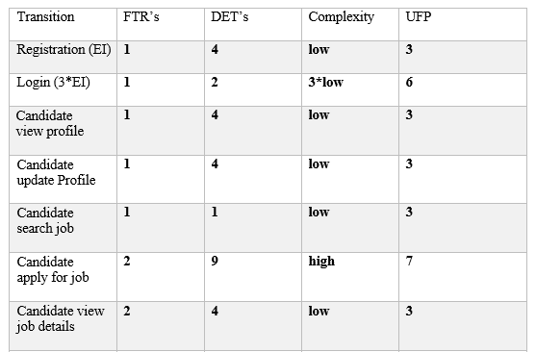
Unadjusted function point contribution of transition function

Slide 27
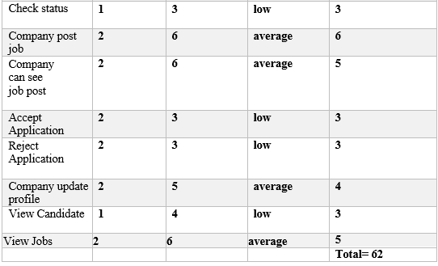
Unadjusted function point contribution of transition function

Slide 28
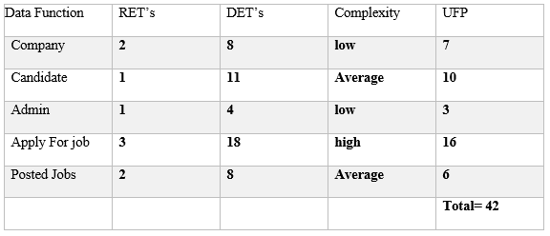
Unadjusted function point contribution of data function

Slide 29
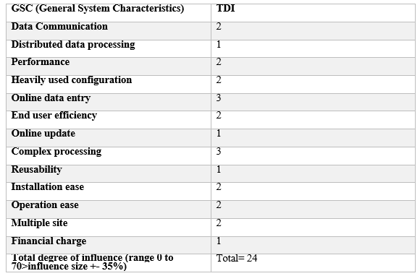
Performance and environmental impact

Slide 30
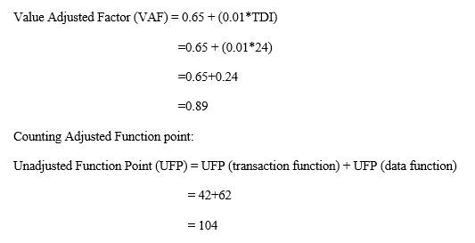
Counting Adjusted Function point

Slide 31
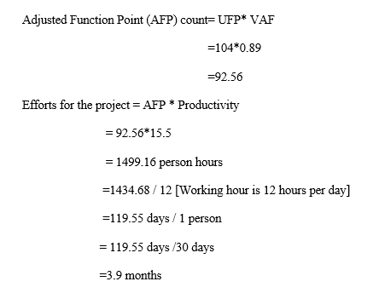
Counting Adjusted Function point

Slide 32
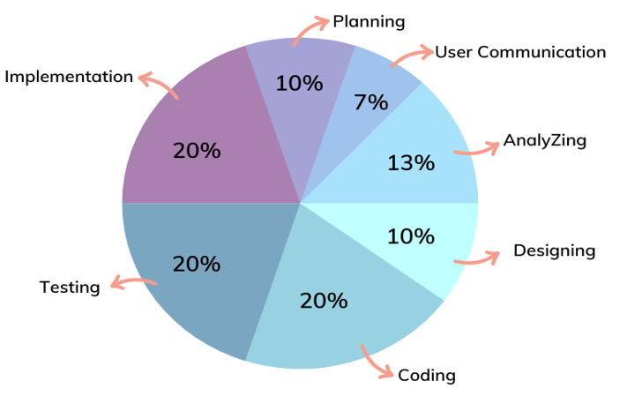
Effort Distribution

Slide 33
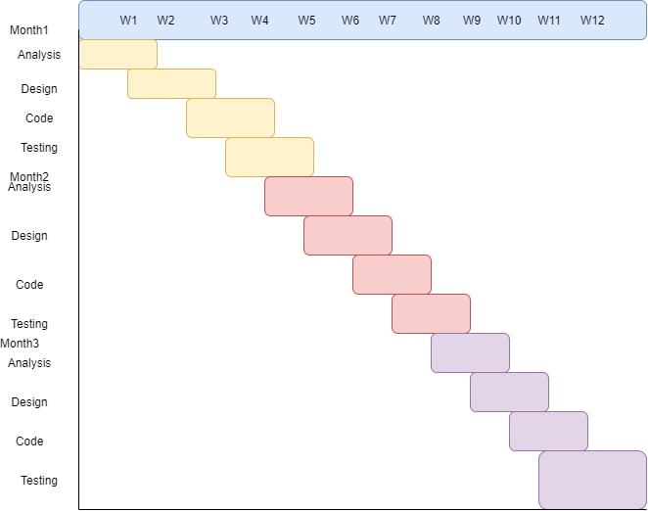
Project Scheduling Chart

Slide 34
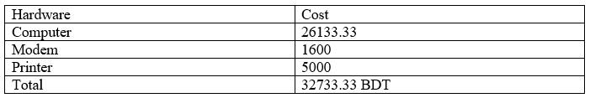
Cost Estimation
Hardware Cost

Slide 35
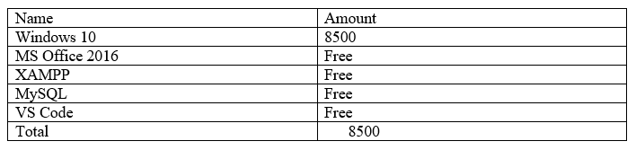
Cost Estimation
Software Cost

Slide 36
RISK MANAGEMENT

Slide 37
Risk Analysis
Categories of risks-
Project risks
Technical risks
Business risks

Slide 38
PROJECT RISK-1
Name | Changes in requirements
Probability | Low
Impact | Marginal
Description | Customer may change their requirements
Mitigation and Monitoring | Requirements are redefined by the company due to time or business needs. Meeting will be held with the company regularly. This ensures that the product we are producing solves a problem.
Management | Emergency meeting between both parties to identify new project requirements and goals.
Status | Occurred

Slide 39
PROJECT RISK-2
Name | Poor Quality of documentation
Probability | Low
Impact | Catastrophic
Description | Documentation quality may be poor
Mitigation and Monitoring | Routine Meeting will be held to offer documentation suggestions and topics. The progress on documentation will also have a monitor in each meeting.
Management | Meeting will call and discuss about quality improvement of documentation. New things will be assigned to responsible person.
Status | Observing it

Slide 40
TECHNICAL RISK-1
Name | Computer crash
Probability | High
Impact | Catastrophic
Description | Computer may crash due to several reason
Mitigation and Monitoring | We should take proper follow up of computers. Need to use them carefully.
Management | If computer has been crashed then we will restore backup.
Status | Managed it.

Slide 41
ANALYSIS & DESIGN

Slide 42
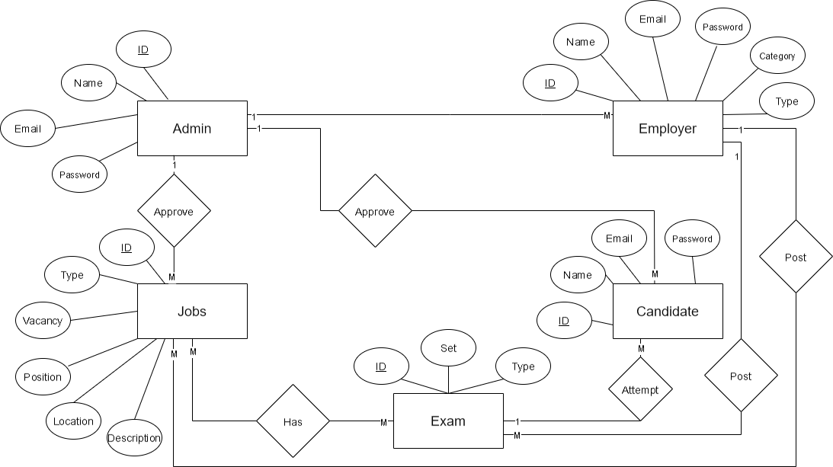
ER DIAGRAM

Slide 43
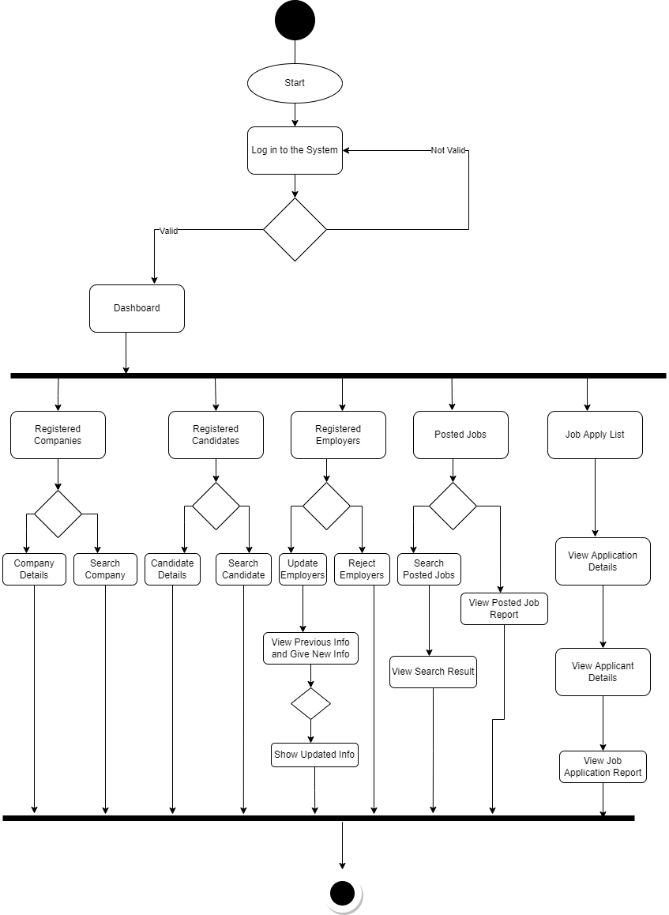
ACTIVITY DIAGRAM FOR ADMIN

Slide 44
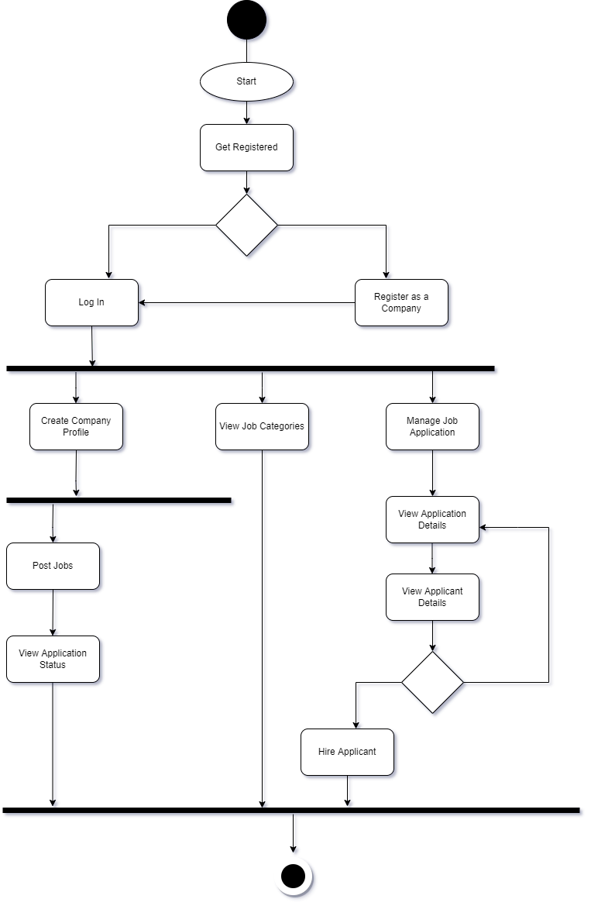
ACTIVITY DIAGRAM FOR EMPLOYER

Slide 45
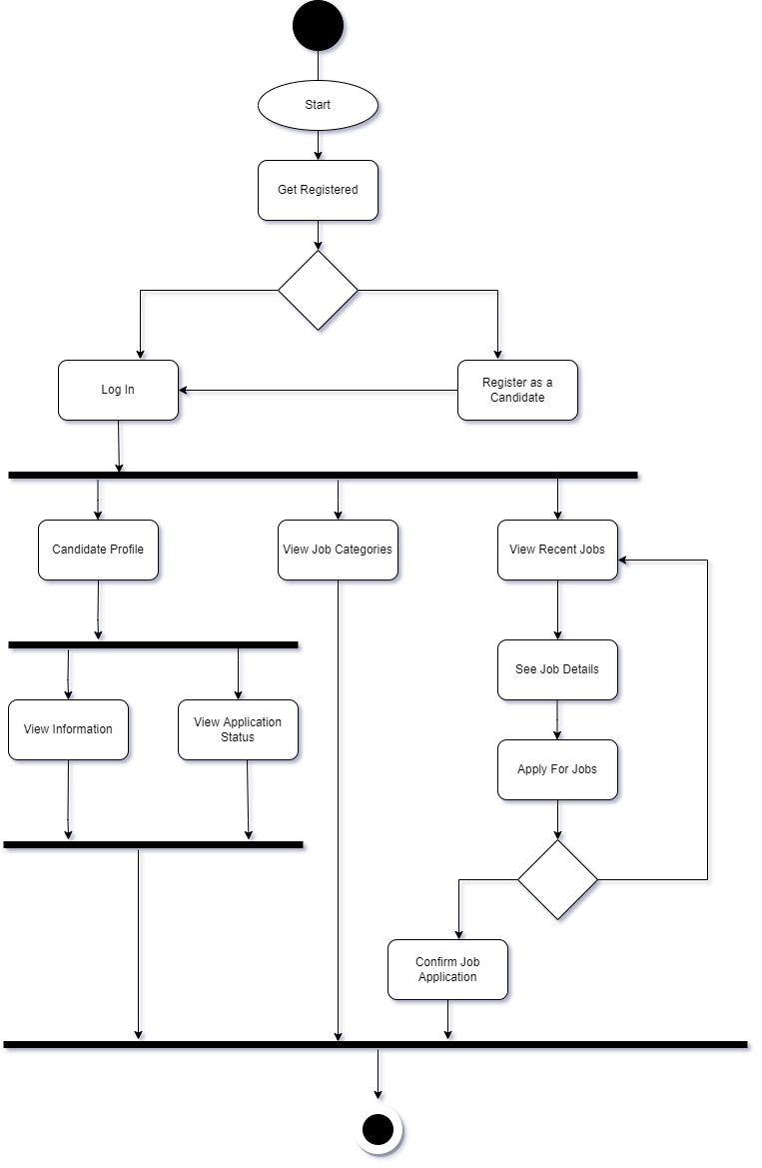
ACTIVITY DIAGRAM FOR APPLICANT

Slide 46
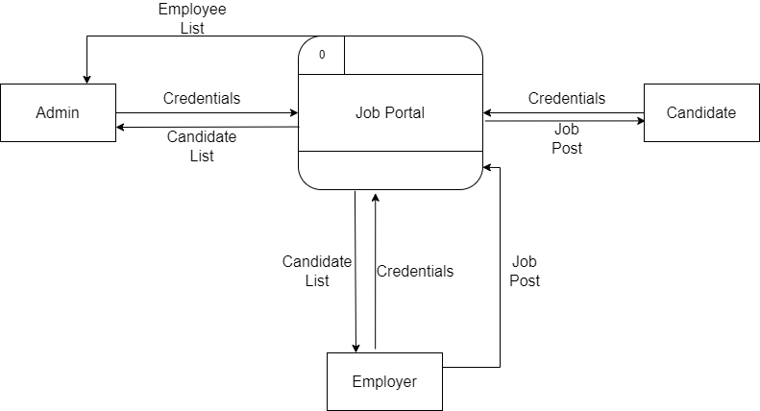
CONTEXT LEVEL DFD

Slide 47
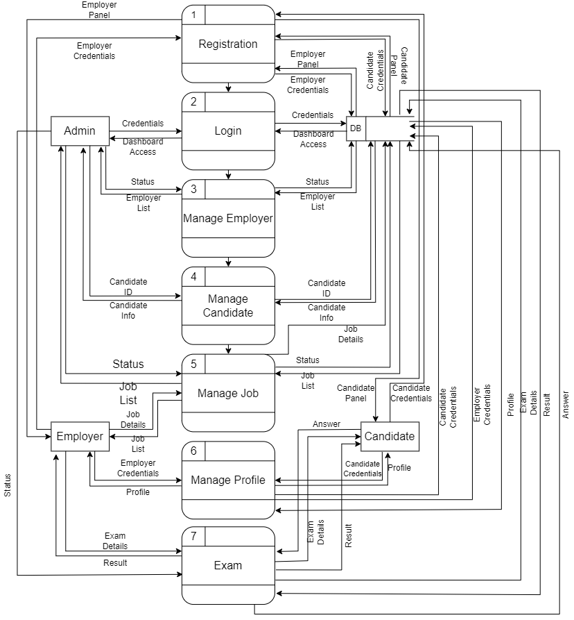
LEVEL 1 DFD

Slide 48
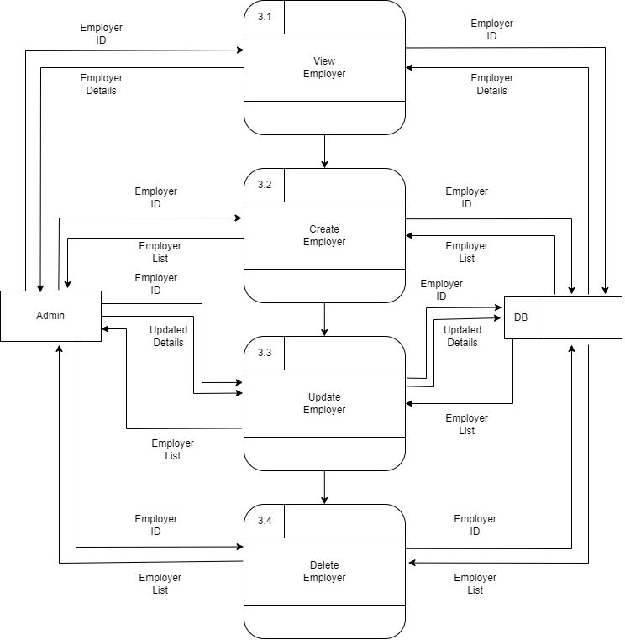
LEVEL 2 PROCESS 1 DFD

Slide 49

LEVEL 2 PROCESS 2 DFD

Slide 50
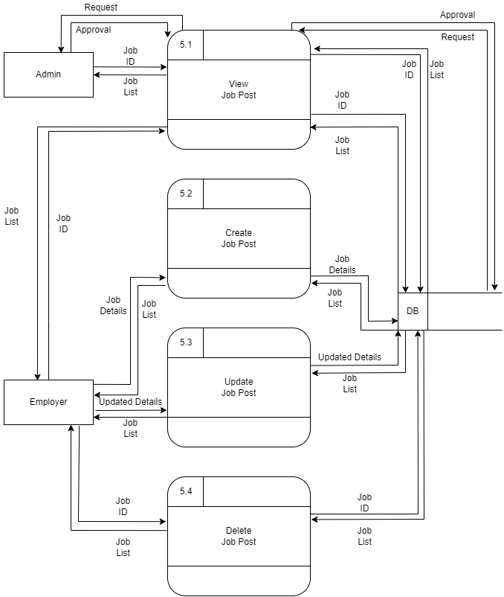
LEVEL 2 PROCESS 3 DFD

Slide 51
Project Demonstration

Slide 52

Drawbacks
No Email Verification
No Forgot Password Option

Slide 53

Future Plan
Email Verification
Forgot Password
Notification
Toaster message for different activities
More optimized UI/UX

Slide 54

Conclusion
Interactive web application
User friendly
Low of cost

Slide 55


Slide 56


