Slide 1





走近 克劳德·香农
王翎羽 华中科技大学
2024.4.14

Slide 2
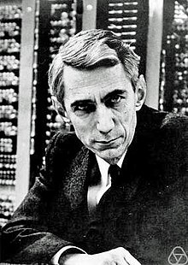
走近克劳德·香农
Introduction
Claude Elwood Shannon (April 30, 1916 – February 24, 2001), an American mathematician, electrical engineer, computer scientist, and cryptographer, is known as the "father of information theory.“
In 1948, he authored "A Mathematical Theory of Communication," setting the stage for modern information theory, digital computing, and circuit design. Shannon also constructed the first machine learning device, pioneering the field of artificial intelligence.

Slide 3
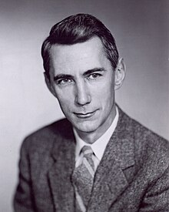
走近克劳德·香农
His Quotes On Research and Problem-solving
Suppose that you are given a problem to solve, I don’t care what kind of a problem — a machine to design, or a physical theory to develop, or a mathematical theorem to prove, or something of that kind — probably a very powerful approach to this is to attempt to eliminate everything from the problem except the essentials; that is, cut it down to size.
-Claude Shannon

Slide 4
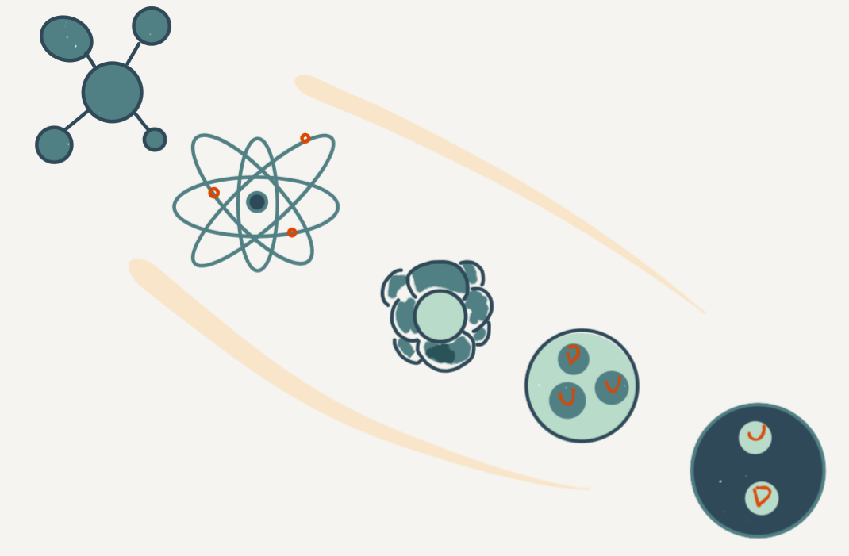
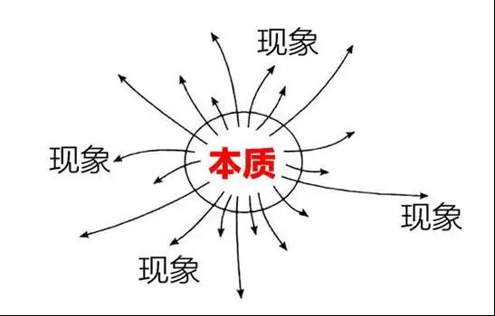
走近克劳德·香农
My Understanding
Focus solely on the core aspects of the problem.

Slide 5
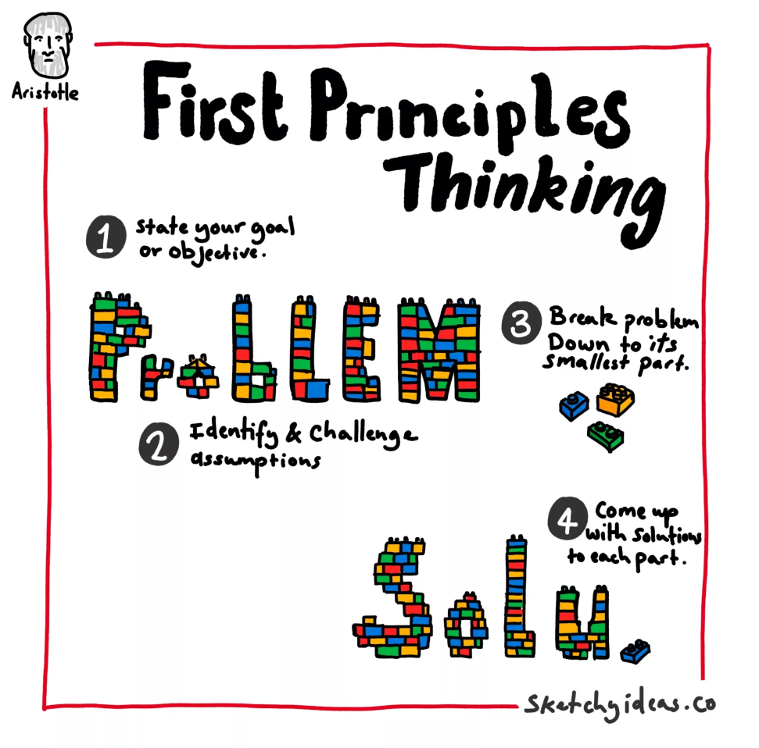

走近克劳德·香农
My Understanding
Strip a problem down to its fundamental components.

Slide 6
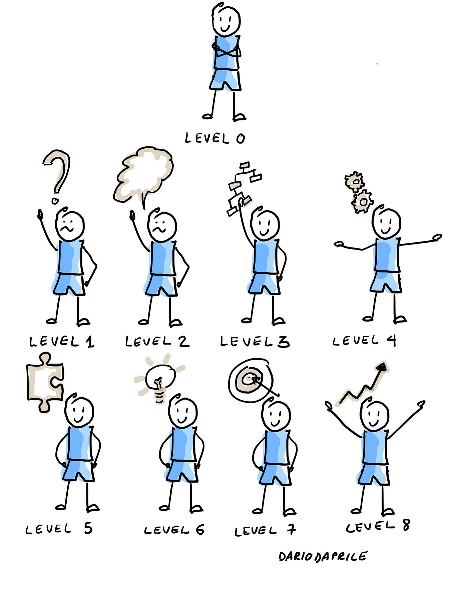

走近克劳德·香农
My Understanding
Start simple.

Slide 7
谢谢大家
王翎羽 华中科技大学
2024.4.14

