Slide 1
Generative AI for Semantic Communication:
Architecture, Challenges, and Outlook
Le Xia, Yao Sun, Chengsi Liang, Lei Zhang, Muhammad Ali Imran, Dusit Niyato.
University of Glasgow

Slide 2
CONTENT
01
02
03
04
Introduction
System Design
Evaluation
Conclusion
Notes:
分享将以下4个部分进行

Slide 3
Introduction
Background
Current SemCom lacks context reasoning and background knowledge, needing integration with generative AI (GAI).
Chanllenge
SemCom requires vast data for background knowledge and model pre-training.
Existing systems lack semantic accuracy when handling complex contexts.
Large GAI models need significant computing and storage resources.
Solution
Propose a GAI-assisted semantic communication network (GAI-SCN) that collaborates across cloud, edge, and mobile layers using global and local GAI models to provide multimodal content and joint source-channel coding.

Slide 4
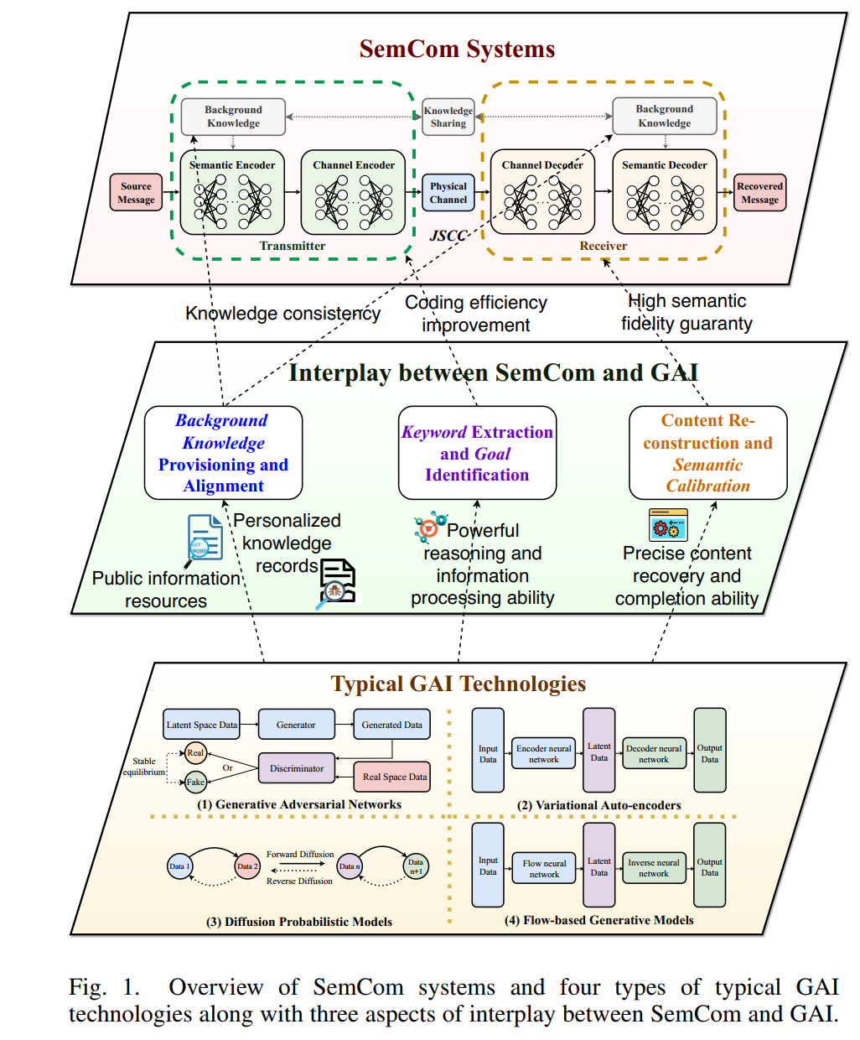
Introduction
When SemCom Meets GAI
Current semantic communication (SemCom) systems lack context reasoning and background knowledge.
Generative AI (GAI) shows potential in creating valuable, diverse, and personalized content.
Integrating GAI with SemCom can improve training efficiency, context reasoning, and spectrum utilization.
A new GAI-assisted SemCom network (GAI-SCN) framework aims to enhance semantic reasoning and resource efficiency.

Slide 5
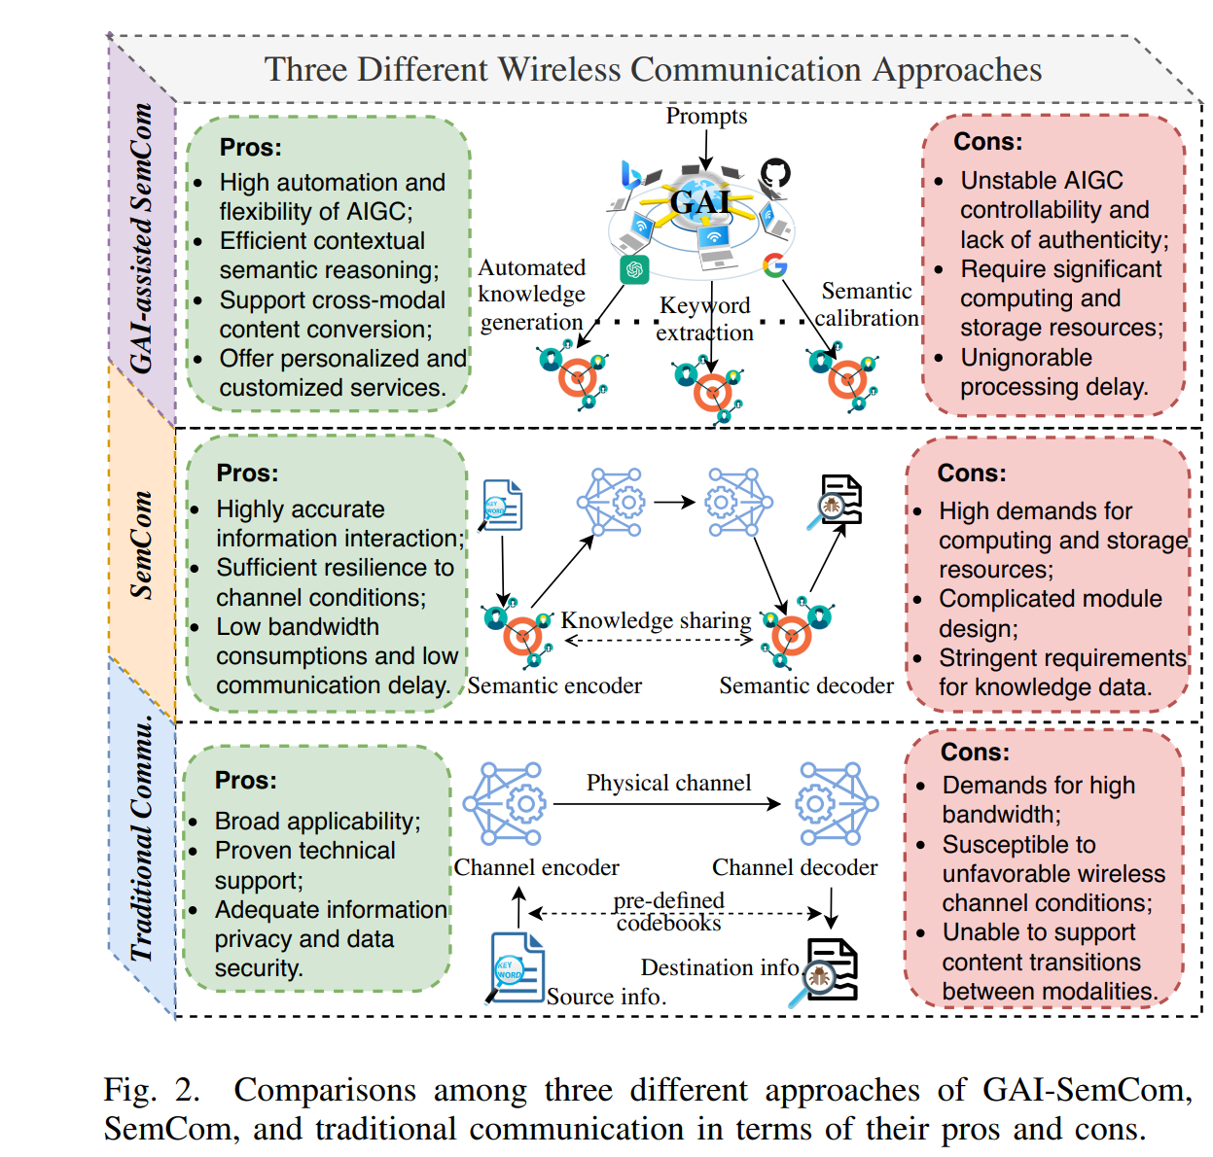
System Design
Interplay between SemCom and GAI
Background Knowledge:
Provides global and personalized data for consistency and customization.
Keyword Extraction:
Extracts keywords and identifies goals, reducing data transmission.
Content Reconstruction:
Reconstructs content and corrects errors, improving accuracy and reliability.

Slide 6
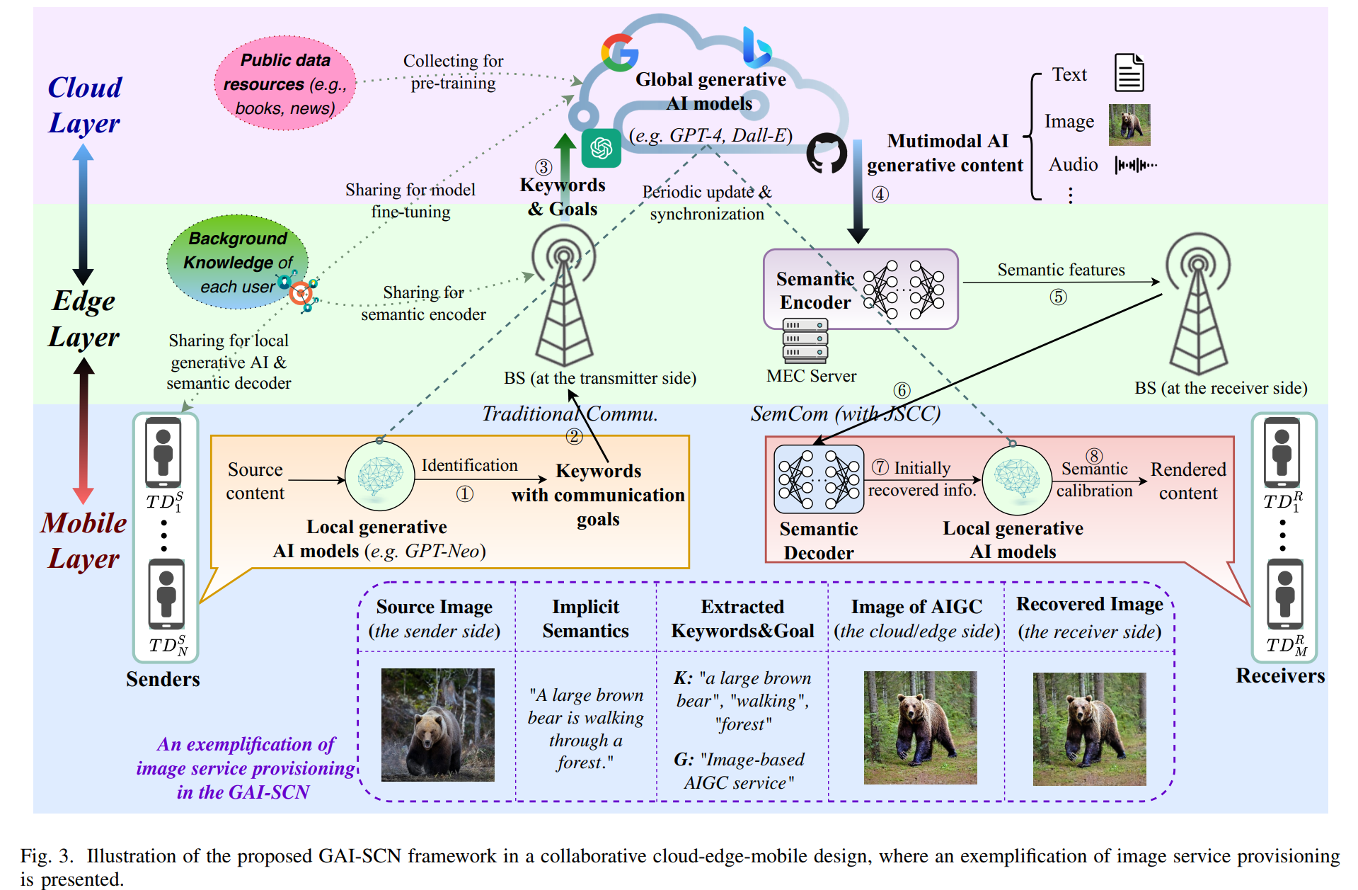
System Design

Slide 7
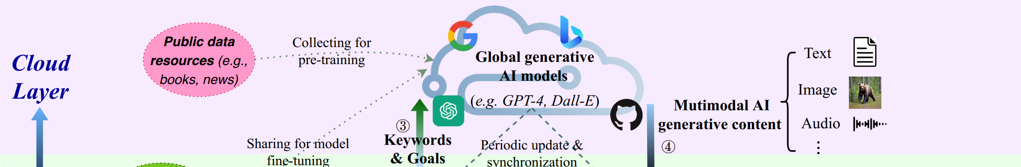
System Design
Mobile (Local) Layer:
Role: Handle local processing and personalization.
Components: Lightweight GAI models (e.g., GPT-Neo).
Functions:
Extract keywords and identify communication goals from user data.
Perform initial semantic decoding and calibration.
Fine-tune user preferences and provide personalized content.

Slide 8
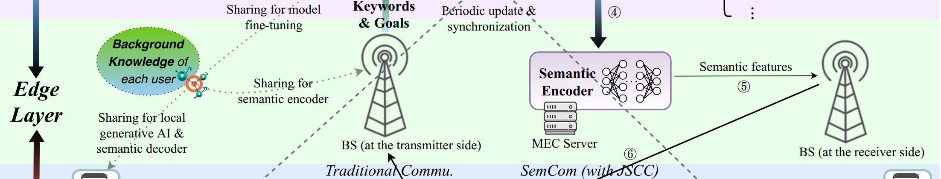
System Design
Edge Layer
Role: Intermediate processing to enhance resilience and efficiency.
Components: Semantic encoders and edge servers.
Functions:
Pre-process and encode AI-generated content (AIGC) using joint source-channel coding (JSCC).
Offload computational tasks from the cloud to reduce latency.
Ensure robustness and resilience of SemCom against channel impairments.

Slide 9
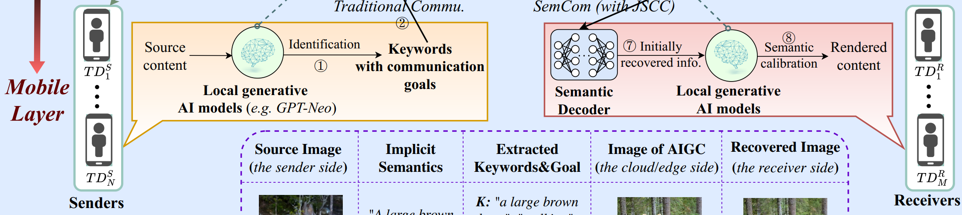
System Design
Cloud Layer
Role: Handle heavy computational tasks and global model management.
Components: Large GAI models (e.g., GPT-4, Dall-E).
Functions:
Generate AI-generated content (AIGC) based on keywords and goals provided by the local layer.
Perform extensive data analysis and model training using vast computational resources.
Synchronize and update models with data from edge and local layers.

Slide 10
Evaluation
Model Selection
Local GAI Model: ViT combined with GPT-2 for image-to-text conversion and keyword extraction.
Global GAI Model: Stable Diffusion 2.1 for generating AI-generated images from prompts.
Each edge server has identical storage capacity.
Semantic Communication Setup:
Use deep convolutional network (Observation-Centric Sort) and Transformer-based semantic decoder for segmentation and recovery.
Train models with additive white Gaussian noise channel at 0 dB SNR, testing with 327 images.

Slide 11
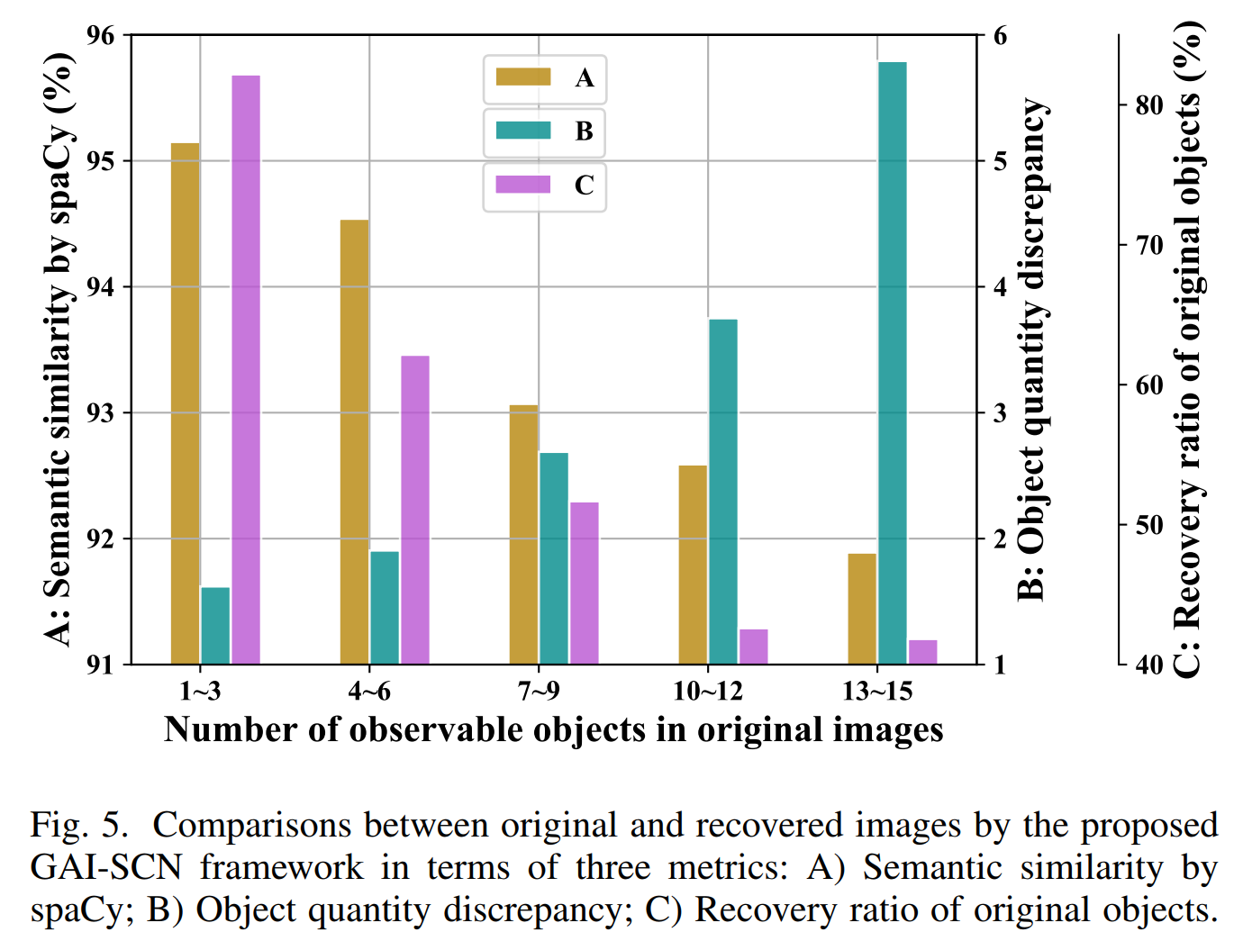
Evaluation
The complexity of images significantly impacts the recovery performance when using the GAI-SCN framework.
As the number of observable objects in the original images increases:
Semantic similarity decreases.
Object quantity discrepancy increases.
Recovery ratio of original objects declines.
This demonstrates that the framework faces greater challenges in maintaining recovery accuracy and semantic consistency with more complex images.
Notes:
Fig. 5 表明，在使用GAI-SCN框架恢复图像时，图像的复杂度对恢复效果有显著影响。具体而言，随着原始图像中可见对象数量的增加，语义相似性逐渐下降，对象数量差异增加，原始对象的恢复率降低，这表明在处理复杂图像时，解决关于框架的恢复准确性和语义一致性难度是问题的关键。

Slide 12
OPEN RESEARCH ISSUES AND OUTLOOKS
Limited Device Resources
Challenge:
Implementing sophisticated AI models on devices with limited storage, memory, and computational power.
Potential Solution:
Use model compression and acceleration techniques like knowledge distillation, parameter pruning, and quantization to reduce model complexity and size.

Slide 13
OPEN RESEARCH ISSUES AND OUTLOOKS
Randomness in GAI Content
Challenge:
Variability in AI-generated content and semantic decoder outputs, leading to inconsistencies.
Potential Solution:
Investigate granularity tuning for keyword extraction and semantic calibration to mitigate randomness.

Slide 14
OPEN RESEARCH ISSUES AND OUTLOOKS
Inactive Sharing of Knowledge and Preferences
Challenge:
Encouraging users to share personal preferences and background knowledge necessary for customized AI and SemCom services.
Potential Solution:
Develop incentive mechanisms, such as rewards or benefits, to motivate users to contribute their data for system improvements.

Slide 15
Conclusions
Pros
This article shows us the interplay between semantic communication and AIGC, as well as taking advantage of the edge for information transmission.
It also shows us the research direction of the future development of voice communication.
Cons
The experimental discussion is not detailed enough.

Slide 16
Thank You!

