Slide 1


Sarcyk Management
and
Consulting
ClearView
Business Management System
Project Proposal
www.target-innovations.com

Slide 2

ClearView
Business Management System
Requirements
Requirements are described in the Pdf document provided as wel as the Zoom meeting recordings:
Josh & Neil
(Sponsors)

Slide 3
ClearView
Business Management System
Business Overview
Employees
Sales Reps
Properties
Warehouse
Management Consulting
Contacts
(Clients)
ATM Transactions
Tenants
1
Contacts
Vendors
Commissions
Inventory
Business Units
2
4
5
3
Union Vending Machine
SM Enterprise (ATM Route)
64 Foxglove Group and 75 Baldwin Park
SMAC Distributing
(Bingo)
Equipment
Equip. Types
Charity 1
Charity 2
Reps
Sales($)
Location A
Location B
Location X
Location Y
Location Y
x
Priorities

Slide 4




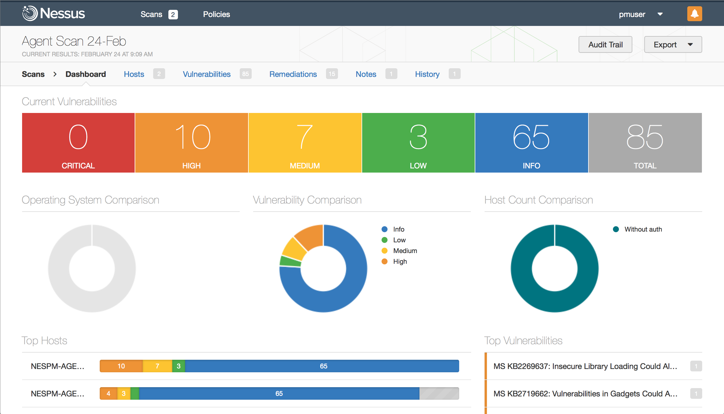


ClearView!
Business Management System
Context Diagram
User Access Management to ensure segregation of the duty
System Logs to ensure traceability of the user actions in the system
Users
Log
Trails
Various Data entries
Employees
Charities
Locations
Contacts
Delivery Reports
Team Members
Equipment
Types
Properties
Business
Envelops
Equipments
Inventory
KPIs
System Dashboard and Reporting Center
Tenants
Sales Reps
Tickets
Various Data Entries
Owner
(Upper Management)
Management
&
Accountant
Cheques
Invoices
Receipts
Reports & Dashboard
ATM
Transactions
Employee
Time-Offs
Payroll
Splits

Slide 5
ClearView!
Business Management System
Schedule & Cost
Scope Definition
Actors: Regular Users / Admins
Tables: 25
Screens: 30
Views: 10
KPI Dashboard: Yes
Reports: 20
Authentication Module: Yes
Authorization Module: Yes
Data Imports: Yes
Data Exports: Yes
System Documentation: Yes
Source code: Yes
Project Cost: $3,200 USD$
Reviews: 20
Delivery Time: 90 Days
Remarks: 90 days delivery time is only achievable given PM and/or Client is fully available to answer questions and Guide Design/Developments decisions timely

Slide 6
Release Management Process
Backup Area
V1.2.0 (FE)
V4.0.0 (BE)
Development
UAT – User Acceptance Test
Production
V1.2.x
V1.2.34
V1.2.0
V1.2.34
Data V4.0.15
(BE)
Data V4.0.0
(BE)
Data V4.0.x
(BE)
V4.0.15
Dev Team
Sponsor
Users

Slide 7



ClearView!
Business Management System
Payroll Utilization Module
I use to see what was paid out vs what was set aside for payroll during a monthly cycle. Each Spreadsheet is for each company for the month of May 2024.
Employees
Employee Payout
BA Invoices
Quicken
BB Invoices
Bx
Invoices
These are the spreadsheets that I use to create paystubs for each employee and calculate how much each company paid them. This data is used inside of the previous attachments

Slide 8
ClearView!
Payroll Management System
Data Model
1. Employee contact information, time off,
pay, Logins, and permissions
Payment Methods
Charge Splits
Line of Businesses
(Divisions)
BA – DD - 80%
BB – DD - 20%
BA – MM – 50%
BB – MM – 50%
Employees
Time-Off-Table
Bi-Weekly entry by Employee by Line Of Business
Payroll Entries
Union Vending Machine
SM Enterprise
64 Foxglove Group
75 Baldwin Park
SMAC Distributing
Invoice Items
Tax to be paid by Business to Different States by Period
Payrool Splits
Invoice Details
Authorization and Authentication
Users
User Types

Slide 9
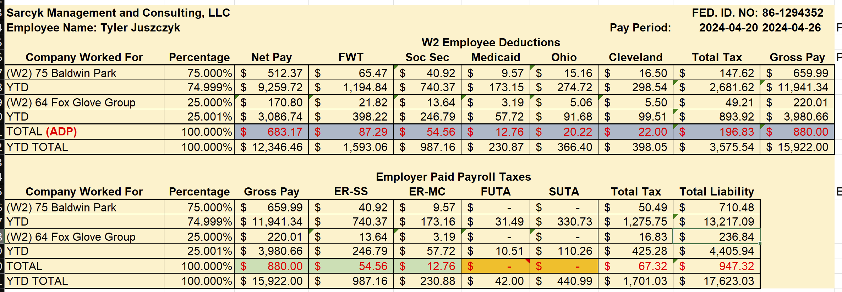
ClearView!
Business Management System
Payroll Use Case

Slide 10
ClearView!
Union Vending System
Data Model
Business
Partners
Split Setup
Equipment
Types
Equipments
Locations
Income Targets
Employees
Collections
Collection:
Employee: Donald Duck
Location: Street Mall
Machine: Nice Tunes
Date: 30-Aug-24
Amount: $150
Mobile Pay - 4%
Touch Tunes - 25%
Location – 35.5%
BB – MM – 35.5%
Authorization and Authentication
Users
User Types

Slide 11
ClearView!
SMAC System
Data Model
Marketing
Rep
Sales
Rep
Charities
Associations
Locations
Supplier Pay Structure
Ownership
GameStyle
OrderForm
(Menu)
Boxes
(Inventory)
Ticket Distribution
Manufacturer
Ticket Delivery
Orders Items
Inventory
Ownership
Suppliers
Ticket Delivery
Orders
Placement
(Machines)

Slide 12
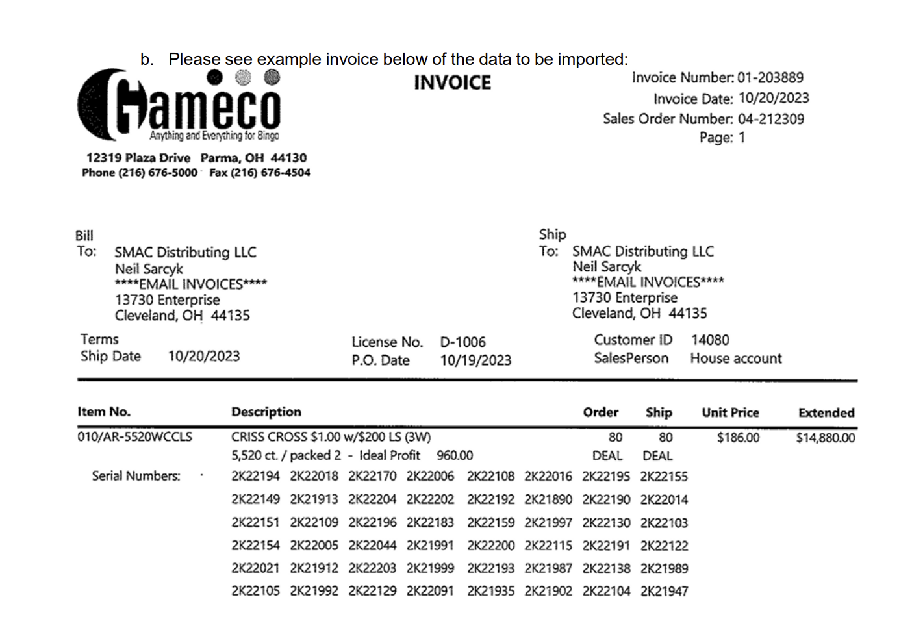
ClearView!
Business Management System
Classes
cTicketInventory
Add Inventory Methods
Validate(Invoice #) (Order Enter)
GetGameInfo (FormId)
SerialNumberExists(Serial#)
Set Distribution Methods
SubmitDistribution(OrderId)
DistributeBox(Serial #)
SetInventoryState(Serial #)
SetDeliveryOrderState(DeliveryId)
GetCurrentDistributionStatus(Various)
TransferOwnerShip(From, to)
SetLastSaleToBox(Serial #) (-- Profit)
RoundItDown(Nearest Dolar)
SetUsAsOwner(Serial#)
CreditSourceOwner()
DebitTargetOwner()
SetIntialSupplier()
SetBillingStyle(CharityBillingStype, SupplierId)
SaleOrderExist()
InvoiceExist()
Inventory
Ownership
Delivery
Distribution

Slide 13


ClearView!
Business Management System
Excel Dashboard
ClearView!
307-Detailed-Receipt-To-Excel (Query)
ClearView-Dashboard.xlsx
db-dataset (Sheet)
main-pivot (Sheet)
Josh & Neil

Slide 14
Q&A Section – SMAC
Id | Question | Answer
1 | BoxInventory.Status - What are the possible values? Distributed; New?
2 | BoxInventory.Purchaser - Employees?
3 | GamePrice on BoxInventory. Where does it come from? It does not exist in the OrderForm table
4
5 | Distribution Date: Why do we need it in the Inventory Table if the Distribution table already has that info? Same ideas with SoldSameMonth?
5 | What are the validation rules for: InitialSupplyStockOwnerID , InitialSupplyStockOwner , TransferDate , CharityDistributedFor , SMACSaleInvoiceNumber , SaleDate , NewSupplyStockOwnerID , NewSupplyStockOwner
7 | Let’s talk about Transfer of remaining boxes between charities since we need to find a better way to handle it
8 | Distribution Statuses: (Newly Created) -> Active - (Location Check #) -> Paid -> (SMAC Writes a check to Location) -> Reimbursement Check Ready -> (Create Envelop #) -> Enveloped (Populate Date Sent) -> (Update Reimbursement Sent Date) -> Reimbursement Sent (Done)
9 | Rep Commission Calculator (Pending)
10 | Ticket Value: =('Distribution Data Entry Form'!F8+'Distribution Data Entry Form'!K7)/'Distribution Data Entry Form’!D8 (Pending)

Slide 15
Phase I – Project Backlog
PENDING / IN-PROGRES / DONE
Id | Requirement | Status
1 | Project Scope Definition (PowerPoint) | DONE
2 | Data Model Specification | IN-PROGRES
3 | User Cases Definitions | PENDING
4 | Business Rules Definitions | PENDING
5 | Reporting and Exports Definition | PENDING
6 | System Design (Architecture) | PENDING
7 | System Coding (Components) | PENDING
8 | System Tests with Live data | PENDING
9 | Production Implementation | PENDING

Slide 16
Q&A Section
Id | Question | Answer
1 | PayPeriod on ADP | Q: Where do you want me to get the pay period for the ADP file? A: Josh to provide business rules
2 | ADP Data Mapping | Q: What are the proper data mapping for the ADP files? A: Josh to provide proper mapping
 | ADP File Type | Q: Is there a way to save ADP files as xlsx? A:
 |  | Q: Why the employee name comes in different formats? (i.e. Employee: Reese, Aaron J on file 13) R:

Slide 17
Q&A Section – Union Vending
Id | Question | Answer
1 | Setup with Different Splits for different locations | Q: Is it really needed? Your calculator does not take it into account. A: Yes (Pending)
2 | Petty Cash Process | Q: How does it work? Do you close the petty cash daily by person? How do you see it the process working? LE002 user case is working fine A: Daily by By Person / Locations (Done)
3 | Apply Fee? | Crane = Yes and TouchTunes = False by default (Done)
4 | Email Attachment | Send Summary report and move Executive Summary to the top (Pending)
5 | Executive Summary | Mimic the Receipt Look and feel (box at the bottom) (Pending) Lock the split screen even before approval (Pending) Put a check if a collection has already been done for that day and stop it (Pending) Change To Location to the name of the bar instead (Done) No needed anymore Create Report by Day / Employee / Bar / Total (Filter either employe or dates)

Slide 18
Extra Requirements List
Id | Name | Description
1 | Locations | Each location associated with a charity has a contract that expires every so often therefore needs to me alerted in the Dashboard that it needs to be renewed (Pending)
2
3

Slide 19
Issue Log
PENDING / IN-PROGRES / DONE
Id | Description | Status
1 | Splits with no employee Bug. Note: I also added the Total Split Box | Fixed -
2 | Not Recording the CheckDate and PayCycle & File Name | Fixed
3 | Splits summaries not showing | Fixed
4 | Issue Deleting ADP PayStub | Fixed
5
6
7
8
9
10

Slide 20


Turning Ideas into Reality.

Slide 21
Q&A Section – Union Vending
Id | Question | Answer
3 | Setup with Different Splits for different locations | Q: Is it really needed? Your calculator does not take it into account. A: Yes (Pending)
4 | Petty Cash Process | Q: How does it work? Do you close the petty cash daily by person? How do you see it the process working? LE002 user case is working fine A: Daily by PerDate
6 | Apply Fee? | Crane = Yes and TouchTunes = False (Pending)
7 | Custom Fee Form | Golden Tee Only (Pending)
8 | Email Attachment | Send Summary report and move Executive Summary to the top (Pending)
9 | Executive Summary | Mimic the Receipt Look and feel (box at the bottom) (Pending) Lock the split screen even before approval (Pending) Put a check if a collection has already been done for that day and stop it (Pending) Change To Location to the name of the bar instead (Pending) Report by Day / Employee / Bar / Total (Filter either employe or dates)

