Slide 1
Co-Evolution of generalist morphology and control for diverse environments
Kubilay Tarhan
Supervisor: Anil Yaman

Slide 2
Main question
Can we co-evolve a morphology-controller pair that exhibits generalist behavior to achieve high performance across a wide range of diverse environments?

Slide 3
Importance and motivation
Evolving morphology-controller pairs
01
Evolving generalist morphology-controller pairs
02
Notes:
Evolving morphology-controller pairs
More effective AI agent systems, due to embodied cognition
Avoiding conventional physical design stage
Evolving generalist morphology-controller pairs
Practicality due to real-world being dynamic and unpredictable providing more reliability

Slide 4
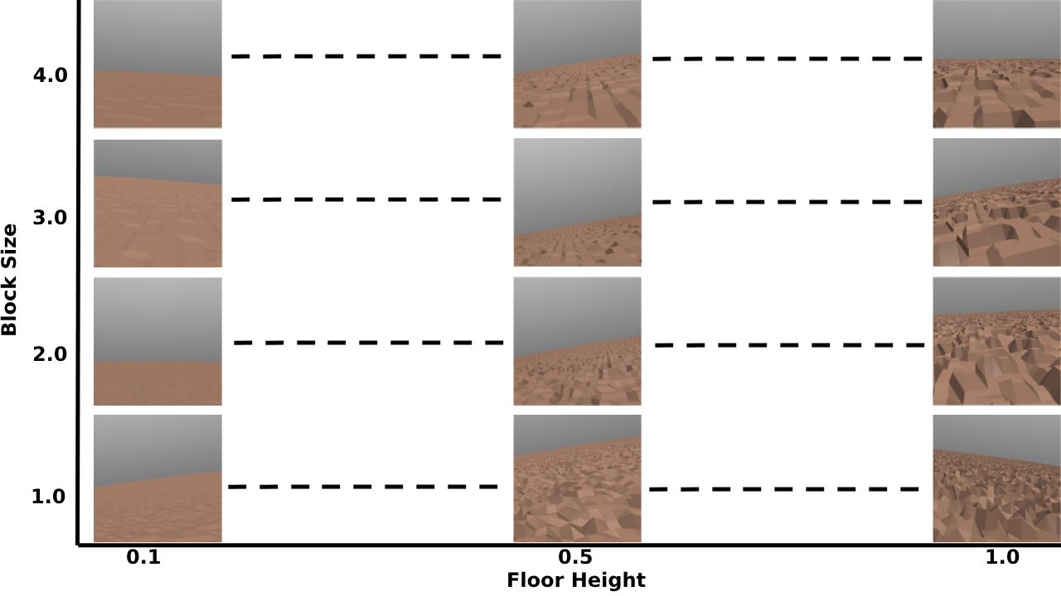
Notes:
Total of 85 environments

Slide 5
Algorithm

