Slide 1
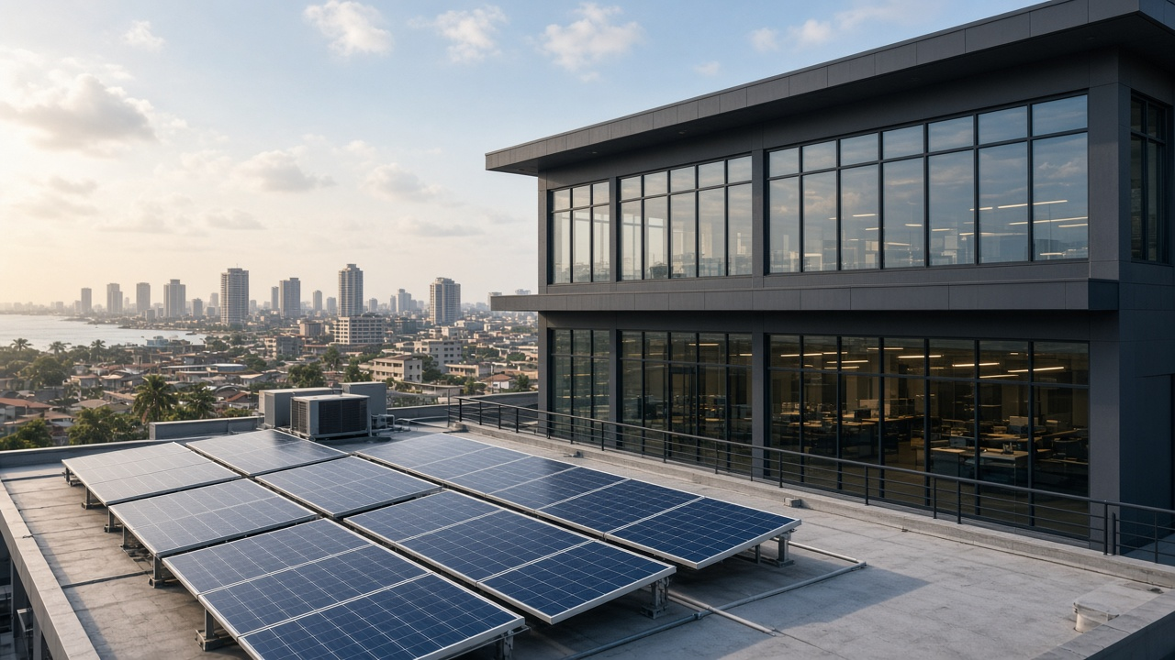
Solar & Inverter Co.
Accounting System
One company · Many branches · Double-entry GL · Nigerian Naira (NGN)
Product & architecture overview · Sections 1–16 complete
1

Slide 2
Agenda
What this presentation covers
Purpose and product scope
Runtime architecture and monorepo
Financial authority and money rules
Company structure and security
Posting engine and dashboard
Sales and procurement cycles
Inventory, expenses, banking, projects
Reports, closing, payroll, admin
Historical data import
Testing and production readiness
Deployment
Roadmap Sections 1–16
Solar Accounting · Confidential
2

Slide 3
Problem & purpose
Operational ERP with a true general ledger
Built for a solar and inverter business that sells products, manages stock, and delivers installation projects.
One legal company with many branches — not a multi-tenant SaaS platform.
Every financial figure on screens and exports comes from posted double-entry journals.
The NestJS API owns posting, tax, costing, and approvals; the browser displays decimal-string amounts only.
Currency is Nigerian Naira (NGN). Totals are never calculated with JavaScript floating-point numbers.
Solar Accounting · Confidential
3

Slide 4
What is in the product
Modules from operations through close and import
Sales
Purchases
Inventory
Expenses
Banking
Projects
Reports
Closing
Payroll
Admin
Import
Dashboard
Solar Accounting · Confidential
4

Slide 5
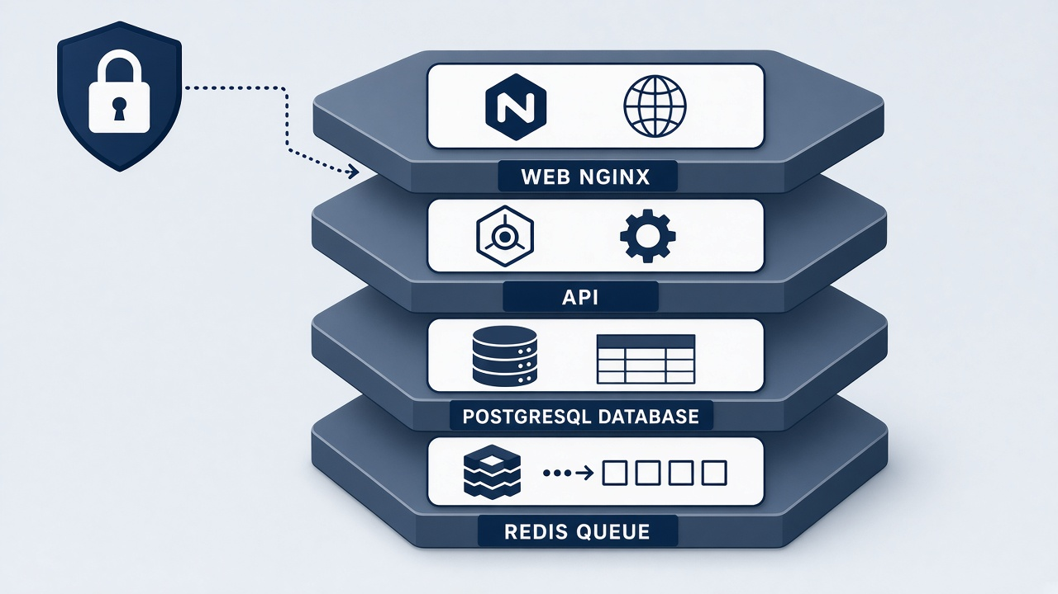
Runtime architecture
Web → API → PostgreSQL, with Redis and Docker
PostgreSQL 16
Web
API
System of record
Docker
React · Vite
Permission nav
NestJS 11
Posting · Auth
Compose
dev & prod
Redis 7
BullMQ jobs
Health checks database, Redis, and queue depth. Swagger is available outside production.
Production path: nginx (TLS) → API → managed or compose Postgres; migrate deploy on start.
Solar Accounting · Confidential
5

Slide 6
Monorepo layout
pnpm workspace · Node 22
apps/web
React shell, feature clients, dashboards, module pages
apps/api
Nest modules, Prisma, posting engine, auth, imports
packages/shared
Types and NGN display formatting — no Prisma
packages/accounting-rules
Posting event catalog; API remains financial authority
Solar Accounting · Confidential
6

Slide 7
Financial authority
The API is the only writer of journals
AccountingPostingService records every journal — sales, purchases, expenses, banking, projects, payroll, and opening balances call it.
packages/shared formats amounts for display. It does not own balances or profit.
packages/accounting-rules lists posting event mappings; the API applies them.
Posted journals cannot be edited or deleted. A reversal is a new journal that preserves the original.
Dashboard cards, reports, and PDFs all read posted journal lines — empty ledgers show 0.0000.
Solar Accounting · Confidential
7

Slide 8
Money & dates
Decimal strings and company timezone
Money
Dates
API amounts are decimal strings
(e.g. 150000.0000)
Display uses decimal.js and NGN
No JS number maths for totals
Opening inventory reconciles
quantity × unit cost to value
Seeded timezone: Africa/Lagos
Dashboard month/year presets
use company timezone
Custom ranges pass through
Closed fiscal periods reject
posting without adjustment
Solar Accounting · Confidential
8

Slide 9

Company structure
One legal entity, branch-aware operations
Single company profile with fiscal settings.
Branches, departments, and employees.
Default chart of accounts and roles.
Document numbers allocated with row locks so concurrent requests stay unique.
Soft delete for masters; branch deactivation keeps history readable.
Header branch selector narrows scope via X-Branch-Ids within the user’s assignments.
Solar Accounting · Confidential
9

Slide 10
Security & access
Sessions, CSRF, RBAC, branch scope
HTTP-only session cookies and a readable CSRF cookie; unsafe methods require X-CSRF-Token.
Argon2id passwords; five failed logins lock the account for fifteen minutes.
Privileged roles must enroll TOTP before other protected routes.
Invite-only staff; no public registration. Reset tokens are hashed.
Permissions drive navigation and API guards. Company-wide roles see all branches; others use assignments.
Separation rules block originators from approving their own restricted actions.
Audit events are append-only; secrets are redacted from payloads.
Solar Accounting · Confidential
10

Slide 11
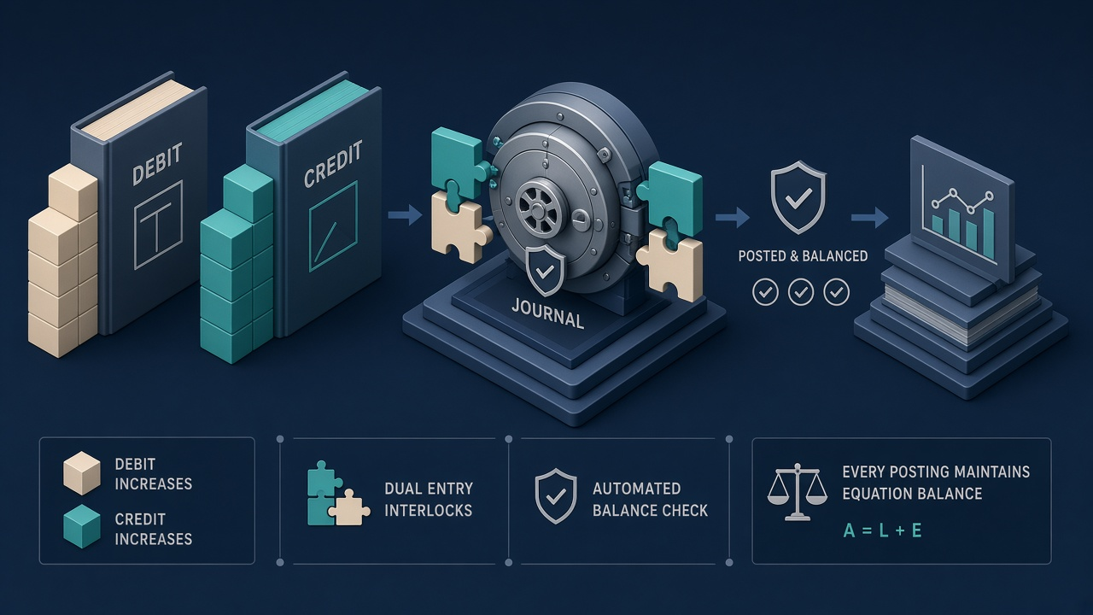
Posting engine
Events map to balanced, immutable journals
1
2
3
4
Business event
Account mapping
Balanced draft
Posted lines
Opening balances reconcile to control accounts.
Closed periods reject posting unless an approved adjustment.
Reversal creates a linked opposite journal once.
Solar Accounting · Confidential
11

Slide 12
Dashboard
KPIs from posted activity for selected branches
Sales, purchases, gross profit, expenses, cash & bank, AR, AP, inventory valuation.
Net profit = revenue − cost of sales − operating expenses from journal lines.
Charts for revenue, expenses, branch sales/profit, and cash movement.
Each financial card opens the journal lines that make up the figure.
Pending approvals open the accounting review workspace.
With no posted journals, totals remain 0.0000.
Solar Accounting · Confidential
12

Slide 13
Sales cycle (order to cash)
Quotations do not post revenue
Quotation
Invoice
Stock issue
Receipt
Credit note
No GL
AR / revenue
COGS
Cash/bank
Reversal
Invoice totals, tax, and discounts are calculated by the API.
Receipts settle invoices or record advances without posting revenue again.
Customer statements and aging come from posted sales documents.
Solar Accounting · Confidential
13

Slide 14
Procurement cycle (procure to pay)
PO does not post; GRN and bill do
PO
GRN
Bill
Payment
No GL
Inventory / GRNI
AP
Cash/bank
Approvals enforce separation of duties and branch purchase limits.
Central procurement requires a company-wide user.
Supplier bank numbers are masked in API responses.
Solar Accounting · Confidential
14

Slide 15
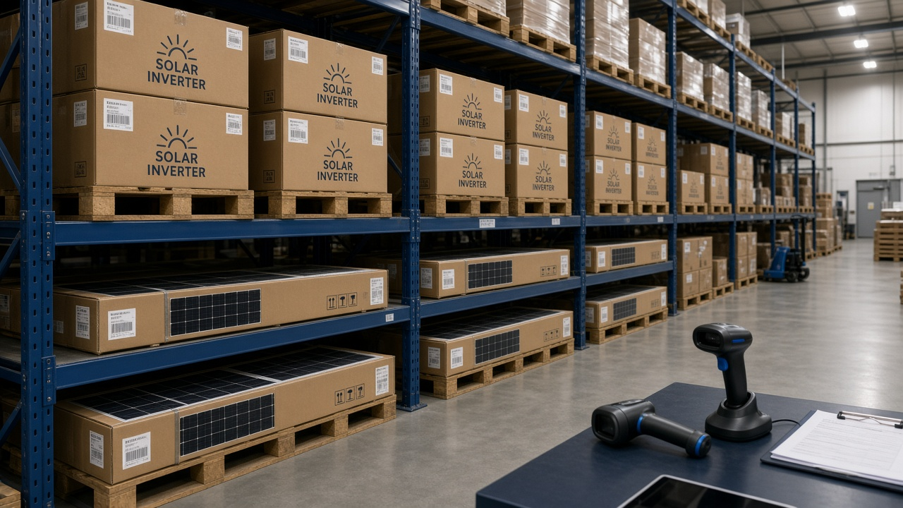
Inventory, warehouses & costing
Weighted-average cost and controlled transfers
Each branch has a main warehouse and an in-transit warehouse.
Receipts and returns recalculate branch weighted-average cost.
Transfers: draft → approve → ship → receive; company inventory total unchanged.
Stock counts post shortages/surpluses through the journal.
Serial-tracked products need one in-stock serial per unit sold.
Solar Accounting · Confidential
15

Slide 16
Expenses & approvals
Creator cannot approve; budgets can block
Expense categories map to postable accounts (not inventory or fixed-asset accounts).
Submit → approve (different user) → pay (different user).
Approval accrues expense; payment clears the accrual from cash.
Budgets can block approval when the month would go over the limit.
Reports cover branch, category, department, project, and budget versus actual.
Solar Accounting · Confidential
16

Slide 17
Banking, cash & reconciliation
Book balances from journals
Bank accounts and cash drawers map to GL accounts; book amounts come from posted lines.
Same-day transfers debit destination and credit source; later receipts use transfers in transit.
Cash counts compare counted cash to the drawer; a different user posts differences.
Cash book shows opening, receipts, payments, and closing.
Statement import (CSV/manual), suggested matches, lock by a different user.
Solar Accounting · Confidential
17

Slide 18
Solar installation projects
Deposits, WIP, milestone recognition
Projects store contract, quotation, and budget; profit and WIP come from journals.
Material issues (after approval) debit WIP and credit inventory for installations.
Customer deposits credit advances — not revenue — and create an advance receipt.
Milestone invoices recognize revenue and a proportional share of WIP as cost.
Dashboard lists project profitability inside the selected date range.
Solar Accounting · Confidential
18

Slide 19
Financial reports
Same rows on screen, PDF, spreadsheet, and CSV
General journal & ledger
Trial balance
Profit & loss
Balance sheet
Cash flow (indirect)
AR / AP ledgers
Inventory valuation
Fixed assets
Tax codes
Solar Accounting · Confidential
19

Slide 20
Daily closing & fiscal periods
Reviewer ≠ preparer; lock after checklist
Daily close stores sales, collections, expenses, exceptions, and cash difference for the branch day.
Month close moves open → closing → locked after checklist and a second person’s approval.
Closed periods reject ordinary posting.
Year-end stores statement snapshots, closes income/expense to retained earnings, and opens the next year.
Reopening requires permission and a reason.
Solar Accounting · Confidential
20

Slide 21
Employees & salary accounting
External payroll summaries through the posting engine
Employee directory holds branch, department, and status — not salary amounts on the person record.
Accountants enter approved external payroll summaries.
Approval posts gross expense, deduction liabilities, and salaries payable (different approver).
Payments settle one or more summaries against account 2300, including partial settlement.
Future payroll integrations must keep using the posting engine.
Solar Accounting · Confidential
21

Slide 22
Administration, audit & notifications
Settings hub and immutable history
Settings covers company profile, templates, account mappings, tax codes, periods, policies, delegations, and separation rules.
Managed documents enforce MIME type, 2 MB size, and branch-aware access.
Company and configuration changes write redacted audit events.
In-app notifications for approvals, overdue invoices, low stock, bills due, failed postings, and closing reminders.
Solar Accounting · Confidential
22

Slide 23
Historical data import
Staged CSV — unbalanced openings cannot commit
Upload
Parse
Validate
Preview
Approve
Commit
Report
Masters (customers, suppliers, products, CoA) create through domain services.
Opening financials go through importOpeningBalances — not direct journal-line writes.
A different user must approve. Unbalanced trial balance / bank opening batches are rejected.
Permissions: imports.view and imports.manage. Schema version 16.
Solar Accounting · Confidential
23

Slide 24
Testing & production readiness
Automated gates plus a human checklist
Unit, integration, security, April 2028 accounting scenario, and import pipeline packs.
Backup dump/restore into a throwaway database with schema_version verified.
CI: install, migrate, typecheck, tests, backup-restore.
GET /health reports BullMQ waiting/active/delayed/failed counts.
Human items remain open: accountant acceptance, independent report sign-off, secret rotation, production TLS.
Solar Accounting · Confidential
24

Slide 25
Deployment
Production compose, TLS, migrate-then-start
docker-compose.prod.yml: Postgres (no published port by default), Redis, API production image, nginx web.
API entrypoint runs prisma migrate deploy then starts Node.
TLS terminates at nginx with mounted certificates.
COOKIE_SECURE with NODE_ENV=production.
Backup scripts for Linux/macOS and Windows PowerShell.
Structured Pino JSON logs for shipping.
Solar Accounting · Confidential
25

Slide 26
Section roadmap 1–16
All listed sections are complete
1 Foundation
2 Company
3 Auth
4 Posting engine
5 Dashboard
6 Sales
7 Procurement
8 Inventory
9 Expenses
10 Banking
11 Projects
12 Reports
13 Closing
14 Payroll
15 Admin
16 Import & deploy
Solar Accounting · Confidential
26

Slide 27
Thank you
Sections 1–16 are in place. Section 17 has not started.
Questions welcome.
Solar Accounting · Confidential

