Slide 1
The Completely Randomized Design
Single Factor

Slide 2
Completely randomized design
Consider an experiment that involves a single factor with k treatments. The completely randomized design is a design in which the k treatments are randomly assigned to the experimental units or in which independent random samples of experimental units are selected for each treatment.
When an equal number of experimental units is assigned to each treatment it is called a balanced design.

Slide 3
Analysis of Variance
The techniques used to analyze the means from a designed experiments is called an analysis of variance (ANOVA). Variances of different sources are analyzed to make inferences. Different designs have different ANOVA tables.

Slide 4
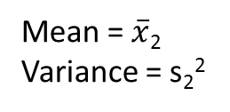
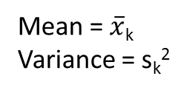
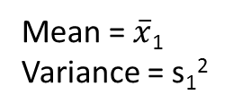
Completely Randomized Design
Population 1 Population 2 … Population k
Mean = μ₁
Variance = σ₁²
Mean = μ₂
Variance = σ₂²
Mean = μ_{k}
Variance = σ_{k}²
Sample size: n₁
Sample size: n₂
Sample size: n_{k}
Mean = $\overline{x}$₁
Variance = s₁²
Mean = $\overline{x}$₂
Variance = s₂²
Mean = $\overline{x}$_{k}
Variance = s_{k}²
The k populations are independent

Slide 5
Completely Randomized Design
Purpose of the test: to compare the means of several populations when independent samples have been chosen.
Assumptions: 1) Samples are selected randomly and independently from the respective populations, 2) All k population variances are equal, and 3) All k population probability distributions are normal.

Slide 6
The “Fixed Effects” ANOVA Model.
This ANOVA model is appropriate when the k treatments being compared are the only treatments in which we are interested.
E.g. Comparing the milk yield of cattle fed on 4 different diets. We assume that these 4 diets are the only ones of interest and any repetition of the complete experiment would involve these same 4 diets.
Hence the treatment effects are fixed.

Slide 7
In ANOVA, we want to compare the means of the k populations and this is done using
H_{o} : µ₁ = µ₂ = µ₃ = …………= µ_{k}
If H_{o} is true, each population mean µ_{j} is equal to the grand mean µ and there are no treatment effects.
Ha: at least two of the k treatment means differ

Slide 8
We wish to compare four brands of golf balls with respect to the distance they travel when hit by a mechanical driver

Slide 9
Ho: μ_{A}= μ_{B=} μ_{c} = μ_{D} Ha: at least two golf ball brands mean distance traveled differ
To conduct a formal statistical hypothesis test of the hypothesis requires numerical measures of the differences between the treatment means and the sampling variability within each treatment

Slide 10
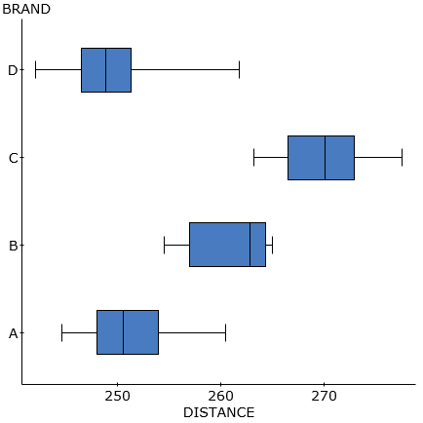
Distribution of Golf Ball Distances (in yards) for Four Brands

Slide 11
Brand A | Brand B | Brand C | Brand D
251.2 | 263.2 | 269.7 | 251.6
245.1 | 262.9 | 263.2 | 248.6
248 | 265 | 277.5 | 249.4
251.1 | 254.5 | 267.4 | 242
260.5 | 264.3 | 270.5 | 246.5
250 | 257 | 265.5 | 251.3
253.9 | 262.8 | 270.7 | 261.8
244.6 | 264.4 | 272.9 | 249
254.6 | 260.6 | 275.6 | 247.1
248.8 | 255.9 | 266.5 | 245.9
Mean = 250.78 | Mean = 261.06 | Mean = 269.95 | Mean = 249.32
Std.dev. = 4.7352 | Std.dev. = 3.8661 | Std.dev = 4.5009 | Std. dev=5.2032

Slide 12
Overall Mean | 257.7775 yds
Overall Standard Deviation | 9.5497 yds
Sample Size | N=40 golf balls

Slide 13
Variation Between Treatment Means
The variation between treatment means is measured by the sum of squares for treatments (SST), which is calculated
SST =
Where represents the overall mean responses of all samples, n_{i} sample size for the ith treatment.
SST = 10(250.78-257.7775)² + 10(261.06-257.7775)² + 10(269.95-257.7775)² + 10(249.32-257.7775)²
= 2,794.388

Slide 14
Sampling Variability Within the Treatments
The Sums of Squares for Error (SSE) measures the variability around the treatment means that is attributed to sampling error, which is calculated using the following simplified formula
SSE =
SSE = 9(4.7352)² + 9(3.8661)² + 9(4.5009)² + 9(5.2032)²
= 762.302

Slide 15

Decomposition of Variation - ANOVA
In ANOVA, we decompose or partition the sum of squared deviations:
SS(Total) = SSE + SST
j = 1, 2, … k treatments.
n_{j} = number of observations for treatment j

Slide 16
Compare the Variability
To make the two measurements of variability comparable, we divide each by the degrees of freedom to convert the sums of squares to mean squares. Note: k = number of groups or treatments and N = total number of observations
Mean Square for Treatments (MST) =
Mean Square for Error (MSE ) =
Example: MST = MSE =

Slide 17
F statistic
Calculate the ratio of MST to MSE
Values of the F statistics near 1 indicate that the two sources of variation, between treatment means and within treatments means are approximately equal. Thus, all F tests in ANOVA are right tailed tests.

Slide 18
F-distribution
The F distribution considers both the numerator degrees of freedom (k – 1) and denominator degrees of freedom (N – k).
Thus we define ν₁ = k – 1 and ν₂ = N – k

Slide 19
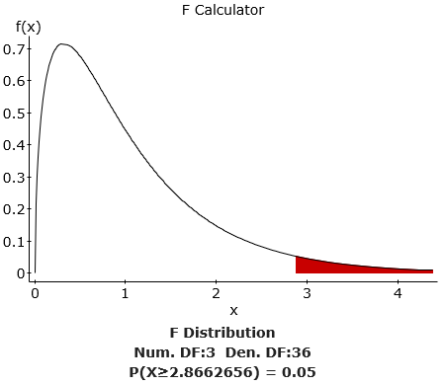

Slide 20
The ANOVA table:
Source | DF | SS | MS | F
Treatments | 3 | 2794.3887 | 931.4629 | 43.9886
Error | 36 | 762.303 | 21.1751
Total | 39

Slide 21
H_{o} : No difference between treatment means.
From tables, = 2.8662 @ 5% Using critical value approach as the teat statistic of 43.9886 is greater than 2.8662, we reject the null hypothesis
P-value from StatCrunch = approximately 0
Hence we have evidence of a difference between the population mean distanced traveled of the three brands of golf balls.

Slide 22
ANOVA TABLE
BRAND | n | Mean | Std. Dev. | Std. Error
A | 10 | 250.78 | 4.735164 | 1.4973903
B | 10 | 261.06 | 3.8661494 | 1.2225838
C | 10 | 269.95 | 4.5009258 | 1.4233177
D | 10 | 249.32 | 5.2031614 | 1.6453841
Source | DF | SS | MS | F-Stat | P-value
BRAND | 3 | 2794.3887 | 931.46292 | 43.988746 | <0.0001
Error | 36 | 762.301 | 21.175028
Total | 39 | 3556.6897

Slide 23
Computational Forms - Faster
SS(Total)
Where is the sum of the squares of all observations and G is the grand total of all observations.
SST
Where C_{j} is the total of jth column

Slide 24
Golf Balls – Quicker Way
SS(Total) = 2661566- (10311.1² /40)= 3556.41975
SST =
((2507.8² /10)+(2610.6² /10)+ (2699.5² /10)+(2493.2² /10))-(10311.1²/40)
=2660763.969-2657969.58=2794.3885
In computational forms, whenever we square a total, we divide it by the number of observations which make up that total.

Slide 25
The Analysis of Variance Table
An ANOVA table is used to display the various sources of variation, along with the sums of squares and the mean squares associated with those sources.
Source | DF | SS | MS | F
Treatments | k-1 | ΣC²/n - G²/N | MST | MST/MSE
Error | N-k | By subtraction | MSE
Total | N-1 | ΣΣx² – G²/N

Slide 26
Completely Randomized Design
Assumptions:
Samples are selected randomly and independently from the respective populations,
All k population probability distributions are normal, and
All k population variances are equal

Slide 27
How do we check these assumptions?
Assumption 1: The samples of experimental units selected for the treatments must be random and independent.
Check: Look at the design of the experiment.
In the golf ball example, the sample consisted of 10 randomly selected balls of each brand hit using a mechanical driver.

Slide 28
Assumption 2: The probability distributions of the populations of responses associated with each treatment must be all normal.
Check: Check graphically using a normal probability plot of the residuals and if the points follow the line we are comfortable with the idea that the error terms are approximately normal.
ANOVA is robust to moderate departures in the normally assumption.

Slide 29
Normal Probability Plots (QQ plots)

Slide 30
Assumption 3: The probability distributions of the population of responses associated with each treatment must have equal variances.
Check: Check graphically by plotting the residuals versus the fitted values and compare the distributions OR s_{max}/s_{min} should be less than roughly 2
Note: ANOVA is not robust with respect to departures to the equal variance assumption. The effect is slight when sample sizes are equal

Slide 31
Assumption of Equal Variances

Slide 32
Practice
To detect the presence of harmful insects in farm fields, we can put up boards covered with a sticky material and examine the insects trapped on the boards. Which color attracts insects best? Experimenters placed six boards of each of four colors at random locations in a field of oats and measured the number of cereal leaf beetles trapped.

Slide 33
Vocabulary Check
Identify the response variable in the study.
Identify the factor and its levels in the study.
Identify the experimental unit.
If this is a balanced design? Explain
Is this an observational study or randomized experiment? Explain

Slide 34
Conduct a complete analysis to determine if there is a difference in the mean number of beetles trapped for the four board colors.
i)State Ho and Ha
ii)Check that all the assumptions for inference have been satisfied.
iii)Use the computational formulas to complete an ANOVA table
iv)Use the results in your ANOVA table to make a decision regarding the Ho hypothesis
v) Interpret your finding in the context of the question.

Slide 35
Use the information below and the Computational formulas the complete an ANOVA table
Board Color | Beetles Trapped
Blue | 16 | 11 | 20 | 21 | 14 | 7
Green | 37 | 32 | 20 | 29 | 37 | 32
White | 21 | 12 | 14 | 17 | 13 | 20
Yellow | 45 | 59 | 48 | 46 | 38 | 47

Slide 36
Source | DF | SS | MS | F
Treatments | k-1 | ΣC²/n - G²/N | MST | MST/MSE
Error | N-k | By subtraction | MSE
Total | N-1 | ΣΣx² – G²/N

