Slide 1
Stat 350
Categorical Variables

Slide 2
Contingency Tables
A two-way table (also called a contingency table) is a useful tool for examining relationships between categorical variables.
Each cell in the table gives the count (or percent) for a combination of values of the two variables.

Slide 3
Results of poll asking adults whether they were looking forward to the Super Bowl, the commercials and did not plan to watch
 | MALE | FEMALE | TOTAL
GAME | 279 | 200 | 479
COMMERCIALS | 81 | 156 | 237
WON’T WATCH | 132 | 160 | 292
TOTALS | 492 | 516 | 1008

Slide 5
What percent of the respondents were female given that they stated they planned to watch for the commercials? 156/237 = 65.8% What percent of the respondents were male given that they stated they planned to watch for the commercials? 81/237 = 34.2%
 | MALE | FEMALE | TOTAL
GAME | 279 | 200 | 479
Commercials | 81 | 156 | 237
WON’T WATCH | 132 | 160 | 292
TOTALS | 492 | 516 | 1008

Slide 6
What percent of respondents stated they planned to watch the game given they were male? What percent of respondents stated they do not plan to watch the game given they were female?
 | MALE | FEMALE | TOTAL
GAME | 279 | 200 | 479
Commercials | 81 | 156 | 237
WON’T WATCH | 132 | 160 | 292
TOTALS | 492 | 516 | 1008

Slide 7
TESTING FOR ASSOCIATION IN CATEGORICAL DATA

Slide 8
Example:
The data below comes from the sinking of the Titanic.
Was there a relationship between the kind of ticket a passenger held on the Titanic and the passenger’s chances of making it into the lifeboat?

Slide 9
 | First | Second | Third | Crew | Total
Alive | 202 | 118 | 178 | 212 | 710
Dead | 123 | 167 | 528 | 673 | 1491
Total | 325 | 285 | 706 | 885 | 2201

Slide 10
This way of representing categorical data using a 2-way table is known as a “Contingency Table” representation.
We can also view the data in graphic form:

Slide 12
The question poses a choice between two hypotheses:
H₀: Survival was independent of status on ship.
H_{a}: Survival was not independent of status on ship. The two variables are associated .
To decide between these two hypotheses, we must work out what we expect to happen if Ho were true, and then see if the data is near to, or far from, what we expected.

Slide 13
If Ho is true, then we would expect that the probability of surviving or dying would be the same whatever ticket category was held.
Looking at the observed data, overall 710/2201 survived and 1491/2201 did not.
If Ho is true, then we would expect, on average, that 710/2201 of the 325 first-class passengers would survive, that is 0.3226 x 325, which equals 104.84

Slide 14
We can re-express this calculation as:
Expected Frequency =
(Row Total) x (Column Total) / (Grand Total)
Expected Frequency =
(710 x 325) / 2201 = 104.84
Similar computations give the expected frequencies (if Ho were true) for the remaining cells of the contingency table as follows:

Slide 15
EXPECTED FREQUENCIES
 | First | Second | Third | Crew | Total
Alive | 104.84 | 91.94 | 227.74 | 285.48 | 710
Dead | 220.16 | 193.06 | 478.26 | 599.52 | 1491
Total | 325 | 285 | 706 | 885 | 2201

Slide 16
Note that there are differences between the observed frequencies(O) and the expected frequencies(E).
Are these differences large in relation to the sort of sampling error we would expect? If they are large we would want to reject H₀ in favor of H_{a}.

Slide 17
If the differences are relatively small, we would not want to reject Ho on the grounds that they could be due to chance.
To answer this question we must learn about a statistical distribution known as a chi-square ( ) distribution.

Slide 18
The Chi-Square Test for Independence
The test statistic which we use to summarize the discrepancies between the observed and expected frequencies is given by
Σ (O-E)²/E
where we “sum” over all the cells in the table.

Slide 19
If the O’s and the E’s agree well, this test statistic has a small value. Poor agreement gives a large value.

Slide 20
Here,
Σ(O-E)²/E = (202-104.84)²/104.84
+ (118-91.94)²/91.94
+ (178-227.74)²/227.74
+ (212-285.48)²/285.48
+ (123-220.16)²/220.16
+ (167-193.06)²/193.06
+ (528-478.26)²/478.26
+ (673-599.52)²/599.52

Slide 21
= 90.046 + 7.930 + 10.864 + 18.915 + 42.879 + 3.519 + 5.173 + 9.007
= 187.793
This test statistic has approximately a chi-square distribution if the null hypothesis of no association is true.

Slide 22
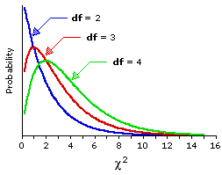
Chi-Square Sampling Distributions for df = 2,3, and 4

Slide 23
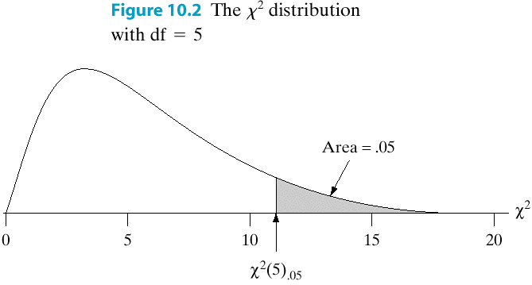
Properties of χ²
The χ² dist’n is
always ≥ 0
skewed right
has integer df’s
has upper-α critical
points given in tables.

Slide 24
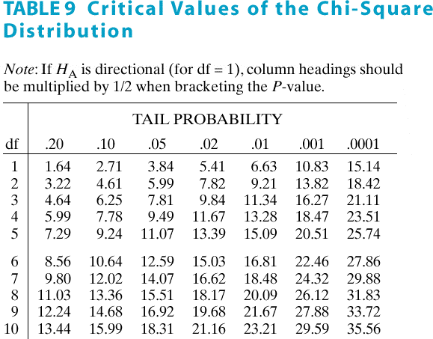

Slide 25
Tables of the chi-square distribution list the values of which cut off various areas in the right-tail of the curve at various levels of the degrees of freedom.
The number of degrees of freedom for a contingency table is given by:
df = (r-1)(c-1)
where r = number of rows in the table
c = number of columns in the table
This value represents the number of cells we are “free” to fill, given the marginal totals.

Slide 26
Here df = (2-1)(4-1) = 3
From tables, the 5% critical value for 3 degrees of freedom is 7.815
Our observed value of 187.793 is far greater than this 5% critical value (and is also greater than the 0.5% critical value of 12.838).

Slide 27
It is therefore highly unlikely to have occurred by chance and we have strong evidence to reject H₀ in favor of H_{a}
We therefore have strong evidence that survival and the type of ticket held for the fateful journey of the Titanic are associated.
The largest contribution to the chi-square value comes from the top left cell in the table, where far more first class passengers survived than should have, if there had been no association.

Slide 28
Assumption and Conditions for a Chi-Square Test
1. Data must be in counts-
check by examining the data
2. Data in sample are independent-
do we have a SRS and n<10% of population?
3. Sample Size is sufficiently large-
are all expected counts are greater than 5?

Slide 29
Two types of chi-square tests of association
Chi-square test of homogeneity of proportions: is appropriate whenever the explanatory and response variables are clearly defined from the beginning of the study
Tests of independence: are appropriate if one sample is selected from one population and thus neither explanatory or response totals are known in advance

Slide 30
Example
Newspaper headlines at the time, and traditional wisdom in the succeeding decades, have held that women and children escaped the Titanic in greater proportion than men. Below is a table with data by gender. Do you think that survival was independent of gender?

Slide 31
 | Female | Male | Total
Alive | 343 | 367 | 710
Dead | 127 | 1364 | 1491
Total | 470 | 1731 | 2201

Slide 32
Draw a segmented bar chart for gender by survival status

Slide 34
State the null and alternative hypotheses.
Ho: There is no association between gender and survival status
Ha: There is an association between gender and survival status

Slide 35
Female Male Total
A 343 367 710
151.61 558.39
241.596 65.598
D 127 1364 1491
318.39 1172.61
115.046 31.237
Total 470 1731 2201
Chi-Sq = 453.476, DF = 1, P-Value = 0.000
Critical value of χ2 at 5% = 3.841

Slide 36
Testing Goodness of Fit for a Single Categorical Variable

Slide 37
Recall
We have discussed tests for proportions that deal with a single categorical variable. We will now develop methods for testing hypothesis that involve two or more categories.

Slide 38
Goodness of Fit Example
Many standardized tests use questions with a multiple choice format.
Are certain choices more or less likely to occur than other answers?
We will use the frequencies of the letters for correct answers in a sample of 400 multiple choice answers from a standardized exam

Slide 39
Data
Table 1.1 Choice for correct responses of 400 AP multiple choice questions
ANSWER | A | B | C | D | E
FREQUENCY | 85 | 90 | 79 | 78 | 68

Slide 40
Find the relative frequency (proportion) of answers for each letter in Table 1.1
Use these proportions to construct a bar chart of the data.

Slide 41
Relative Frequency Table
ANSWER | A | B | C | D | E
RELATIVE FREQUENCY | 85/400= 0.2125 | 90/400= 0.2250 | 79/400= 0.1975 | 78/400= 0.1950 | 68/400= 0.1700

Slide 42
Figure 1.1. Percent of correct responses for 400 AP multiple choice questions

Slide 43
So??
How can we determine if the letter choices are really made at random?
What should be the proportion of all AP multiple choice questions that have each letter as the correct answer?

Slide 44
Hypothesis Statements
If each of the five options is equally likely to occur then we would expect each letter to occur 20% of the time. So our null hypothesis would be:
H_{o}: p_{A}=p_{b}=p_{c}=p_{d}=p_{e} = =0.20
The research question would be at least one of the choice selections does not equal 20% so our alternative hypothesis would be:
H_{a}: at least one p ≠ 0.20

Slide 45
How do we test this hypothesis?
This null hypothesis does not reduce to a single claim about a value of a single parameter as we have seen before or even about two parameters.
We always start by assuming the null to be true so what would we expect to happen if our null statement is true?

Slide 46
Expected Counts
If the null is true 20% of the 400 MC items would have a correct answer of A, 20% B, etc.
Answer | A | B | C | D | E
Expected Count | 80 | 80 | 80 | 80 | 80

Slide 47
Chi-Square Statistic
We need a statistic to compare the observed counts from the sample to the expected counts from the null hypothesis AND we would like to combine the information from all cells of the table. We calculate a chi-square test statistic.

Slide 48
Computing the chi-square statistic “by hand”
 | Observed | Expected
A | 85 | 80 | 0.3125
B | 90 | 80 | 1.25
C | 79 | 80 | 0.0125
D | 78 | 80 | 0.05
E | 68 | 80 | 1.8
Sum |  |  | 3.425

Slide 49
Finding p-value
First, what are the degrees of freedom?
Df = number of categories – 1
So for our MC example the df = 5-1=4
Now use a statistical software package to find the p-value. Remember this is ALWAYS a right-tailed test.

Slide 50
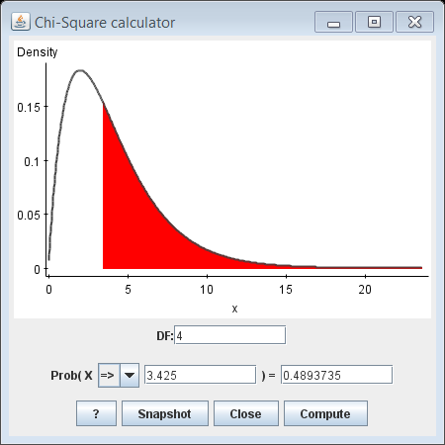
P-value = 0.4894

Slide 51
Conclusion
As the p-value is very large, 0.4894, there is no evidence to support the claim that the correct responses to the MC items are not all equally likely to occur.

Slide 52
Are there assumption checks for a goodness of fit test?
Yes!
The data must be given in counts.
We must make sure we have a random sample and if the sample size is large enough.
To determine if our sample size is large enough look at the expected counts. Are each of the expected counts > 5? If so you can proceed some books suggest that no more than 20% of the expected counts be less than 5.

