Slide 1

Title
DEPARTMENT OF ARTIFICIAL INTELLIGENCE AND DATA SCIENCE
Presented by
TARIKA A G
241801290

Slide 2
TITLE OF THE INTERNSHIP
REGISTRATION NUMBER | : | 241801290
STUDENT NAME | : | TARIKA A G
YEAR / SEMESTER | : | II/IV
NAME OF THE ORGANIZATION / COMPANY | : | ALTRUISTY INNOVATION PVT Ltd
ORGANIZATION ADDRESS | : | T.S. 107, Hindustan Teleprinters Staff Quarters, SIDCO Industrial Estate, Guindy, Chennai, Tamil Nadu 600032
ONLINE / OFFLINE | : | ONLINE
TRAINER NAME | : | PAMAJULA PRAVALIKA
TRAINER’S CONTACT NO. | :
INTERNSHIP PERIOD | : | FROM : 16/12/2025 TO: 31/12/2025
INTERNSHIP DURATION | : | 15 DAYS

Slide 3
About the Training
Internship focused on Data Science and Machine Learning concepts.
Hands-on training in data preprocessing, visualization, and clustering algorithms
Developed Customer Churn Analytics Dashboard project using Python
Built web application for real-time prediction using Flask
Gained experience in real-world data analysis workflow
Improved technical, analytical, and problem-solving skills

Slide 4
Abstract / Executive Summary
This project focuses on developing a Customer Churn Analytics Dashboard to analyze customer data and identify patterns related to customer attrition. Data analysis and machine learning techniques were used to examine factors such as tenure, contract type, and monthly charges that influence customer churn. An interactive dashboard was created to visualize key metrics including churn rate, revenue loss, and customer segmentation. The system helps businesses understand churn behavior and supports data-driven decision-making to improve customer retention strategies.

Slide 5
Introduction
Customer Churn Analytics Dashboard is a data-driven approach used to analyze customer behavior and identify customers who are likely to stop using a service. It helps businesses understand the factors influencing churn and take proactive measures to improve customer retention. In this project, data analysis and machine learning techniques were used to study customer data and identify patterns related to churn.
Key Points:
● Focus on analyzing customer churn patterns using data
● Used Machine Learning techniques for churn prediction
● Helps businesses reduce customer loss and improve retention strategies
● Developed an interactive dashboard to visualize churn insights and key metrics

Slide 6
Objectives of the Internship
-> To gain practical knowledge in the Data Science and Machine Learning domain
-> To understand the complete workflow of a real-world data science project
-> To develop a Customer Churn Analytics Dashboard to analyze and monitor customer churn patterns
-> To learn data preprocessing, exploratory data analysis, and data visualization techniques
-> To implement machine learning algorithms for customer churn prediction
-> To gain hands-on experience with tools like Python, data visualization libraries, and machine learning frameworks
-> To improve analytical thinking, programming skills, and problem-solving ability

Slide 7
Brief Description of Work / Project
The project consists of the following modules:
1. Data Processing
Imported the telecom customer dataset containing attributes such as tenure, contract type, monthly charges, internet services, and payment methods.
Performed data cleaning and preprocessing to handle missing values and correct data types.
Selected relevant features related to customer behavior and churn analysis.
Prepared the dataset for further analysis and model development.
2. Model Development
Implemented machine learning classification algorithms for customer churn prediction.
Split the dataset into training and testing sets for model evaluation.
Trained the model to identify patterns and factors influencing customer churn.
Generated churn predictions to identify customers with a high risk of leaving the service.
3. Data Visualization
Created charts and graphs to visualize churn patterns and customer behavior.
Analyzed churn distribution based on contract type, tenure, and monthly charges.
Interpreted insights to understand key factors contributing to customer attrition.
4. Dashboard Development
Developed an interactive Customer Churn Analytics Dashboard.
Integrated key metrics such as churn rate, revenue loss, and customer segmentation.
Designed a user-friendly interface to present insights through charts and visual reports.
Displayed churn analysis results to support data-driven business decisions.

Slide 8
Learning Outcome
● Gained practical knowledge in Data Science and Machine Learning concepts
● Learned data preprocessing, exploratory data analysis, and data visualization techniques
● Understood the implementation of machine learning algorithms for customer churn prediction
● Developed skills in Python programming and machine learning libraries
● Experienced building and presenting insights through an interactive Customer Churn Analytics Dashboard
● Improved analytical thinking and problem-solving abilities
● Understood real-world applications of data-driven decision-making in customer retention and business strategies

Slide 9
Conclusion
The internship provided valuable hands-on experience in the field of Data Science and Machine Learning. The Customer Churn Analytics Dashboard project demonstrated how data analysis and machine learning techniques can be used to analyze customer data and identify patterns related to customer attrition.
● Implemented machine learning techniques to analyze and predict customer churn
● Identified key factors influencing churn to support business decision-making
● Developed an interactive dashboard to visualize churn metrics and insights
● Gained practical experience in data preprocessing, analysis, and predictive modeling
● Demonstrated the real-world application of data science in improving customer retention and business strategies

Slide 10
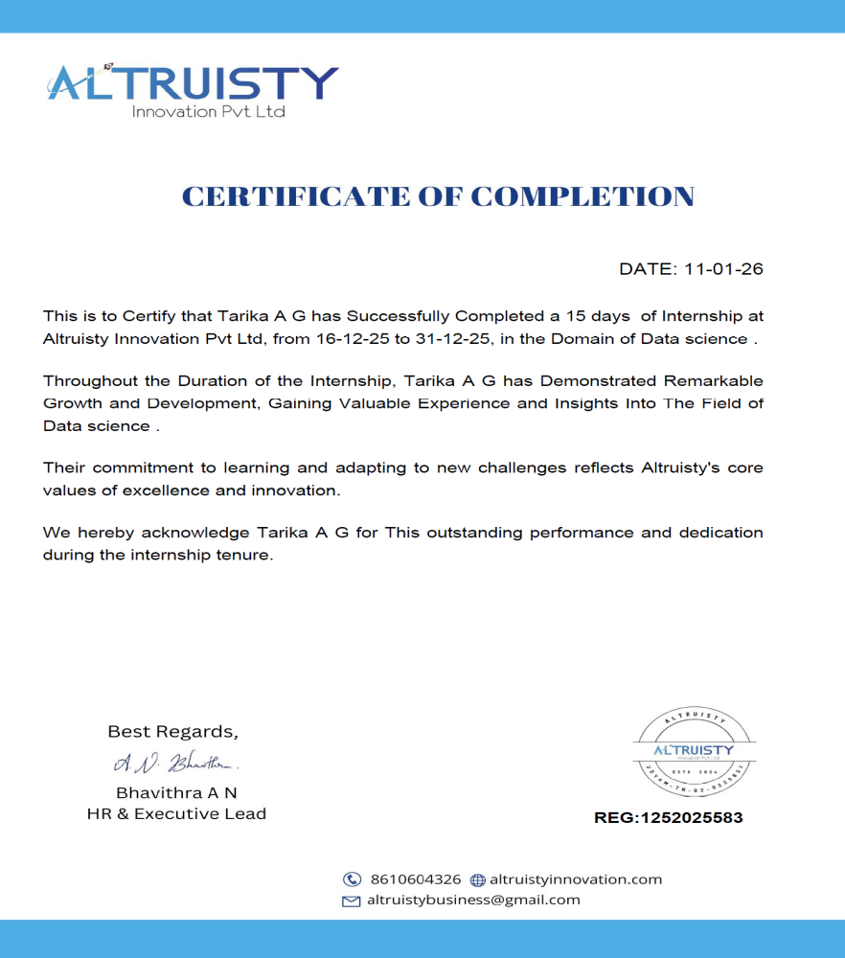
INTERNSHIP CERTIFICATE

Slide 11
Thank You

