Slide 1
Cats and Dogs Object Detection (CaDoD)
Group 30 – PHASE 2

Slide 2


Group 30 - Team

Slide 3
Presentation Outline
Work done previously - Phase 1 & 2
Goal - Phase 3
Data Pre-processing
Homegrown Logistic and Linear Regression
(BSE + MSE Loss + Regularization)
Data Preparation for Pytorch Object Detector Models
Transfer Learning
EfficientDet D0 and D7 Comparison
FCN Classification
FCN Object Classification and Detection
Results
Conclusion

Slide 4
Work done previously Phase 1 and 2
SECTION 1

Slide 5
Work done in previous phase (Phase 1 & 2)
Data Pre-processing and EDA
SKLearn Baseline models for Logistic Regression
SGD classifier
Grid Search Comparison between different Classifiers
SKLearn Baseline models for Linear Regression
Grid Search Comparison between different Regressors
Homegrown logistic regression
Pytorch Implementation of Classification & Regression of MLP Models
Multihead Cat and Dog CNN Detector

Slide 6
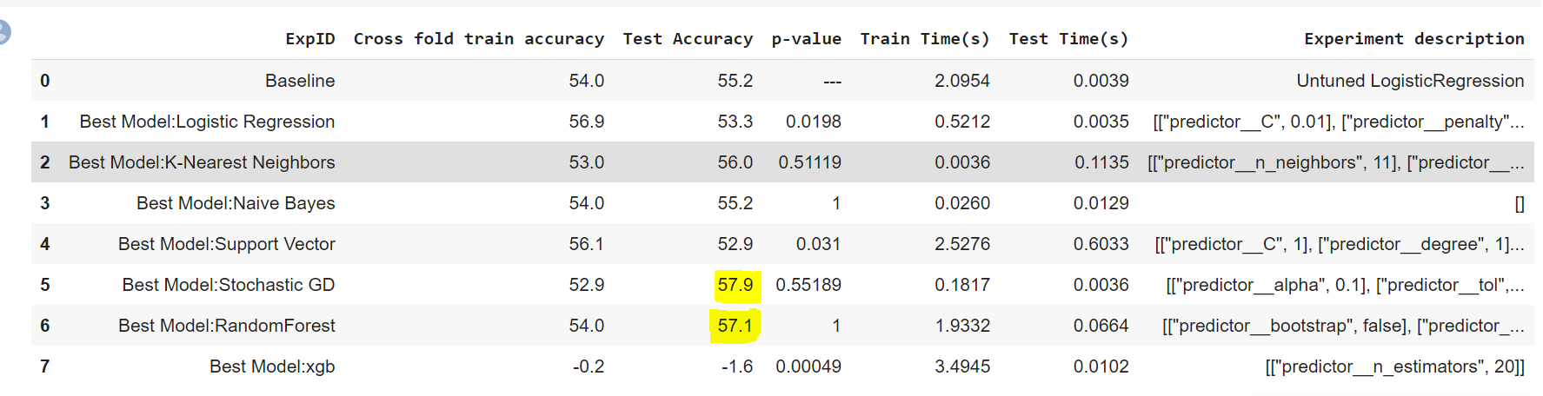
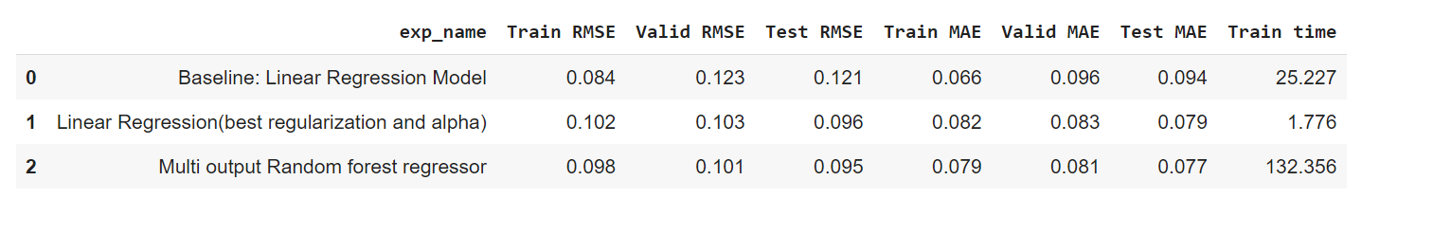
Baseline Classification and Models
Baseline Linear Regression and Models

Slide 7
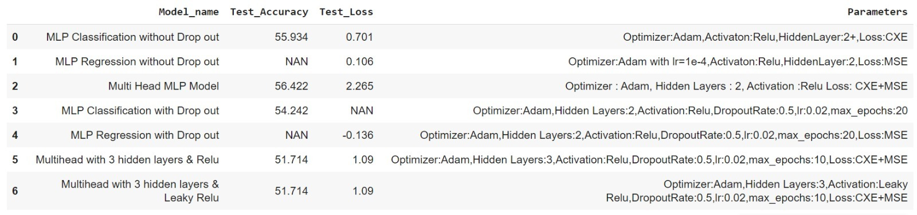
Pytorch Models For Classification & Regression
Using relu and leakyrelu did not make a difference in results.
Respective best parameters can be seen for MLP models with drop out.
52.56% classification accuracy and 47.53 MSE loss was obtained in the combined Homegrown Logistic regression model that does classification and regression at the same time.
48.55 MSE loss was obtained in homegrown linear regression.

Slide 8
Project Goal
SECTION 2

Slide 9
Work accomplished in Phase 3
Homegrown multi-task
(BCE+MSE + Regularization) model using Python and NumPy.
Transfer learning for object detection and fine-tuning using Efficient Det (D0-D7)
Built a fully convolutional neural network (FCN) for a single object classifier and detector.

Slide 10
Homegrown multi-task (BCE+MSE + Regularization) model using Python and NumPy.
SECTION 3

Slide 11
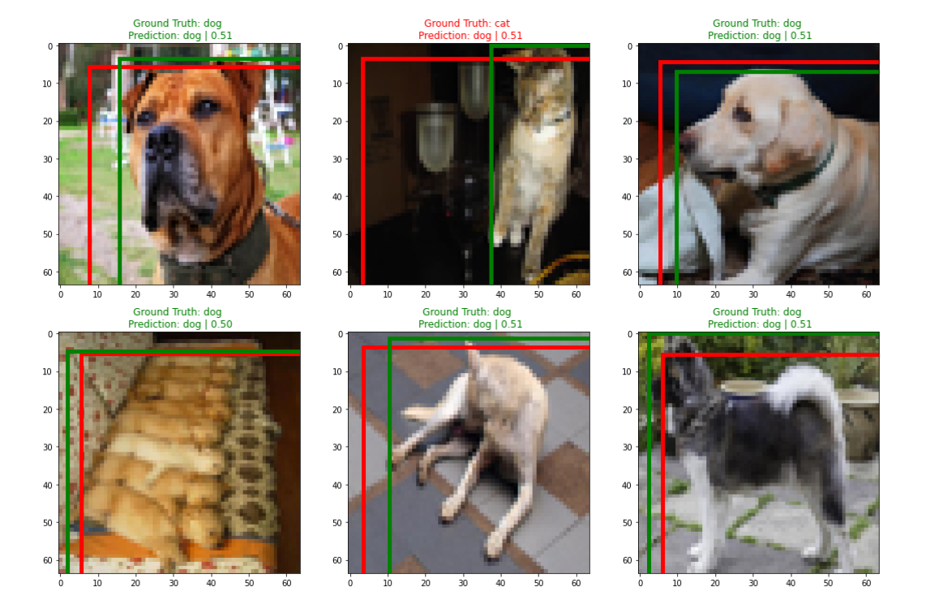
Model | Train_Acc | Test_Acc | Train_Loss | Test_Loss
Homegrown Logistic Regression without Regularization | 51% | 48.03% | 4.60 | 4.07
Homegrown Logistic Regression with Regularization | 53% | 49.03% | 4.60 | 4.18

Slide 12
Transfer Learning & Fine Tuning Using EfficientDet(D0-D7)
SECTION 4

Slide 13
Transfer Learning & Efficient Det
Backbone – Extracts features from the input images
Takes multiple levels of features from the backbone and generates features as outputs that determines some characteristics of the images
Class/ Box Network – Predicts the class and bounding boxes for the images
Developed a script in Python to transform the given dataset into compatible with Efficient Det
Efficient Det achieved a mean average precision of around 0.042

Slide 14
Fully Convoluted Neural Network For Classification & Regression
SECTION 5

Slide 15
FCN Cat and Dog Classification and Regression
Our Pytorch FCN Cat and Dog model defines classification accuracy and predicts bounding boxes.
We have used 2 convolution layers with 3 Max pooling and Relu as our activation function.
Adam : Optimizer used
Learning rate 1 e-3
We have achieved a train accuracy of 99-100% and Test Accuracy of 69%. Test loss of about 0.827

Slide 16
Results and Analysis
SECTION 6

Slide 17
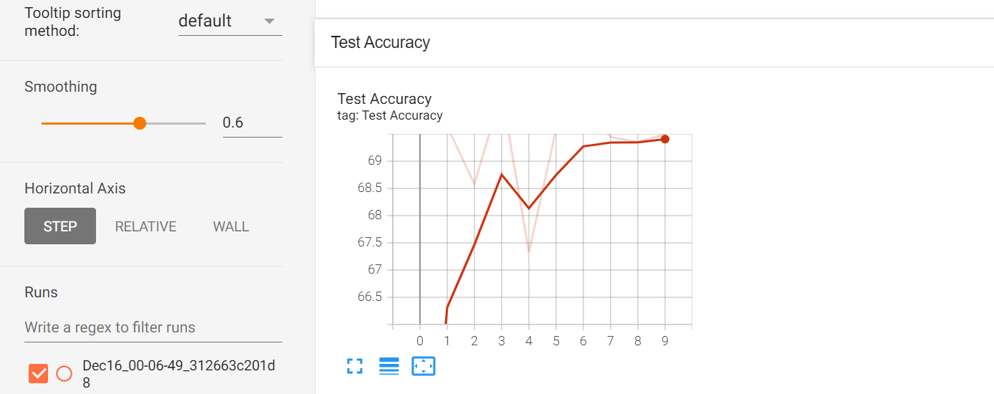
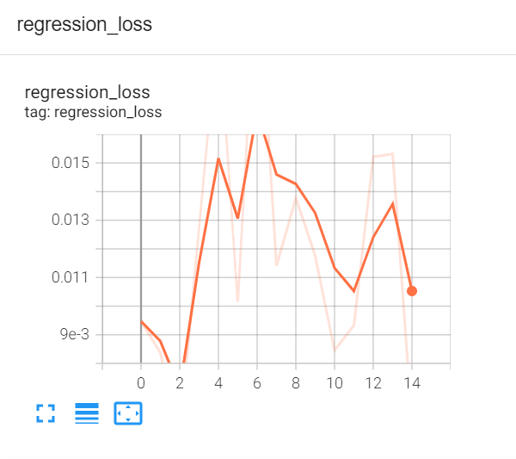
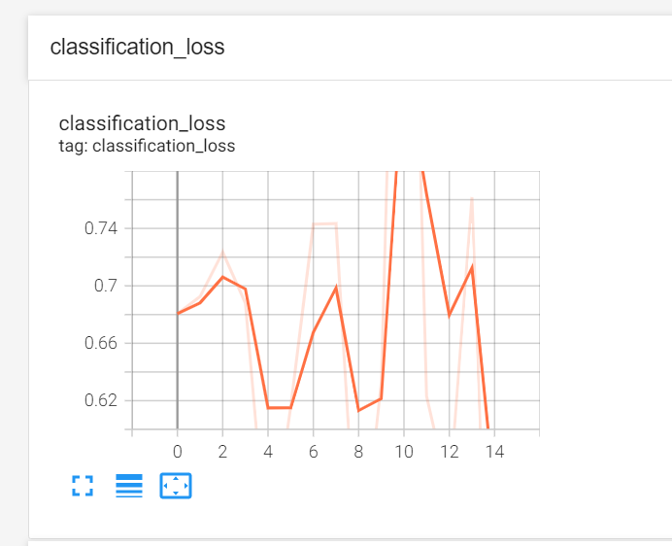
Overall Results

Slide 18
Challenges
SECTION 7

Slide 19
Problems Faced/ Challenges
It took a long time to train models like EfficientDet because of the enormous number of layers involved. As a result, we used pre-trained weights and simply fine-tuned the head layers when training on our unique CaDoD dataset.
For better versions, such as D1-D7, will take much longer to train. Due to Google Colaboratory's limitations, we were unable to train the other models.

Slide 20
Conclusion
SECTION 8

Slide 21
CONCLUSION
In this phase we developed a Fully Convolutional neural network models using Pytorch
We have performed transfer learning and tried implementing Efficient det algorithm. Trained our Efficient det D0 model and compared its results with Efficient det D7.
With increase in convolutional layers we saw a significant increase in the computation time and an increase in accuracy prediction.
In conclusion I could say that for Image classification and detection Neural Networks work better compared to Sklearn models.

