Slide 1

Academic Assistant
A Modern Web-Based Platform for BUBT Students & Faculty

Slide 2
Team information :
→ Omar Faruk Jihad ID:20234103145
→ Rajdip Raha ID:20234103146
→ Riad Ahamed Sarkar ID:20234103148 → Md. Nur Alam ID:20234103153 → Md. Tarikul Hasan Dipu ID:20234103156
Submitted To :
Nasrin Akter
Lecturer,
Dept. of CSE
BUBT

Slide 3
PRESENTATION OUTLINE
→
Abstract: Vision and scope of the project.
→
Class Diagram: Structural system design.
→
Motivation: Why we built this system.
→
CRC Cards: Responsibility mapping.
→
Features: Core tools for students & faculty.
→
Conclusion: Current outcomes.
→
Use Case Diagram: Interaction and logic flow.
→
Future Work: Future expansion plans.

Slide 4
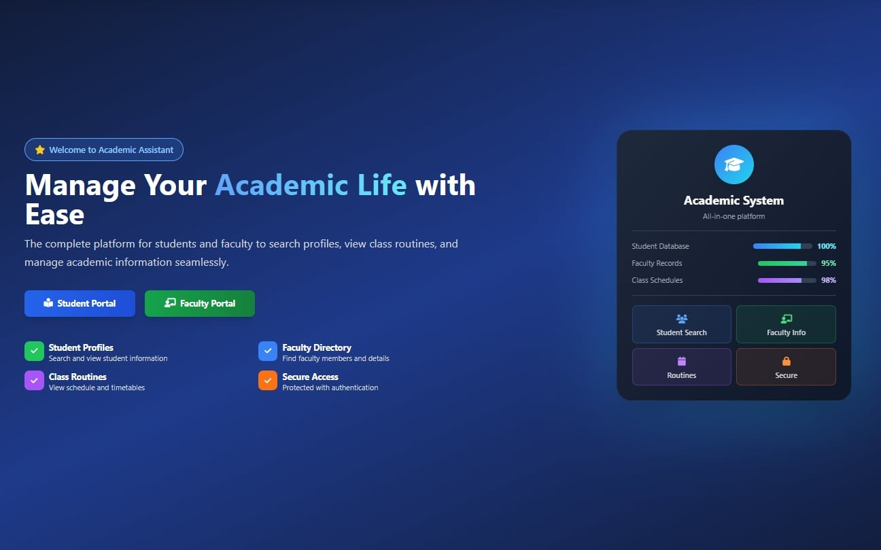

PROJECT ABSTRACT
The Academic Assistant is a centralized web platform designed to make academic tasks easier for the BUBT community.
→
Built with Django (Python) and MySQL.
→
Automates room scheduling and routine management.
Modern Web Implementation
→
Provides real-time updates for Academic Assessments.
→
Simplifies communication between students and faculty.

Slide 5


MOTIVATION: WHY THIS PROJECT?
Manual Scheduling
Room Conflicts
Communication Gaps
Current systems lack dynamic routines, making it hard to manage extra classes or makeup sessions manually.
Finding an empty classroom is often difficult. Our system tracks room availability in real-time.
Students often miss notice about CT dates or assignments. We provide a centralized update board.

Slide 6



SYSTEM FEATURES OVERVIEW
Secure Login
Smart Scheduling
Notice Updates
Role-based access for Students, Faculty, and Admins to ensure data privacy and security.
View routines based on Intake/Section. Faculty can check for free rooms instantly.
Faculty can post CT dates, assignment deadlines, and course news directly to student dashboards.

Slide 7
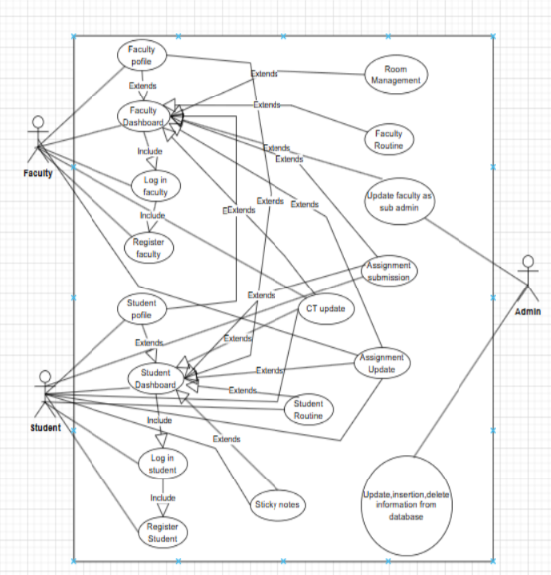

USE CASE DIAGRAM
Actor Roles
→
Student
→
Faculty
[Use Case Diagram Content]
→
Admin
Logic flow between Faculty, Student, and Admin
→ Relationships
Diagram 1.0

Slide 8
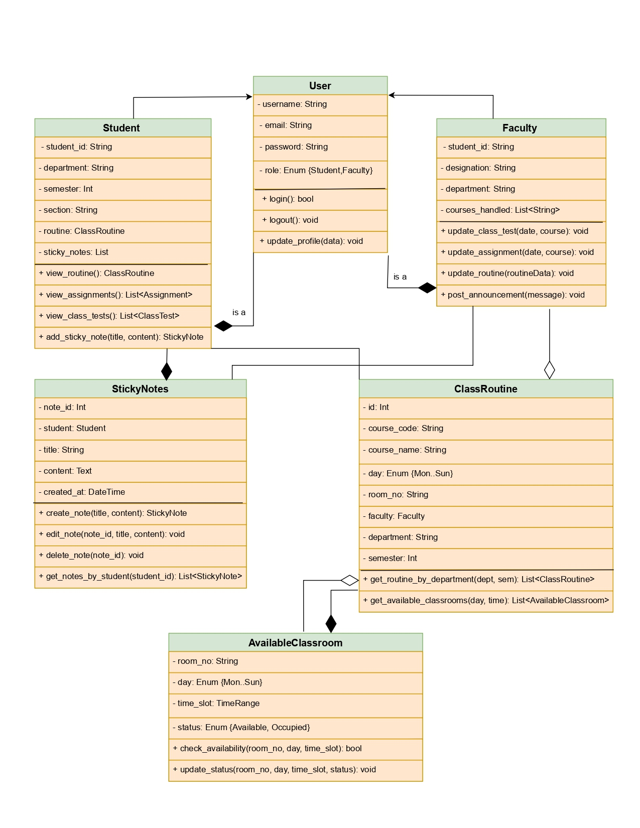

CLASS DIAGRAM
Structural Models
→
User Class: Base class for authentication and role management.
→
Routine Class: Connects Courses, Faculty, and Time slots.
[Class Diagram Content]
→
Room Class: Manages Building numbers and room status (Busy/Free).
Relationship between User, Routine, and Room models
MVT Structure

Slide 9
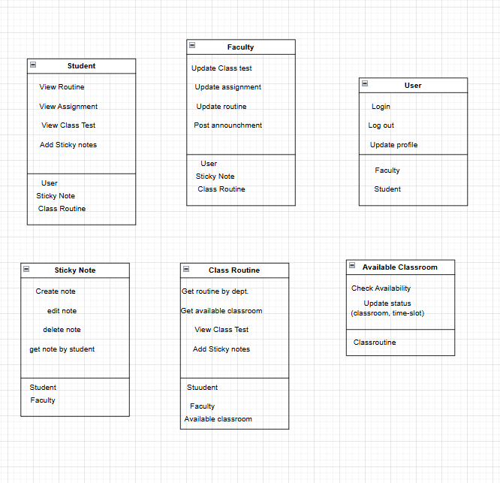
CRC CARDS
→ Responsibility Mapping
→ Collaboration

Slide 10

SYSTEM IMPLEMENTATION
Tools & Stack
Methodology
→
Language: Python
→
Agile Process: Small sprints for each module.
→
Framework: Django
→
MVT Pattern: Model-View-Template flow.
→
Database: MySQL
→
Relational DB: Efficient storage of schedules.
→
UI/UX: Bootstrap & Tailwind CSS

Slide 11
CONCLUSION & FUTURE WORK
Future Enhancements
Conclusion
→
Real-time Email/SMS notifications.
We successfully built a reliable system that simplifies academic communication and room management for BUBT. It reduces manual work for both teachers and students.
→
Full mobile application development.
→
Integrated NLP search capabilities.
→
Student participation analytics.

Slide 12
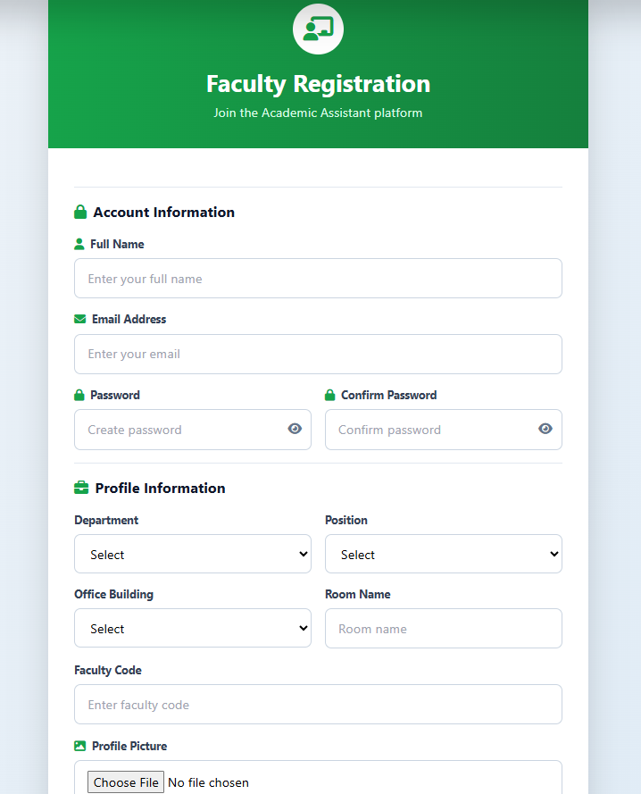
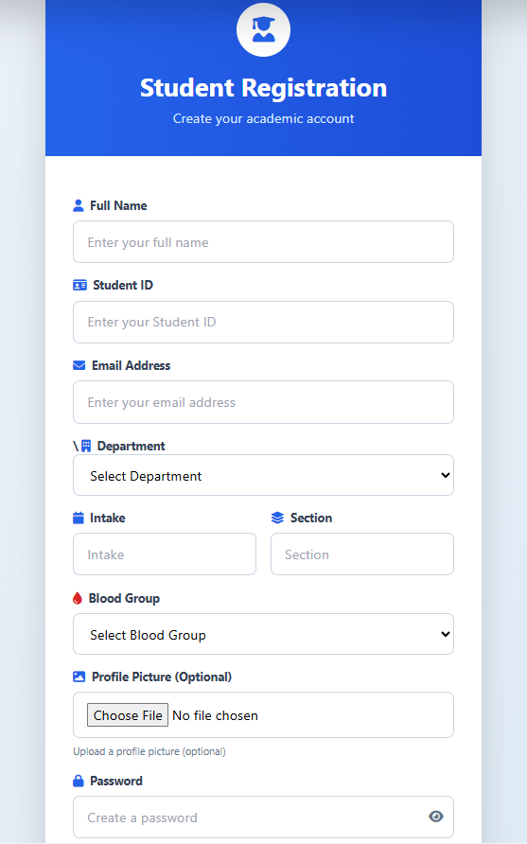
A few Glimpses of our project

Slide 13
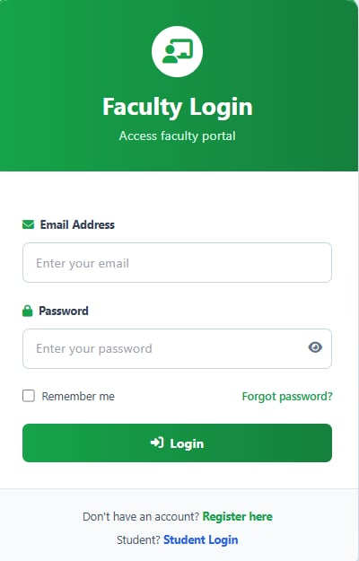
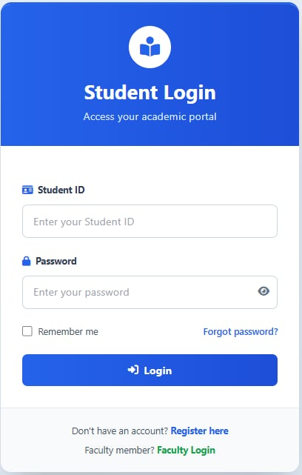
A few Glimpses of our project

Slide 14
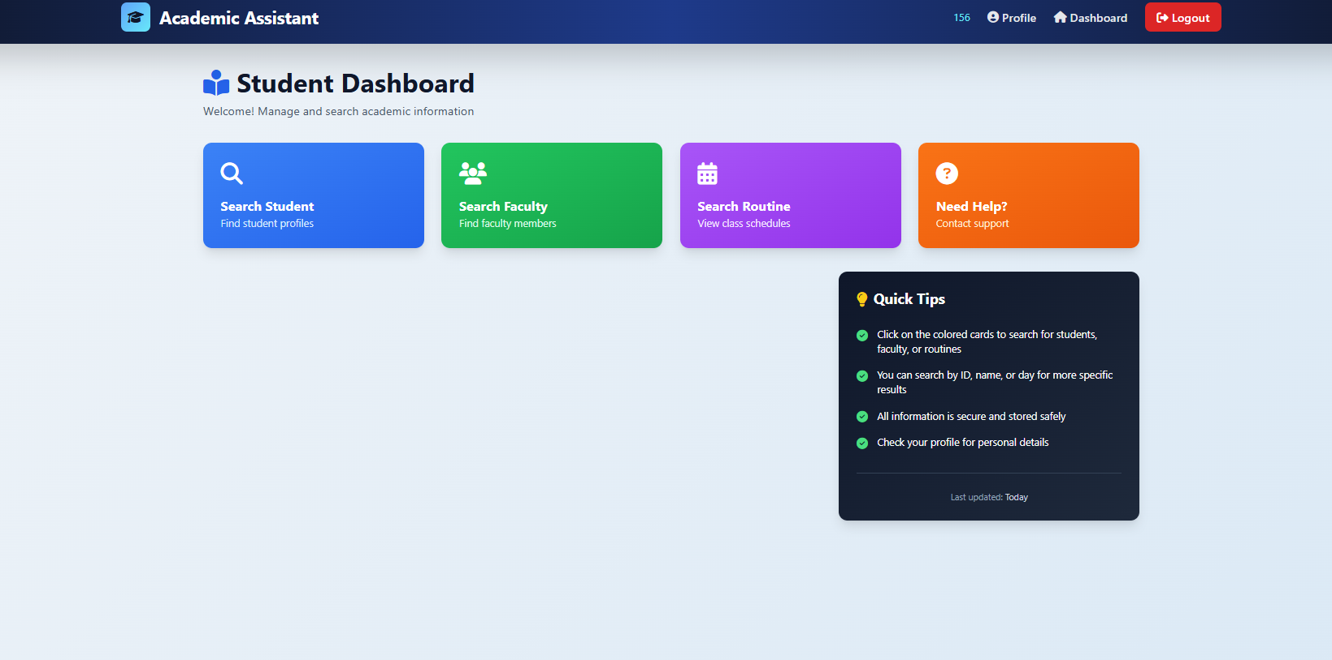
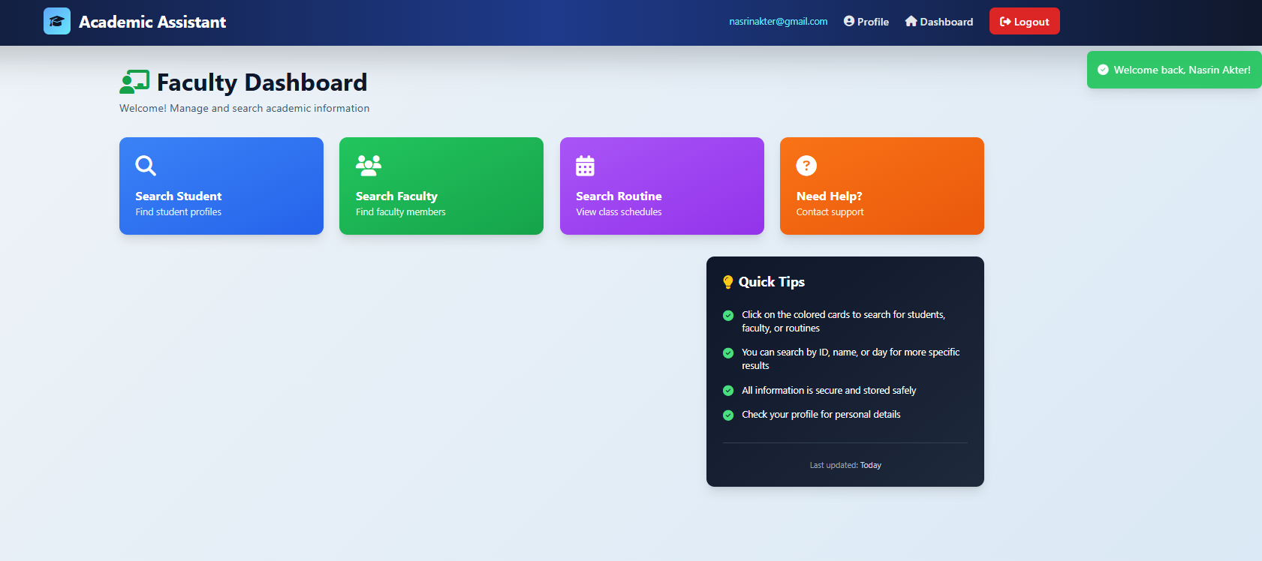
A few Glimpses of our project

Slide 15
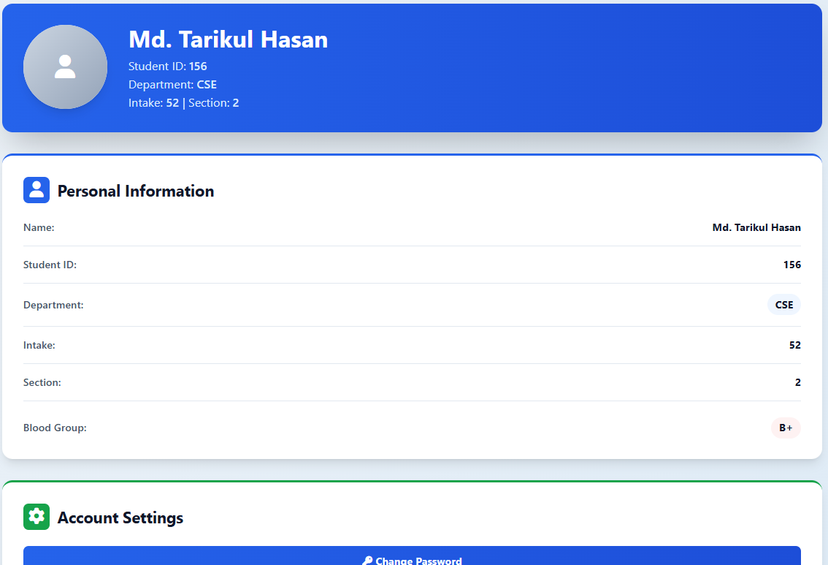
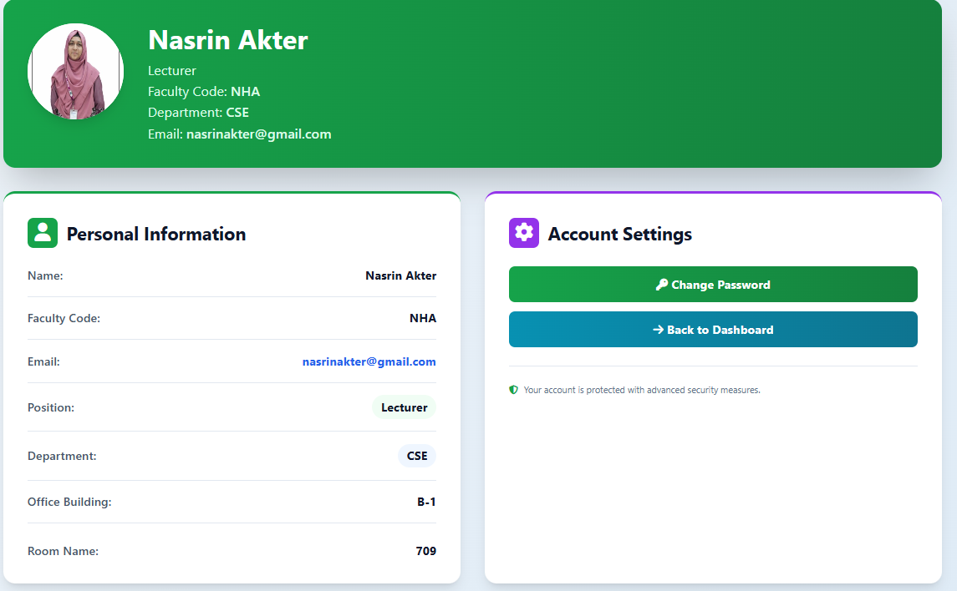
A few Glimpses of our project

Slide 16
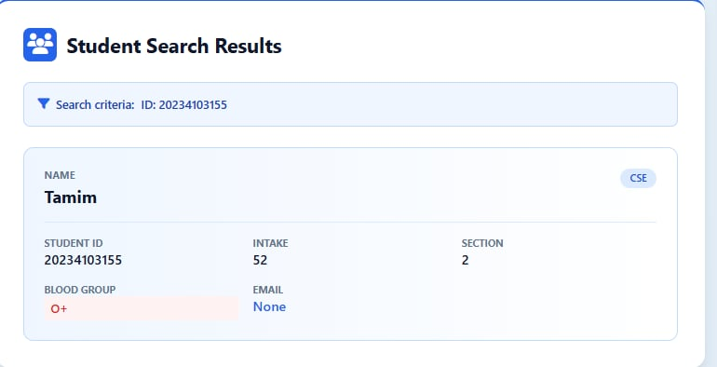
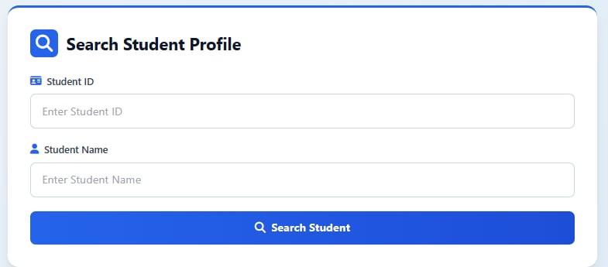
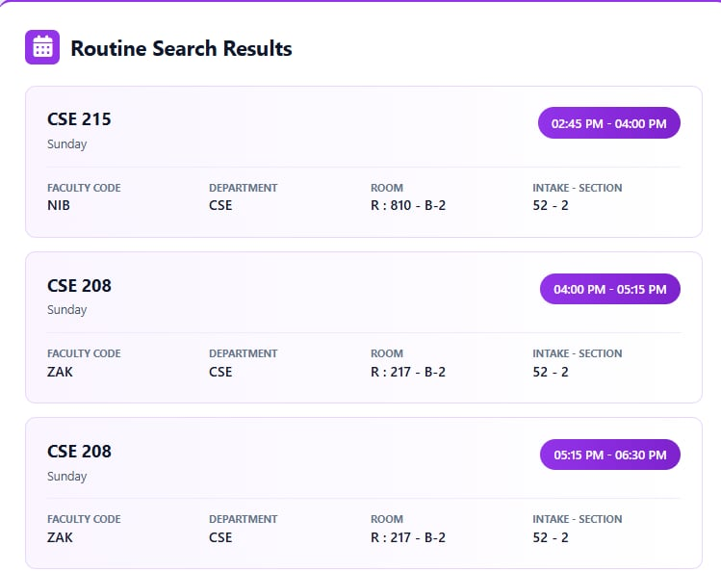
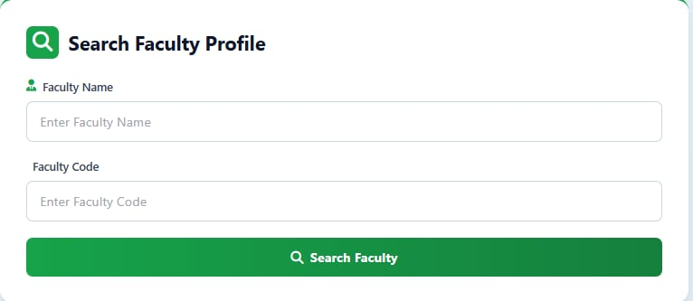
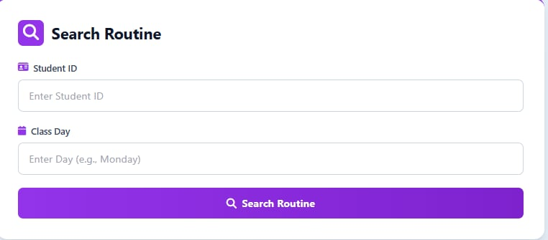
A few Glimpses of our project

Slide 17
Thank You
Any Questions about the Project?

