Slide 1

P-1
Course:CSE111-Object Oriented Programming
Intake-52,Section-04
NAME | ID | Assign Part
Kaniz Fatema Tripti | 20234103482 | Introducing and giving an idea about the topic.
Sadia Khan Priety | 20234103125 | Object as function parameter.
Syed Tausifa | 20234103154 | Returning object.
Ahnaf Ferdous | 20234103134 | Additional Example.
Tarikul Hasan Dipu | 20234103156 | Additional Example & conclusion .

Slide 2

Instructor:
P-2
Md. Mushfiqul Haque Omi
Lecturer (Dept. of CSE )
Bangladesh University of Business and Technology

Slide 3
Topic:
P-3
Object as functi0n parameters & Return Type

Slide 4
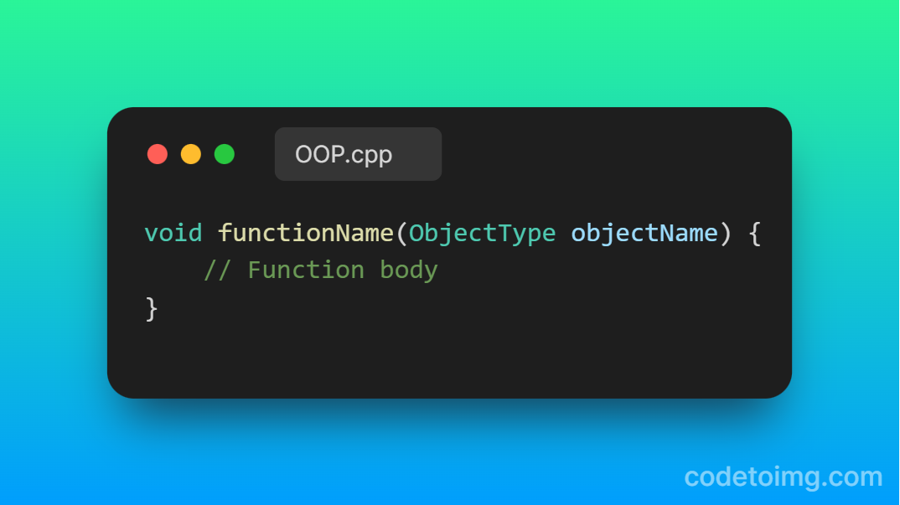
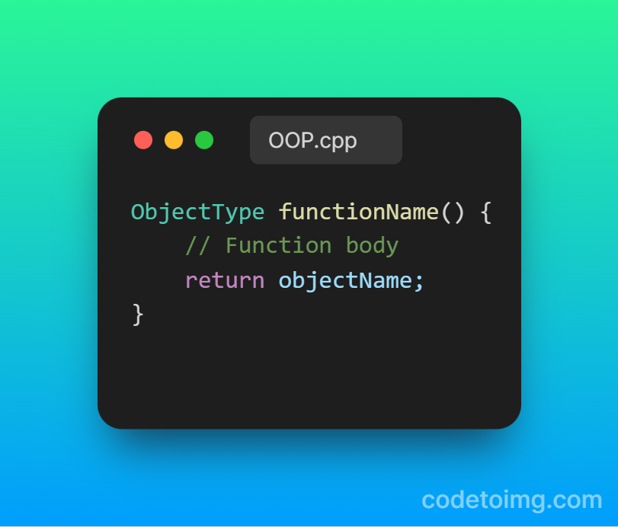
Syntax:
P-4
•Object as function parameter:
•Returning object from function:

Slide 5
Object as function parameter:
P-5
•Objects can also be passed as parameters to member functions.
•The method of passing objects to a functions as parameters is as passing other simple variables.
•It will easily be understand by following example………

Slide 6
Example: Passing object as parameter
P-6
#include<iostream>
using namespace std;
class Rec
{
private:
int height , width;
public:
Rec( int h , int w )
{
height=h;
width=w;
}
void add ( int value )
{
height=height + value;
width=width + value;
};
#include<iostream>
using namespace std;
class Rec
{
private:
int height , width;
public:
Rec( int h , int w )
{
height=h;
width=w;
}
void add ( Rec obj )
{
height=height + obj . height;
width=width + obj . width;
};
int main ()
{
Rec r1 ( 10 , 20 );
Rec r2 ( 30 , 40 );
add ( 10 );
r1 . add ( r2 );
return 0 ;
}
Output :

Slide 7
Returning objects from Member function:
P-7
•The method of returning an object from member function is same as returning a simple variable.
•If a member function returns an object , its return type should be the same as the type of object to be returned.
•It will be understand by following example……..

Slide 8
Example: Returning object
P-8
#include<iostream>
using namespace std;
class Rectangle
{
private:
int height , width;
public:
Rectangle( int h , int w )
{
height=h;
width=w;
}
Rectangle add ( Rec obj1 , Rec obj2 )
{
Rectangle temp;
temp . height = obj1. height + obj2 . height;
temp . width = obj1 . width + obj2 . width;
return temp;
}
void display ()
{
cout <<height<<“ “ <<width;
}
};
int main ()
{
Rectangle r1 ( 10 , 20 );
Rectangle r2 ( 30 , 40 );
Rectangle r3;
Rectangle r4;
r4= r3.add ( r1 , r2 );
r4.display ()
return 0 ;
}
Output :
40 60

Slide 9
Write a C++ program to implement a class called Travel that has private member variables for journey and distance. Include member functions to combine journey and distance
P-9
Example:
#include <iostream>
using namespace std;
class Travel
{
private:
string journey;
int distance;
public:
Travel()
{
journey='\0';
distance=0;
}
Travel(string j, int d)
{
journey=j;
distance=d;
}
void display()
{
cout<<"Destination: "<<journey<<", Distance: "<<distance<<" km"<<endl;
}
Travel combine(Travel obj1,Travel obj2)
{
Travel temp;
temp.journey=obj1.journey+" & "+obj2.journey;
temp.distance=obj1.distance+obj2.distance;
return temp;
}
};
int main()
{
Travel t1("Dhaka",5500);
Travel t2("London",2491);
cout<<"Initial Travel Destinations:"<<endl;
t1.display();
t2.display();
cout<<"Combined Travel Destination:"<<endl;
Travel total=t1.combine(t1,t2);
total.display();
return 0;
}

Slide 10
Example:
P-10
Write a C++ program to implement a class called Personac that has private member variables for acnumber and balance. Include member functions to deposit and withdraw money from the account.
#include<bits/stdc++.h>
using namespace std;
class Personac
{
private:
int acnumber,balance;
public:
Personac()
{
acnumber=0;
balance=0;
}
Personac(int acn,int b)
{
acnumber=acn;
balance=b;
}
void display ()
{
cout<<acnumber<<" "<<balance<<endl;
}
void deposit (Personac obj)
{
acnumber = obj.acnumber;
balance=balance+obj.balance;
}
Personac withdraw (Personac obj1,Personac obj2)
{
Personac t;
t.acnumber=obj1.acnumber;
t.balance=obj2.balance-obj1.balance;
return t;
}
};
int main ()
{
int x,y,a,b;
cout<<" Deposit balance : ";
cin>>x>>y;
Personac r1(x,y);
Personac r2;
Personac r5;
r2.deposit(r1);
r2.display();
cout<<" withdraw balance : ";
cin>>a>>b;
Personac r3(a,b);
r5=r1.withdraw (r3,r1);
r5.display ();
}

Slide 11
Thank You Everyone
P-11

